Slide 1
Analyzing Nursing Unit Similarity Using Correspondence Analysis
SI Team Meeting
26th September 2017
Nayef Ahmad

Slide 2
Overview
What is Correspondence Analysis?
Relationship to previous approach (Manhattan distances)
Working through an example
Interpreting results of nursing unit similarity analysis

Slide 3
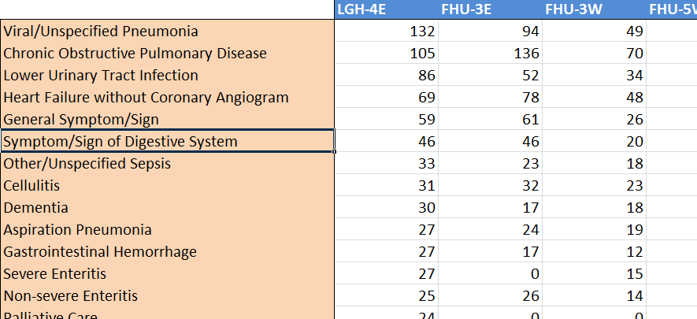
CA analyzes tabular data to find underlying structure
Nursing Unit Categories
…
…
CMG Categories
…
…
…
…
…
Count data
Notes:
Counts are number of cases in FY 16/17
Ratio>interval>ordinal>categorical variables

Slide 4
CA analyzes tabular data to find underlying structure
Key Questions:
Which rows are closely related to other rows?
Which columns are closely related to other columns?
What are the relationships between rows and columns?
What are the key dimensions of variation in the data?
CA generalizes the idea of a scatterplot to work meaningfully with categorical variables

Slide 5
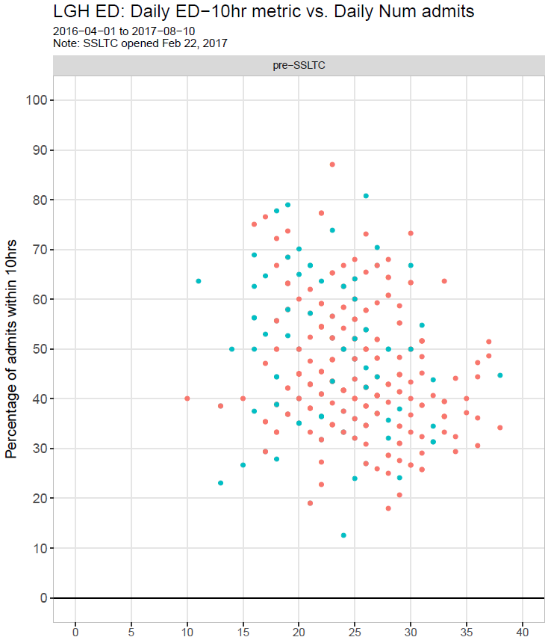
Can we produce something
like this for categorical variables?
Yes!

Slide 6

Relationship to previous methodology
CA is a complimentary approach
Manhattan distances vs. “chi-squared” distances
Appeals to visual intuition
Widely applicable as an EDA technique

Slide 7
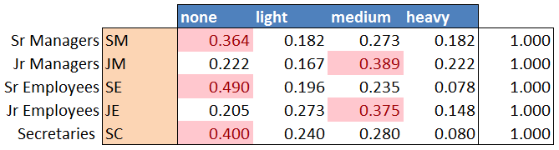
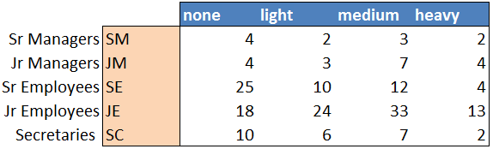
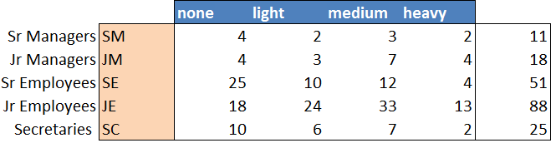
Example: Smoking data
Artificial dataset of smoking habits among 193 employees
Each row profile is a point in 4D space
How do we display this in a 2D scatterplot?

Slide 8
Squishing n-dimensional data onto 2D scatterplots
The goal is to find the optimum 2D surface that minimizes the amount of squishing necessary.
Then, we squish (aka “project”) all data points onto this surface

Slide 9
Technical notes
Chi-squared distances:
Objective function
Symmetry of row and column analysis

Slide 10
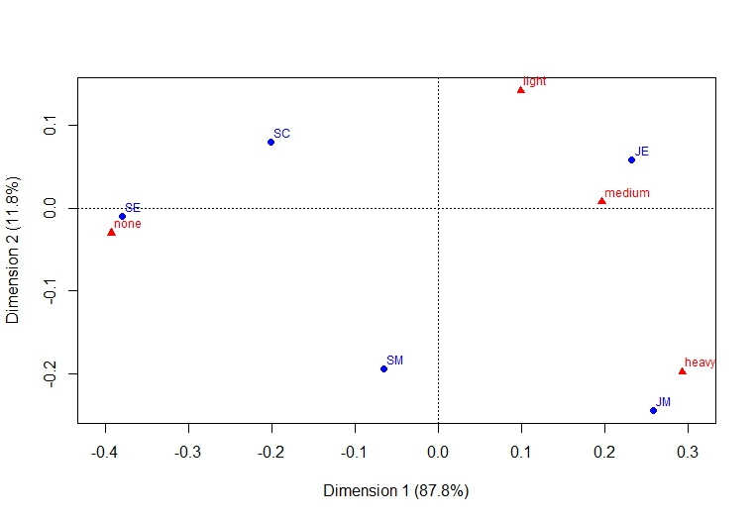
Results from smoking data

