Slide 1
Input Scenario:
1 “representative” day
List of treatments with:
“representative” volumes (random draw from binomial distribution?) and
“representative” treatment times (90th percentiles?)
Let’s say we know that there will be 2 chairs that will have OPAT cases scheduled during the “OPAT window”
Each of these chairs is split into 3 separate “bins” so that the constraints around overlaps with the OPAT window are satisfied
Solution:
Approximation algorithm that minimizes the number of “bins” required to fit all these cases
“First fit descending” (FFD) is a specific algorithm in the general class of “Bin packing algorithms”
FFD has been proven to use no more than 11/9 OPT + 1 bins (where OPT is the number of bins given by the optimal solution)
We will have to manually fiddle with the solution to make sure the OPAT cases are only in the OPAT window

Slide 2
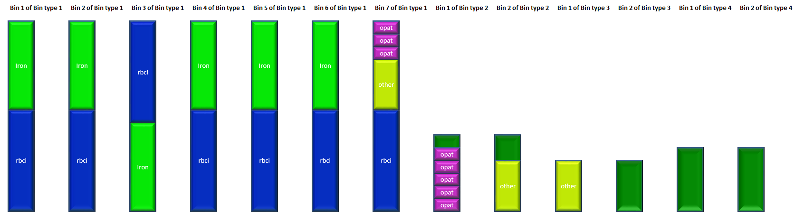
Solution from First Fit Descending Algorithm
http://people.bath.ac.uk/ge277/index.php/bpp-spreadsheet-solver/

Slide 3
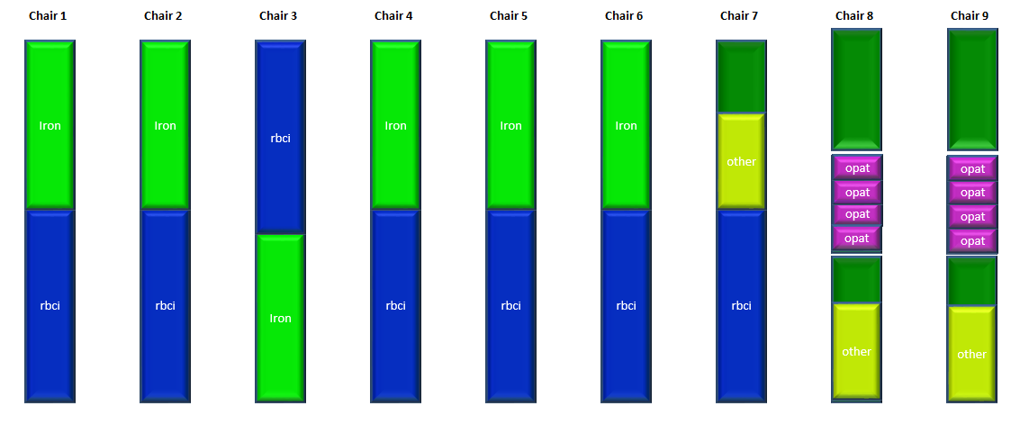
Modified solution
“Waste” due to OPAT window constraint

