Slide 1
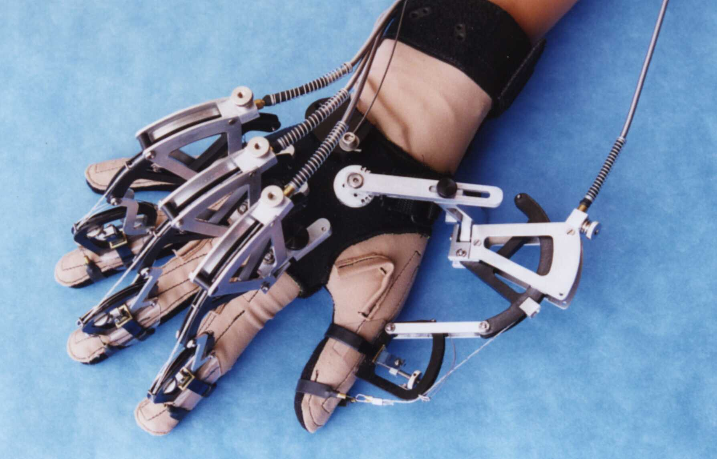

PLACE TITLE OF POSTER HERE (Arial Bold 120 pt.)
Place Poster Subtitle Here (Arial 96 pt., centered)
IMAGE LAYOUT: Use a contrasting colored border to make your images stand out. IMAGE CAPTION: Use a readable font. Clearly explain what the image illustrates about your work. Don’t be too wordy. This is Arial 56 pt type.
Figure 1: A device used to track hand movements in virtual environments.
What happened to the image to the right? The image source’s pixel resolution was too small to look good blown up this large. BEWARE! Make sure your image resolution is high enough to print clearly and to prevent having a pixelated image on your poster. If you’re going to use a rendered image, make sure you specify the exact image dimensions as it will appear on the poster and then render the image. This will also help to avoid effects like the one to the right.
POSTER LAYOUT: Try to balance your titles, text, and images on the poster. How do you know if things are spaced well? You might look at your poster through squinted eyes to see if anything looks off-balance. If you’re still not sure, look around at other posters hanging in the building to get ideas. Having someone else critique your poster is also a good idea. Mary Whitton is willing to do this for graphics students.
FINISHING TOUCHES: Run Spell Check AND have someone thoroughly proofread your poster before it is printed. (This is Arial 54 pt. type.)
Figure 2: Gary Bishop giving a head-mounted display demo to UNC System President Molly Broad. (Times New Roman 34 pt. Italic)
(This template is located on the Web at www.cs.unc.edu/Info/GenInfo/Posters/)
This poster template was updated 4/26/00.
YOUR NAME HERE (Arial 32 pt. Italic)
MONTH AND YEAR HERE
YOUR PROJECT URL HERE

