Slide 1
Automatic Question Detection in Speech Taslima Akter, Hasika Mahtta, Khandokar Md. Nayem
School of Informatics, Computing and Engineering
CSCI-B 659: Project Presentation
INDIANA UNIVERSITY BLOOMINGTON

Slide 2
OVERVIEW

Slide 3
Overview
Identifying questions in human dialogs is an important first step to automatically processing and understanding natural speech.
Question detection can be viewed as a subtask of speech act or dialogue act tagging, which aims to label functions of utterances in conversations, with categories as question/statement/backchannel.
Question detection is useful for meeting indexing and summarization.
The main goal of this project is to build a audio classifier capable of recognising questions and declarative sentences for male and female speech corpus.

Slide 4

Overview

Slide 5
PROBLEM STATEMENT

Slide 6
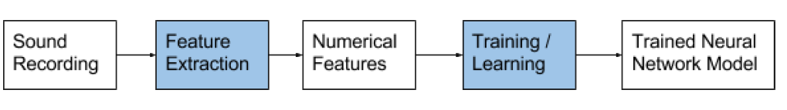
Problem Statement
So, the essence of the problem is that : given a never-before-heard recording, how can a system be trained to identify what it is actually listening to?

Slide 7
MOTIVATION

Slide 8
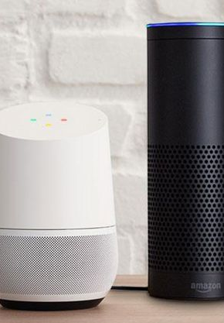
Motivation
The questions can even be detected with the help of the text, but it is difficult to detect the intonation of the speech with different speech levels.
We plan to detect questions in the speech based on stress also.
The main motivation behind automatic Question detection as we have discussed earlier can be seen in the live examples like Alexa and Google home mini.
You can pause, rewind and skip casted content without contextual commands, too. All you have to say is “OK Google, pause” .

Slide 9
RELATED WORKS

Slide 10
Related Works
Question Detection in Spoken Conversations Using Texual Conversations- Comparison between the text-trained model with models trained on manually-labelled, domain-matched spoken utterances with and without prosodic features has been done. ({amargoli,mo}@ee.Washington.edu, Seatttle, WA, USA).
Any Questions? Automatics Question Detection in Meetings- This paper focuses on describing the efforts towards the automatic detection of English questions in meetings using ICSI MRDA Corpus.(Kofi Boaakye, Bnoit Favre, Dilek Hakkini-Tur – Berkeley, CA, USA)
Integration of prosodic tree model with language model based on words yields best performance accuracy in detecting questions/question form (Shriberg et al.’98: English)
Studies of different types (functions) of clarification questions (Rodríguez & Schlangen’94: German; Edlund et al.’95: Swedish)

Slide 11
Corpus

Slide 12
Corpus
Speech corpus
Large collections of audio recordings of spoken language.
Most speech corpora have additional text files containing transcriptions of the words spoken and the time each word occurred in the recording.
We use Timit corpus and some manually recorded audio files in the wav format for questions and declarative sentences.
We labelled the dataset manually.
Our corpus contains around 300 audio input files.

Slide 13
Methodology

Slide 14
Feature Extraction
Python LibROSA feature extraction methods are used.
Spectrogram: Time-Frequency representation of the speech signal
Mel-frequency cepstral coefficients (MFCC) : The coefficient that collectively make up the short term power spectrum of a sound.
RMSE: Compute root-mean-square (RMS) energy for each frame, either from the audio samples or a spectrogram.
Pitch: Allows the ordering of sounds on a frequency-related scale.

Slide 15
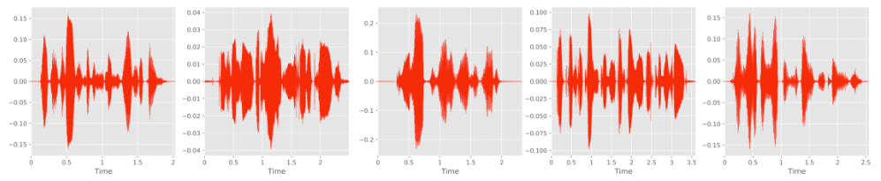
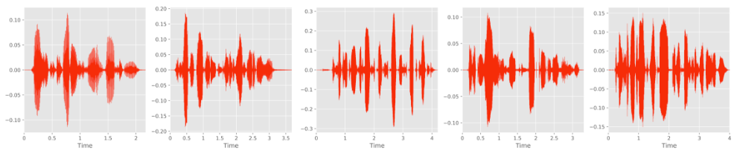
Experimental Result (Wave plots)
Wave plots for Questions (Top) and Declarative (Bottom) sentences

Slide 16
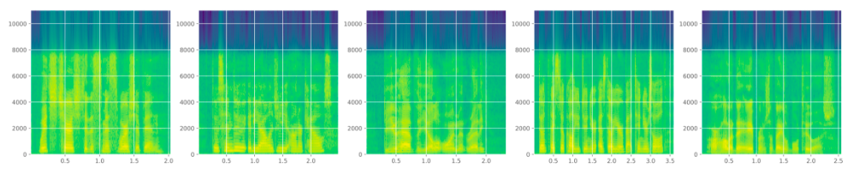
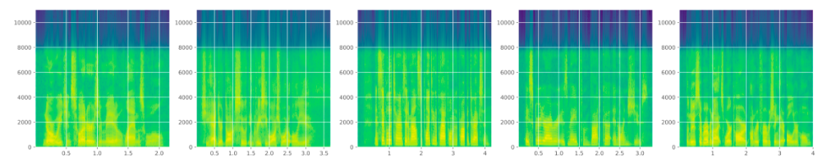
Experimental Result (Spectrogram)
Spectrograms for Questions (Top) and Declarative (Bottom) sentences

Slide 17
Models

Slide 18
Model 1
Recurrent Neural Network (RNN)
Single .wav single sample: At each batch, a .wav file is a single sample, fed to RNN cells.
Single .wav multiple sample: .wav files are mini-batched into overlapping samples and fed to RNN.
Word chunk: Each .wav files are broken down into chunks of word .wav and these are fed into RNN.

Slide 19
Model 2
Convolutional Recurrent Neural Network (CRNN)
Spectrogram as feature (inexpensive), no handcrafted feature
CNN model can be parallelized and faster than RNN (sequential)

Slide 20
Challenges and Future works
No appropriate speech dataset is open/ available for question classification, specially for echo question.
Available dataset is too small for applying Deep Nets.
Ground truth can vary depending on context and perspective.
Word chunking doesn’t 100% accurate which might effect the result.
Stress and intonation in speech will be considered for better classification.
Using text annotation with speech .wavs can be interesting to investigate.
More features can be considered (Chromagram of a STFT, Tonnetz, etc.).

Slide 21
Thank you!

