Slide 1
Activation Function CSCI-B 659
School of Informatics, Computing and Engineering
Khandokar Md. Nayem
INDIANA UNIVERSITY BLOOMINGTON

Slide 2
What is AF?
SECTION 1

Slide 3
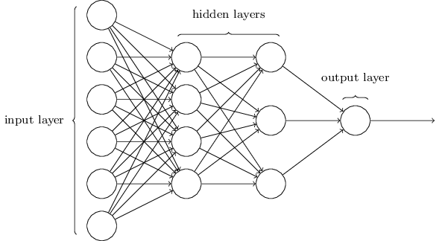
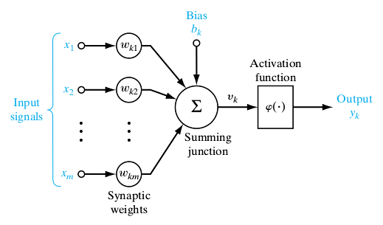
Activation Function
Section 1: What is Activation Function?

Slide 4
Definition
Section 1: What is Activation Function?
Activation function of a node defines the output of that node given an input or set of inputs.
In Biologically inspired the activation function is usually an abstraction representing the rate of action potential firing in the cell.
In its simplest form, this function is binary (Step Function) that is, either the neuron is firing or not.
A line of +ve slope may be used to reflect the increase in firing rate that occurs as input current increases.
https://en.wikipedia.org/wiki/Activation_function

Slide 5
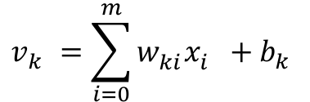

Activation Function Equation
Section 1: What is Activation Function?
$$v_{k}^{}=\sum_{i=0}^{m}{w_{ki}^{}x_{i}^{}+b_{k}^{}}$$
$$y_{k}^{}=φ(v_{k}^{})$$

Slide 6
Why AF is important?
SECTION 2

Slide 7
Nonlinearity in Neural Networks
Section 2: Why Activation Function is important?
A Neural Network without Activation function would simply be a Linear regression Model.
Stacked linear models form another linear model.
Non-linear functions are those which have degree more than one and they have a curvature when we plot a Non-Linear function.
We need to apply activation function so the network is more powerful and add ability to it to learn complex and complicated from data and represent non-linear complex arbitrary functional mappings between inputs and outputs.

Slide 8
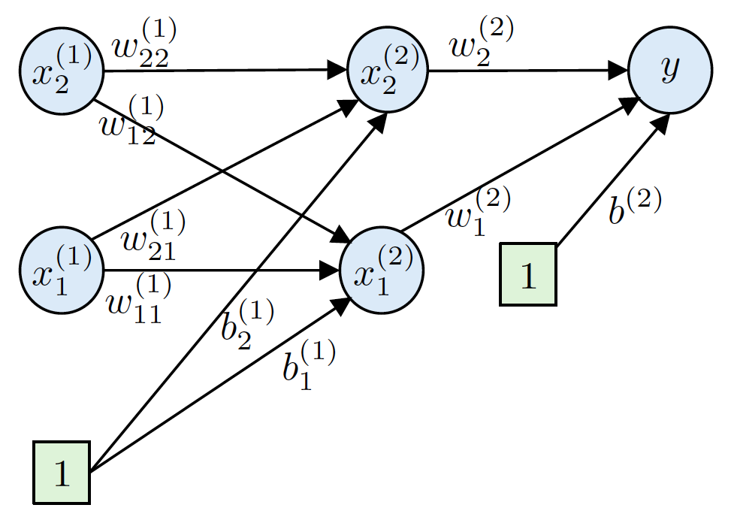
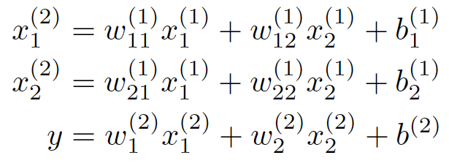
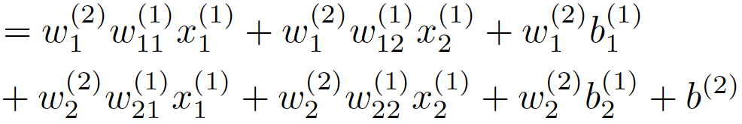
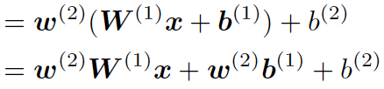
XOR problem
Section 2: Why Activation Function is important?
Courtesy: Prof. Minje Kim, course ENGR-E 533

Slide 9
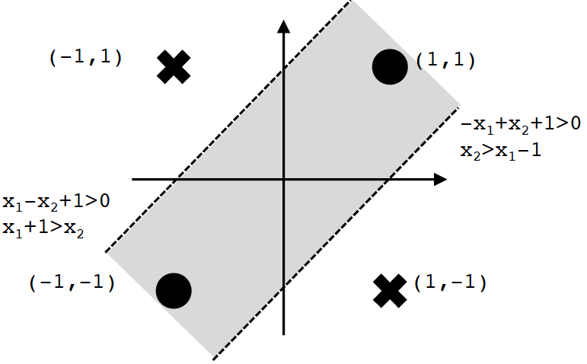
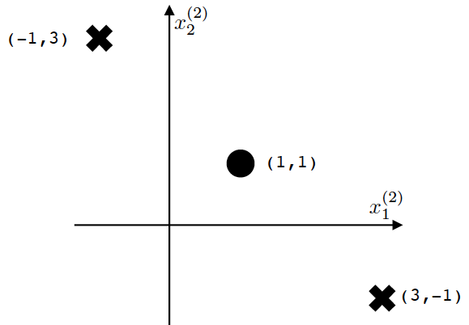

XOR problem
Section 2: Why Activation Function is important?
A nonlinear problem that needs two hyperplanes.
Still NOT linearly solvable!
Courtesy: Prof. Minje Kim, course ENGR-E 533

Slide 10
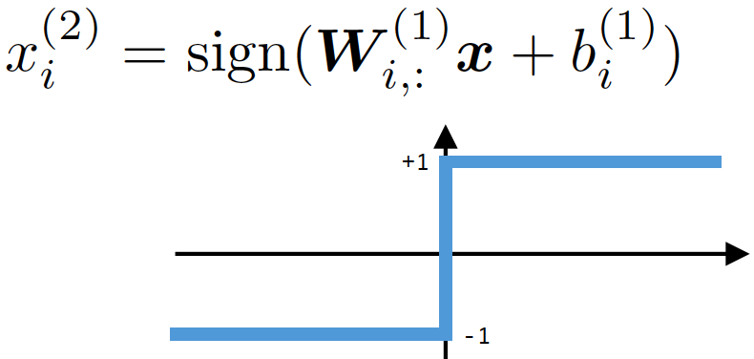
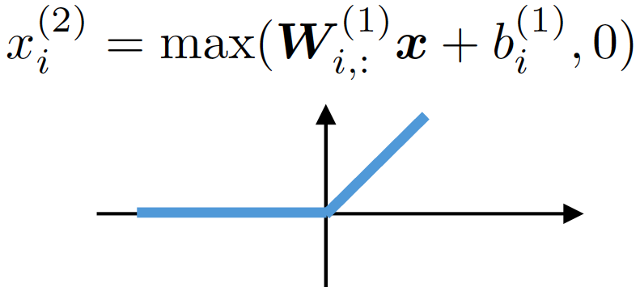
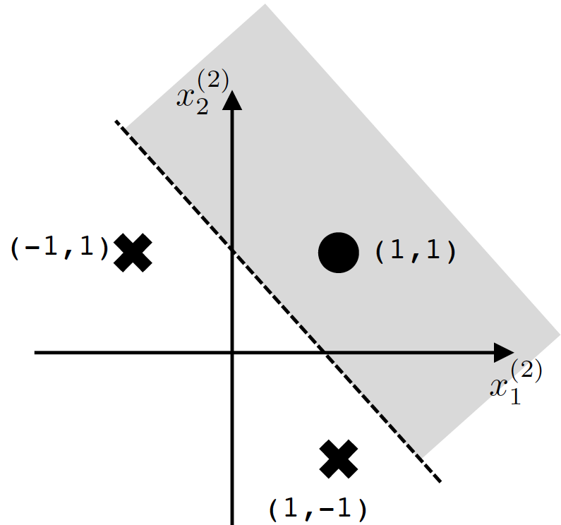
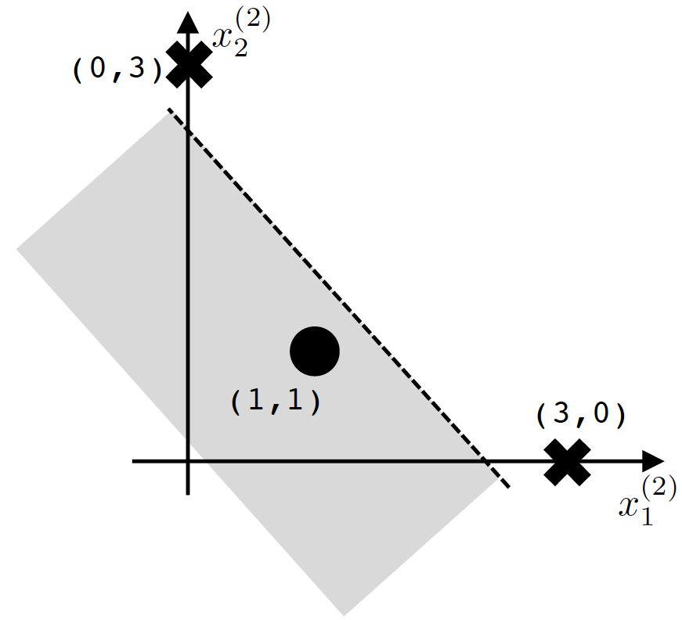
XOR problem Solved
Section 2: Why Activation Function is important?
Courtesy: Prof. Minje Kim, course ENGR-E 533

Slide 11
Different types of AF
SECTION 3

Slide 12
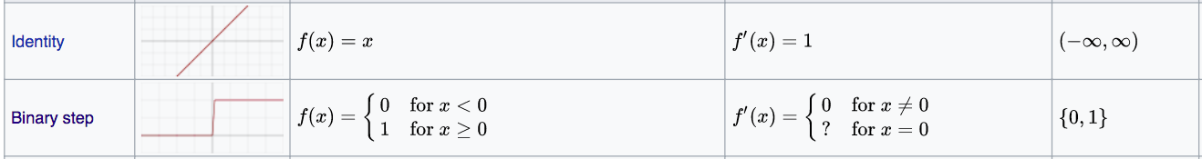
Linear Activation Functions
Section 3: Different types of Activation Function
https://en.wikipedia.org/wiki/Activation_function

Slide 13
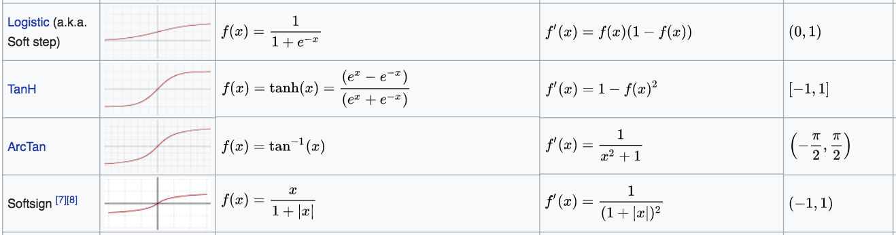
Nonlinear Activation Functions
Section 3: Different types of Activation Function
https://en.wikipedia.org/wiki/Activation_function

Slide 14
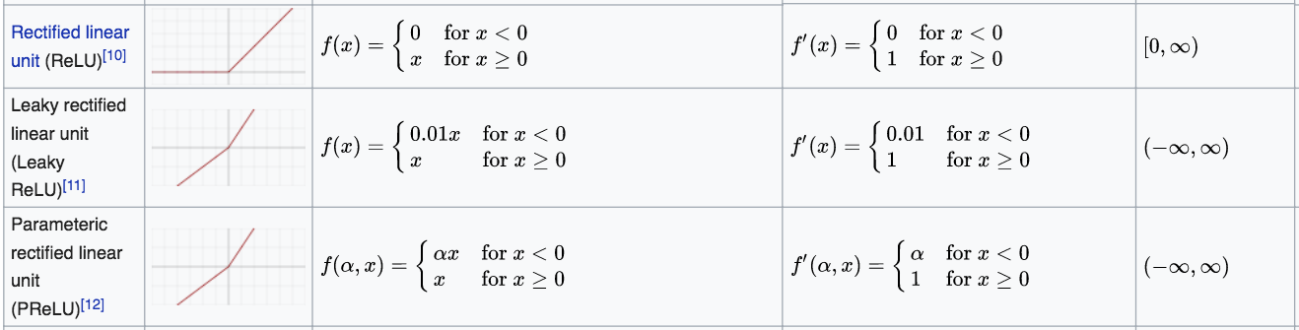
Nonlinear Activation Functions
Section 3: Different types of Activation Function
https://en.wikipedia.org/wiki/Activation_function

Slide 15
Nonlinear Activation Functions
Section 3: Different types of Activation Function
Softmax |  | $$f_{i}(\vec{x})=\frac{e^{x_{i}^{}}}{\sum_{j=1}^{J}{e^{x_{j}^{}}}}$$ | $$\frac{df_{j}(\vec{x})}{dx_{j}}=f_{i}(\vec{x})(δ_{ij}−f_{j}(\vec{x}))$$ | (0,1)
https://en.wikipedia.org/wiki/Activation_function

Slide 16
General Practice of AF
SECTION 4

Slide 17
General Practice
Section 4: General Practice of Activation Function
Sigmoid functions and their combinations generally work better in the case of classifiers.
Sigmoids and tanh functions are avoided due to the vanishing gradient problem.
ReLU function is a general activation function and is used in most cases these days.
Leaky ReLU function is the best choice in case of dead neurons problem.
ReLU function should only be used in the hidden layers.
As a rule of thumb, begin with using ReLU function and then move over to other activation functions, in case ReLU doesn’t provide with optimum results.
https://www.analyticsvidhya.com/blog/2017/10/fundamentals-deep-learning-activation-functions-when-to-use-them/

Slide 18
Thank you!

