Slide 1
Speech Recognition using Deep Neural Network Taslima Akter, Khandokar Md. Nayem
School of Informatics, Computing and Engineering
ENGR-E533: Project Presentation
INDIANA UNIVERSITY BLOOMINGTON

Slide 2
Overview
SECTION 1

Slide 3

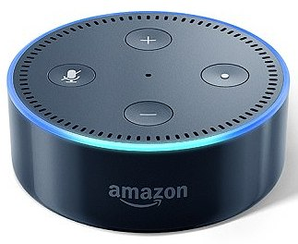
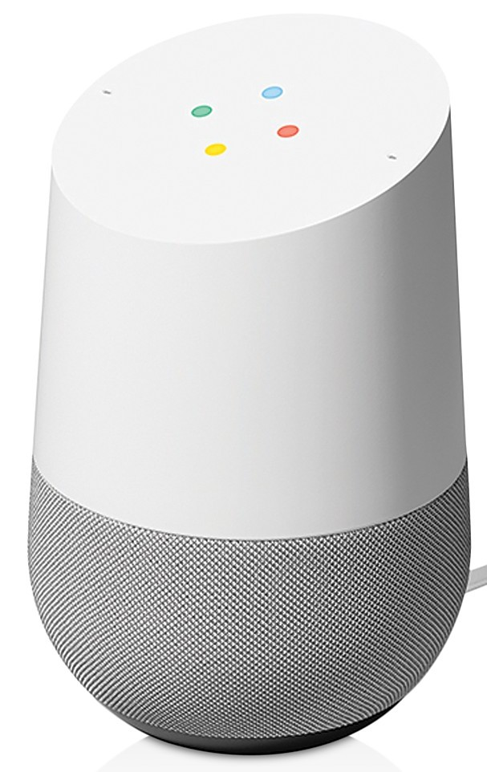

Speech Recognition
SECTION 1: Overview
Automatic recognition and translation of spoken language into text.
For training, use extensive datasets which are not free.
Struggles in noisy environments, in recognizing accented speech, or speaking styles and languages (limited training data available).
Traditional recognizer (before age of Deep Learning ) needed hand-designed components to model background noise, reverberation, or speaker variation.

Slide 4
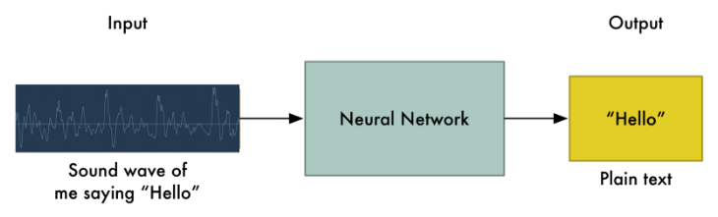
Our Speech Recognition
SECTION 1: Overview
Simple idea, feed sound recordings into a neural network and train it to produce text (architecture: Deep Speech).
Big problem: speech varies in speed.
Need to align audio files of various lengths to a fixed-length piece of text.
Deep Speech: Scaling up end-to-end speech recognition, H. Awni et al.

Slide 5
Corpus
SECTION 1: Overview
Trained on Timit corpus (700 audio files).
For robustness, synthetically increased the volume of the dataset.
10 types of noises (Babble, Cafe, Car, Factory, Machine gun, Plane, Restaurant, SSN, Tank, White Noise)
5 Mixture levels (-3dB, 0dB, 3dB, 6dB, 9dB)
Total dataset size, 700✕10✕5 = 35,000

Slide 6
Feature Extraction
SECTION 1: Overview
Python LibROSA feature extraction methods are used.
Spectrogram: Time-Frequency representation of the speech signal.
Mel-frequency cepstral coefficients (MFCC) : The coefficient that collectively make up the short term power spectrum of a sound.
Currently using MFCC feature as baseline performance.
No manual feature extraction (simply Spectrogram) is the ultimate goal.

Slide 7
Methodology
SECTION 2

Slide 8

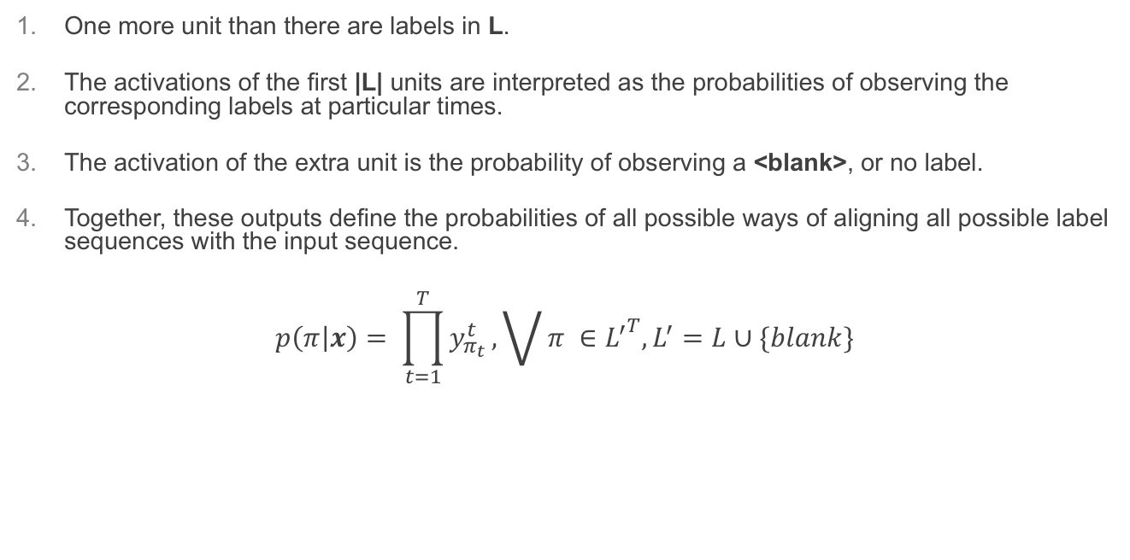
Connectionist Temporal Classification (CTS)
SECTION 2: Methodology
One more unit than there are labels in L.
The activations of the first |L| units are interpreted as the probabilities of observing the corresponding labels at particular times.
The activation of the extra unit is the probability of observing a <blank>, or no label.
Together, these outputs define the probabilities of all possible ways of aligning all possible label sequences with the input sequence.
$$p\left(π | x\right)= \prod_{t=1}^{T}{y_{π_{t}}^{t}}, \bigvee{π ∈{L^{′}}^{T}, L^{′}=L∪\{blank\}}$$
where, x is input sequence and $π$ is label sequence.
Connectionist Temporal Classification: Labelling Unsegmented Sequence Data with Recurrent Neural Networks, G. Alex et al

Slide 9
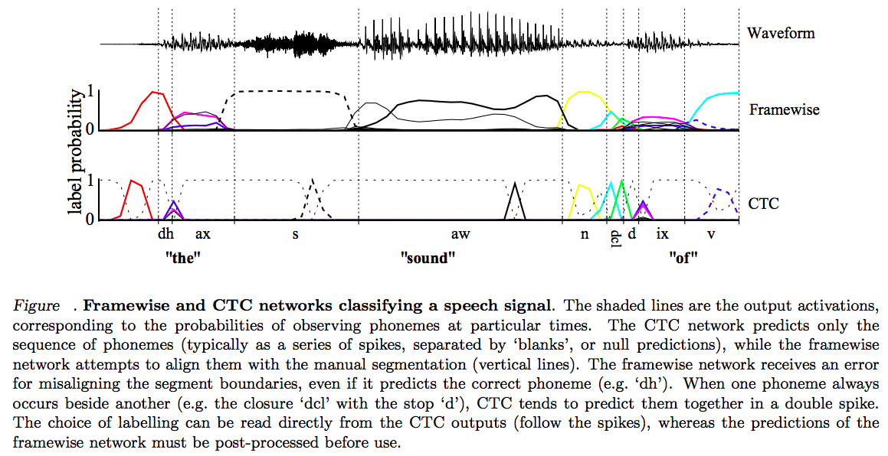
Connectionist Temporal Classification (CTS)
SECTION 2: Methodology
Connectionist Temporal Classification: Labelling Unsegmented Sequence Data with Recurrent Neural Networks, G. Alex et al

Slide 10
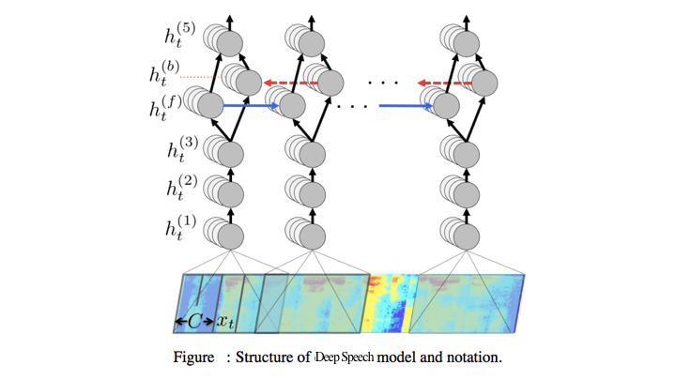
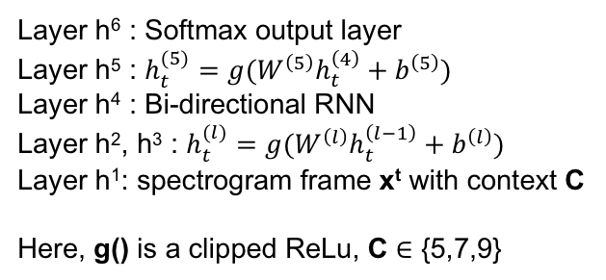
Deep Speech Model
SECTION 2: Methodology
Layer h⁶ : Softmax output layer
Layer h⁵ : $h_{t}^{(5)}=g(W^{\left(5\right)}h_{t}^{\left(4\right)}+b^{\left(5\right)})$
Layer h⁴ : Bi-directional RNN
Layer h², h³ : $h_{t}^{(l)}=g(W^{\left(l\right)}h_{t}^{\left(l−1\right)}+b^{\left(l\right)})$
Layer h¹: spectrogram frame x^{t} with context C
Here, g() is a clipped ReLu, C $∈$ {5,7,9}
Deep Speech: Scaling up end-to-end speech recognition, H. Awni et al.

Slide 11

Our Model (CRNN)
SECTION 2: Methodology
Dense Layer
Layer h⁶ : Softmax output layer
Layer h⁵ : $h_{t}^{(5)}=g(W^{\left(5\right)}h_{t}^{\left(4\right)}+b^{\left(5\right)})$
Layer h⁴ : Bi-directional RNN
Layer h², h³ : $h_{t}^{(l)}=g(W^{\left(l\right)}h_{t}^{\left(l−1\right)}+b^{\left(l\right)})$
Layer h¹: spectrogram frame x^{t} with context C
Here, g() is a clipped ReLu, C $∈$ {5,7,9}
Bi-directional
RNN Layer
CNN Layer

Slide 12
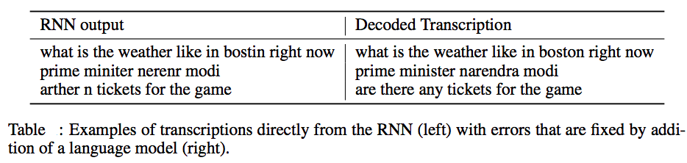
Postprocessing (Language Model)
SECTION 2: Methodology
Deep Speech: Scaling up end-to-end speech recognition, H. Awni et al.

Slide 13
Thank You!

