Slide 1
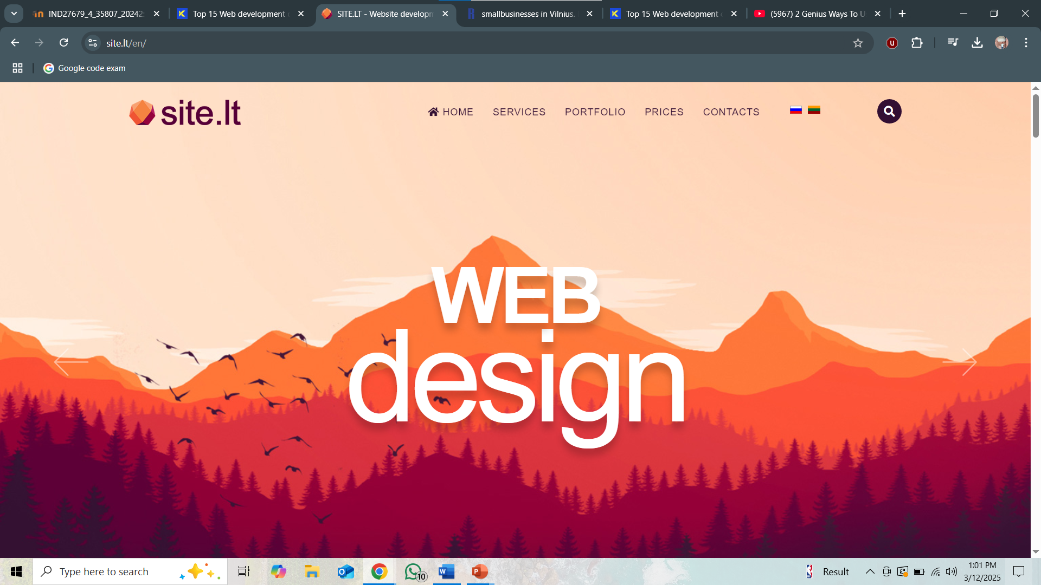
Website UI Analysis: SITE.LT
Evaluating User Interface and Experience
Author: [Al Amin Hossain Nayem]
Date: [12/03/2025]
Link: https://site.lt/en

Slide 2
Introduction
Website Name: SITE.LT
Business Type: Web Development Company (Vilnius, Lithuania)
Objective: Assess UI for usability, navigation, and design feedback

Slide 3
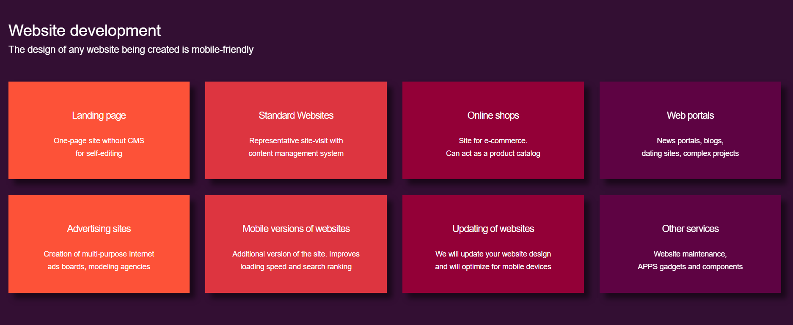

Navigation & Menu Structure
Observation: Simple top navigation bar with essential links.
Issue: Lacks clear hierarchy; some submenus are hard to locate.
Recommendation: Implement a structured dropdown or mega-menu.

Slide 4
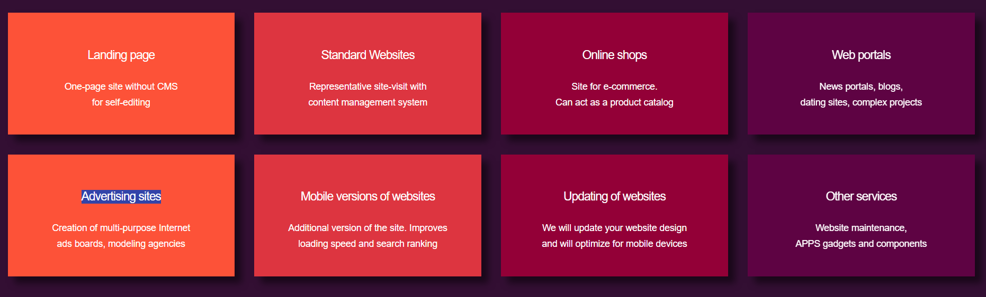
Menu Depth & Grouping
Observation: Shallow structure for easy navigation.
Issue: Some content requires multiple clicks to access.
Recommendation: Restructure pages for better access And add link like if we click the any services it directly take to the price option.

Slide 5

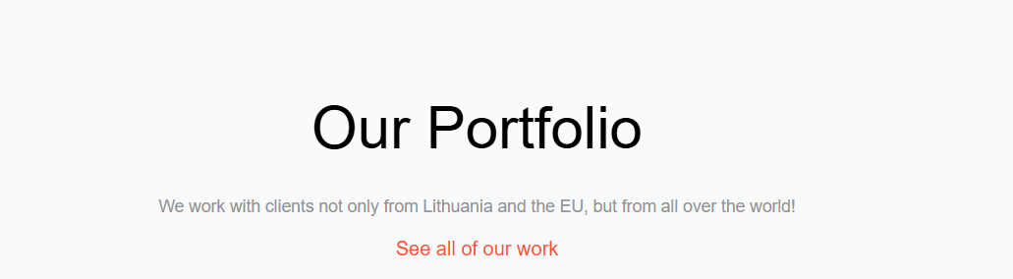
Control Clarity
Observation: Buttons are not recognizable clearly.
Issue: Some buttons are too small.
Recommendation: Increase button size and contrast.

Slide 6
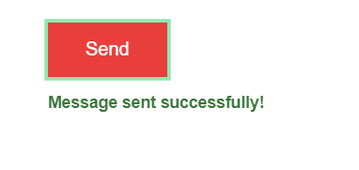
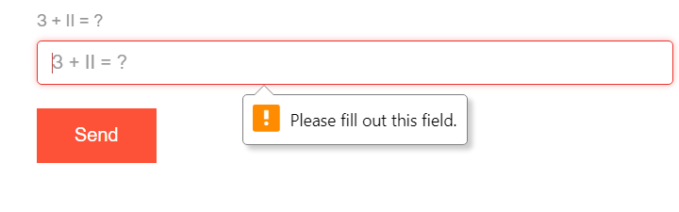
Error Handling
Observation: Forms are doing proper error handling and also giving feedback when done.
Recommendation: More appropriate bot checker can be used.

Slide 7
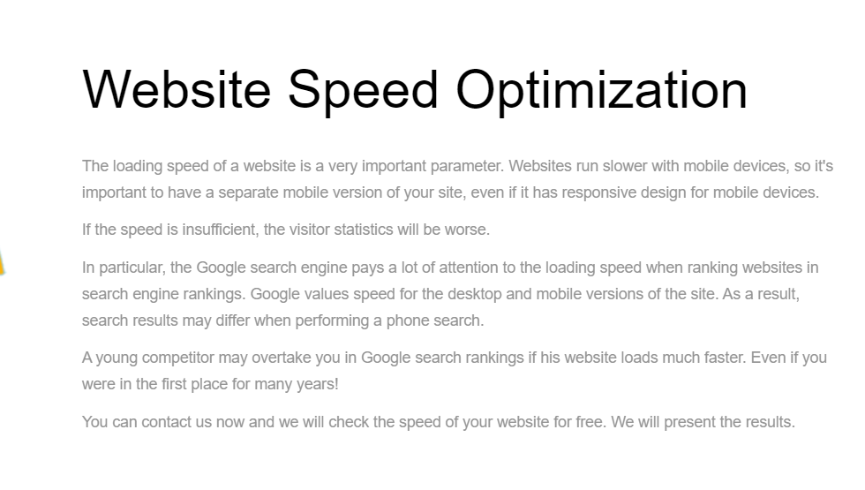
Color Compatibility & Readability
Observation: Minimalistic color palette.
Issue: Some text has low contrast.
Recommendation: Improve contrast for readability.

Slide 8
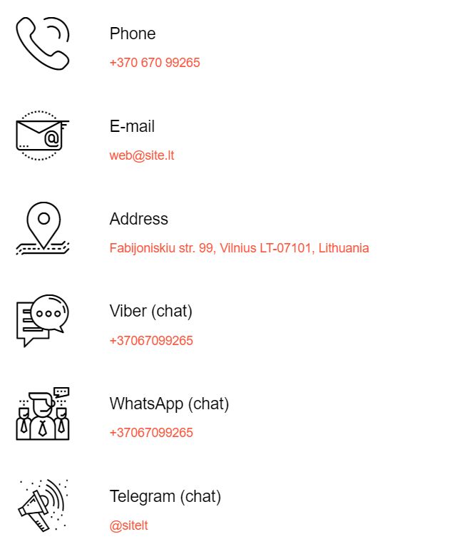

Icon Usage
Observation: Icons are effectively used.
Issue: Some lack tooltips.
Recommendation: Add tooltips for better guidance.

Slide 9

Hotkeys & Shortcuts
Observation: Very few keyboard shortcuts.
Issue: Users rely on mouse interactions.
Recommendation: Introduce keyboard navigation.

Slide 10



Mouse Cursor Interaction
Observation: Hover effects are present.
Issue: Some elements lack hover changes.
Recommendation: Ensure all clickable elements respond to hover.

Slide 11
Summary of Issues & Recommendations
Improve menu hierarchy, add feedback, error handling, better contrast, tooltips, and hotkeys.

Slide 12
Conclusion
Strengths: Simple navigation, clean layout.
Weaknesses: Lack of structured menus, minimal feedback, and hover.
Final Recommendation: Improve usability and accessibility.

Slide 13
Thank You!
SUBMITTED BY: AL Amin Hossain Nayem.
SUBMITTED TO: ASIST. DR. DAINIUS BALBONAS

