Slide 1

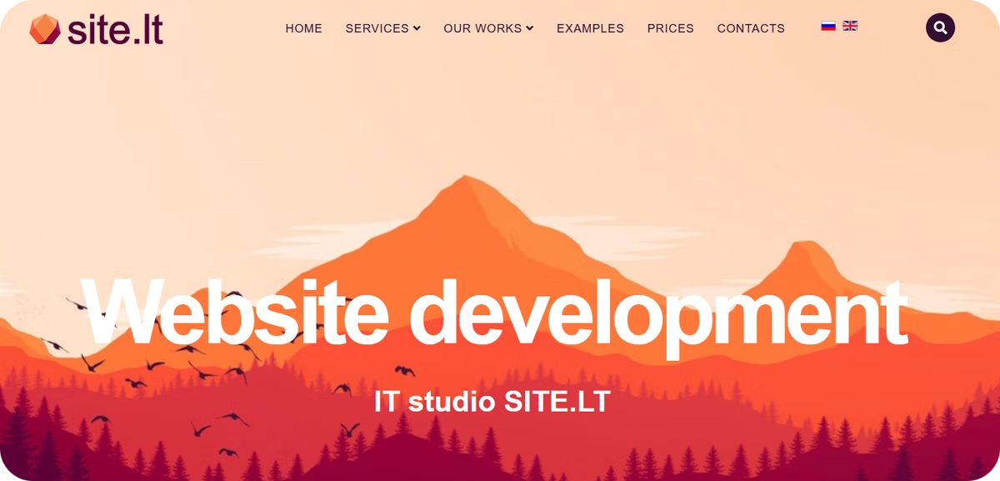
UI/UX Analysis of site.lt
Created by: Al Amin Hossain Nayem
Course: Human-Computer Interaction
Date: 04/04/2005
This presentation provides a UI/UX analysis of site.lt, a Lithuanian web development company website. The analysis covers navigation, usability, clarity, feedback, visuals, and mobile experience, highlighting strengths and suggesting improvements.

Slide 2
Overview of site.lt
Key Features
Analysis Focus
Lithuanian web development company website
Navigation
Clean and modern UI
Usability
Responsive design (desktop & mobile friendly)
Clarity
Feedback
Visuals
site.lt is a Lithuanian web development company website that serves as a good example of clean and modern UI. Its responsive design ensures a seamless experience across desktop and mobile devices. The analysis focuses on key aspects such as navigation, usability, clarity, feedback, and visuals.

Slide 3

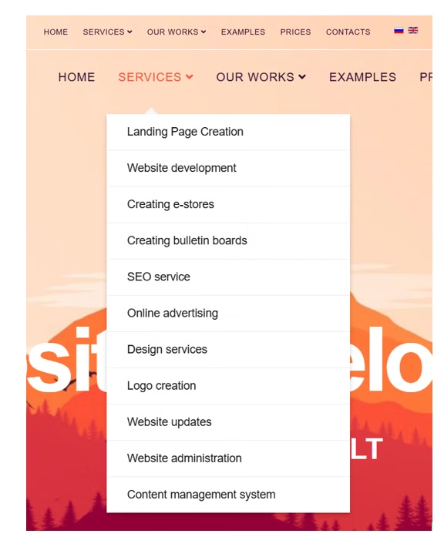



Navigation & Usability
Clear Menu Labels
Logical Menu Depth
Intuitive menu labels enhance user experience.
Avoids overwhelming users with too many levels.
Easy Mobile Menu
Hamburger menu simplifies mobile navigation.
The website features clear and intuitive menu labels, ensuring users can easily find what they're looking for. The logical menu depth prevents overwhelming users with too many levels. The easy-to-use mobile hamburger menu further enhances usability on smaller screens. For better clarity, consider adding clear "Menu" text next to the mobile menu icon.

Slide 4

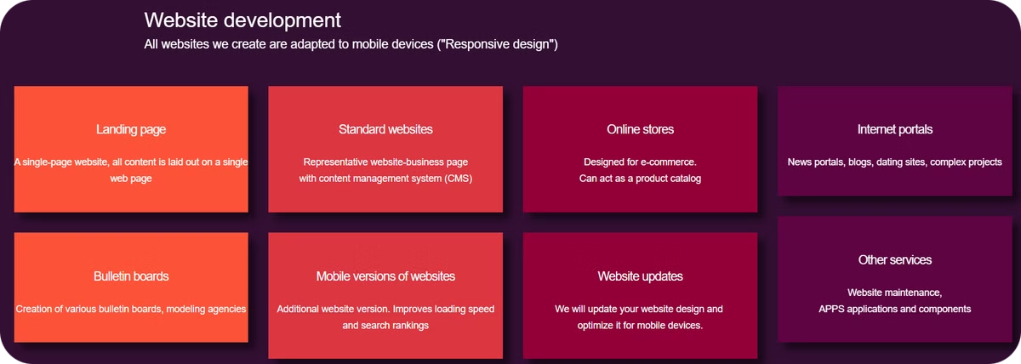
Content Grouping
Logical Sections
Easy to Skim
Clearly separated sections (Services, Portfolio, Contact) improve organization.
Users can quickly find the information they need.
Back to Top
Consider adding a "back to top" button for quicker navigation on longer pages.
The website's content is logically grouped into clearly separated sections such as Services, Portfolio, and Contact, making it easy for users to skim and find information. To further enhance navigation on longer pages, consider adding a "back to top" button.

Slide 5

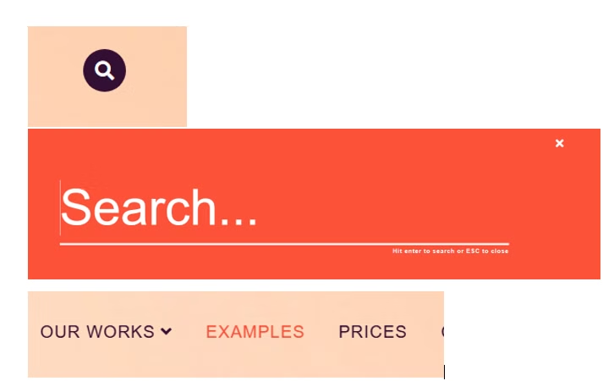



Feedback & Interaction
Visual Feedback
Clear Cursor Indication
Carousel Control
Immediate visual feedback on clickable elements.
Ensure carousel interactions give control to users.
Clear cursor indication for clickable areas.
The website provides immediate visual feedback on clickable elements through hover effects and active states, enhancing user interaction. Clear cursor indication for clickable areas further improves usability.

Slide 6


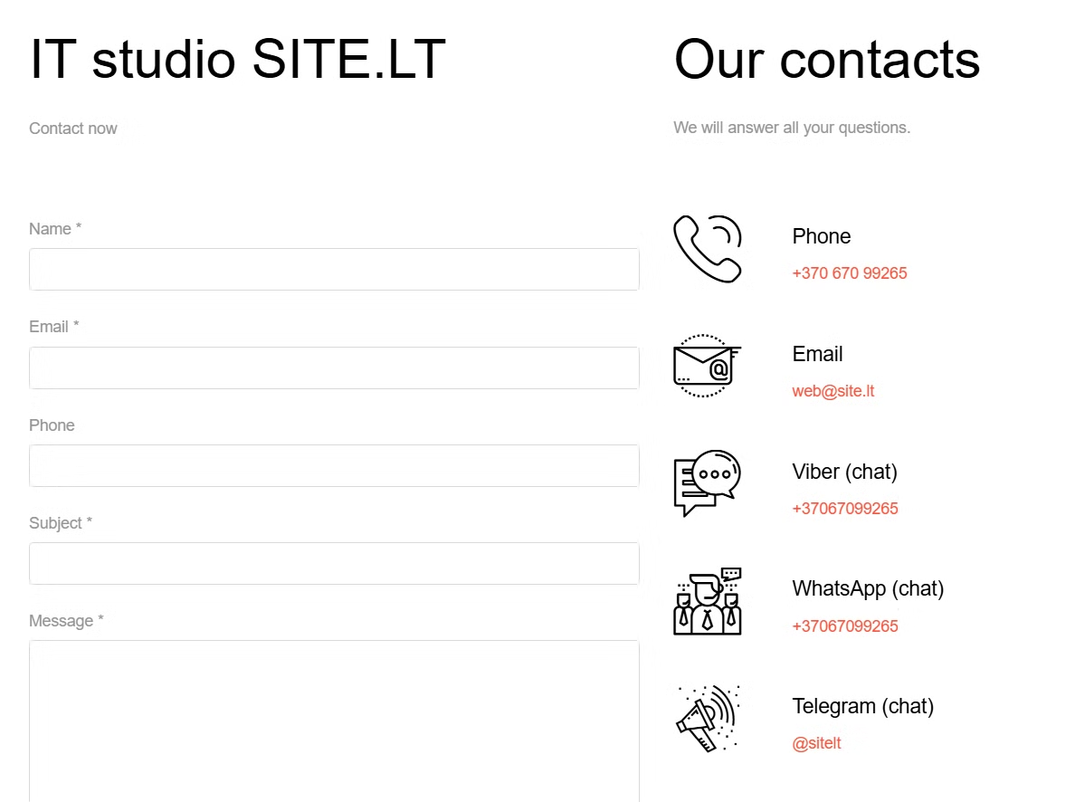


Clarity & Error Handling
Clear Labels
Clear labels on buttons and form fields.
Good Error Messages
Immediate corrections on forms.
Required Fields
Clearly indicate required form fields upfront (* symbols).
The website features clear labels on buttons and form fields, ensuring users understand their purpose. Good error messages and immediate corrections on forms enhance the user experience. To further improve clarity, clearly indicate required form fields upfront with symbols.

Slide 7








Visual Design
Consistent Color Scheme
Readable Typography
Maintains a professional look.
Ensures content is easy to read.
Appropriate Icons
Good Visual Spacing
Simple, recognizable icons enhance usability.
Easy to read layout.
The website boasts a consistent color scheme and readable typography, contributing to a professional and user-friendly design. The appropriate use of simple, recognizable icons enhances usability. Good visual spacing and layout make the content easy to read. Slightly increase contrast on lighter grey text for better readability.

Slide 8



Mobile Experience
Responsive Layout
User-friendly on smartphones.
Easy Mobile Menu
Simple to open and navigate.
Readable Content
No zooming or horizontal scroll needed.
The website offers a responsive and user-friendly layout on smartphones, ensuring a seamless mobile experience. The menu is easy to open and navigate on mobile devices. All content is readable without requiring zooming or horizontal scrolling. Label the mobile menu ("Menu") clearly for less experienced users.

Slide 9

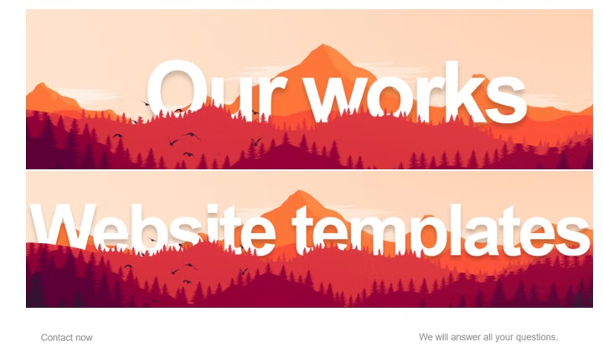
Overall Summary
4
Strengths
Clear navigation, great interaction feedback, consistent visual style, mobile-friendly design.
1
Improvements
Improved contrast.
site.lt is a strong example of good UI/UX design, characterized by clear navigation, logical content grouping, great interaction feedback and usability, a professional and consistent visual style, and a fully responsive, mobile-friendly design. Minor improvements are suggested to enhance accessibility and user experience, including better labeling, slightly improved contrast. As it is a website for web designing there is very few improvements needed.

Slide 10
Conclusion
1
Strong UI/UX Design
2
Accessibility
3
Key Improvements
site.lt offers clear, professional, and user-friendly design.
Enhancements can improve the user experience.
Better labeling can lead to better UX.

