Slide 1
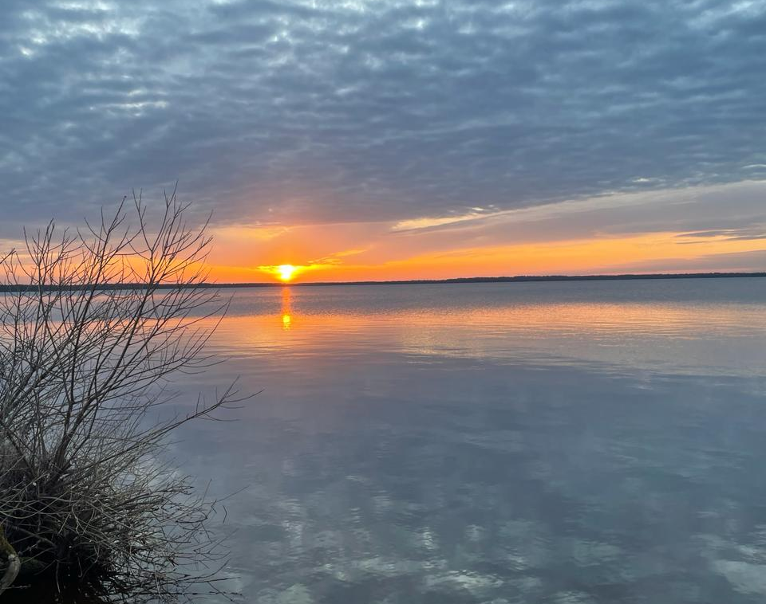
Sunset
Rule of Thirds compositions rule used.

Slide 2
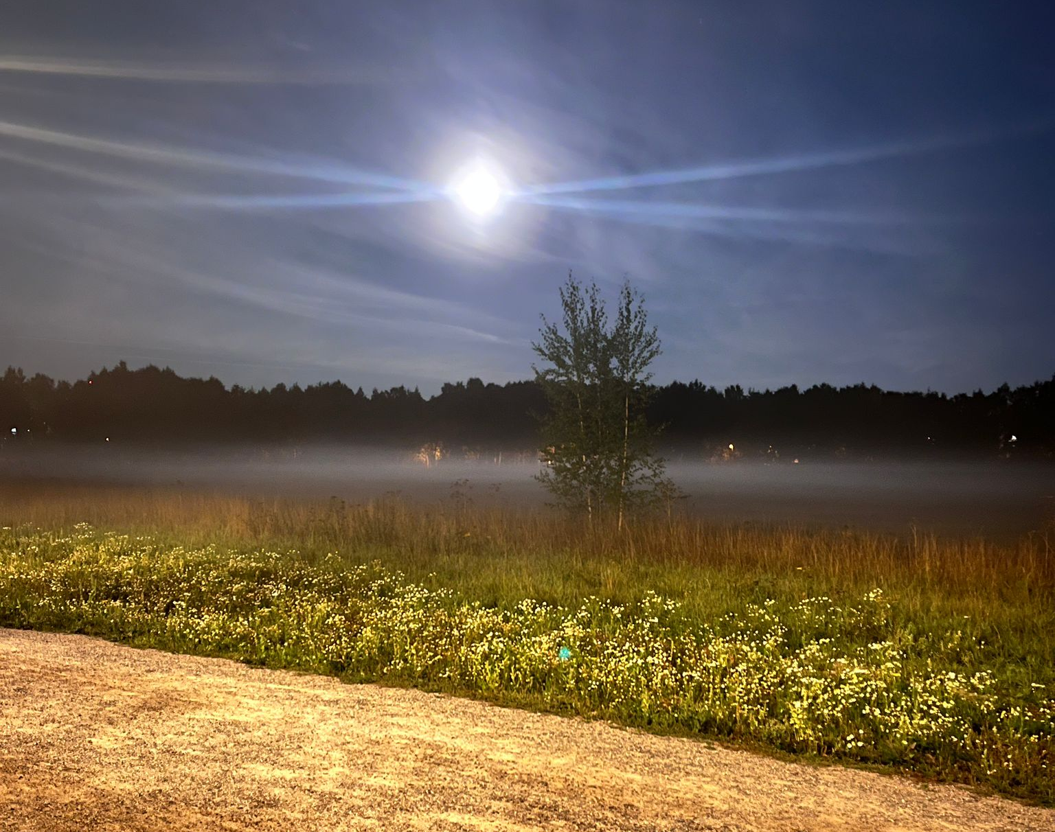
Moon
Rule of Thirds compositions rule used.

Slide 3
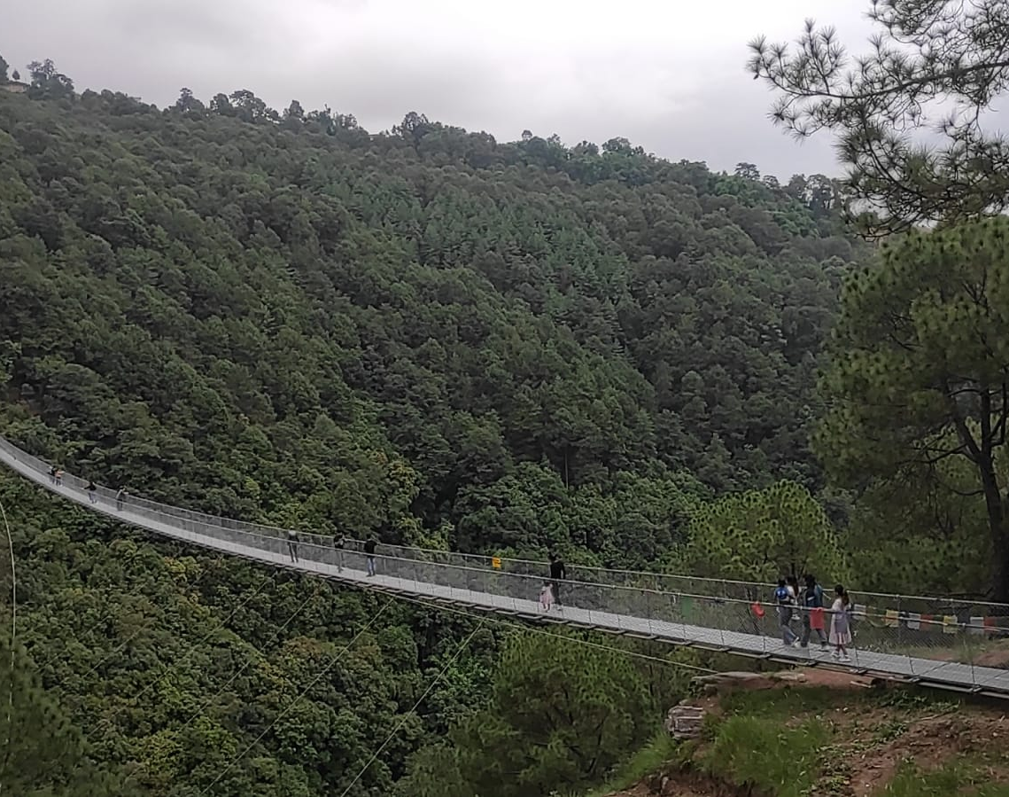
Bridge
Line (horizon) rule composition rule used.

Slide 4
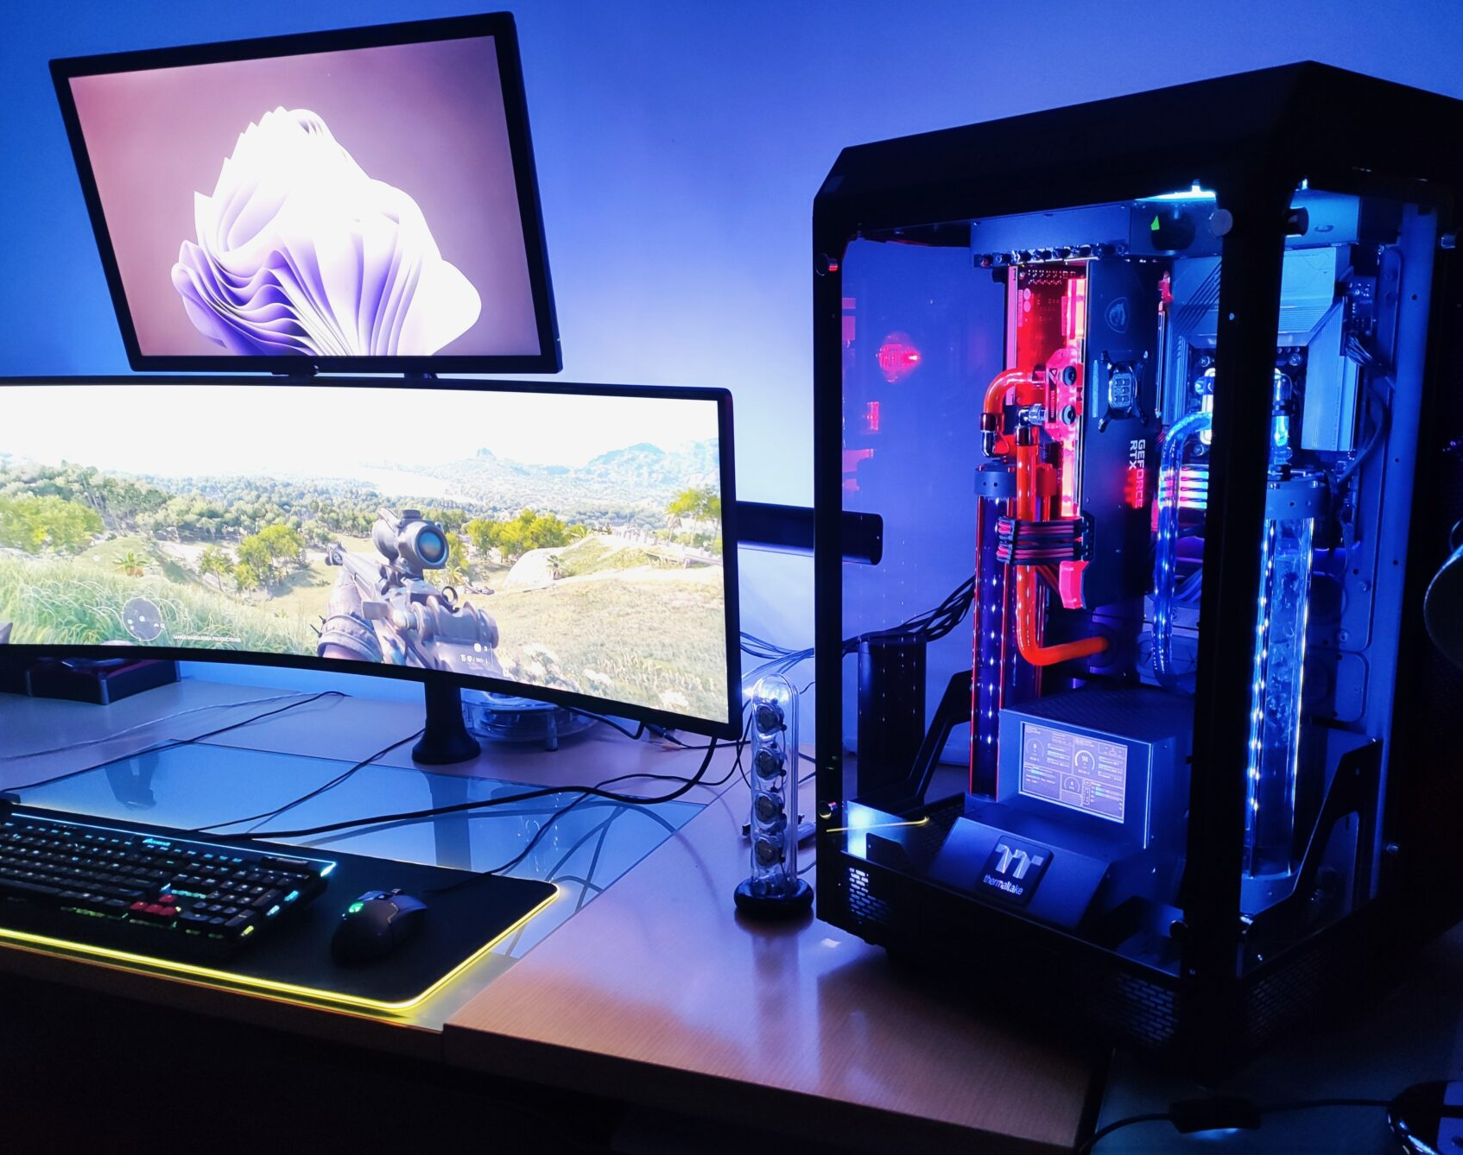
My Dream Desktop
Rule of Thirds compositions rule used.
Collect from web.

Slide 5
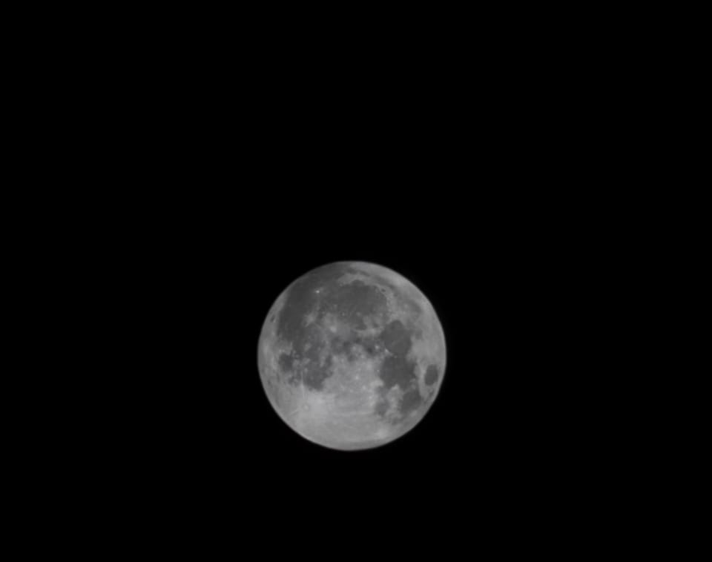
The Moon
Rule of Thirds compositions rule used.

Slide 6
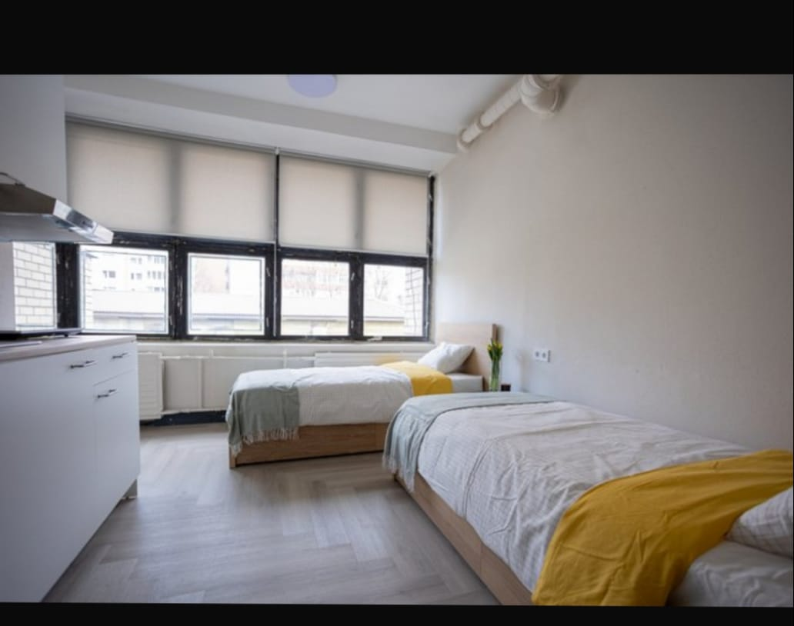
Beds Room
leading lines and a bit of symmetry.

Slide 7
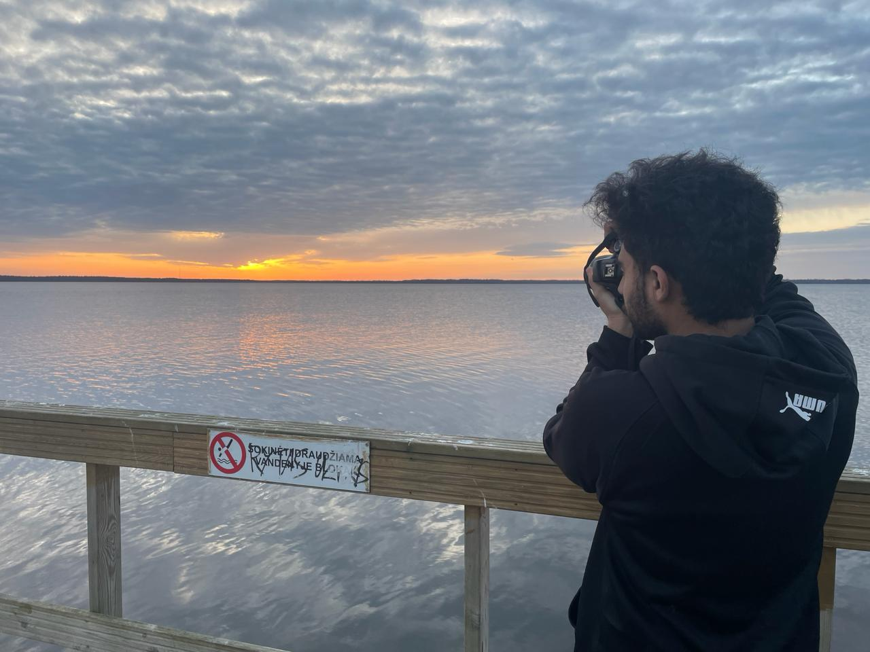
My friend trying to capture the moment
Rule of Thirds compositions rule used.

Slide 8
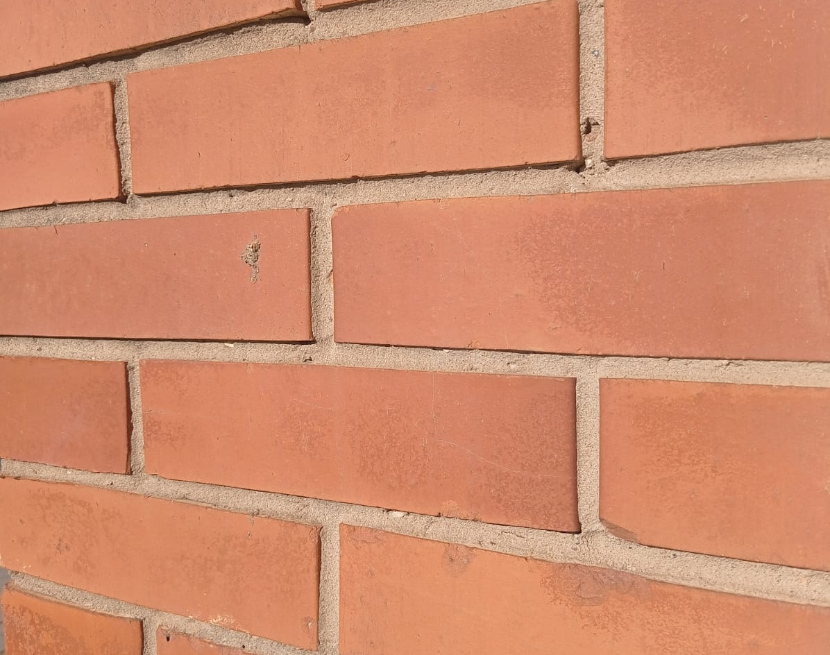
Building wall
Grid / pattern / texture composition rule used.

Slide 9
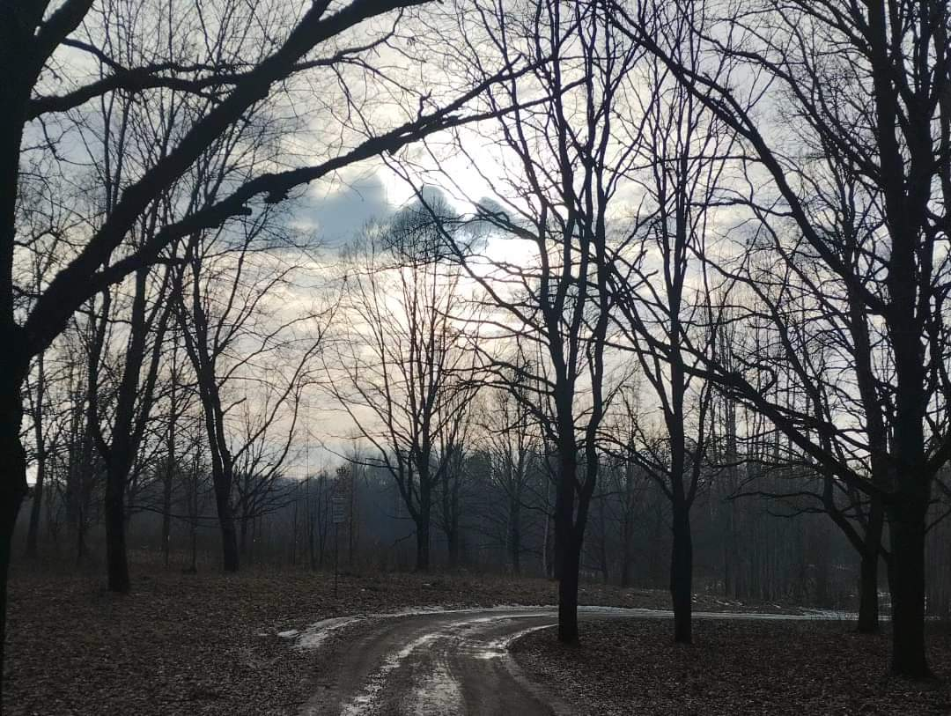
Nature
Rule of Thirds compositions rule used.

Slide 10
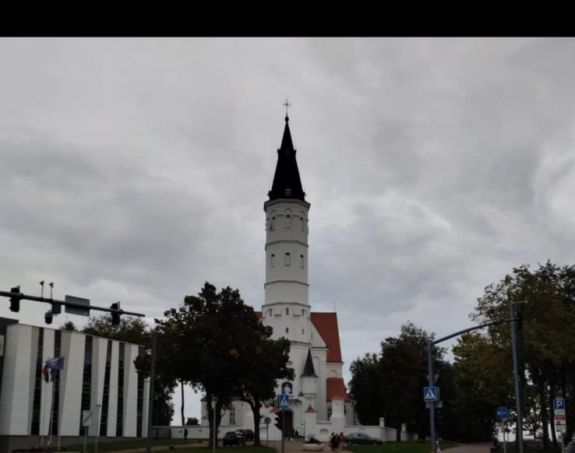
Šiauliai
Centered Composition rule

