Slide 1
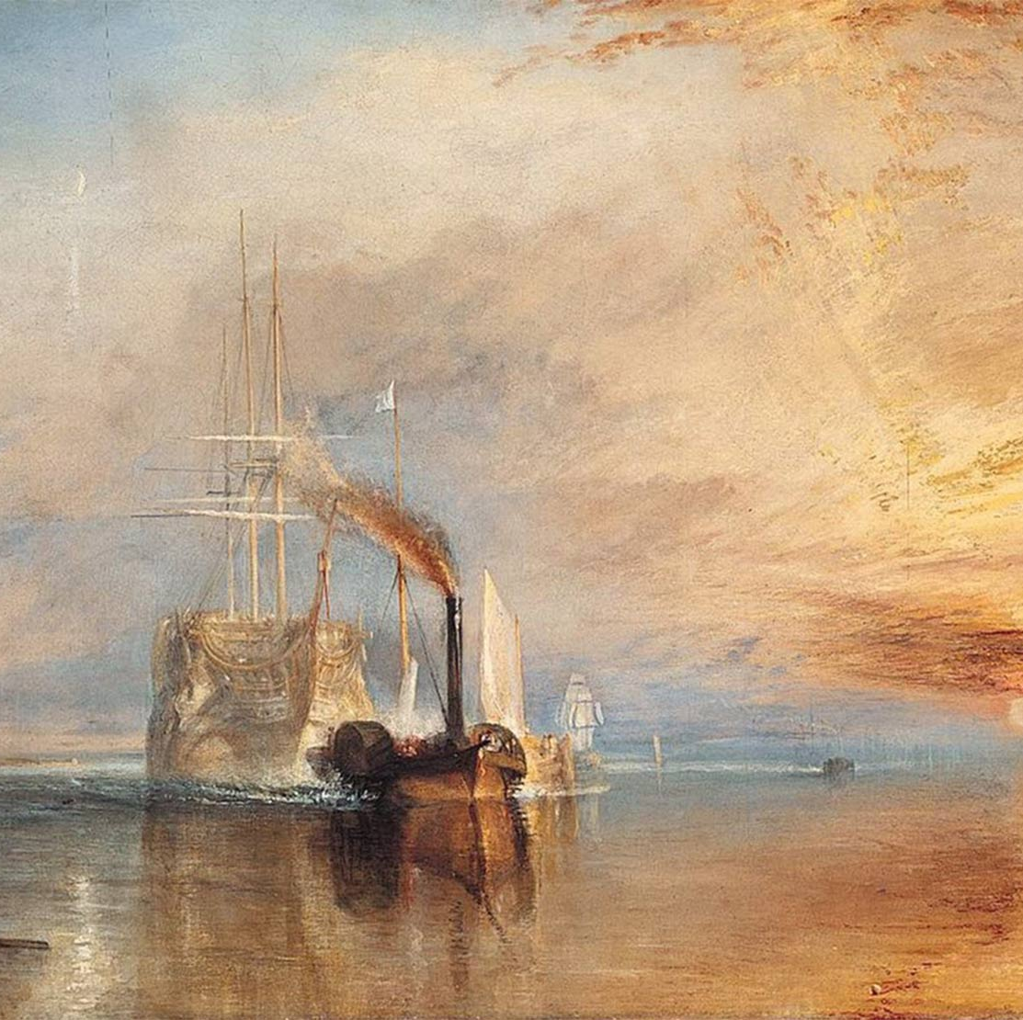
1) Painting rule of third
"The Fighting Temeraire" by J.M.W. Turner

Slide 2
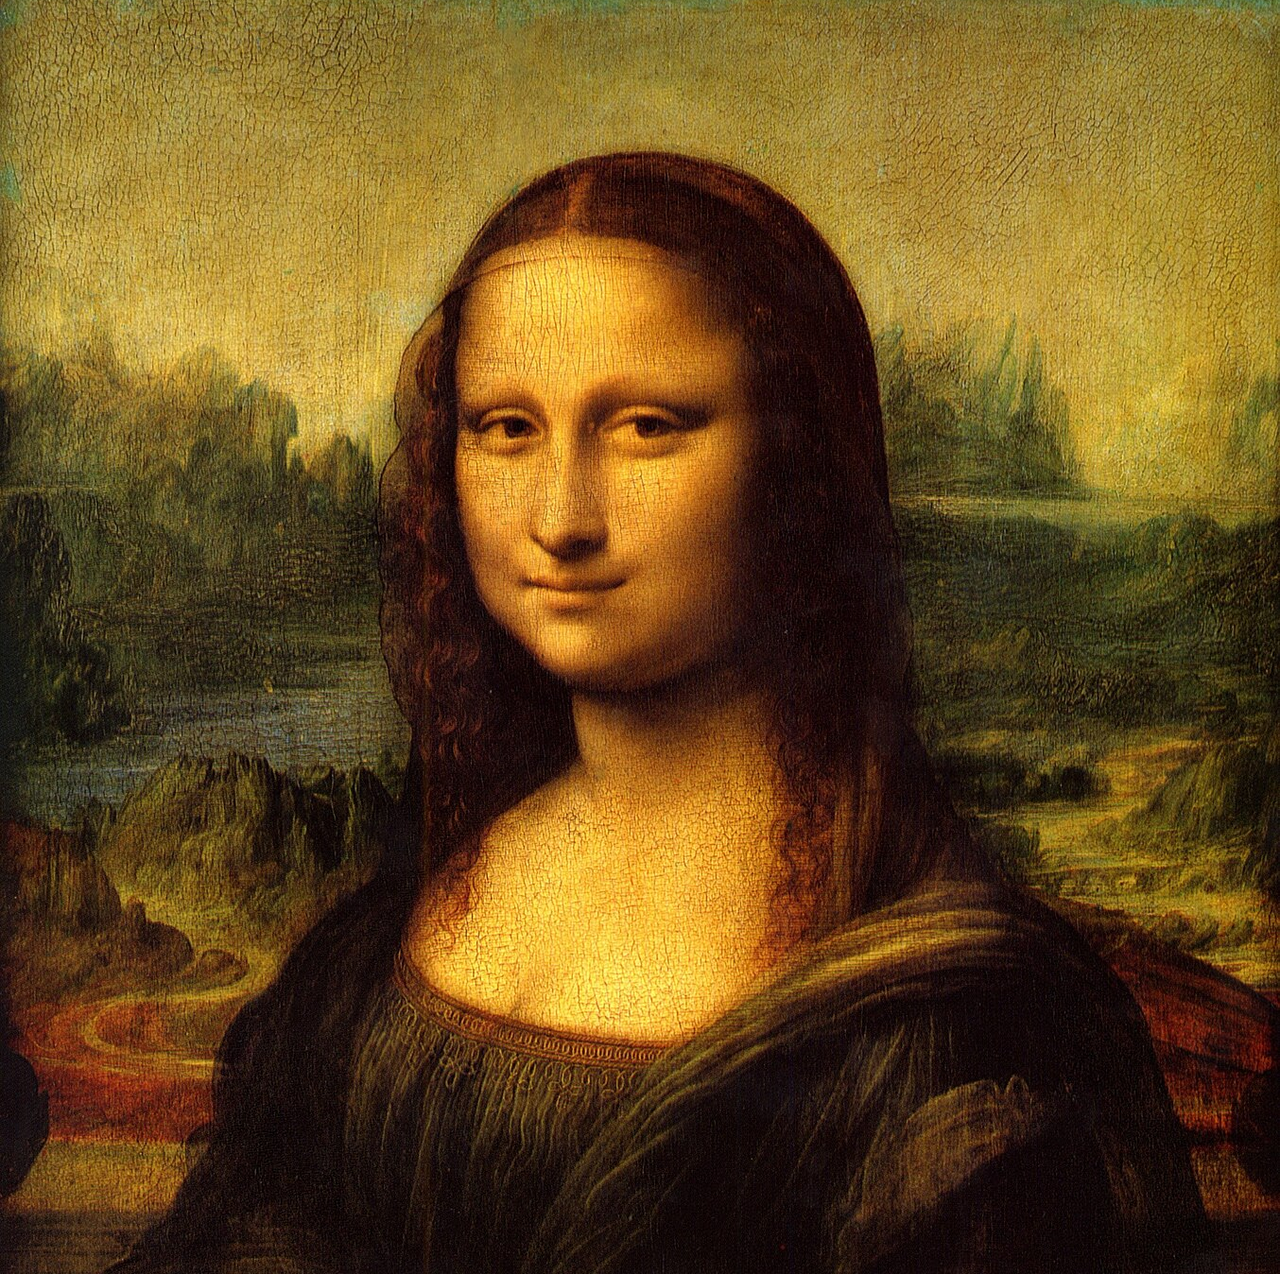
Golden ratio
By Leonardo da Vinci's

Slide 3
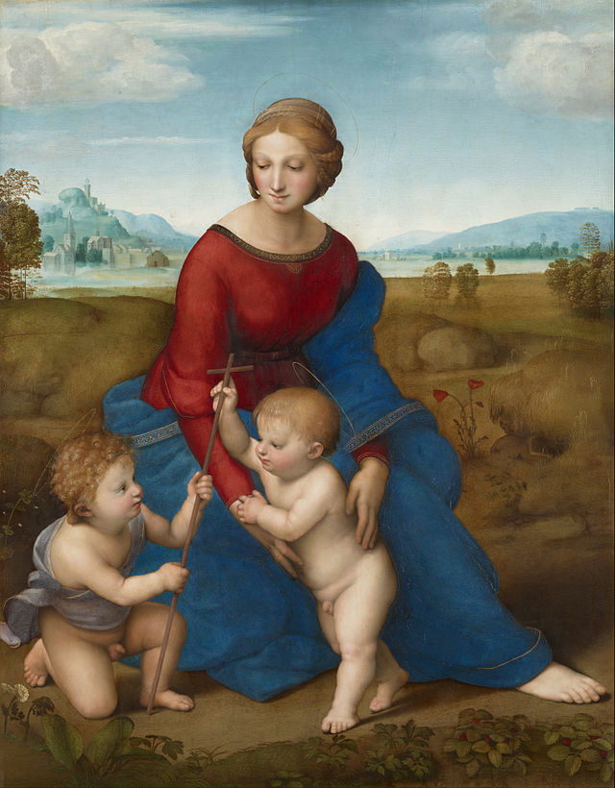
Triangle rule

Slide 4
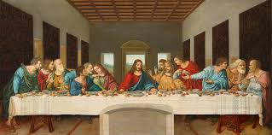
rule of third By Leonardo da Vinci's

Slide 5
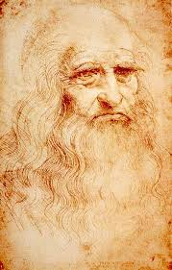
Golden Ratio Leonardo da Vinci: self-portrait

Slide 6
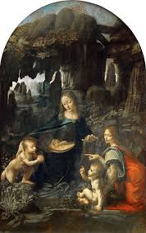
pyramidal composition The Virgin of the Rocks By Leonardo da Vinci's

Slide 7
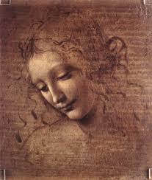
Head of a Woman By Leonardo da Vinci's

Slide 8
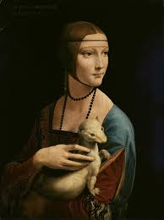
Lady with an Ermine

Slide 9
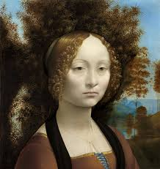
Ginevra de’ Benci

Slide 10
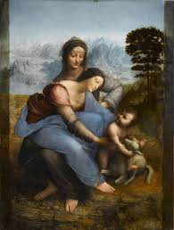
The Virgin and Child with Saint Anne Triangle rule

