Slide 1
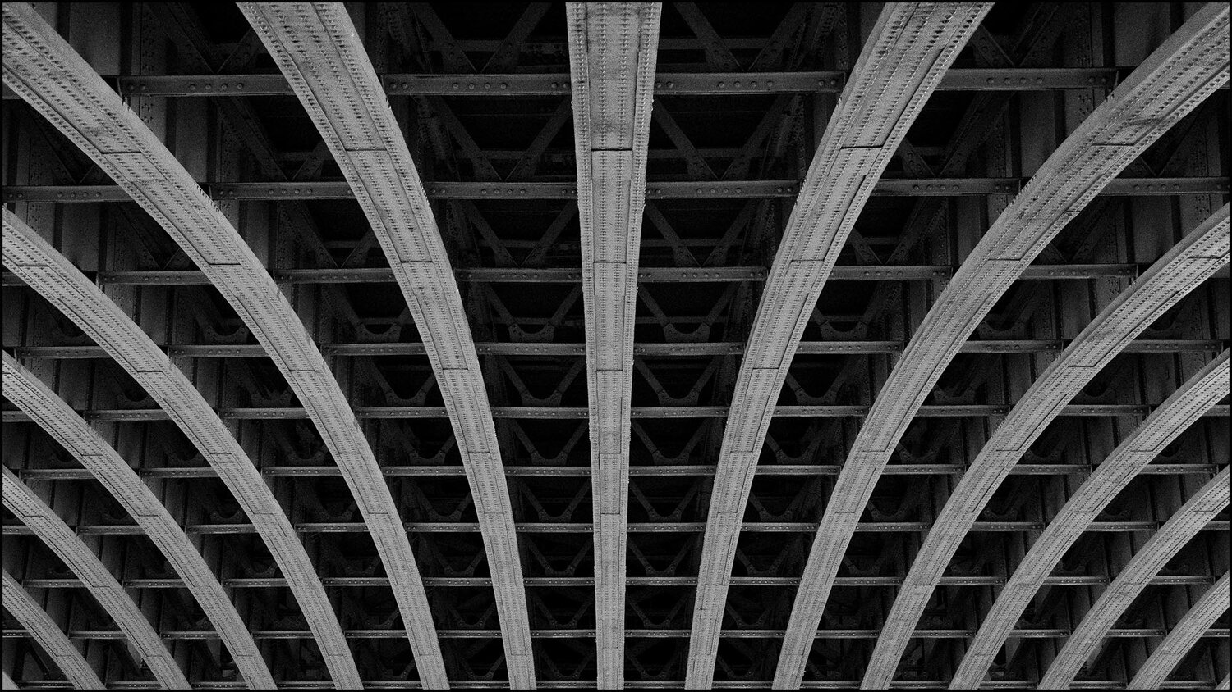
_{Symmetrycal}

Slide 2

Triangle rule

Slide 3

Rule of third

Slide 4

The Rule of Thirds and The Golden Ratio

Slide 5

Rule of third

Slide 6

Golden ratio

Slide 7

Triangle rule

Slide 8

Center & Symmetry

Slide 9

Leading Lines Photography

Slide 10

Diagonal Lines

