Slide 1
Fake News Detection with Deep Learning
by
Md Majharul Islam Nayem
Farjana Islam
Junaid Abbas Mohammed

Slide 2
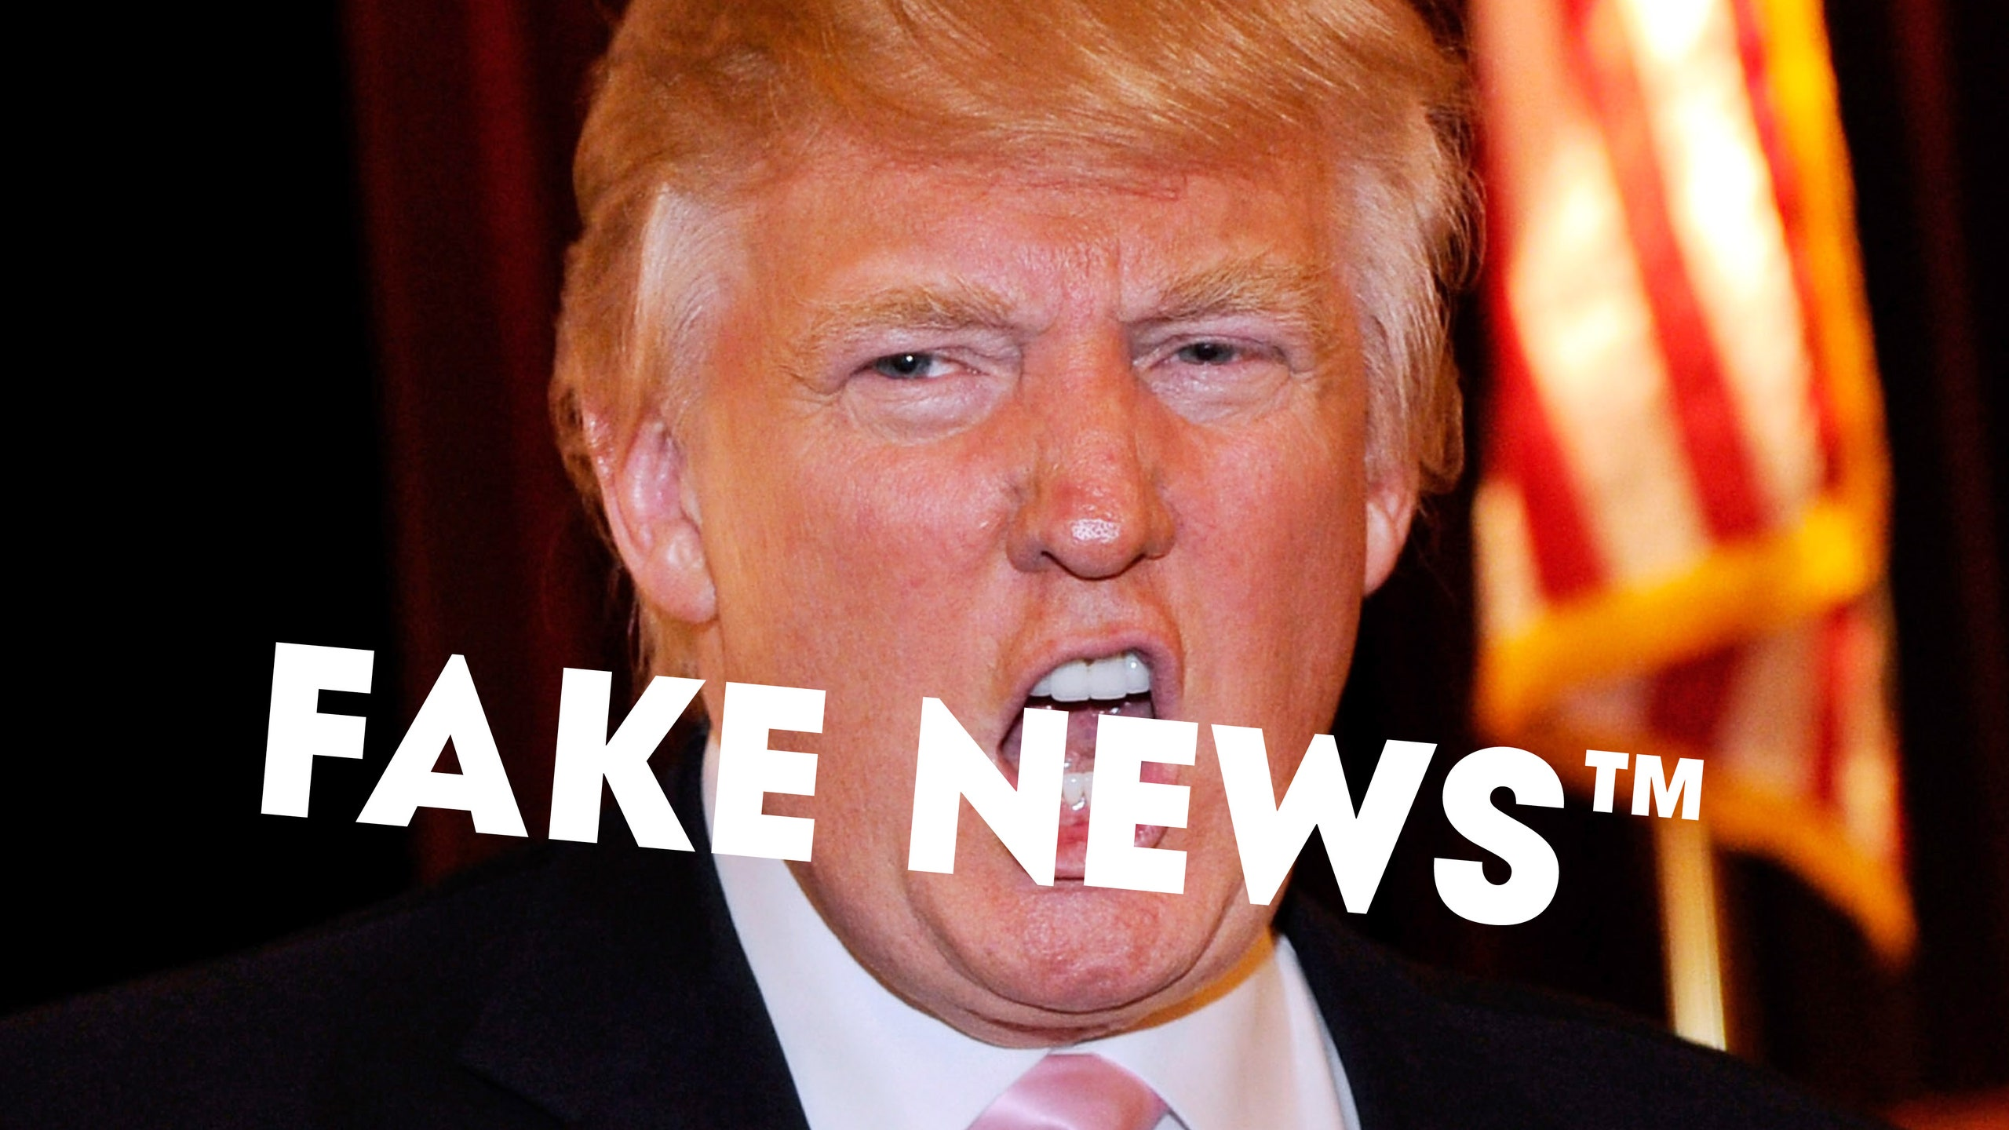

Slide 3
Dataset

Slide 4
Data Preprocessing

Slide 5
Model, Training & Evaluation

