Slide 1

C LANGUAGE ANIL NAYENI

Slide 2
1.Data types
Declaration for variables
C supports different data types like ‘int’ , ’char’ , ’float’, ’double’ ,’signed’, ’unsigned’, ’ enum ’ , and more.
We can create user defined data types using structures and unions .
We are using this data types for memory allocation and storage considerations.
 | 16(bit) | 32(bit) | 64(bit)
int | 2 bytes | 4 bytes | 4 bytes
char | 1 byte | 1 byte | 1 byte
float | 4 bytes | 4 bytes | 4 bytes
double | 8 bytes | 8 bytes | 8 bytes

Slide 3
Type | Storage size(bytes) | Value range
Char | 1 | -128 to 127 or 0 to 255
Unsigned char | 1 | 0 to 255
Signed char | 1 | -128 to 127
int | 2 or 4 | -32,768 to 32,767 or -2,147,483,648 to 2,147,483,647
Unsigned int | 2 or 4 | 0 to 65,535 or 0 to 4,294,967,295
Short | 2 | -32,768 to 32,767
Unsigned short | 2 | 0 to 65,535
long | 4 | -2,147,483,648 to 2,147,483,647
Unsigned long | 4 | 0 to 4,294,967,295

Slide 4
2.Compilation process
The compilation is the process of converting the source code of the c language into machine code
The C program goes through the four phases during compilation.
Preprocessor
Compiler
Assembler
Linker
preprocessor:- remove comments and Expands Macros (.i file)
compiler :- Found errors if it is not convert machine level language to assemble language (.Asm file)
Assembler :- Assemble language to machine level language (.obj file)
Linker :-merge other objective files

Slide 5
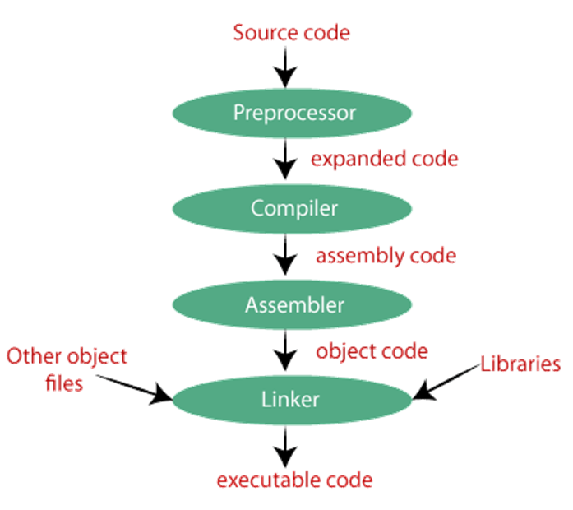

Slide 6
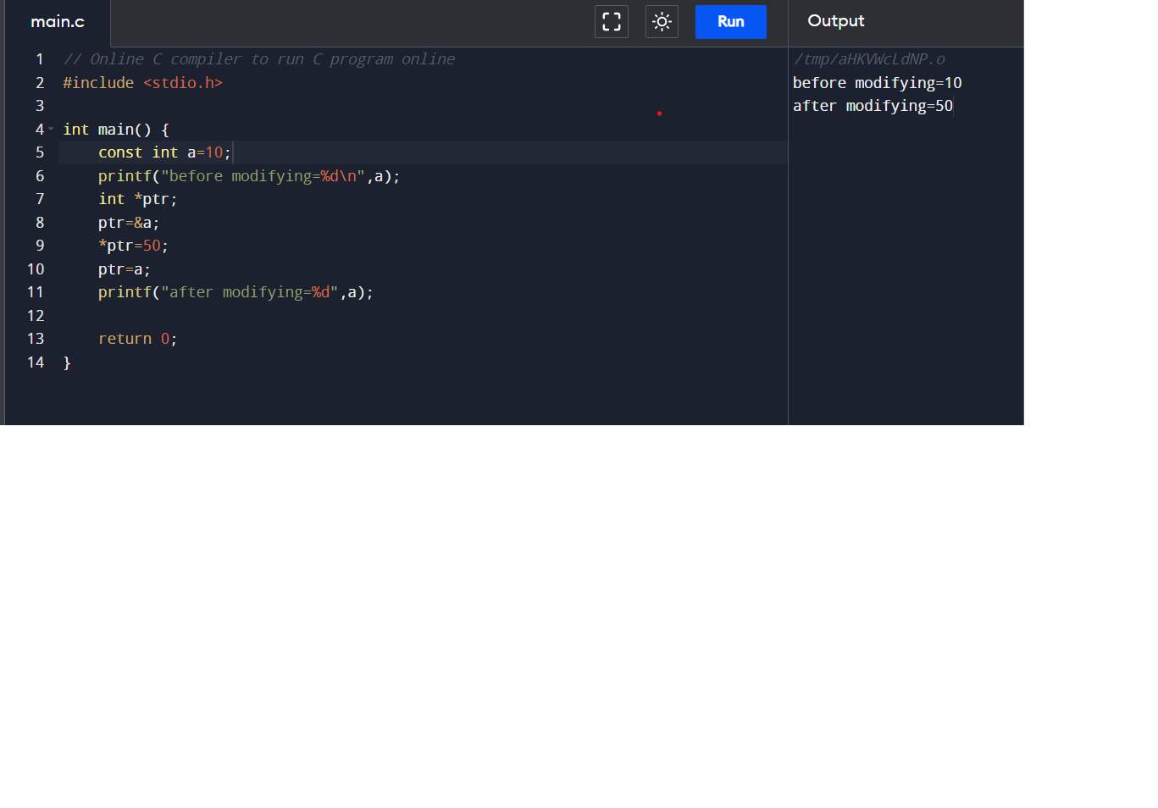
3.Constant
Any Variable before we can declare as a constant that value should be fixed
Ex. const int a=10;
but we can change this constant value by using pointers

Slide 7
4.Volatile
Volatile is a keyword it’s used to prevent the compilation from the optimalization , the volatile value any time will be change by external events.
The main reason behind using volatile is that “it can change value any time a user wants it changed or when another thread is running but using the same variable”0.
The volatile object/variable is always stored in the memory.

Slide 8
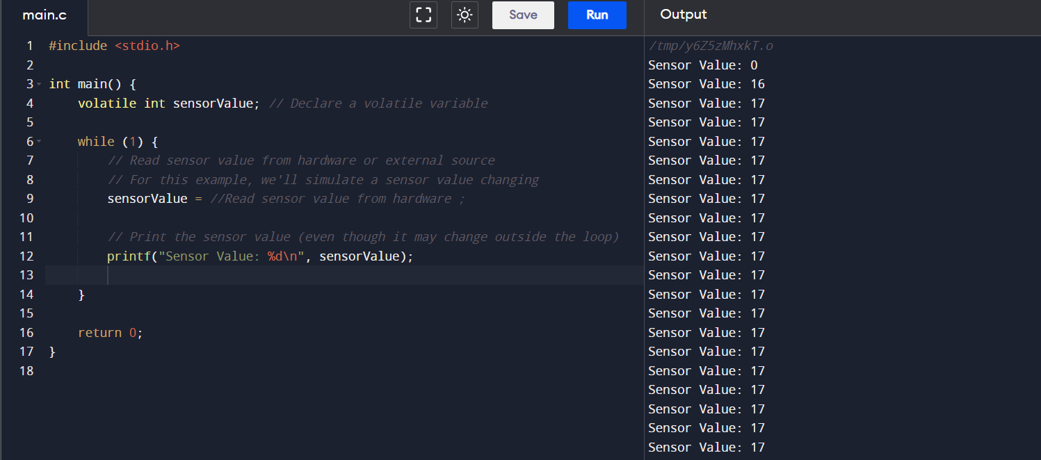

Slide 9


