Slide 1



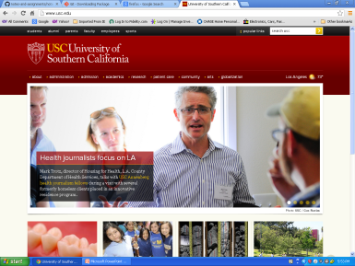
Request sent for http://www.usc.edu
Client / Browser
Server
HTML document index.html sent back from the server to the client.
Your computer w a web browser renders the index.html file

