Slide 1
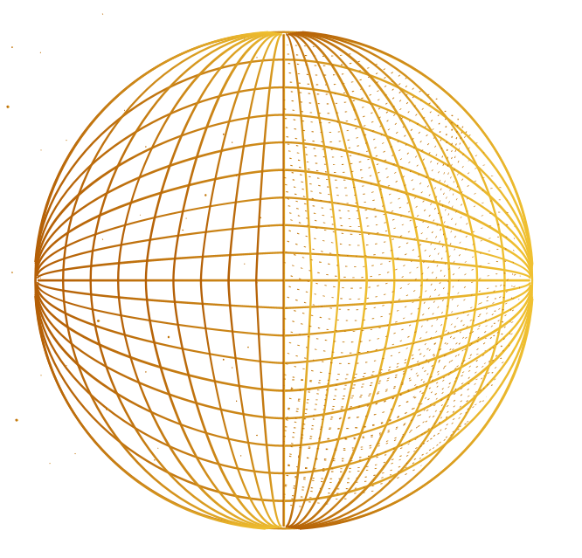
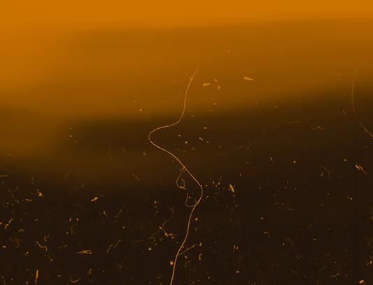
Spectroscopic Identification of Little Red Dots
ANTLIA
1998
ORION
Physics 473
Nayera Abdessalam
1998

Slide 2

OUTLINE
01.
02.
03.
04.
What are Little Red Dots?
T
Use of Spectroscopy
0
NIRSpec + MIRI
Physical Interpretation

Slide 3
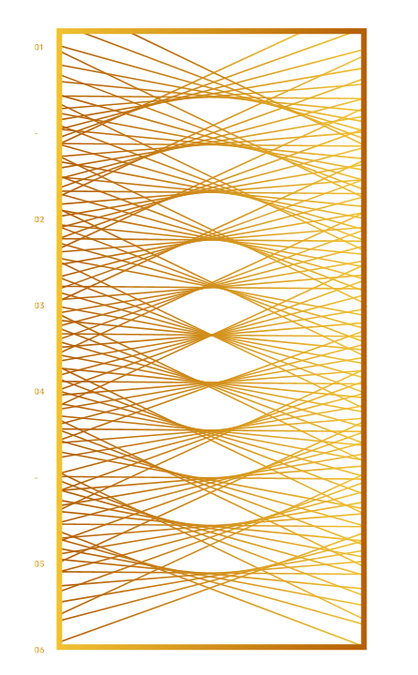
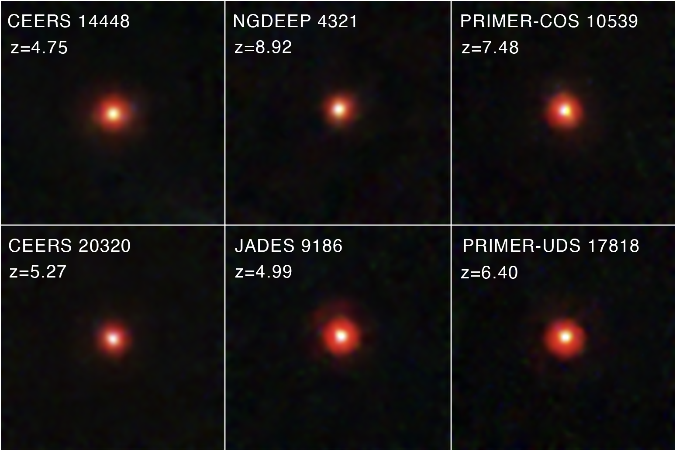
01.
What are Little Red Dots?
T
1
NASA

Slide 4
Features
Discovered with JWST shortly after launch in 2022.
Extremely compact red rest-optical sources at z ≈ 4–9.
Show the characteristic V-shaped SED
  Blue UV + red optical.
Many show broad Balmer emission, suggesting AGN.
Others show narrow lines, allowing alternative interpretations.
T
1
Notes:
Blue = more flux at shorter wavelengths
Red = more flux at longer wavelengths
Steep red slope in the optical wavelengths make them appear red in NIRCam

Slide 5
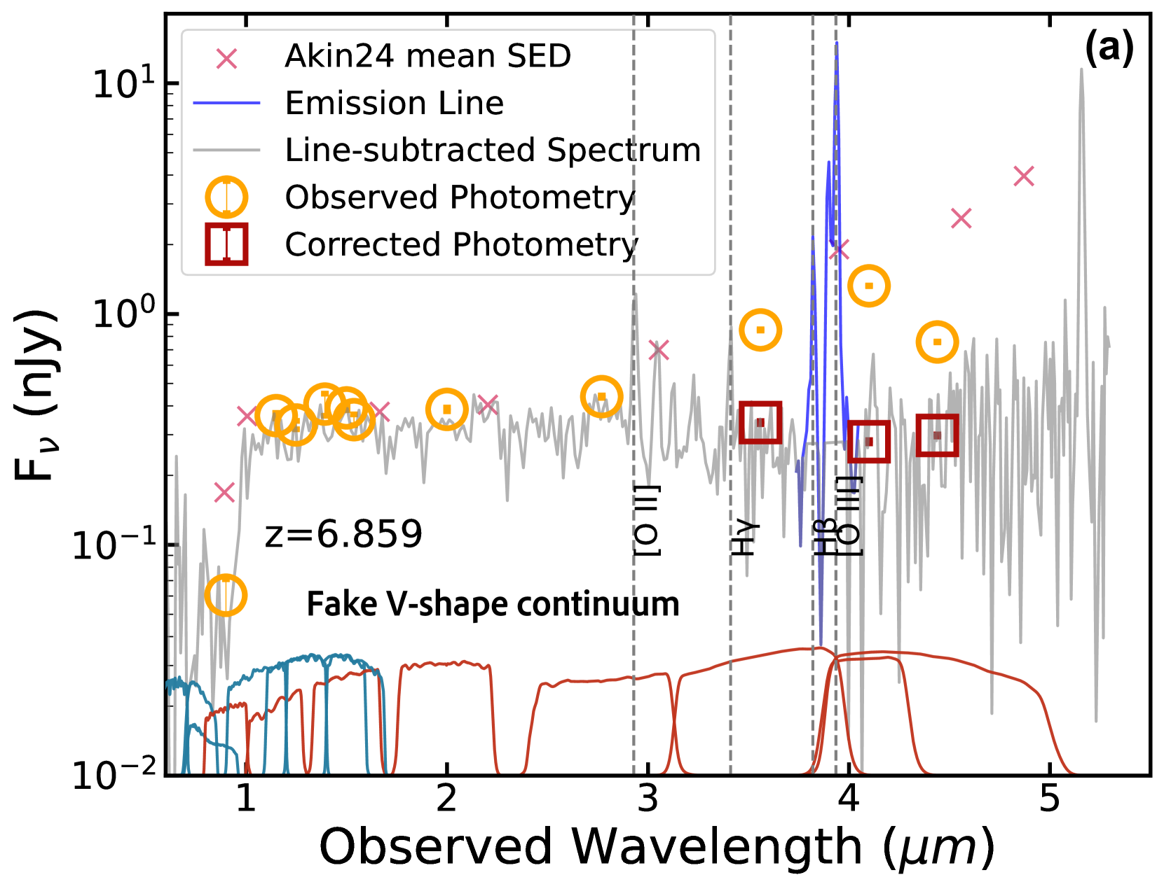
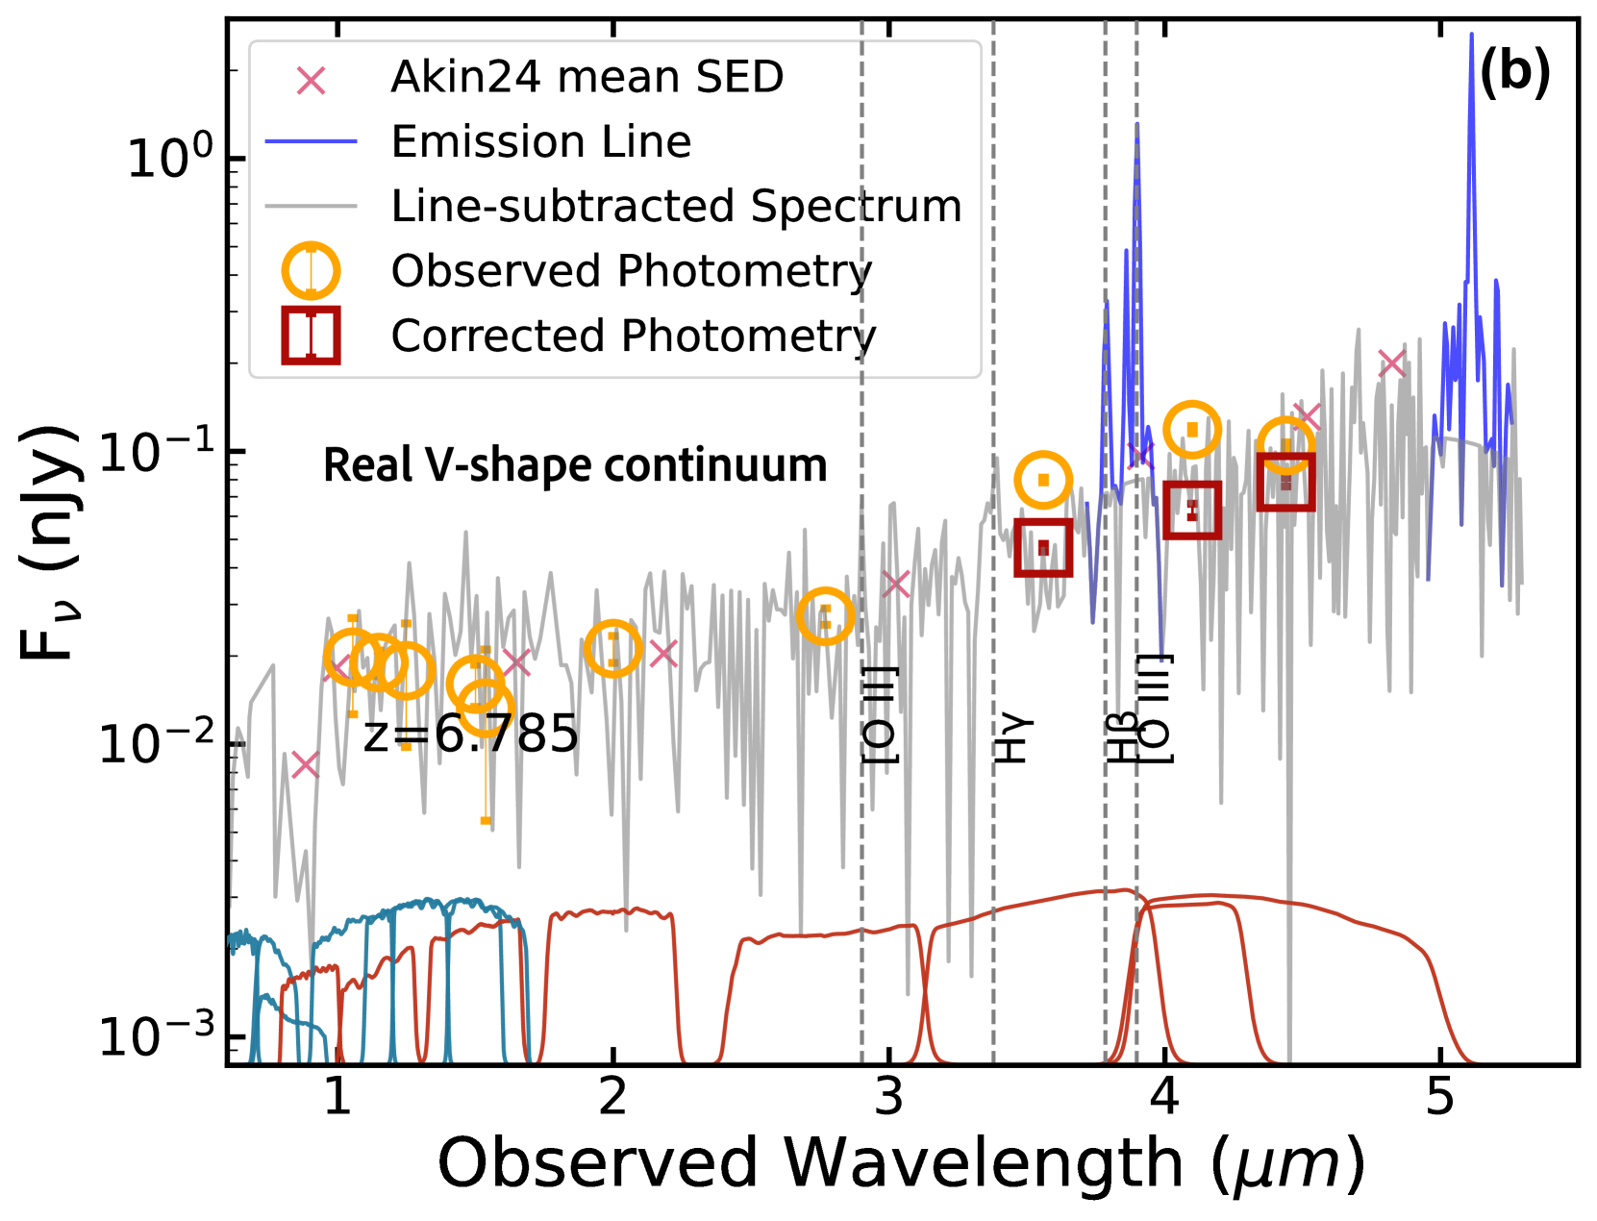
Fake V-shape continuum
T
1
Real V-shape continuum
Zhang et al., 2025
Notes:
UV is left of ~2.5, optical is to the right
SED graph, shows overall picture of flux across many wavelengths
Figure 1. Example of sources with a fake V-shape continuum (a) and a real V-shape continuum (b). In each panel, we show the line-subtracted spectrum in gray and the emission lines (Hβ, [O iii], and Hα lines) in blue. The observed photometry and line-free photometry are shown as the orange circles and red squares, respectively. The average SED of LRDs from H. B. Akins et al. (2024) are shown as the pink cross for comparison. The redshift and main emission lines are labeled. The JWST and HST transmission curves are in red and teal blue, respectively

Slide 6
02.
Use of Spectroscopy
T
2

Slide 7
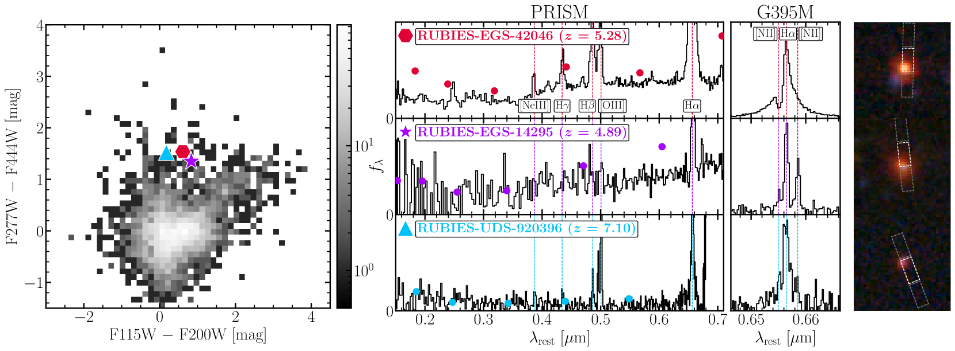

Typical LRD
Spectroscopy reveals:
Forbidden vs. allowed lines
Continuum shape
Balmer line widths (broad = AGN, narrow = other possibilities)
Kinematics and line ratios
T
2
Narrow H$α$ / N II
Bluer continuum
Hviding et al., 2025
Notes:
Photometry alone can’t distinguish LRDs from dusty starbursts or line-boosted galaxies.
Diversity of red, high-redshift sources in RUBIES. Right: F115W$−$F200W vs. F277W$−$F444W for RUBIES with robust $z_{spec}>3.1$ (grey histogram) which populate a broad distribution in color space. Right: PRISM spectra and NIRCam photometry, G395M spectra (zoomed in on H$α$), and 1”$×$1” NIRCam F444W/F277W/F150W RGB images for three RUBIES targets that are close in color space. The top row shows a typical LRD, with a v-shaped continuum, broad H$α$ emission line and very compact morphology. The middle row shows an extended red object with a v-shaped continuum, but narrow H$α$ and [N ii] emission. The red source in the bottom row is a point source with a relatively blue continuum, but appears as red due to high EW emission lines, including a broad H$α$ line. This demonstrates that sources with similar broad-band photometric colors can have very different spectral properties.

Slide 8
LRD Common Spectral Features
1
Broad Balmer Lines- several thousand km/s
2
3
T
V-shaped UV to Optical continuum
2
Dominant rest-optical point source
4
Forbidden lines -> rule out outflows, e.g. O III
Notes:
Forbidden lines are important for studying "little red dots" (LRDs) because they are a signature of a central black hole surrounded by dense gas and dust. Their presence, especially when combined with the absence of X-ray emission, suggests that the red color is due to this obscuring gas and dust rather than a dense population of stars. This implies that at least some LRDs are likely powered by central black holes rather than just stars
Forbidden lines help rule out line broadening from outflows.
Mention forbidden lines discussed in class!!!!

Slide 9
03.
NIRSpec + MIRI
T
3

Slide 10
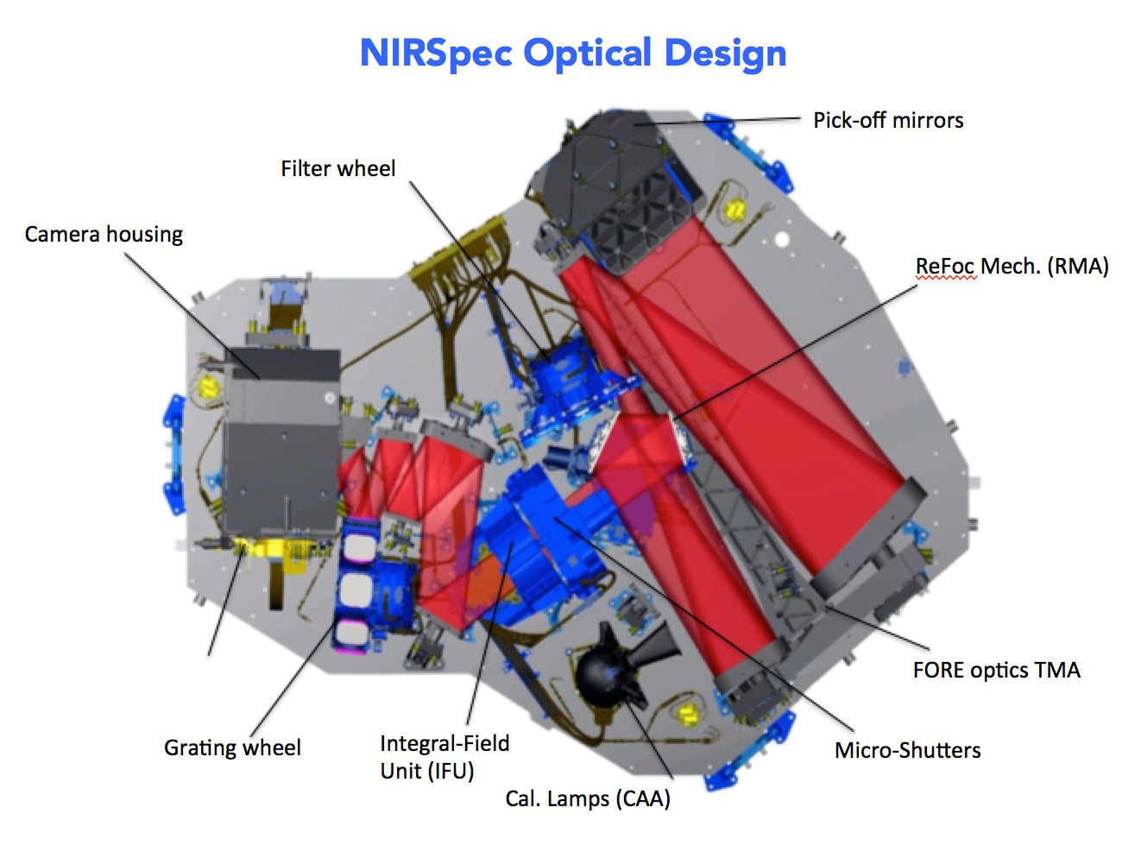
NIRSpec
PRISM (0.6–5.3 μm): low-res, full coverage
  V-shape
  Broad lines
G395M (2.9–5.1 μm): medium-res, narrow range
  Resolve Balmer line widths
NIRCam grism can find Balmer lines but lacks simultaneous forbidden-line coverage.
NIRSpec is the only JWST instrument that resolves Hα, Hβ, [O III], [N II] together
T
3
NASA
Notes:
G395- diffraction gratings used for medium resolution spec
Grism = slitless spectroscopy

Slide 11
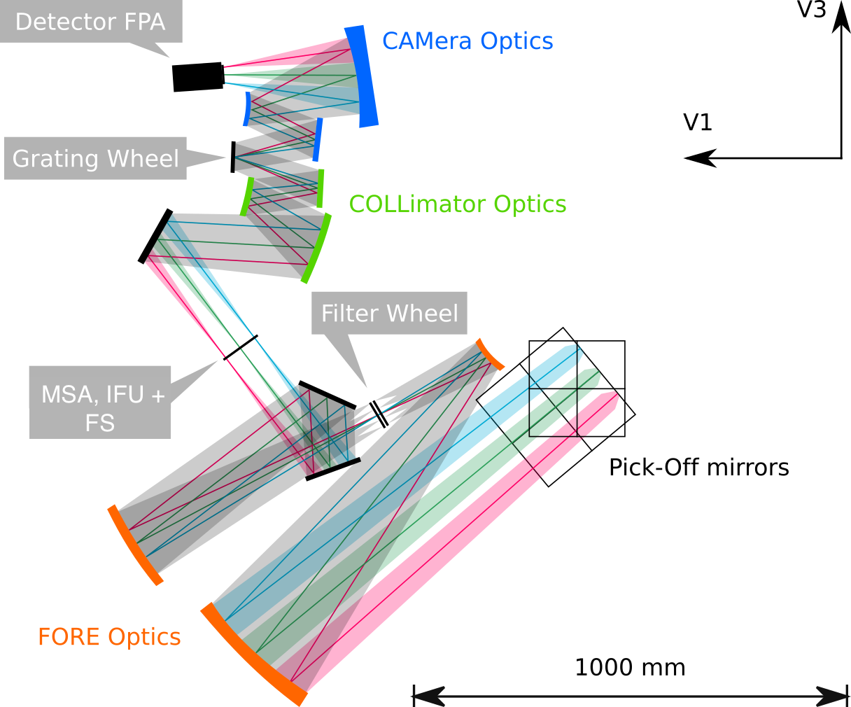
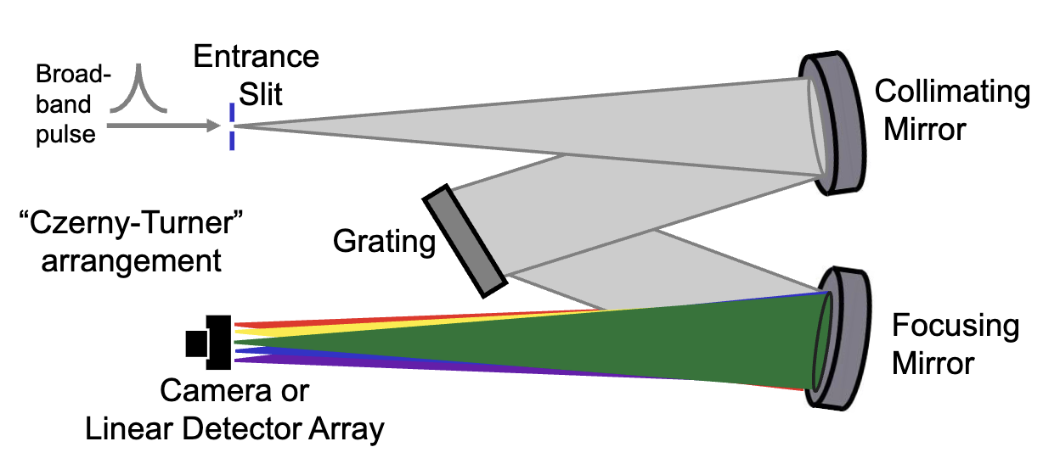
T
3
Lecture 18, Slide 7
NASA
Notes:
NIRSpec does exactly what this Czerny–Turner spectrometer does: it takes incoming light, passes it through a slit, collimates it, disperses it into colors, and focuses it onto a detector, just at much higher precision and in the near-infrared.

Slide 12
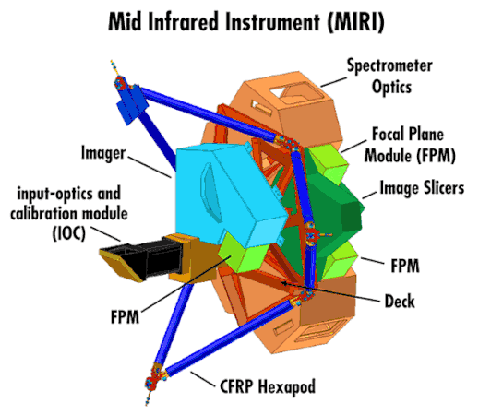
MIRI
For LRDs, this probes the rest-near-IR (~1–3 μm) at z ≈ 5–8.
This wavelength range is where:
  Hot dust emission from AGN tori normally peaks.
  Evolved stellar populations strongly affect the continuum.
  Differences between starburst vs. AGN become much more pronounced than in NIRCam bands.
Many LRDs show weak or absent hot-dust emission, even when they have broad lines.
T
3
Notes:
MIRI’s spectrometer follows the same principles: take the light, collimate it, disperse it, and detect it, but instead of a simple grating, it uses an integral-field unit that makes a data cube: a 2D image plus a spectrum for each pixel

Slide 13
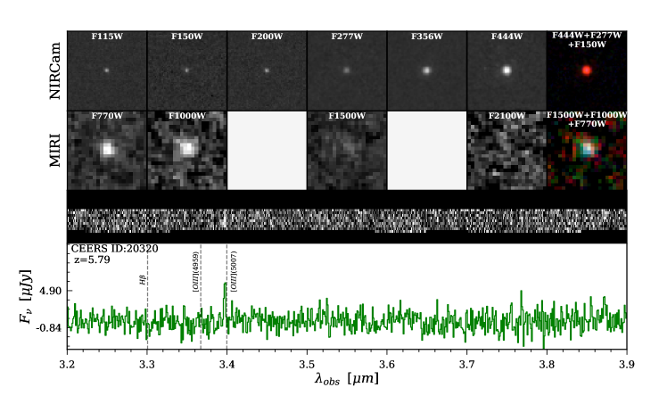
- NIRCam
- MIRI
T
- NIRSpec 1D Spectra
3
- NIRSpec 2D Spectra
Notes:
JWST/NIRCam (first row) and MIRI (second row) 2”x2” postage stamps. The last postage stamp in each row are the RGB images with F444W (R) + F277W (G) + F150W (B) for NIRCam, and F1500W (R) + F1000W (G) + F770W (B) for MIRI. The bottom two rows are the 2D and 1D NIRCam/grism data for 24253 and 20320, with the observed emission lines labeled.

Slide 14
04.
Physical Interpretation
T
4

Slide 15
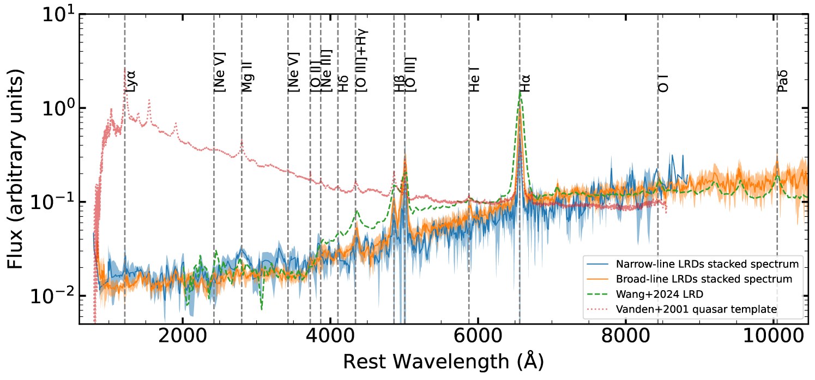
Notes:
Figure 8:Median-stacked spectra of narrow-line LRDs (blue solid curve) and broad-line LRDs (orange solid curve). For comparison, we also plot the LRDs at $z=3.1$ from B. Wang et al. (2024, green dashed curve) and the composite spectrum of typical SDSS quasars (D. E. Vanden Berk et al., 2001, red dotted curve).
BROAD/NARROW LINES = Ha/Hb (balmer lines)

Slide 16
Notes:
Figure 8:Median-stacked spectra of narrow-line LRDs (blue solid curve) and broad-line LRDs (orange solid curve). For comparison, we also plot the LRDs at $z=3.1$ from B. Wang et al. (2024, green dashed curve) and the composite spectrum of typical SDSS quasars (D. E. Vanden Berk et al., 2001, red dotted curve).
BROAD/NARROW LINES = Ha/Hb (balmer lines)

Slide 17
Notes:
Figure 8:Median-stacked spectra of narrow-line LRDs (blue solid curve) and broad-line LRDs (orange solid curve). For comparison, we also plot the LRDs at $z=3.1$ from B. Wang et al. (2024, green dashed curve) and the composite spectrum of typical SDSS quasars (D. E. Vanden Berk et al., 2001, red dotted curve).
BROAD/NARROW LINES = Ha/Hb (balmer lines)

Slide 18
Current theories
Broad lines: strong AGN evidence
Narrow-line LRDs exist and may be:
  Compact star-forming galaxies
  Low-mass AGN
V-shaped SED explanation:
  Dust attenuation geometry
  Scattered AGN continuum
  Low-metallicity starburst + patchy dust
  Intrinsic AGN two-component disk
  Cannot be reproduced by standard galaxy-only or AGN-only templates.
T
4

Slide 19
Current Models
AGN Dominated
Dense Gas + AGN Model
Compact Starbursts
Low-Mass AGN
Raman Scattering
Binary Black Holes
Broad lines; sometimes weak hot dust, possible torus-free AGN
Hot dense gas fits Balmer breaks. Needs extra thermal component for MIRI
Low-metallicity, patchy dust; can mimic red colors
T
2
Narrow lines; black hole masses 10⁵–10⁶ M⊙
More exotic theory
More exotic theory

Slide 20
Bibliography
Hviding, R. E., et al. (2025). RUBIES: A Spectroscopic Census of Little Red Dots; All V-Shaped Point Sources Have Broad Lines. Astronomy & Astrophysics, 702, A57. https://doi.org/10.1051/0004-6361/202555816
Kocevski, D. et al. (2025). The Rise of Faint, Red AGN at $z>4$: A Sample of Little Red Dots in the JWST Extragalactic Legacy Fields (No. arXiv:2404.03576). arXiv. https://doi.org/10.48550/arXiv.2404.03576
Ronayne, K., et al. (2025). MEGA: Spectrophotometric SED Fitting of Little Red Dots Detected in JWST MIRI (No. arXiv:2508.20177). arXiv. https://doi.org/10.48550/arXiv.2508.20177
Wang, B., et al. (2025). RUBIES: JWST/NIRSpec Confirmation of an Infrared-luminous, Broad-line Little Red Dot with an Ionized Outflow. The Astrophysical Journal, 984(2), 121. https://doi.org/10.3847/1538-4357/adc1ca
Zhang, Z., Jiang, L., Liu, W., Ho, L. C., & Inayoshi, K. (2025). JWST Insights into Narrow-line Little Red Dots (No. arXiv:2506.04350). arXiv. https://doi.org/10.48550/arXiv.2506.04350

Slide 21
Thank you!
Questions?

