Slide 1
Charge-to-Mass Ratio of Electrons
Nayera Abdessalam

Slide 2
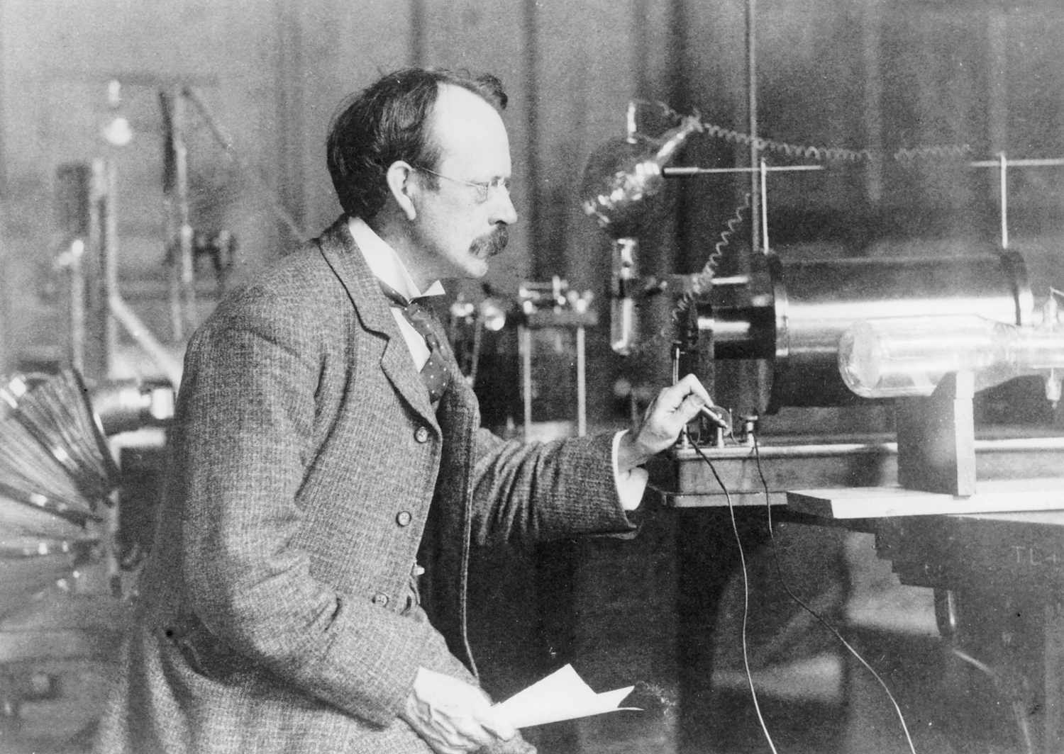
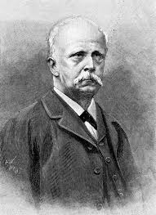
Background
J. J. Thomson
Hermann von Helmholtz proposed a design to create a uniform, concentrated B-field in 1849
J. J. Thomson first measured e/m in 1897 using B- and E-fields
Value of e/m constrained using an independent method by Dunnington in 1933
This experiment reproduces Thomson’s method using Helmholtz coils to determine e/m
Source: ThoughtCo
Hermann von Helmholtz
Source: Britannica

Slide 3
Introduction & Motivation
Electron mass on its own is difficult to measure
Demonstrates that electrons are universal, subatomic particles
Connects electricity and magnetism through observation
  Lorentz Force
e⁻
B-field
(out of page)
Plates
Notes:
Lorentz Force Law:
A charged particle moving in a magnetic field experiences a force perpendicular to its velocity

Slide 4
Experimental Method
Helmholtz Coil
Two circuits to power Helmholtz coils, electron ray
Voltage across plates gives electron’s initial velocity
Measure electron path for many combinations of voltage and current
Voltmeter
V
Glass bulb
Power
Spokes
A
Ground
Fuse
Filament
A
Ammeter

Slide 5
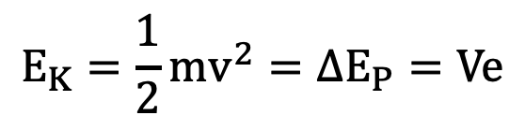
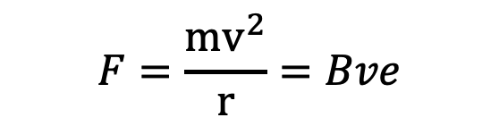
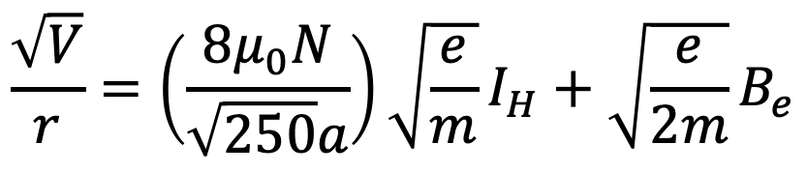
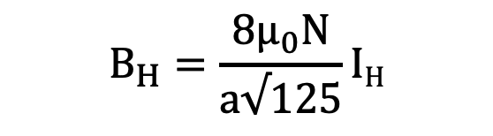
Theory
$$F=\frac{mv^{2}}{r}=Bve$$
1. Force Balancing
2. Conservation of Energy
3. Helmholtz Coil Strength
Working Equation
$$E_{K}=\frac{1}{2}mv^{2}=∆E_{P}=Ve$$
$$B_{H}=\frac{8μ_{0}N}{a√125}IH$$
$$\frac{\sqrt{V}}{r}=\left(\frac{8μ_{0}N}{\sqrt{250}a}\right)\sqrt{\frac{e}{m}}I_{H}+\sqrt{\frac{e}{2m}}B_{e}$$

Slide 6
Data

Slide 7
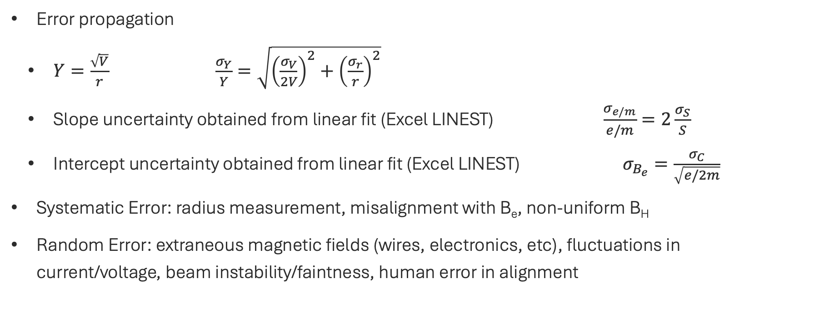
Uncertainty Analysis
Error propagation
  $Y=\frac{\sqrt{V}}{r}$ $\frac{σ_{Y}}{Y}=\sqrt{{\left(\frac{σ_{V}}{2V}\right)}^{2}+{\left(\frac{σ_{r}}{r}\right)}^{2}}$
  Slope uncertainty obtained from linear fit (Excel LINEST) $\frac{σ_{e/m}}{e/m}=2\frac{σ_{S}}{S}$
  Intercept uncertainty obtained from linear fit (Excel LINEST) $σ_{B_{e}}=\frac{σ_{C}}{\sqrt{e/2m}}$
Systematic Error: radius measurement, misalignment with B_{e}, non-uniform B_{H}
Random Error: extraneous magnetic fields (wires, electronics, etc), fluctuations in current/voltage, beam instability/faintness, human error in alignment
S: slope
C: intercept

Slide 8
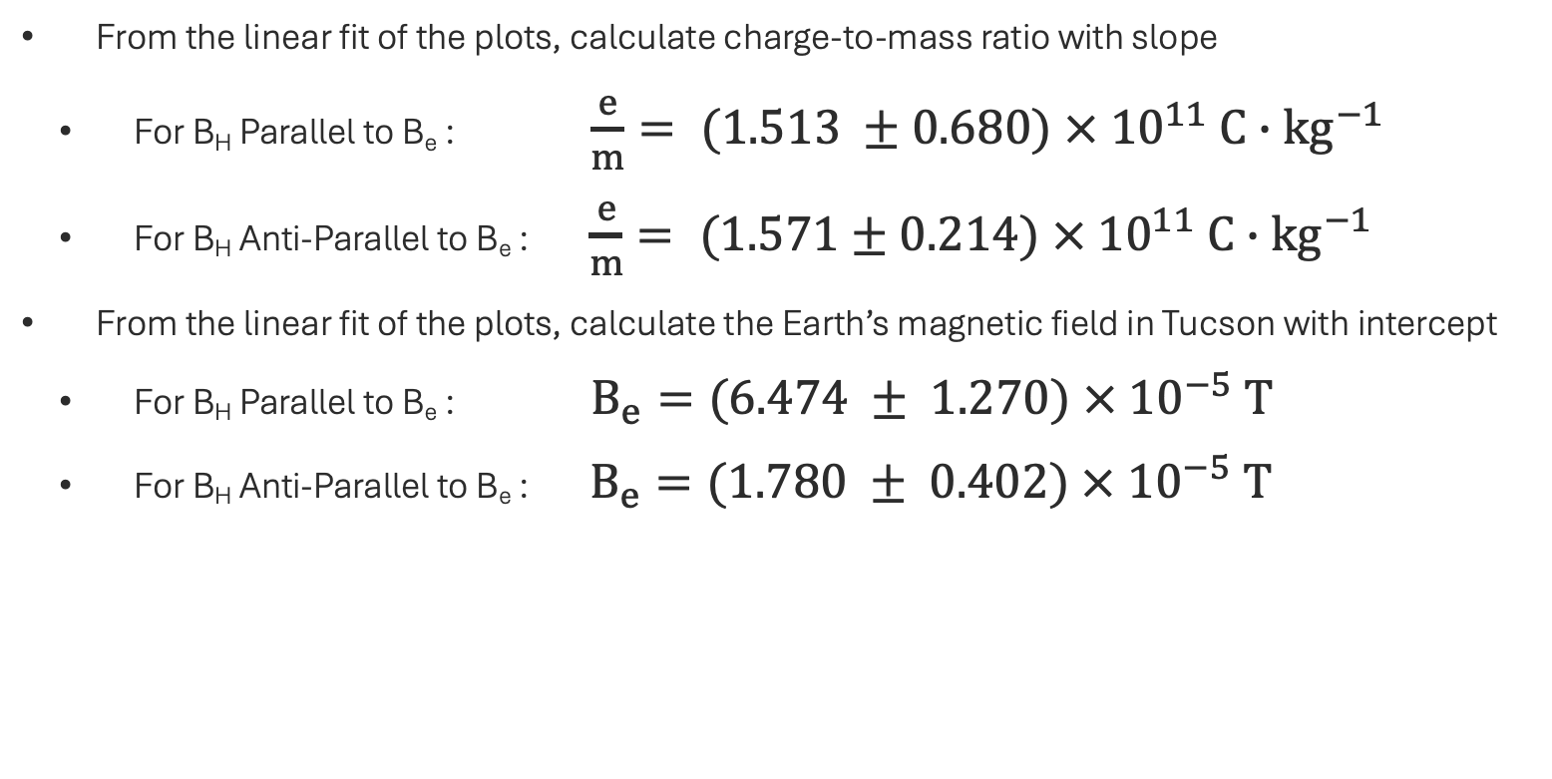
Results
From the linear fit of the plots, calculate charge-to-mass ratio with slope
  For B_{H} Parallel to B_{e} : $\frac{e}{m}= (1.513 ±0.680) × {10}^{11} C∙{kg}^{−1}$
  For B_{H} Anti-Parallel to B_{e} : $\frac{e}{m}= (1.571±0.214) × {10}^{11} C∙{kg}^{−1}$
From the linear fit of the plots, calculate the Earth’s magnetic field in Tucson with intercept
  For B_{H} Parallel to B_{e} : $B_{e}=(6.474 ± 1.270) ×{ 10}^{−5} T$
  For B_{H} Anti-Parallel to B_{e} : $B_{e}=(1.780 ± 0.402) × {10}^{−5} T$

Slide 9
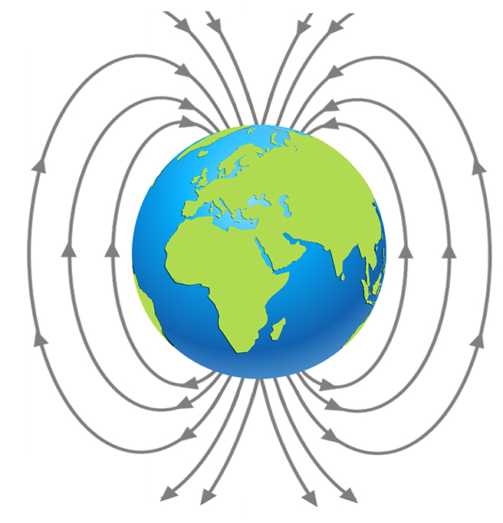
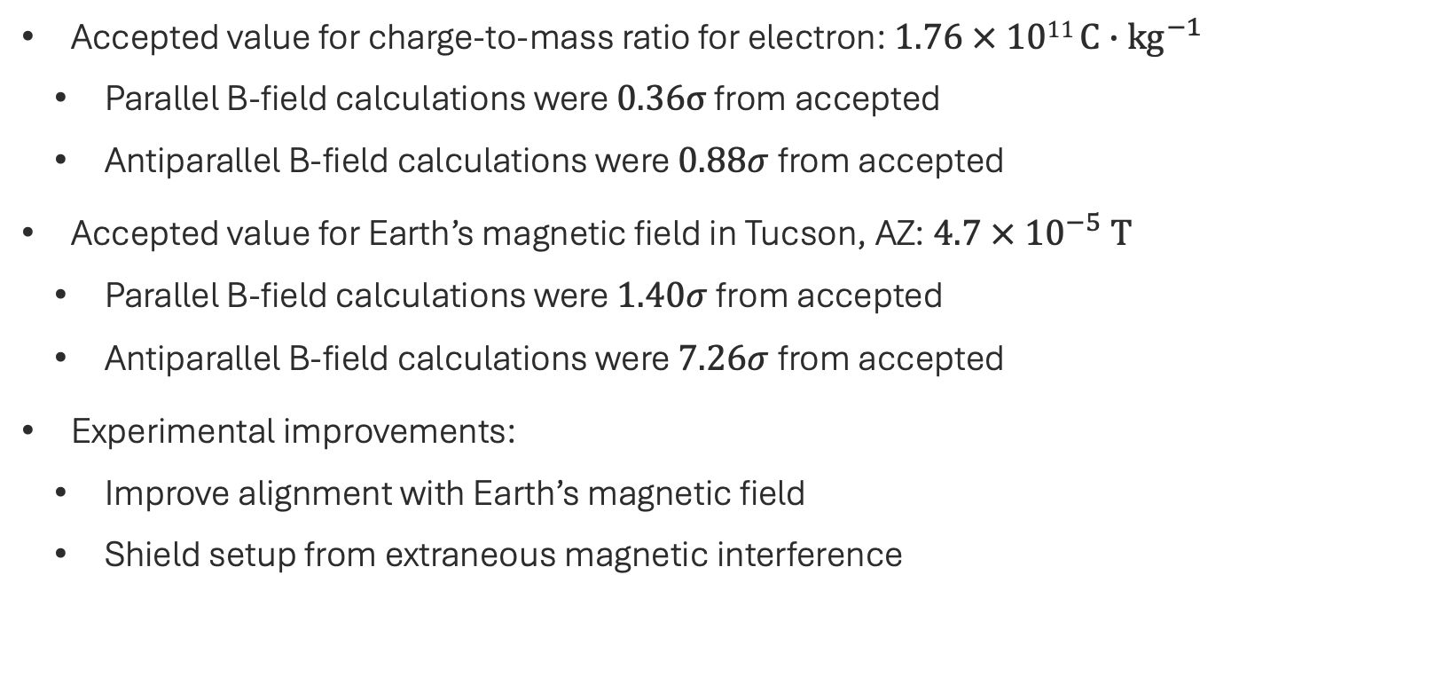
Conclusions
Accepted value for charge-to-mass ratio for electron: $1.76 × 1011 C∙{kg}^{−1}$
  Parallel B-field calculations were $0.36σ$ from accepted
  Antiparallel B-field calculations were $0.88σ$from accepted
Accepted value for Earth’s magnetic field in Tucson, AZ: $4.7 × {10}^{−5} T$
  Parallel B-field calculations were $1.40σ$from accepted
  Antiparallel B-field calculations were $7.26σ$from accepted
Experimental improvements:
  Improve alignment with Earth’s magnetic field
  Shield setup from extraneous magnetic interference
Source: science-resources.co.uk

Slide 10
Thank you!

Slide 11
Title Slide: Clear title, your name, and lab partners (if any).
2. Introduction & Motivation: Why is this experiment important? What physical principle or constant are you investigating?
3. Experimental Method: A schematic or brief description of the apparatus. Do not list every nut and bolt; focus on the functional components.
4. Data & Results: This is the core of the talk. Show your raw data and your processed results (e.g., fits, linearized plots).
5. Uncertainty Analysis: Discuss sources of error (systematic vs. random) and how they propagated to your final result.
6. Conclusion: Compare your results to accepted values. Suggest one specific way the experiment could be improved.

