Slide 1
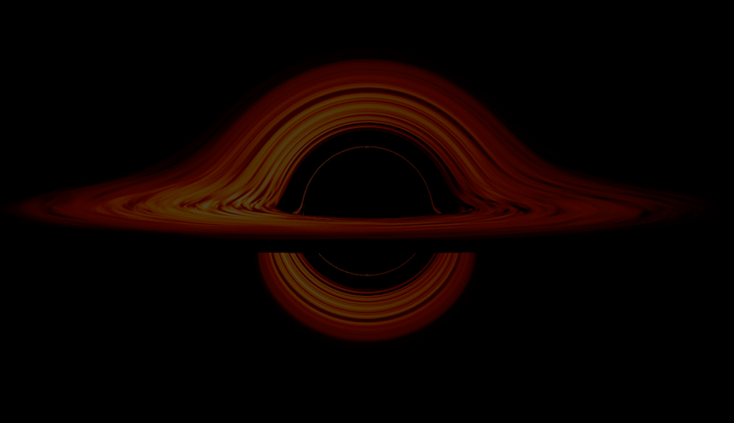

Probing Early Supermassive Black Hole Growth:
C IV-Based Mass Estimates in z ~ 4.8 Quasars
Nayera Abdessalam
Advised by: Dr. Richard Green & Dr. Weizhe Liu
PHYS 305 Creative Project Presentation
May 5th, 2026
Notes:
Background image credit: https://svs.gsfc.nasa.gov/13326

Slide 2
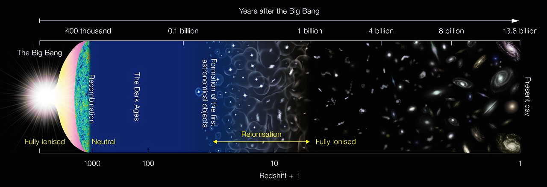
How do supermassive black holes (SMBHs) evolve in the first billion years after the Big Bang?
Our Sample
Years after the Big Bang
Redshift + 1
NASA

Slide 3
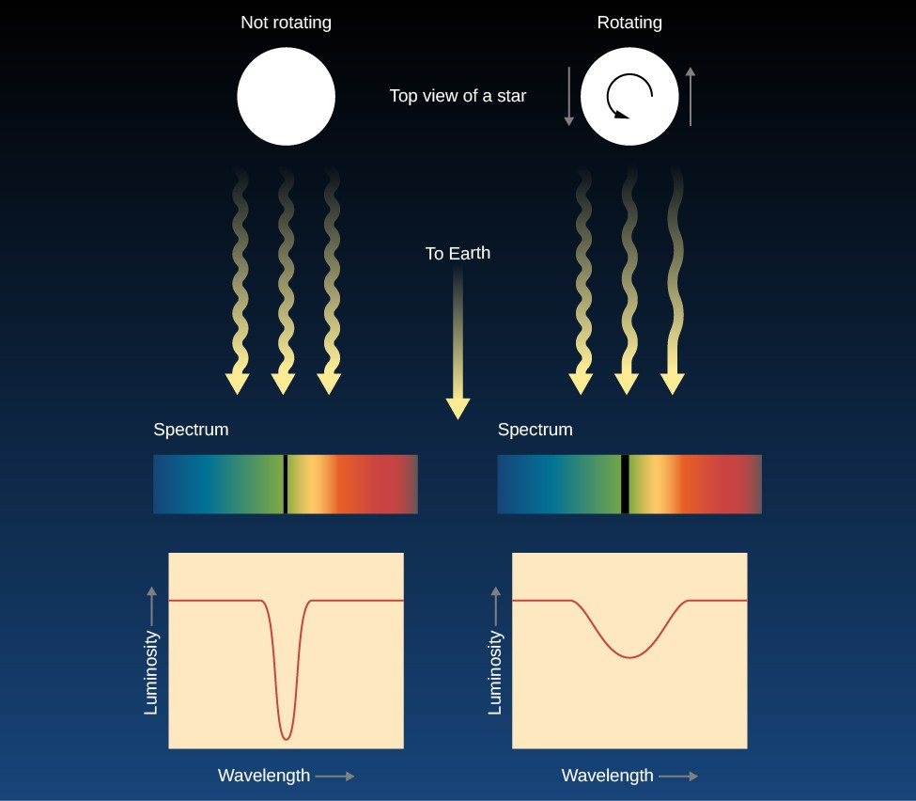
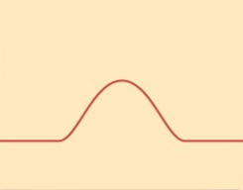
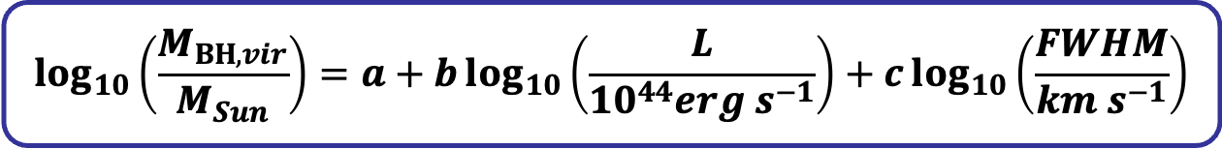
Theory
Top view of a black hole
Lumen Learning
$$\log_{10}\left(\frac{M_{BH,vir}}{M_{Sun}}\right)=a+b\log_{10}\left(\frac{L}{{10}^{44}erg s^{−1}}\right)+c\log_{10}\left(\frac{FWHM}{km s^{−1}}\right)$$
Notes:
Speaking notes:
Both lines come from gas around the black hole, but Hβ traces more stable, gravitational motion, while C IV is affected by winds and outflows
Emphasize velocity and how we get from gas movements to broad emission line
Use graphic to shows how hb masses measures were made/correlated, show that it has been redshifted (from Wenwen or Vestergaard) : h beta as a mass calibrator (it is straight line)
CIV λ = 1549 Å,
Hb λ = 4861 Å

Slide 4
Objectives
Compare C IV and Hβ SMBH mass estimates
Apply correction methods to C IV estimates
Evaluate agreement with Hβ base line
Notes:
Speaking notes:
Both lines come from gas around the black hole, but Hβ traces more stable, gravitational motion, while C IV is affected by winds and outflows
Emphasize velocity and how we get from gas movements to broad emission line
Use graphic to shows how hb masses measures were made/correlated, show that it has been redshifted (from Wenwen or Vestergaard) : h beta as a mass calibrator (it is straight line)
CIV λ = 1549 Å,
Hb λ = 4861 Å

Slide 5
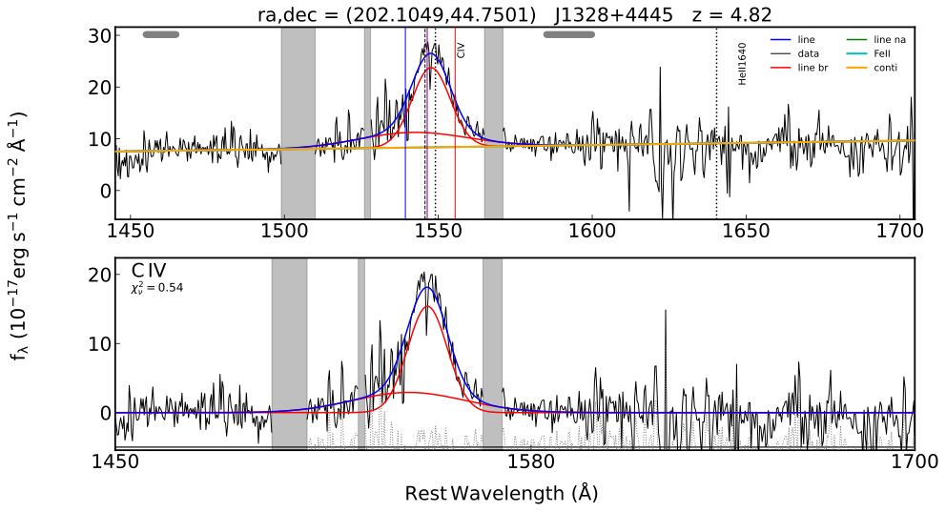
Sample & Methods
14 Quasar Spectra, z ~ 4.8
C IV (1549 Å) rest-frame UV data (Sloan Digital Sky Survey)
Hβ (4861 Å) rest-frame optical (IR with JWST)
Line fitting:
  FWHM, Blueshift, Asymmetry, Peak
Blueshift
Peak
FWHM
Notes:
Source weizhe paper

Slide 6
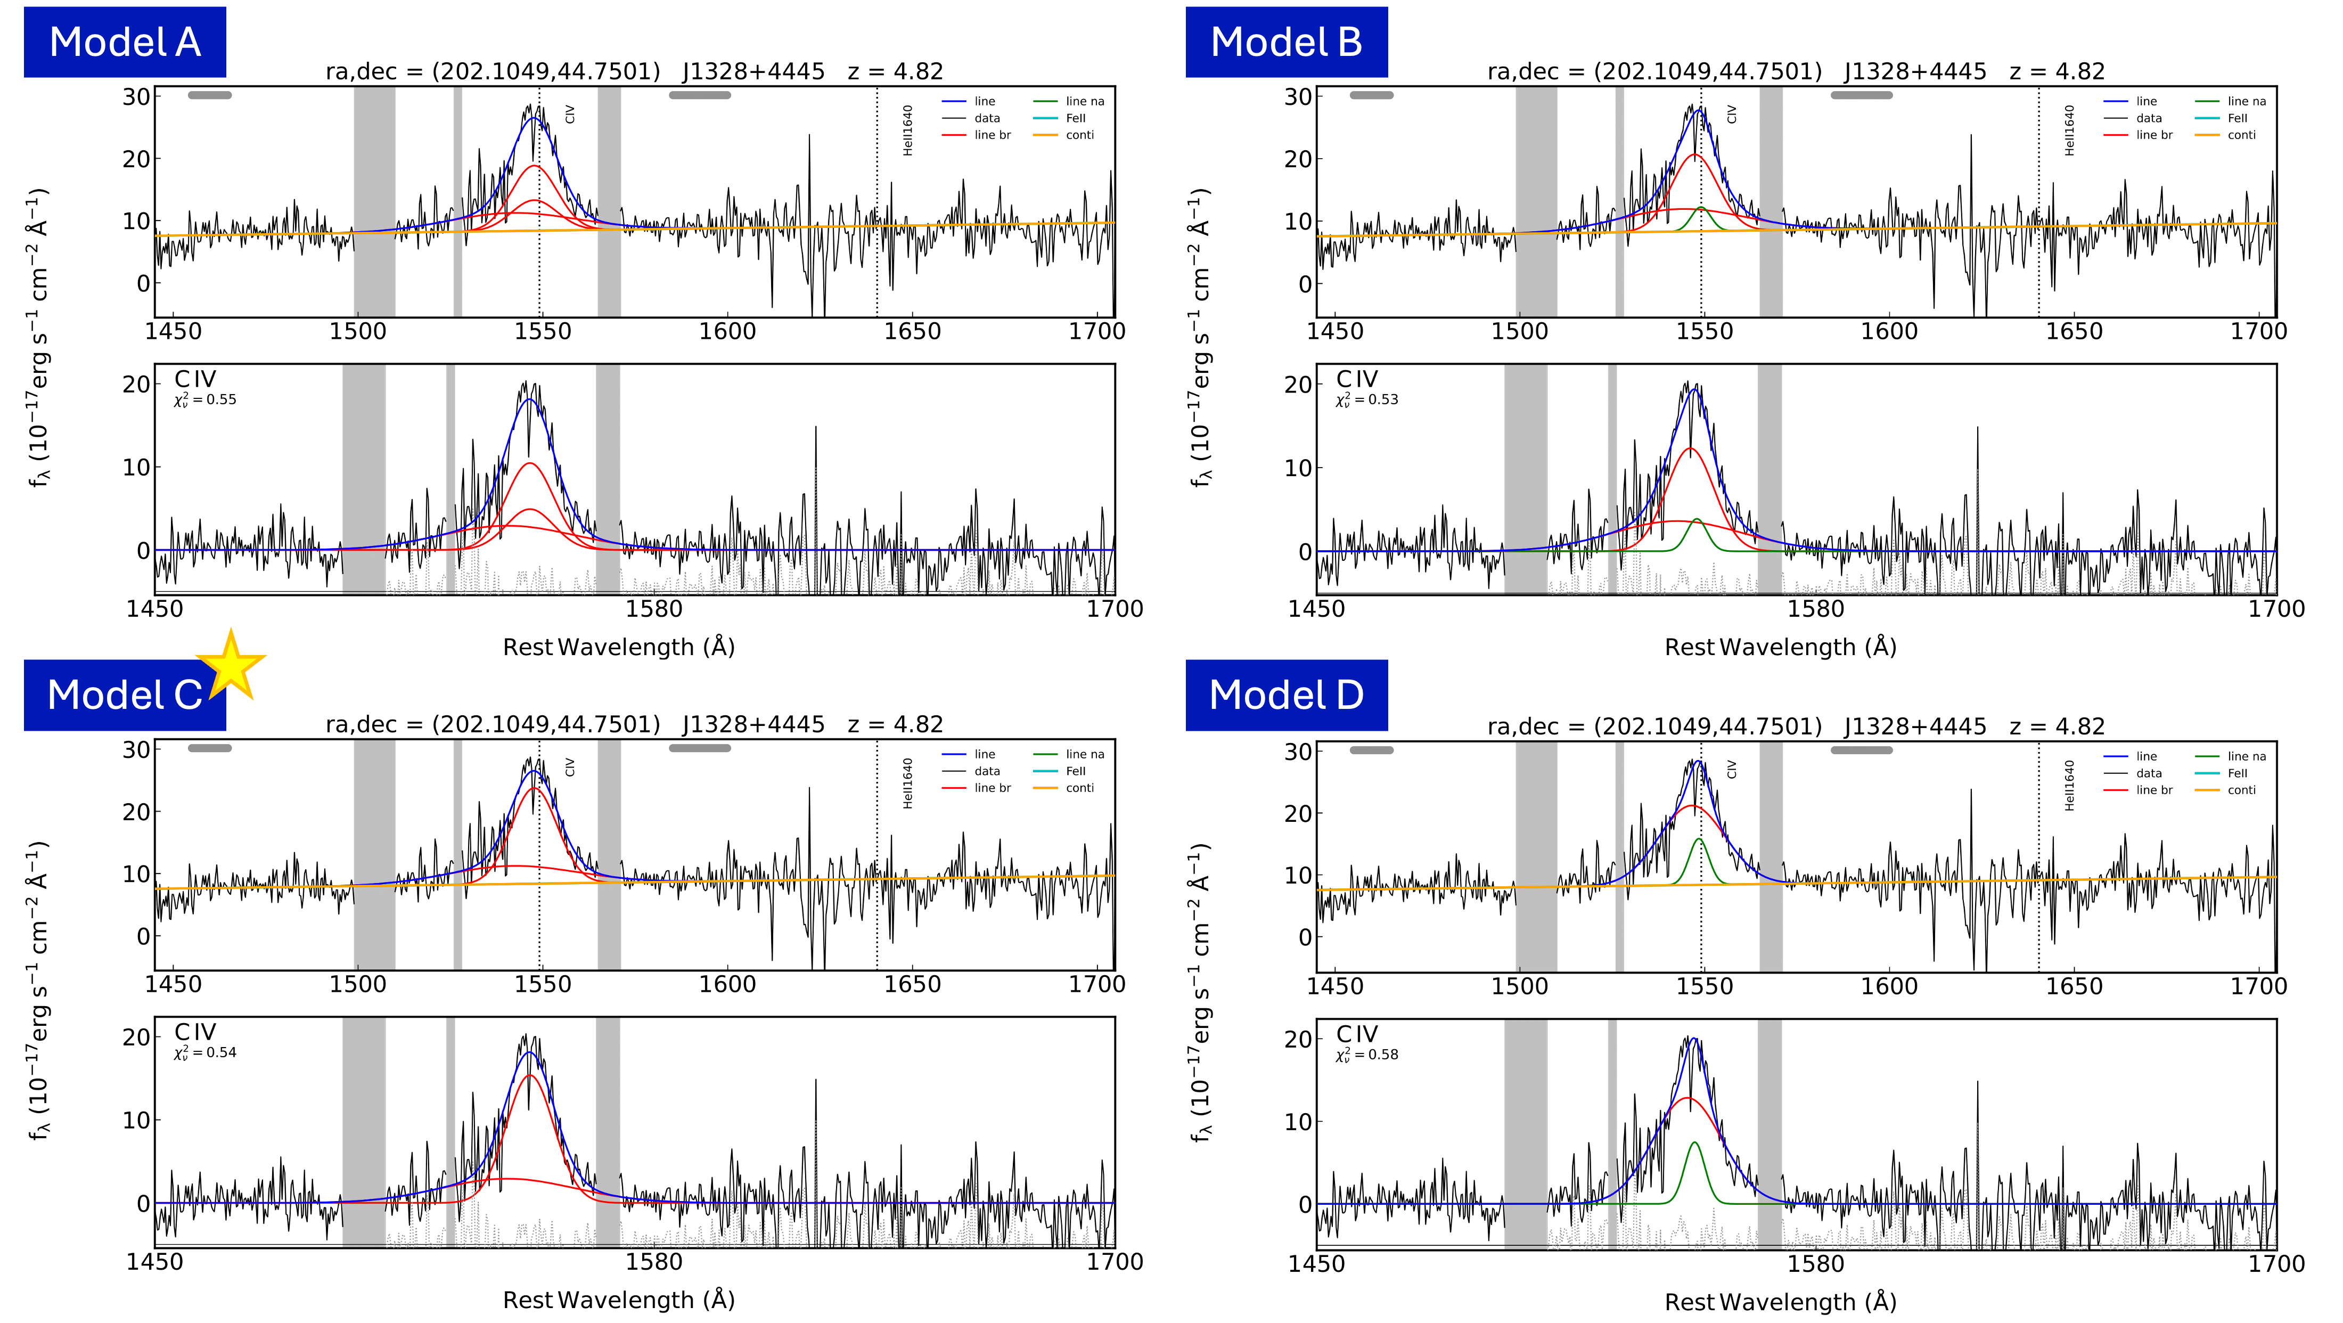
Sample & Methods
PyQSOFit pipeline
Notes:
Luminosity -> radius
Line width -> motion
if still too long, reduce this slide to show just one good spectrum example, talk about line width

Slide 7
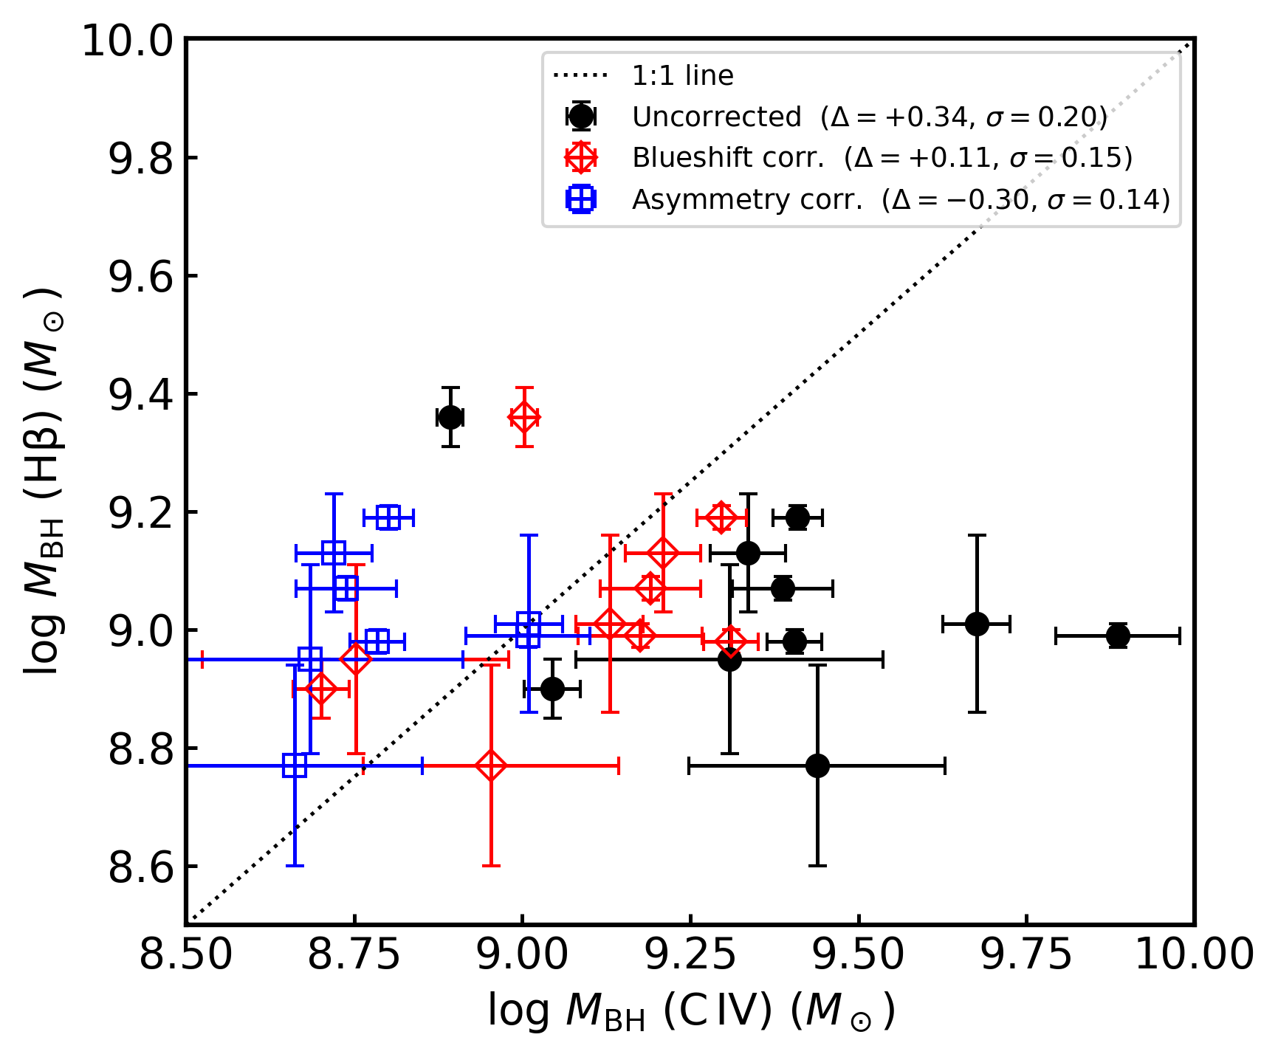


Key Results
Zuo+2020 Correction Parameters
$$FWHMC IV/FWHMHβ=α+β(∆V/1000 km s−1)$$
$$FWHMC IV/FWHMHβ=α+β ASC IV$$
Notes:
LINMIX: A Bayesian approach to linear regression with errors in both X and Y.

Slide 8
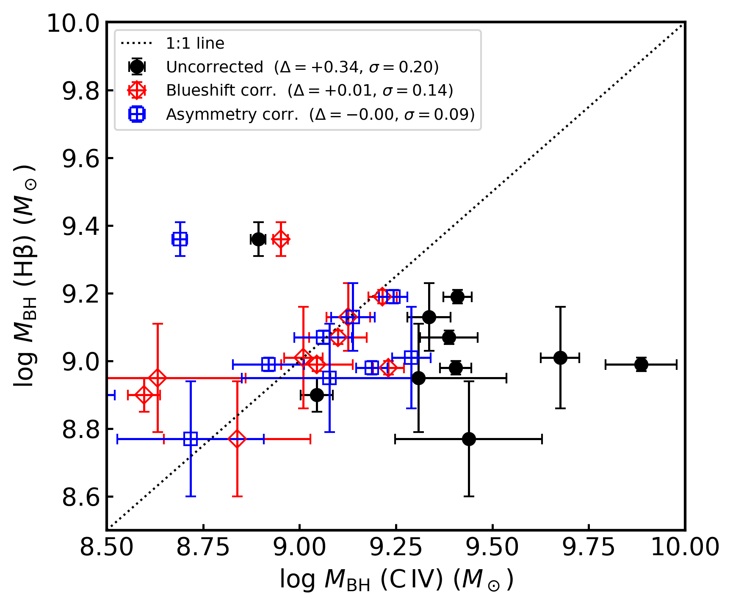


Key Results
Zuo+2020 Correction Parameters
Fitted Correction Parameters
$$FWHMC IV/FWHMHβ=α+β(∆V/1000 km s−1)$$
$$FWHMC IV/FWHMHβ=α+β ASC IV$$
Notes:
LINMIX: A Bayesian approach to linear regression with errors in both X and Y.

Slide 9
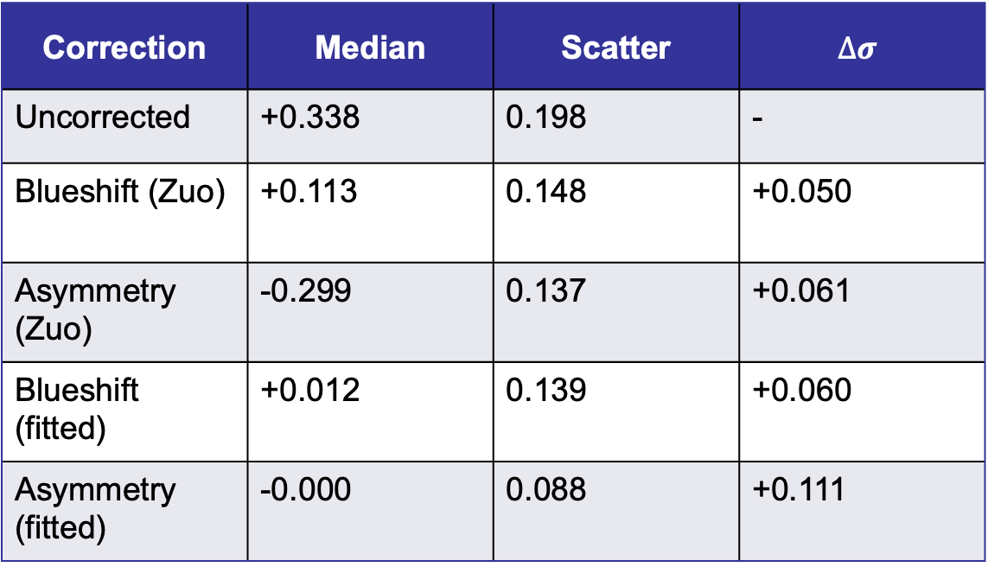


Key Results
$$FWHMC IV/(α+β (∆V/1000 km s−1))$$
FWHM Correction
$$FWHMC IV/(α+β ASC IV)$$
Correction | Median | Scatter | $$∆σ$$
Uncorrected | +0.338 | 0.198 | -
Blueshift (Zuo) | +0.113 | 0.148 | +0.050
Asymmetry (Zuo) | -0.299 | 0.137 | +0.061
Blueshift (fitted) | +0.012 | 0.139 | +0.060
Asymmetry (fitted) | -0.000 | 0.088 | +0.111

Slide 10
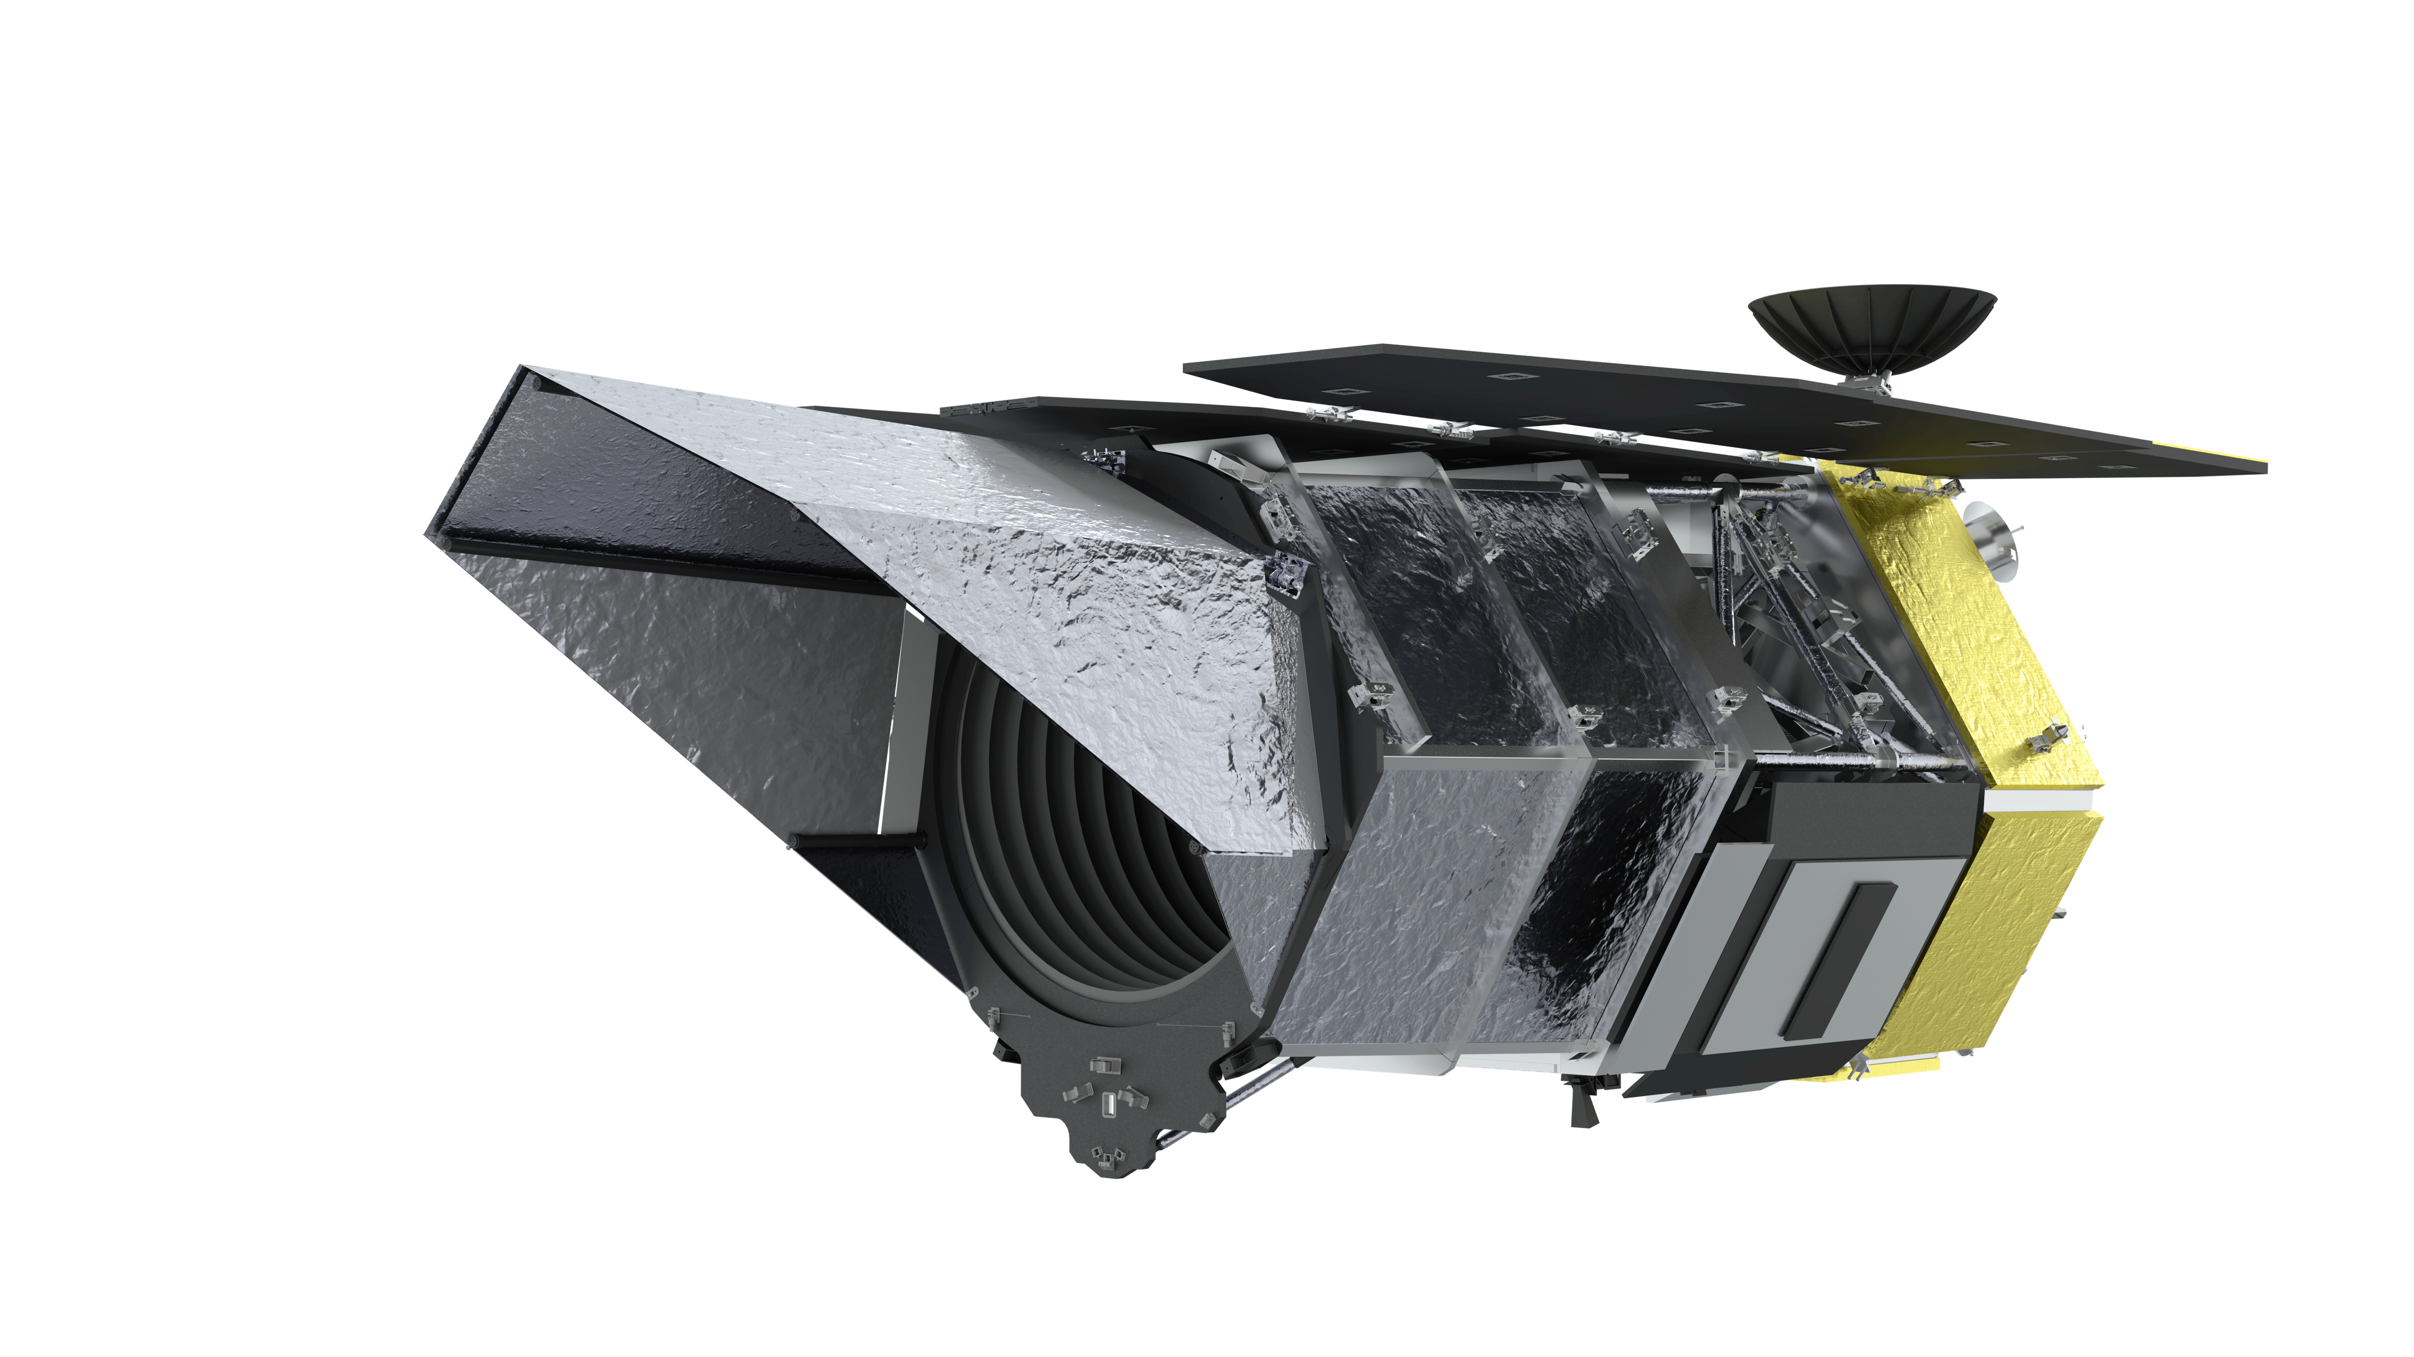
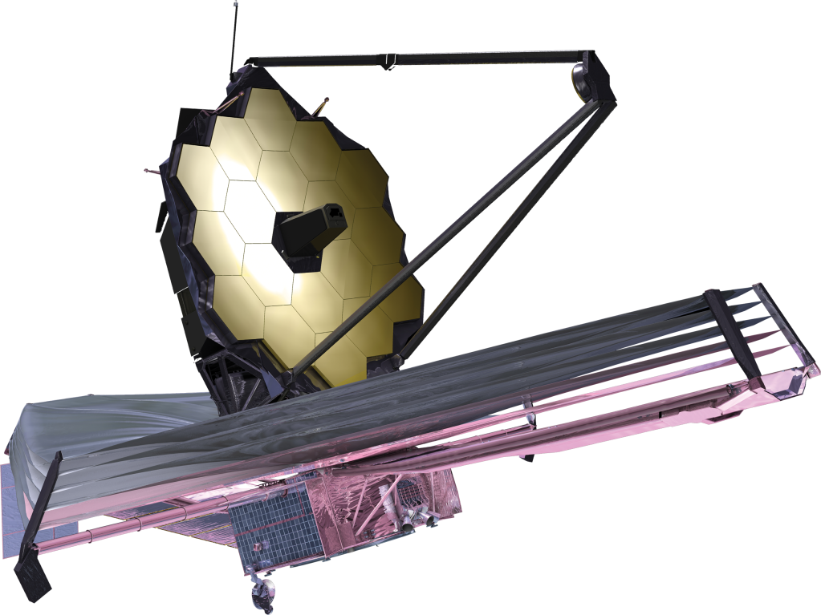

Conclusions & Next Steps
Corrected C IV better isolates gravitational motion
Agreement with Hβ improves after correction
Use mass estimation technique to compare multiple populations
Notes:
Test other factors effecting black hole mass corrections
Calibrating away specific motions from the gas that is not just the pure gravitational motion, we are succeeding somewhat well at getting out the extraneous motions. Specific other corrections depending on each motion
Mention: Roman telescope, more CIV measurments. SphereX mission- hbeta and civ measurements

Slide 11
Acknowledgements
Thank you to my advisors and mentors, Dr. Richard Green and Dr. Weizhe Liu, for their continued support through this project. Their patience and guidance have been essential.
This research has been funded in part through
  Arizona NASA Space Grant Consortium, Cooperative Agreement 80NSSC25M7084
  University of Arizona W. A. Franke Honors College Exploratory Mini-Grant
  Generous donation from Mike Kaiserman

Slide 12
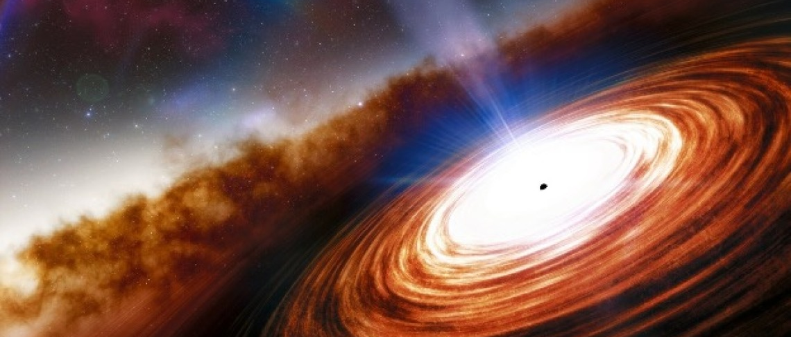
Thank you!
NOIRLab/NSF/AURA/J. da Silva
Contact: nmabdessalam@arizona.edu

Slide 13
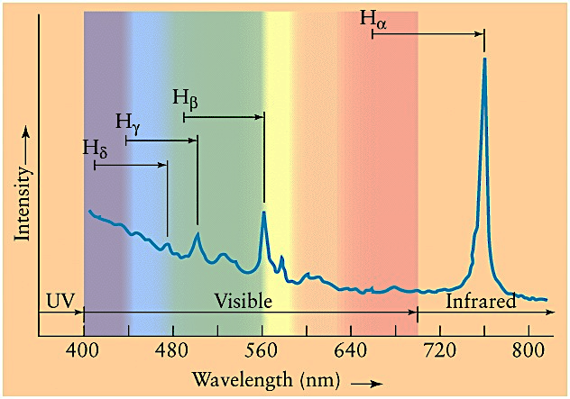
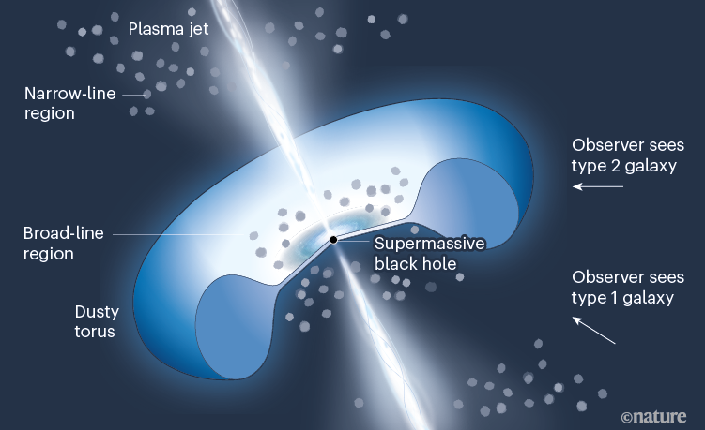
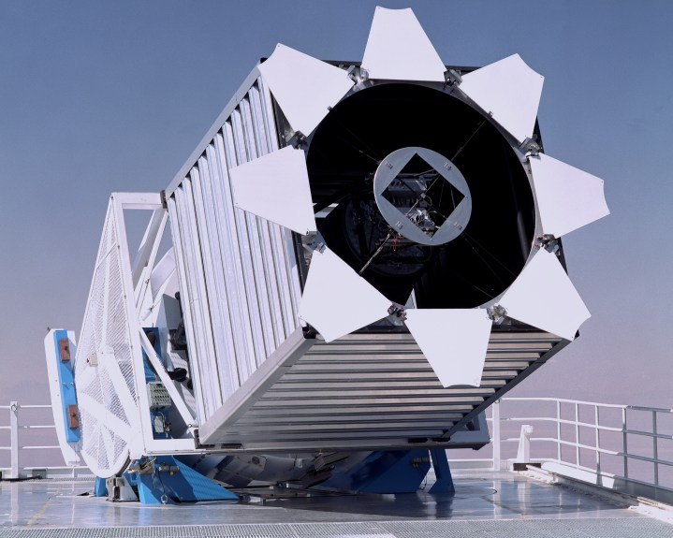
Extra
Redshift (z): how far back in time we’re seeing
Quasar: black hole actively accreting gas/dust
Spectroscopy: measuring light intensity as a function of wavelength
Quasar 3C 273 Spectrum
Source: Antonucci 2022
Mass Estimates
Source: SDSS
Notes:
SMBH extreme gravity -> Matter pulled in (but not all of it -> gas and dust rotating SMBH (hot & bright) -> light travels through space -> measured with telescopes on Earth

