Slide 1
Week 2

Slide 2
Operating System
Windows, Linux, Google Android, MacOS, iOS
  Program that manages a computer’s resources (CPU, Memory, etc.)
Filesystem
  A method of organizing blocks on a storage device into files and directories

Slide 3
Filesytem
Windows
  C:\Users\Documents\file.txt
    C: is the device (a disk on which we put data)
    \Users\Documents\ is the location, also called a path
    file.txt is one file under file

Slide 4
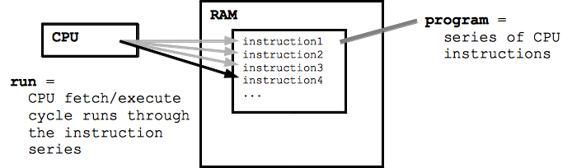
Ecosystem

Slide 5
What does a program do
CPU: Processing (work)
Memory (RAM): Data juggling used by the CPU
I/O: Input/Output. Signal/Device

Slide 6
Python Interpreter
A translator, be precise with instructions
It reads the .py files and puts them in memory
Tries to optimize the code
Executes it

Slide 7
Simple terminal commandes
cd <path>: Change directory
ls: List directory
python / python3: Python program to interpret code
pip: package installer for Python

