Slide 1
Programming Introduction

Slide 2
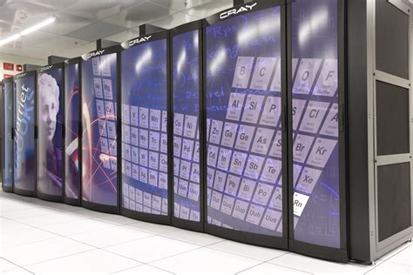
Nice to meet you
High Performance Computing
Parallelism
System administration
Software development

Slide 3
Course Syllabus
< link here >
Half theory + half practice
What’s learned in class covers how to achieve projects
2 exams, 2 projects

Slide 4
What about you?
Your name?
Why are you learning programming?
How will it be useful to you?

Slide 5
Goals of this class
Learn to automate tasks
Learn to collaborate and make a program evolve
Translate needs into program requirements

Slide 6
What you won’t be learning
Computer architecture
Operating system and how memory / cpus are managed
Software engineering
System administration (maybe..)

Slide 7
Ecosystem
How does a program work?

Slide 8
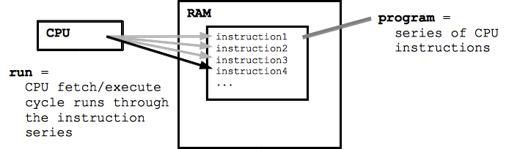
Programming = Writing instructions
web.stanford.edu

Slide 9
Python
Interpreted language, no typing
Good | Bad
I/O bound | CPU bound
Coordinating | Games
Simple | Front-end (web pages)
Flexible | Performance
Very well adopted
Science

Slide 10
Let’s get started
Setting the environment
Create a program

Slide 11
Setting up Git
Github.com (create an account)

