Slide 1

DS461: Big Data Analytics
Fall 2026 — GIKI
31 Aug 2026

Slide 2

The Big Question
How do we make data mining and machine learning work when data no longer fits on one computer?
This course answers that question through theory, algorithms, hands-on implementation, and real research.

Slide 3


Why Big Data Matters Now
ML and deep learning have achieved remarkable results — but success hinges on two things: big data and compute.
Scale Changed Everything - Compute
More Data = Smarter Models
The algorithms aren't new — what changed is the infrastructure to run them at planetary scale.
More data combined with more compute unlocks increasingly capable models and predictions.

Slide 4
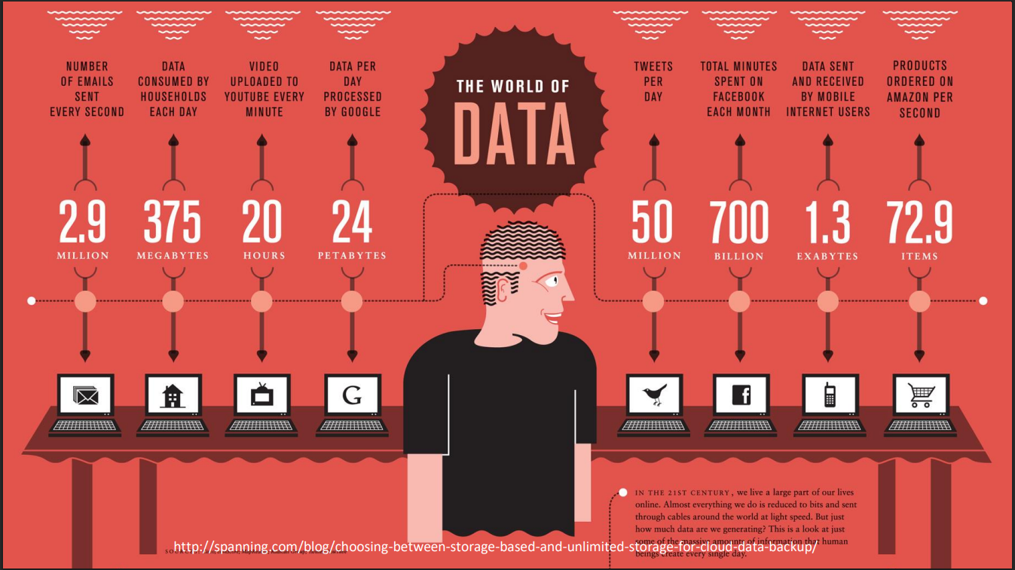

Slide 5
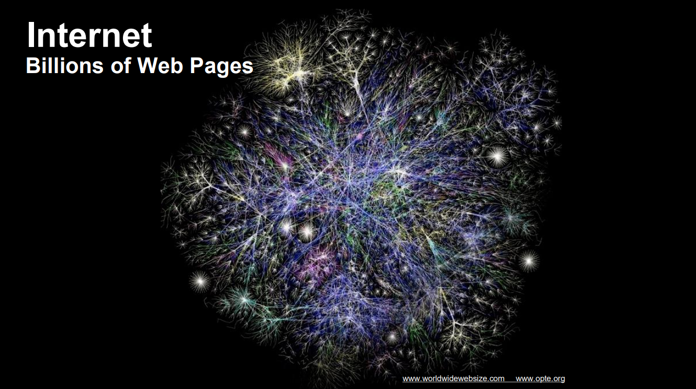

Slide 6


Slide 7
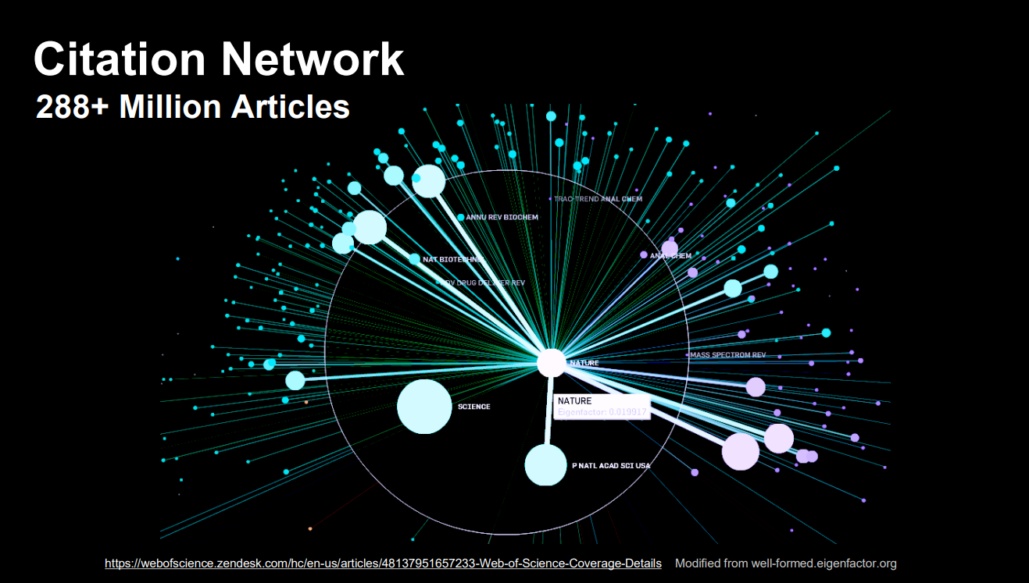

Slide 8
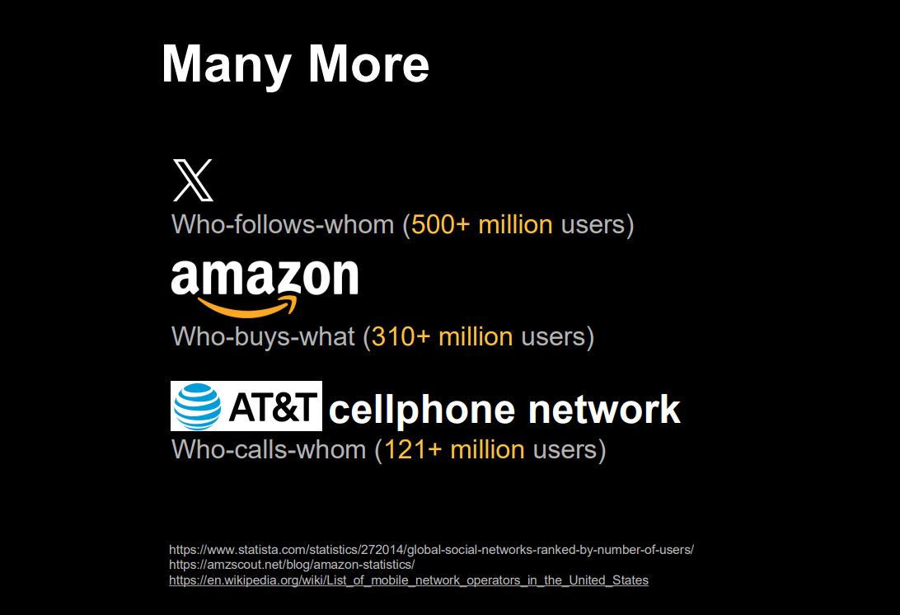

Slide 9
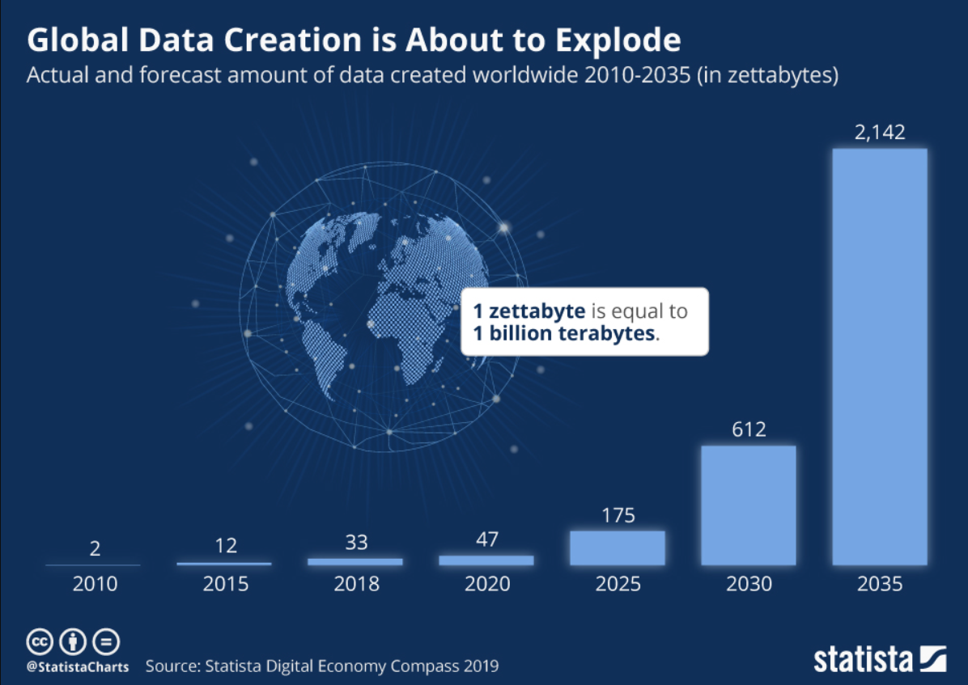

Slide 10
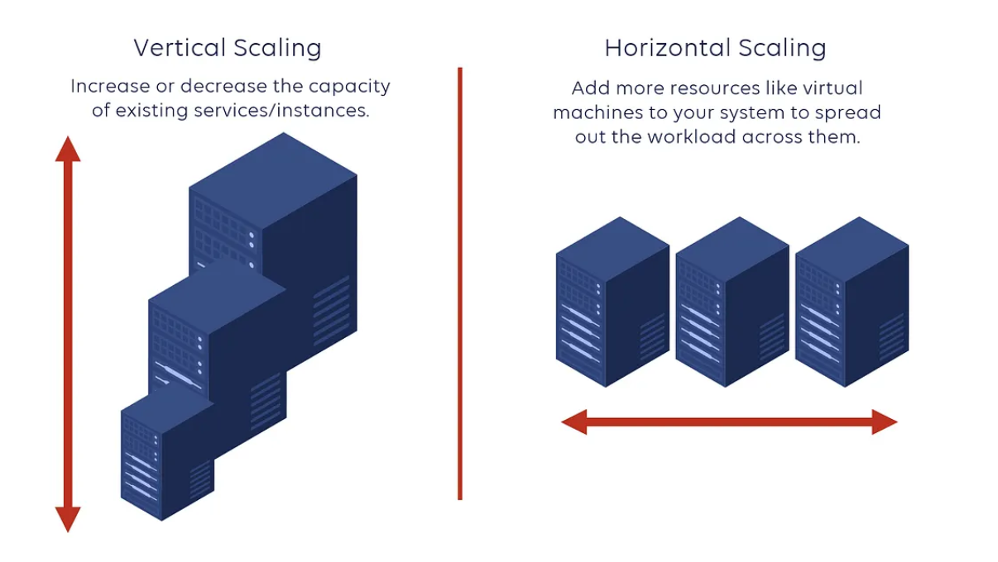
Distributed Systems, Scalability, and Designing for Failure
Vertical Scaling (Single Machine)
Add more CPU, memory, disk to one machine.
Has physical limits.
If the machine fails → system goes down.
Low fault tolerance.
Horizontal Scaling (Distributed Systems)
Add more machines.
Work is distributed across nodes.
Leader node assigns tasks to worker nodes.
If one machine fails → others continue.
Data is replicated for redundancy

Slide 11
Course at a Glance
3 Credit Hours
Research-Oriented
Prerequisites
15-week semester
Theory meets hands-on implementation
Linear Algebra, Probability & Statistics, Programming Fundamentals

Slide 12



How to Reach Your Instructor
Email
Office
Office Hours
farah.saeed@giki.edu.pk
S18, 2nd Floor, New Academic Block
Tuesday & Thursday, 10:00–11:00 AM — or by appointment

Slide 13

Class Schedule
Day | Time | Room
Monday | 4:30–5:20 AM | LH9
Tuesday | 8:00–9:00 AM | LH9
Thursday | 12:30–1:20 PM | LH9
All materials, announcements, and resources are shared on MS Teams.

Slide 14

COURSE
Contents

Slide 15
Six Modules
01
02
Foundations
Distributed Frameworks
Linear algebra, vectors, matrices, and graphs
MapReduce and Apache Spark
03
04
Similarity & Hashing
Dimensionality Reduction
Finding similar objects at scale
Handling thousands of features efficiently
05
06
Graph Analytics
Streams & Scale
PageRank, recommendations, community detection
Real-time data, large-scale ML, and project presentations

Slide 16

Learning Outcomes
Understand & Analyze
Apply at Scale
Design & Evaluate
Understand and analyze big data processing frameworks at depth.
Apply algorithms for large-scale data mining and machine learning.
Design, implement, and evaluate a research-oriented big-data solution end-to-end.

Slide 17

Your Team Research Project
Team of 4
Each member owns one distinct subproblem
Real-World Dataset
Millions of records tackling a genuine problem
Research Arc
Problem → Literature → Baselines → Method → Experiments → Results
Milestone
Baselines running by mid-semester break
Final Presentation
Improvement from your solution

Slide 18
How You'll Be Assessed
Assignments & Quizzes
Late Work Policy
Academic Honesty
Attendance
A grace period may apply, but late submissions may not be accepted after the deadline.
Violations result in immediate assessment cancellation — no exceptions.
University policy requires 100% attendance throughout the semester.
5 quizzes + 2 retake quizzes; demos required for all submissions.

Slide 19
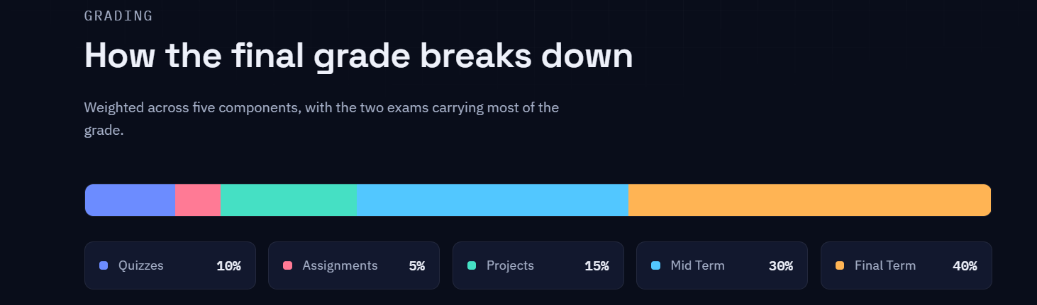

Slide 20
