Slide 1
Travel guide bd
Project presentation

Slide 2
Website feature
Front end for visitor
Separate User panel for users’
Panel for tour guides
Back end for admin/manager
Full restricted admin panel
Full restricted manager panel
user verification system (manual or dynamic)

Slide 3
what a visitor can do?
Browse for tour packages, features, and many more.
Registration for user
Search for a package from the website
send message to admin

Slide 4
What a user can do?
User login system
Book a tour plan
Add a package to users’ favorite list
Show journey history
Contact with manager/admin to solve any problem

Slide 5
What an admin/manager can do?
Show users (Pending, active, muted, disabled)
Only the admin can see managers and disabled users
Change user status and user information
tour packages management
Confirm or reject users’ booking
Respond to user messages/questions
Show monthly/yearly progress report
Manage company tour guides

Slide 6
Let’s see the project outline

Slide 7
Table lists
Tables already added:
users
user_info
user_type
packages
package_category
Tables will be added:
bookings
messages
wishlists
tour_guides
and more tables will be added for application purpose

Slide 8
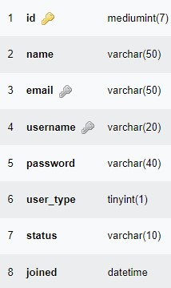
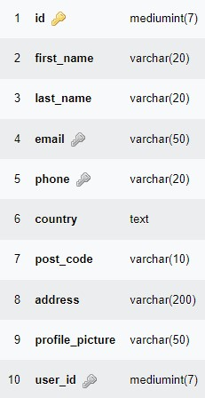
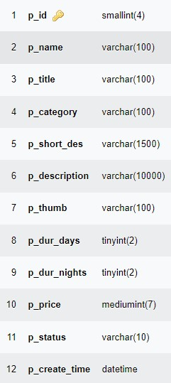
Table structure sample
users table
user_info table
packages table

Slide 9
Thank you

