Slide 1
Angular-6
Notes:
g

Slide 2
Introduction to Angular
■ Angular is a framework for building single-page client applications using HTML and TypeScript.
■ Angular is written in Typescript.
■ It implements core functionality as a set of Typescript libraries that you import into your apps.
■ Sponsored and maintained by Google.

Slide 3
Why Angular?
■ Angular combines declarative templates, dependency injection, services, end to end testing, and integrated best practices to solve development challenges
■ Cross Platform
■ Speed and Performance
■ Productivity

Slide 4
Angular Framework
■ Extendable: easily enhance applications to create new and useful features for your users.
■ Maintainable: Angular apps are easy to debug and fix, which means that long-term maintenance is simplified.
■ Testable: Angular has good support for unit and end-to-end testing, meaning that you can find and fix defects before your users do.

Slide 5
Pre-requisites ■ HTML5 fundamentals ■ CSS3 fundamentals ■ JavaScript Basics

Slide 6
Angular 6 - Environment Setup

Slide 7
Angular Installation
To install Angular 6
Nodejs and Node Package Manager(npm)
To get started with Angular, you’ll need to have Node.js installed
https://nodejs.org/en/download/
Angular CLI(command Line Interface)
Command Line Interface – This is simply a tool set, which is used for creating, managing and building angular applications quickly.
npm install -g @angular/cli
Typescript
npm install -g typescript
IDE for writing your code-Visual Studio
https://code.visualstudio.com/download#

Slide 8
Angular Installation
To check installed versions
Nodejs-
node –v
Npm
npm –v
Typescript
tsc -v
Angular CLI
ng version

Slide 9
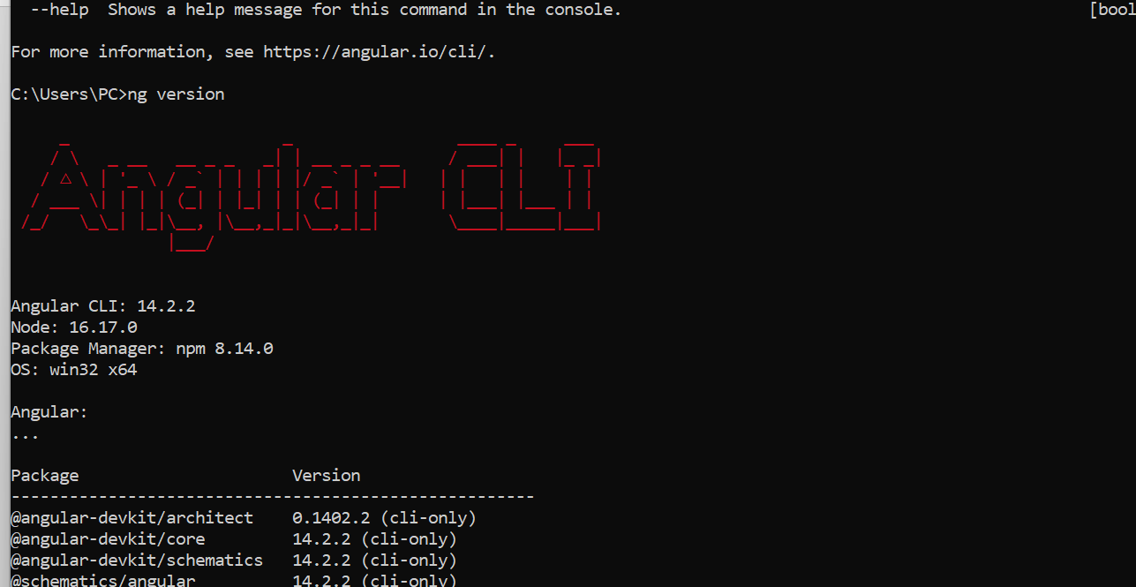

Slide 10
Essentials of Angular
Notes:
g

Slide 11
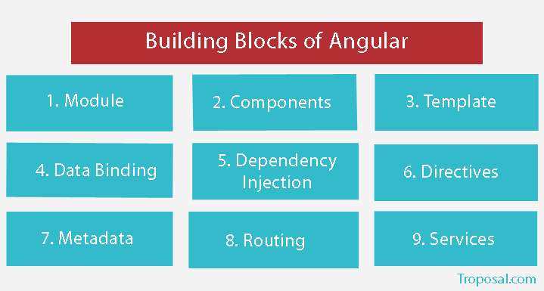

Slide 12
Components
The basic building blocks of the Angular framework are Angular components.
Components define views, which are sets of screen elements that Angular can choose among and modify according to your program logic and data
Components use services, which provide background functionality not directly related to views such as fetching data. Such services can be injected into components as dependencies, making your code modular, reusable, and efficient.
Components and services are classes marked with decorators. These decorators provide metadata that tells Angular how to use them.

Slide 13
A component made up of three parts:
Class(Typescript class)
Template(HTML Template or Template URL)
Decorator(@Component)
Class:-we can write a code which is required for a template to render in the browser.
Template:-user-interface, is a form of HTML that tells Angular how to render the component
Decorator/Metadata:(@Component):- Metadata tells Angular how to process a class. We can attach metadata to a class by using a decorator

Slide 14
Modules
Module in Angular refers to a place where the components, directives, pipes, and services can be grouped, which are related to the application.
In case you are developing a website, the header, footer, left, center and the right section become part of a module.
To define module, the NgModule can be used.
Angular apps are modular and Angular has its own modularity system called NgModule.
Every Angular app has at least one NgModule class, the root module, conventionally named AppModule.

Slide 15
Angular libraries
■ Angular ships as a collection of JavaScript modules. You can think of them as library modules.
■ Each Angular library name begins with the @angular prefix. You install them with the npm package manager and import parts of them with JavaScript import statements.
– Component @angular/core
– BrowserModule @angular/platform-browser
– FormsModule @angular/forms

Slide 16
App Module
■ declarations − In declarations, the reference to the components is stored. The Appcomponent is the default component that is created whenever a new project is initiated. We will learn about creating new components in a different section.
■ imports − This will have the modules imported as shown above. At present, BrowserModule is part of the imports which is imported from @angular/platformbrowser.
■ providers − This will have reference to the services created. The service will be discussed in a subsequent chapter.
■ bootstrap − This has reference to the default component created, i.e., AppComponent

Slide 17
■ app.component.css − You can write your css structure over here.
■ app.component.html − The html code will be available in this file.
■ app.component.spec.ts − These are automatically generated files which contain unit tests for source component.
■ app.component.ts − The class for the component is defined over here. You can do the processing of the html structure in the .ts file. The processing will include activities such as connecting to the database, interacting with other components, routing, services, etc.

