Slide 1
I. Issues Relevant to the Topic
1. Access to Education
2. Employment Opportunities
3. Reproductive Health & Rights
5. Gender-based Violence
6. Child Marriage
7. Gender Equality

Slide 2
I. Topic
• The Major Works of Female Authors during the Contemporary Period
• The Role of Women in Literature

Slide 3
Learning Outcomes
A. Who are the notable female authors during the Contemporary Period?
B. What are The Major Works of Female authors during the Contemporary Period?
C. What are the roles of women in Literature?

Slide 4
Salient Points
The Major Works of Female Authors during the Contemporary Period
The Role of Women in Literature

Slide 5
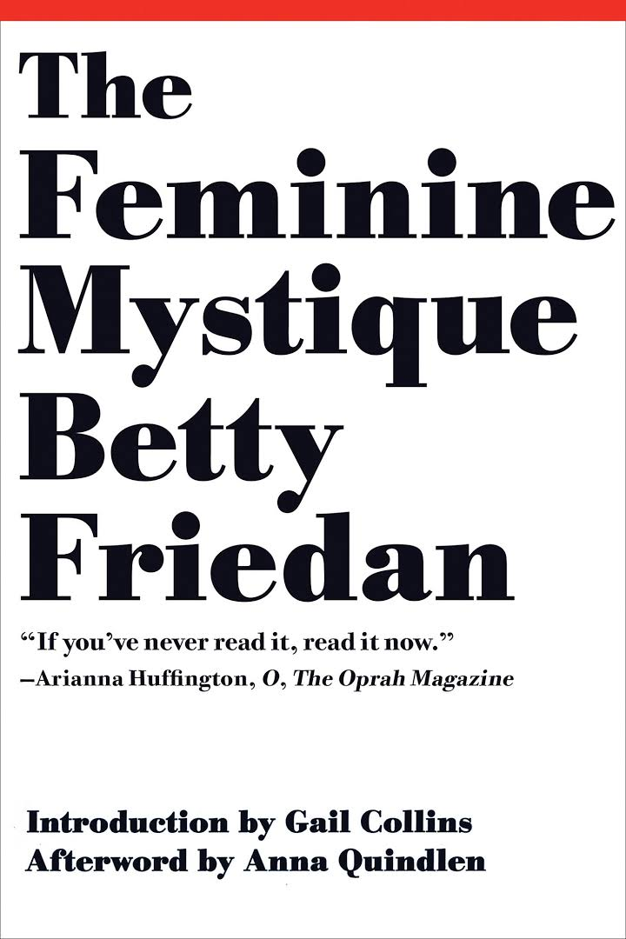
The Feminine Mystique
Betty Friedan
how unsatisfied they were as housewives

Slide 6
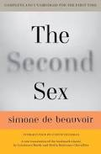
The Second Sex
Simone de Beauvoir
covered how women had been treated throughout history

Slide 7
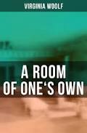
A Room of One's Own
Virginia Woolf
a long form essay
the case that women writers should have a space of their own

Slide 8

The Vagina Monologues
Eve Ensler
monologues covered a variety of topics from a feminist perspective
topics ranged from sex to menstruation, birth, rape, female genital mutilation, and more

Slide 9
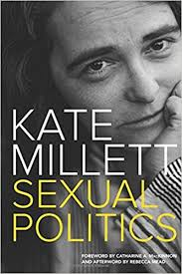
Sexual Politics
Kate Millett
dissected the work of D. H. Lawrence, Norman Mailer, and Henry Miller
pointed out how the three authors wrote about women in a sexist way

Slide 10
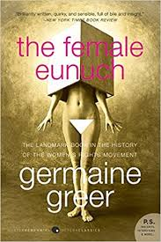
The Female Eunuch
Germaine Greer
Body, Soul, Love, and Hate
explored the self-perception of women throughout history

Slide 11
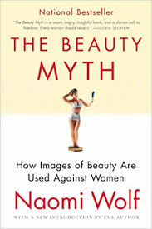
The Beauty Myth
Naomi Wolf
a reevaluation of society's current standards of beauty
scrutiny in these five areas: hunger, religion, sex, violence, and work

Slide 12

The Color Purple
Alice Walker
many of the characters breakaway from traditional gender roles

Slide 13
The Role of Women in Literature

Slide 14
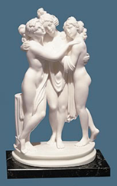
Greek Mythology
were perceived to be more as sexual objects than individuals.
women’s rights were very limited and they were not allowed to express much of their freedoms
were blamed for wars, destruction of towns, and the death of men

Slide 15
Medieval Literature
torn between the ideal and the physical desires and domineering character

Slide 16
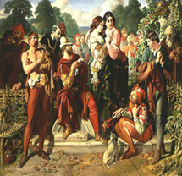
Elizabethan Literature
Women were not looked to as a person but were considered a mere necessity for the procreation process
Women continued to be split between the ideal of the Virgin Mary

Slide 17
Victorian and Turn of the Century Literature
portrayed as protagonists more often than in the past
they redefine their place in society by accepting an image of themselves which involved both home-centeredness and inferiority

Slide 18
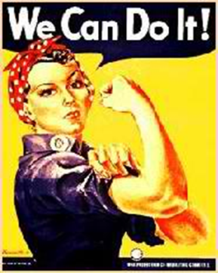
20th Century Literature
had lead women to develop into strong independent roles
strong independent females

Slide 19
IV. Generalization
Feminist vision of justice—one which asserts that interdependence, responsibility, respect for and relationship with the environment, and an ethics of care are the foundation for a more reasoned and reasonable practice of justice.
The literary world has long been a place for women to tell their stories, in both fiction and nonfiction
how the works of female writers are as extraordinary as their male counterparts

Slide 20
V. Insights
"I hate to hear you talk about all women as if they were fine ladies instead of rational creatures. None of us want to be in calm waters all our lives."
― Jane Austen, Persuasion

Slide 21
V. Insights
"What you're supposed to do when you don't like a thing is change it. If you can't change it, change the way you think about it. Don't complain."
― Maya Angelou, Wouldn't Take Nothing for My Journey Now

