Slide 1
THAI CHESS
C++ PROJECT FOR 261102

Slide 2
MEMBERS
620610784 - CHARTTRAKARN CHOOSIRI
620610785 – NUTCHANON THONGANUN
620610786 - NATTAPON TANCHO
620610789 - THADTHON PRECHAMANASART
620610790 - THANAKORN CHAININPHUN

Slide 3
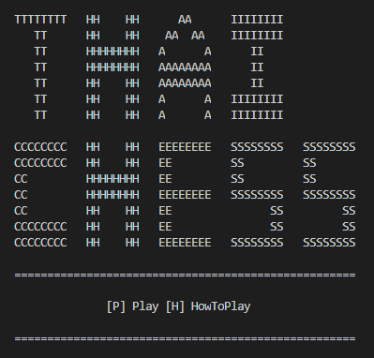
REVIEW

Slide 4
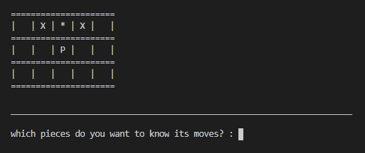
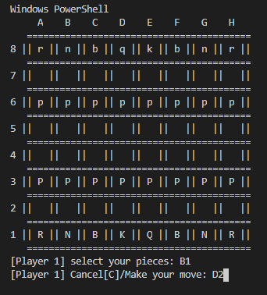
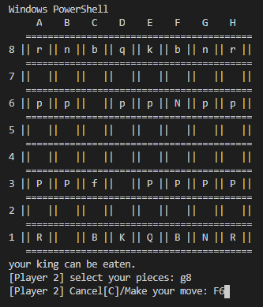

Slide 5
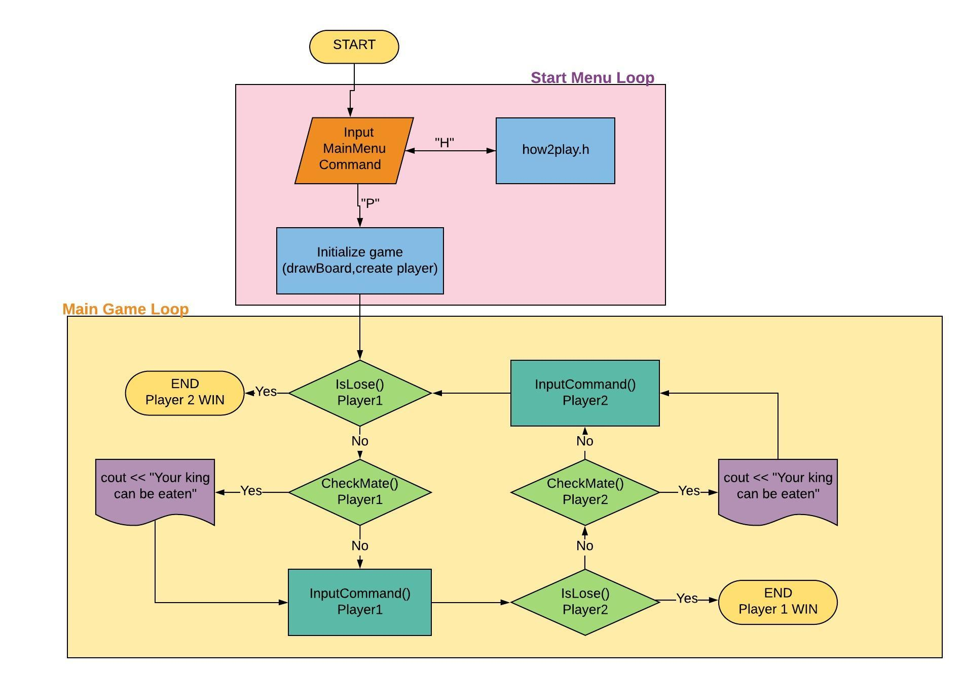
FLOWCHART

Slide 6
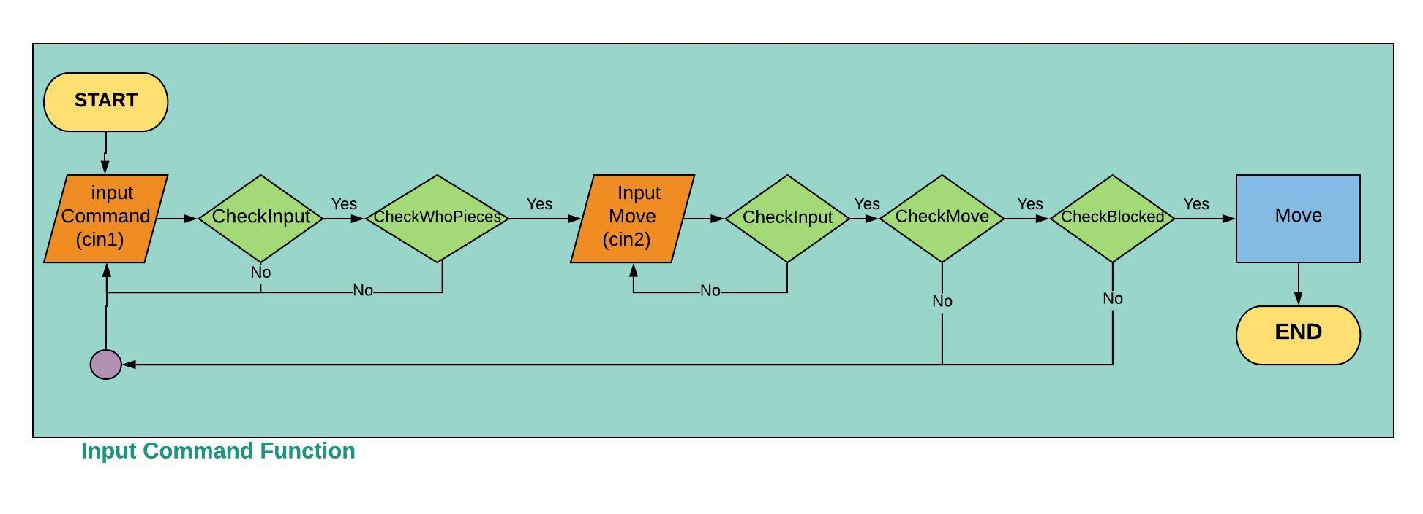
FLOWCHART

Slide 7
THANK YOU FOR YOUR ATTENTION

