Slide 1
Chapter 2: Intro to Relational Model

Slide 2
What is an “Algebra”
Mathematical system consisting of:
  Operands --- variables or values from which new values can be constructed.
  Operators --- symbols denoting procedures that construct new values from given values.

Slide 3
What is Relational Algebra?
An algebra whose operands are relations or variables that represent relations.
Operators are designed to do the most common things that we need to do with relations in a database.
  The result is an algebra that can be used as a query language for relations.

Slide 4
Core Relational Algebra
Union, intersection, and difference.
  Usual set operations, but both operands must have the same relation schema.
Selection: picking certain rows.
Projection: picking certain columns.
Products and joins: compositions of relations.
Renaming of relations and attributes.

Slide 5

Example of a Relation
attributes
(or columns)
tuples
(or rows)

Slide 6
Attribute Types
The set of allowed values for each attribute is called the domain of the attribute
Attribute values are (normally) required to be atomic; that is, indivisible
The special value null is a member of every domain
The null value causes complications in the definition of many operations

Slide 7
Relation Schema and Instance
A₁, A₂, …, A_{n} are attributes
R = (A₁, A₂, …, A_{n} ) is a relation schema
Example:
instructor = (ID, name, dept_name, salary)
Formally, given sets D₁, D₂, …. D_{n} a relation r is a subset of
D₁ x D₂ x … x D_{n}
Thus, a relation is a set of n-tuples (a₁, a₂, …, a_{n}) where each a_{i} ∈ D_{i}
The current values (relation instance) of a relation are specified by a table
An element t of r is a tuple, represented by a row in a table

Slide 8

Relations are Unordered
Order of tuples is irrelevant (tuples may be stored in an arbitrary order)
Example: instructor relation with unordered tuples

Slide 9
Database
A database consists of multiple relations
Information about an enterprise is broken up into parts
instructor
student
advisor
Bad design:
univ (instructor-ID, name, dept_name, salary, student_Id, ..)
results in
  repetition of information (e.g., two students have the same instructor)
  the need for null values (e.g., represent an student with no advisor)
Normalization theory (Chapter 7) deals with how to design “good” relational schemas

Slide 10
Keys
Let K ⊆ R (K is a subset of R)
K is a superkey of R if values for K are sufficient to identify a unique tuple of each possible relation r(R)
  Example: {ID} and {ID,name} are both superkeys of instructor.
Superkey K is a candidate key if K is minimal
  Example: {ID} is a candidate key for Instructor
One of the candidate keys is selected to be the primary key.
  which one?
Foreign key constraint: Value in one relation must appear in another
  Referencing relation
  Referenced relation

Slide 11
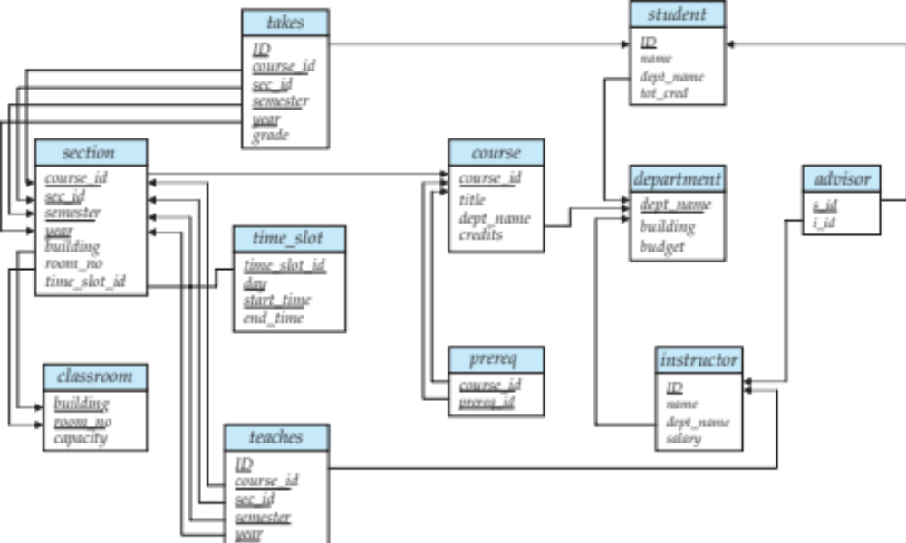
Schema Diagram for University Database

Slide 12
Schema Diagram for Bank
branch
branch_name
city
assets
account
account_num
branch_name
balance
depositor
customer_name
account_num
loan
loan_num
branch_name
amount
borrower
customer_name
loan_num
customer
customer_name
customer_street
city

Slide 13
Relational Query Languages
Procedural vs. non-procedural, or declarative
“Pure” languages:
  Relational algebra
  Tuple relational calculus
  Domain relational calculus
Relational operators

Slide 14
Selection
R1 := σ_{C} (R2)
  C is a condition (as in “if” statements) that refers to attributes of R2.
  R1 is all those tuples of R2 that satisfy C.

Slide 15
Example: Selection
Relation Sells:
bar beer price
Joe’s Bud 2.50
Joe’s Miller 2.75
Sue’s Bud 2.50
Sue’s Miller 3.00
JoeMenu := σ_{bar=“Joe’s”}(Sells):
bar beer price
Joe’s Bud 2.50
Joe’s Miller 2.75

Slide 16

Selection of tuples
Relation r
Select tuples with A=B and D > 5
σ _{A=B and D > 5} (r)

Slide 17
Projection
R1 := π_{L} (R2)
  L is a list of attributes from the schema of R2.
  R1 is constructed by looking at each tuple of R2, extracting the attributes on list L, in the order specified, and creating from those components a tuple for R1.
  Eliminate duplicate tuples, if any.

Slide 18
Example: Projection
Relation Sells:
bar beer price
Joe’s Bud 2.50
Joe’s Miller 2.75
Sue’s Bud 2.50
Sue’s Miller 3.00
Prices := π_{beer,price}(Sells):
beer price
Bud 2.50
Miller 2.75
Miller 3.00

Slide 19

Selection of Columns (Attributes)
Relation r:
Select A and C
  Projection
  Π _{A, C} (r)

Slide 20
Product (or Cartesian Product)
R3 := R1 Χ R2
  Pair each tuple t1 of R1 with each tuple t2 of R2.
  Concatenation “t1t2” is a tuple of R3.
  Schema of R3 is the attributes of R1 and then R2, in order.
  But beware attribute A of the same name in R1 and R2: use R1.A and R2.A.

Slide 21

Joining two relations – Cartesian Product
Relations r, s:
r x s:

Slide 22
Example: R3 := R1 Χ R2
R3( A, R1.B, R2.B, C )
1 2 5 6
1 2 7 8
1 2 9 10
3 4 5 6
3 4 7 8
3 4 9 10
R1( A, B )
1 2
3 4
R2( B, C )
5 6
7 8
9 10

Slide 23

Union of two relations
Relations r, s:
Schemas must
be identical!
r ∪ s:

Slide 24

Set difference of two relations
Relations r, s:
r – s:

Slide 25

Set Intersection of two relations
Relation r, s:
r ∩ s

Slide 26
Theta-Join
R3 := R1 ⋈_{C} R2
  Take the product R1 Χ R2.
  Then apply σ_{C} to the result.
  Equivalent to σ_{C} (R1 Χ R2)
As for σ, C can be any boolean-valued condition.
  Historic versions of this operator allowed only A θ B, where θ is =, <, >, etc.; hence the name “theta-join.”

Slide 27
Example: Theta Join
Sells( bar, beer, price ) Bars( name, addr )
Joe’s Bud 2.50 Joe’s Maple St.
Joe’s Miller 2.75 Sue’s River Rd.
Sue’s Bud 2.50
Sue’s Coors 3.00
BarInfo := Sells ⋈_{Sells.bar = Bars.name} Bars
BarInfo( bar, beer, price, name, addr )
Joe’s Bud 2.50 Joe’s Maple St.
Joe’s Miller 2.75 Joe’s Maple St.
Sue’s Bud 2.50 Sue’s River Rd.
Sue’s Coors 3.00 Sue’s River Rd.

Slide 28
Joining two relations – Natural Join
Let r and s be relations on schemas R and S respectively.
Then, the “natural join” of relations R and S is a relation on schema R ∪ S obtained as follows:
  Consider each pair of tuples t_{r} from r and t_{s} from s.
  If t_{r} and t_{s} have the same value on each of the attributes in R ∩ S, add a tuple t to the result, where
    t has the same value as t_{r} on r
    t has the same value as t_{s} on s

Slide 29

Natural Join Example
Relations r, s:
Natural Join
  r s

Slide 30
Rename operation
Rename operator
  ρ_{x} (E) : the result of expression E under the name x
  e.g.,
    select a tuple loan_number = ‘1234’ with renaming the relation ‘borrower’ to b
    σ_{b.loan_number=‘1234’} (ρ_{b} (borrower))

Slide 31
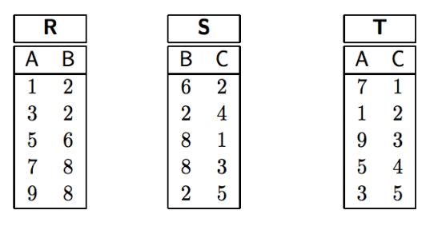


Exercise
R ⋈ (S ⋈ T)
(S ⋈ R) ⋈ T

Slide 32
Schema Diagram for Bank
branch
branch_name
city
assets
account
account_num
branch_name
balance
depositor
customer_name
account_num
loan
loan_num
branch_name
amount
borrower
customer_name
loan_num
customer
customer_name
customer_street
city

Slide 33
Example of relations
customer_name | loan_number
Adams | L-16
Curry | L-93
Hayes | L-15
Jackson | L-14
Jones | L-17
Smith | L-11
Smith | L-23
Williams | L-17
loan_number | branch_name | ammount
L-11 | Round hill | 900
L-14 | Donwtown | 1500
L-15 | Perryridge | 1500
L-16 | Perryridge | 1300
L-17 | Donwtown | 1000
L-23 | Redwood | 2000
L-93 | Mianus | 500
<loan relation>
<borrower relation>

Slide 34
Exercise
Select tuples of the loan relation where the branch is “Perryridge”
Find tuples in which the amount lent is more than $1200
Find tuples pertaining to loans of more than $1200 made by the Perryridge branch
List all loan numbers and the amount of the loan
Find those customers who live in Harrison

Slide 35
Exercise
Find the names of all customers who have a loan at the Perryridge branch
branch
branch_name
city
assets
account
account_num
branch_name
balance
depositor
customer_name
account_num
loan
loan_num
branch_name
amount
borrower
customer_name
loan_num
customer
customer_name
customer_street
city

Slide 36
Exercise
Find the names of all customers who live on the same street and in the same city as Smith
branch
branch_name
city
assets
account
account_num
branch_name
balance
depositor
customer_name
account_num
loan
loan_num
branch_name
amount
borrower
customer_name
loan_num
customer
customer_name
customer_street
city

Slide 37
Exercise
Find the names of all branches with customers who have an account in the bank and who live in Harrison
branch
branch_name
city
assets
account
account_num
branch_name
balance
depositor
customer_name
account_num
loan
loan_num
branch_name
amount
borrower
customer_name
loan_num
customer
customer_name
customer_street
city

Slide 38
Exercise
Find all customers who have both a loan and account at the bank
  Hint: 1) use a natural join or 2) use a set intersection
branch
branch_name
city
assets
account
account_num
branch_name
balance
depositor
customer_name
account_num
loan
loan_num
branch_name
amount
borrower
customer_name
loan_num
customer
customer_name
customer_street
city

Slide 39
Exercise
Find the largest account balance in the bank
  Use renaming, set difference, join and projection operations
  HINT: account X ρ_{d}(account)
account
account_num
branch_name
balance

Slide 40
Aggregate Functions
Aggregate functions
  sum : e.g., G_{sum(salary)} (instructor)
  avg : e.g., G_{avg(salary)} (instructor)
  count
  min, max
Grouping
  sum : e.g., _{branch_name}G_{sum(salary)} (instructor)
employee | branch_name | salary
A | Austin | 10
B | Perryridge | 30
C | Austin | 20
D | Perryridge | 10
E | Perryridge | 10
branch_name | salary
Austin | 30
Perryridge | 50

Slide 41

Figure in-2.1

Slide 42
End of Chapter 2

Slide 43
Figure 2.01

Slide 44

Figure 2.02

Slide 45

Figure 2.03

Slide 46
Figure 2.04

Slide 47

Figure 2.05

Slide 48

Figure 2.06

Slide 49

Figure 2.07

Slide 50

Figure 2.10

Slide 51

Figure 2.11

Slide 52

Figure 2.12

Slide 53

Figure 2.13

