Slide 1
Chapter 4: Intermediate SQL

Slide 2
Chapter 4: Intermediate SQL
Join Expressions
Views
Transactions
Integrity Constraints
SQL Data Types and Schemas
Authorization
Notes:
1

Slide 3
Joined Relations
Join operations take two relations and return as a result another relation.
A join operation is a Cartesian product which requires that tuples in the two relations match (under some condition). It also specifies the attributes that are present in the result of the join
The join operations are typically used as subquery expressions in the from clause

Slide 4
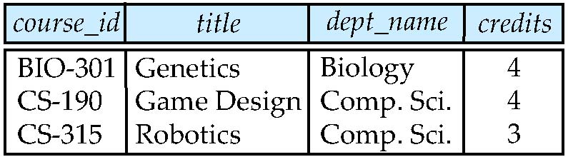
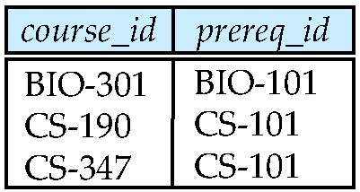
Join operations – Example
Relation course
Relation prereq
Observe that
prereq information is missing for CS-315 and
course information is missing for CS-437

Slide 5
Outer Join
An extension of the join operation that avoids loss of information.
Computes the join and then adds tuples form one relation that does not match tuples in the other relation to the result of the join.
Uses null values.

Slide 6
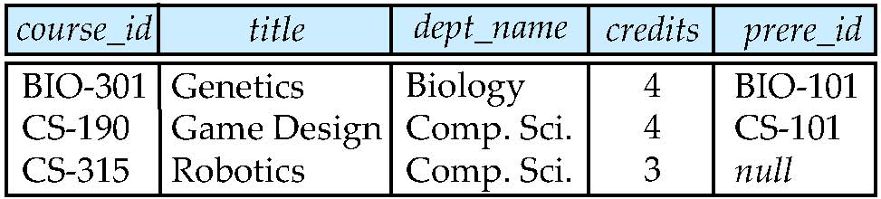
Left Outer Join
course natural left outer join prereq

Slide 7
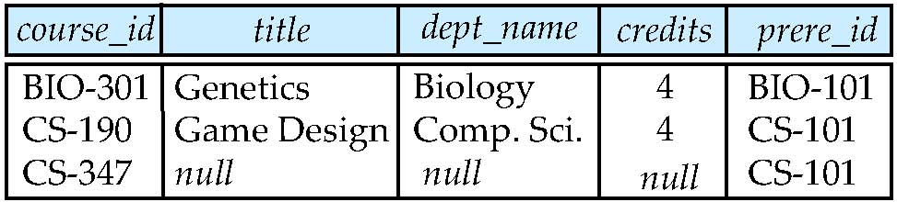
Right Outer Join
course natural right outer join prereq

Slide 8
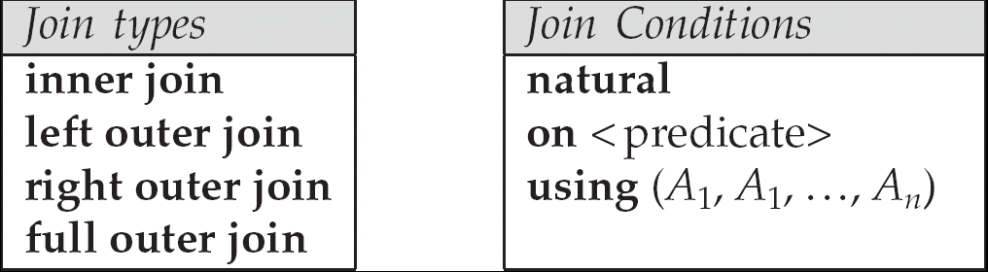
Joined Relations
Join operations take two relations and return as a result another relation.
These additional operations are typically used as subquery expressions in the from clause
Join condition – defines which tuples in the two relations match, and what attributes are present in the result of the join.
Join type – defines how tuples in each relation that do not match any tuple in the other relation (based on the join condition) are treated.

Slide 9
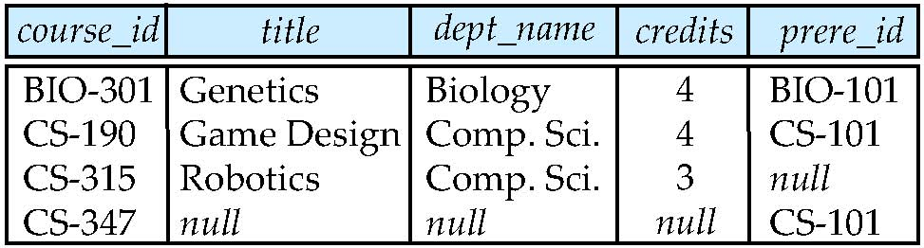
Full Outer Join
course natural full outer join prereq

Slide 10
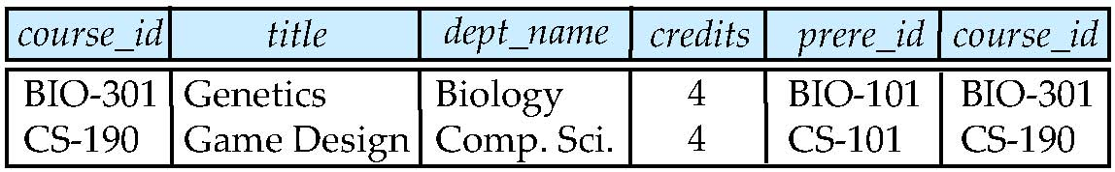
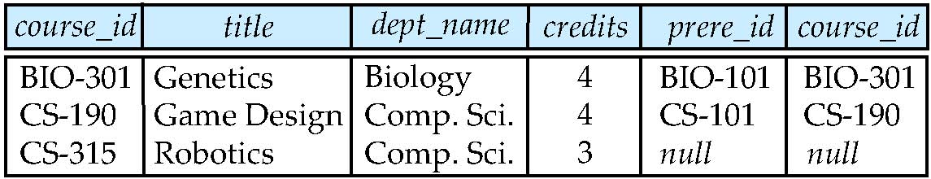
Joined Relations – Examples
course inner join prereq on course.course_id = prereq.course_id
What is the difference between the above, and a natural join?
course left outer join prereq on course.course_id = prereq.course_id

Slide 11
Joined Relations – Examples
course natural right outer join prereq
course full outer join prereq using (course_id)

Slide 12
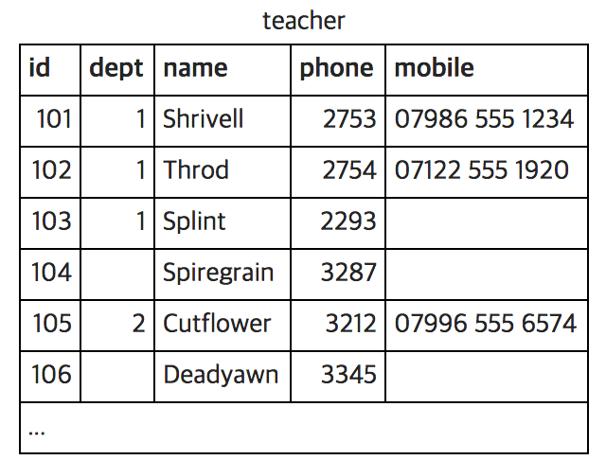
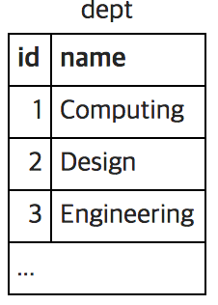
Exercise
See http://sqlzoo.net/wiki/Using_Null

Slide 13
Exercise
List the teachers who have NULL for their department.
Use COALESCE to print the mobile number. Use the number '07986 444 2266' if there is no number given. Show teacher name and mobile number or '07986 444 2266’
COALESCE(x,y) = x if x is not NULL
COALESCE(x,y) = y if x is NULL and y is not NULL
SELECT name, COALESCE(mobile,'07986 444 2266')FROM teacher

Slide 14
Exercise
Use the COALESCE function and a LEFT JOIN to print the teacher name and department name. Use the string 'None' where there is no department.
SELECT t.name, COALESCE(d.name, 'None') FROM teacher AS t LEFT JOIN dept AS d ON t.dept = d.id

Slide 15
Exercise
Use COUNT to show the number of teachers and the number of mobile phones.
The COUNT(column_name) function returns the number of values (NULL values will not be counted) of the specified column
SELECT COUNT(id), COUNT(mobile) FROM teacher

Slide 16
Exercise
Use COUNT and GROUP BY dept.name to show each department and the number of staff. Use a RIGHT JOIN to ensure that the Engineering department is listed.
SELECT d.name, COUNT(t.id) FROM teacher AS t RIGHT JOIN dept AS d ON t.dept = d.id GROUP BY d.name

Slide 17
Views
In some cases, it is not desirable for all users to see the entire logical model (that is, all the actual relations stored in the database.)
Consider a person who needs to know an instructors name and department, but not the salary. This person should see a relation described, in SQL, by select ID, name, dept_name from instructor
A view provides a mechanism to hide certain data from the view of certain users.
Any relation that is not of the conceptual model but is made visible to a user as a “virtual relation” is called a view.

Slide 18
View Definition
A view is defined using the create view statement which has the form
create view v as < query expression >
where <query expression> is any legal SQL expression. The view name is represented by v.
Once a view is defined, the view name can be used to refer to the virtual relation that the view generates.
View definition is not the same as creating a new relation by evaluating the query expression
Rather, a view definition causes the saving of an expression; the expression is substituted into queries using the view.

Slide 19
Example Views
A view of instructors without their salary create view faculty as select ID, name, dept_name from instructor
Find all instructors in the Biology department select name from faculty where dept_name = ‘Biology’
Create a view of department salary totals create view departments_total_salary(dept_name, total_salary) as select dept_name, sum (salary) from instructor group by dept_name;

