Slide 1
PINN-Based Cardiovascular Hemodynamics and 2D Stenosis Detection
Baseline flow solver -> synthetic stenosis -> inverse recovery -> 2D PINN detection Suryadeep Deswal

Slide 2
Problem Statement
Goal: model cardiovascular flow and detect stenosis severity/location using a physics-informed workflow.
Estimate velocity, pressure drop, wall shear stress, and stenosis parameters.
Use reduced-order models for controlled synthetic data and fast validation.
Use PINNs for the main 2D flow and stenosis-detection stages.
Stop at a complete 2D stenosis project; no 3D component is claimed in this submission.

Slide 3
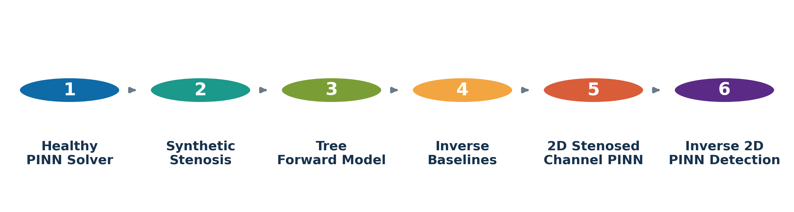
Completed Project Pipeline
Final endpoint: inverse 2D PINN recovery of stenosis severity and center.
Completed pipeline

Slide 4
Physical Assumptions
We model blood as steady, incompressible, Newtonian, and laminar:
$$∇⋅u=0$$
$$(u⋅∇)u+\frac{1}{ρ}∇p−ν∇^{2}u=0$$
For the 2D PINNs:
$$N_{θ}(x,y)=\left[\begin{matrix}u_{θ}(x,y) \\ v_{θ}(x,y) \\ p_{θ}(x,y)\end{matrix}\right]$$

Slide 5
Stage 1: Healthy Baseline PINN
Domain
$$Ω_{0}=\{(x,y):0≤x≤L, −h≤y≤h\}, h=H/2$$
Boundary conditions
$$u(0,y)=U_{max}\left(1−\frac{y^{2}}{h^{2}}\right), v(0,y)=0$$
$$u(x,±h)=v(x,±h)=0, v(L,y)=0, p(L,y)=P_{\text{out}}$$

Slide 6
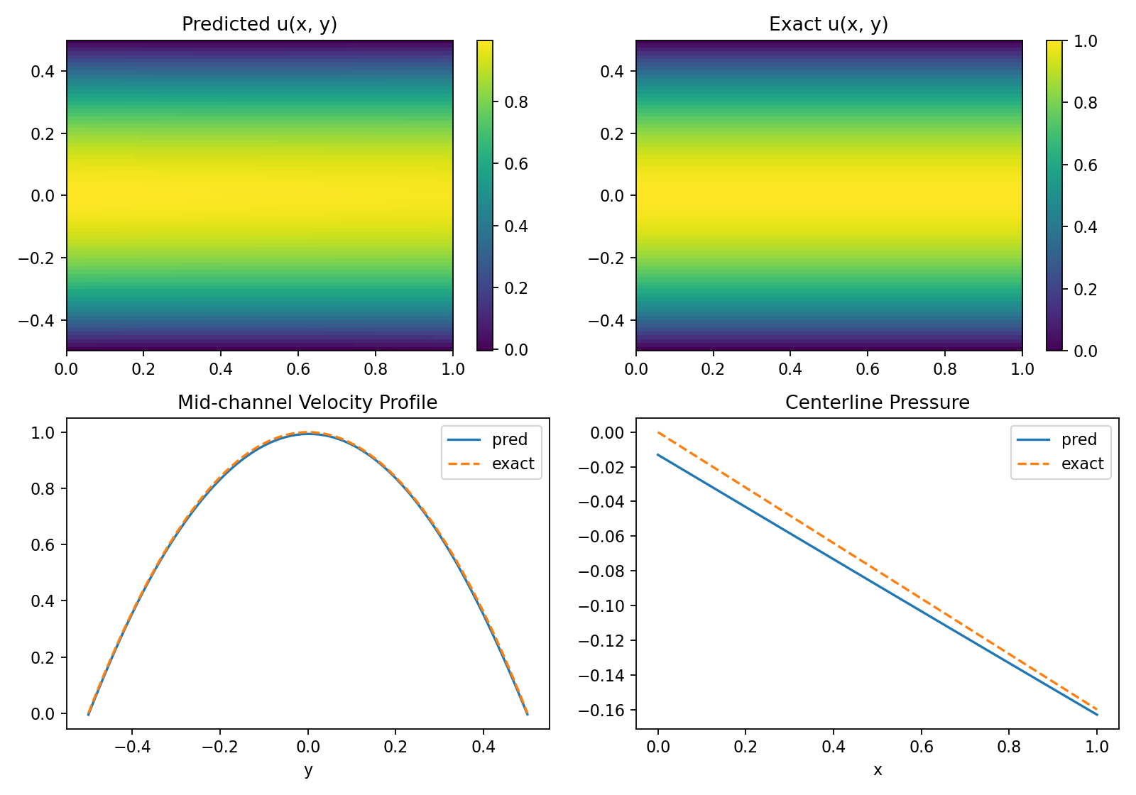
Baseline PINN Result
Verification: relative velocity error 0.00883, continuity residual 0.00529.
Baseline Poiseuille PINN

Slide 7
Stage 2: Synthetic Single-Vessel Stenosis
The stenosed radius is modeled as a Gaussian narrowing:
$$R(x;s,c,w)=R_{0}\left[1−sexp\left(−\frac{1}{2}{\left(\frac{x−c}{w}\right)}^{2}\right)\right]$$
From conservation of flow:
$$A(x)=πR(x)^{2}, U(x)=\frac{Q}{A(x)}$$
Pressure drop:
$$ΔP(x)=\int_{0}^{x}{\frac{8μQ}{πR(ξ)^{4}}} dξ$$

Slide 8
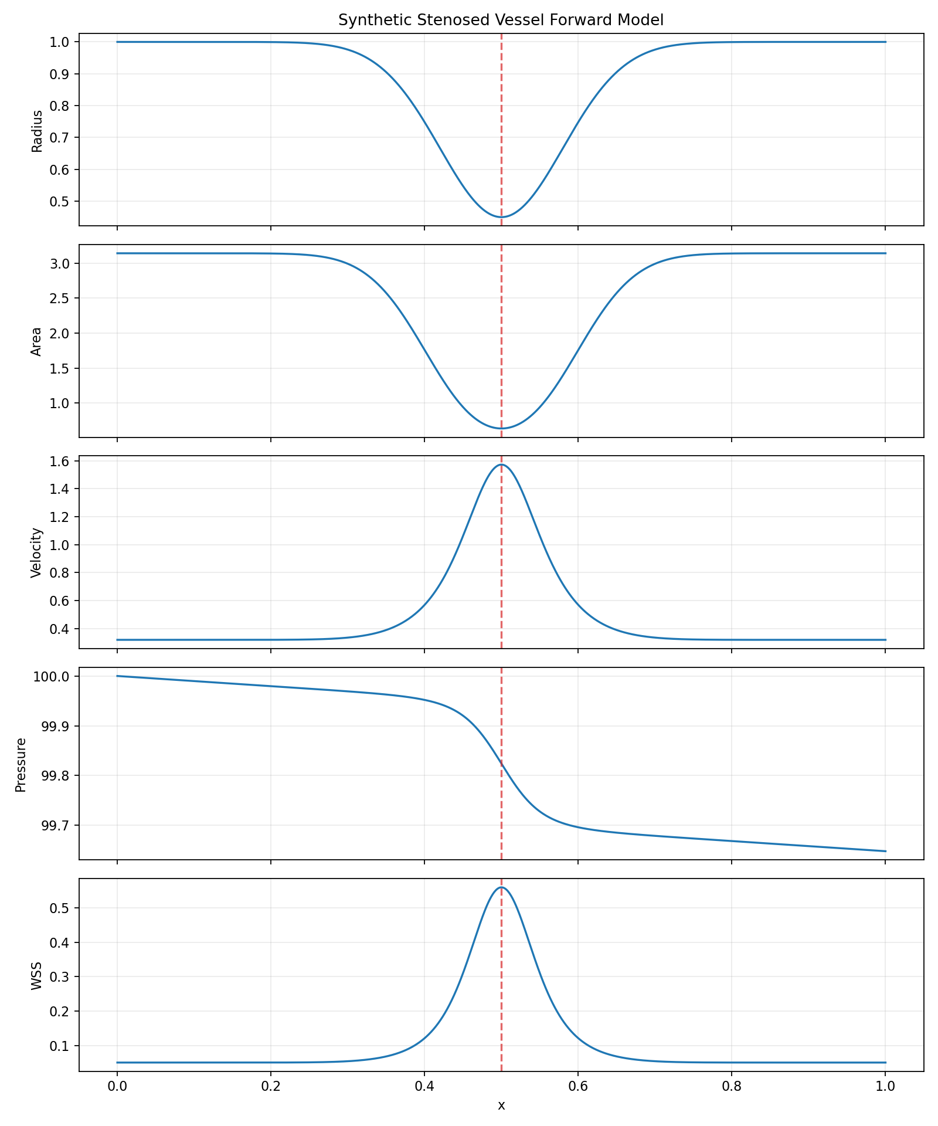
Synthetic Stenosis Forward Result
Key behavior: stenosis narrows radius, accelerates velocity, increases pressure drop, and raises wall shear stress.
Synthetic stenosed vessel

Slide 9
Stage 2B: Y-Bifurcation Vessel Tree
Fixed tree topology:
$$B=\{b_{0},b_{L},b_{R}\}$$
Murray-style outlet flow split:
$$Q_{L}=Q_{\text{in}}\frac{R_{0,L}^{3}}{R_{0,L}^{3}+R_{0,R}^{3}}, Q_{R}=Q_{\text{in}}\frac{R_{0,R}^{3}}{R_{0,L}^{3}+R_{0,R}^{3}}$$
Mass conservation:
$$Q_{0}=Q_{L}+Q_{R}$$

Slide 10
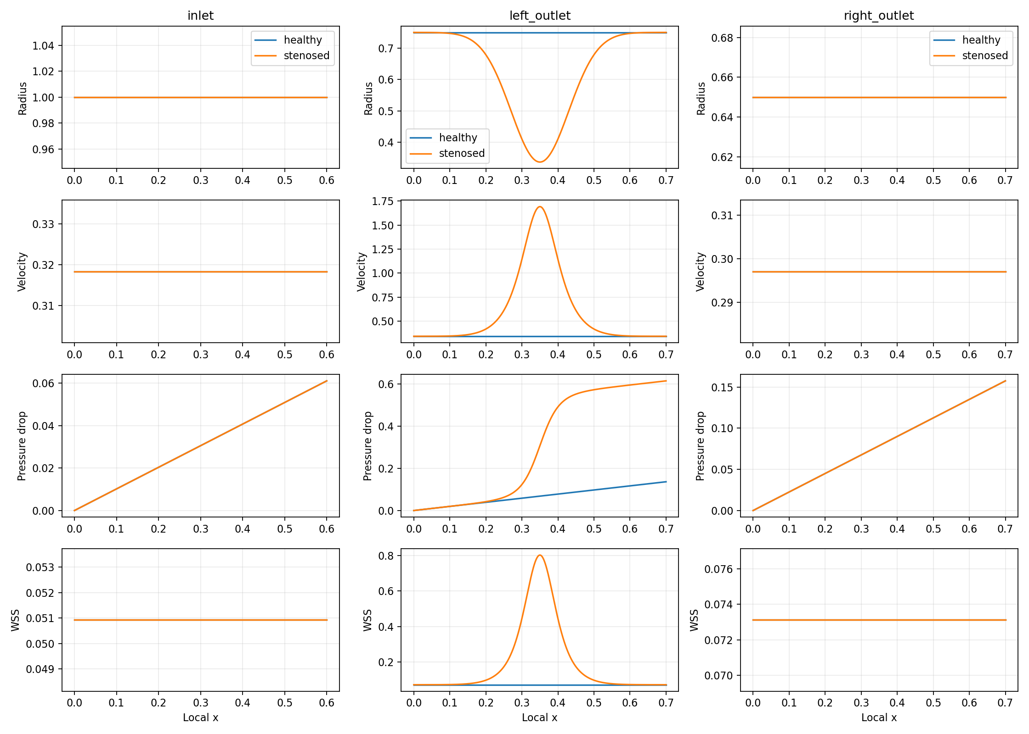
Tree Forward Result
Verification: inlet flow equals outlet flow sum; pressure decreases monotonically along every branch.
Y-bifurcation tree forward model

Slide 11
Stage 3: Reduced-Order Inverse Baselines
The reduced-order inverse models are fast baselines, not the final detection endpoint.
Single-vessel inverse:
$$(s^{*},c^{*})=arg\min_{s,c}L_{\text{RO,1D}}(s,c)$$
Tree inverse:
$$(s_{L}^{*},s_{R}^{*})=arg\min_{s_{L},s_{R}}\left[L_{L}(s_{L})+L_{R}(s_{R})\right]$$
Classification:
$$b^{*}=arg\max_{b∈\{L,R\}}s_{b}^{*}$$

Slide 12
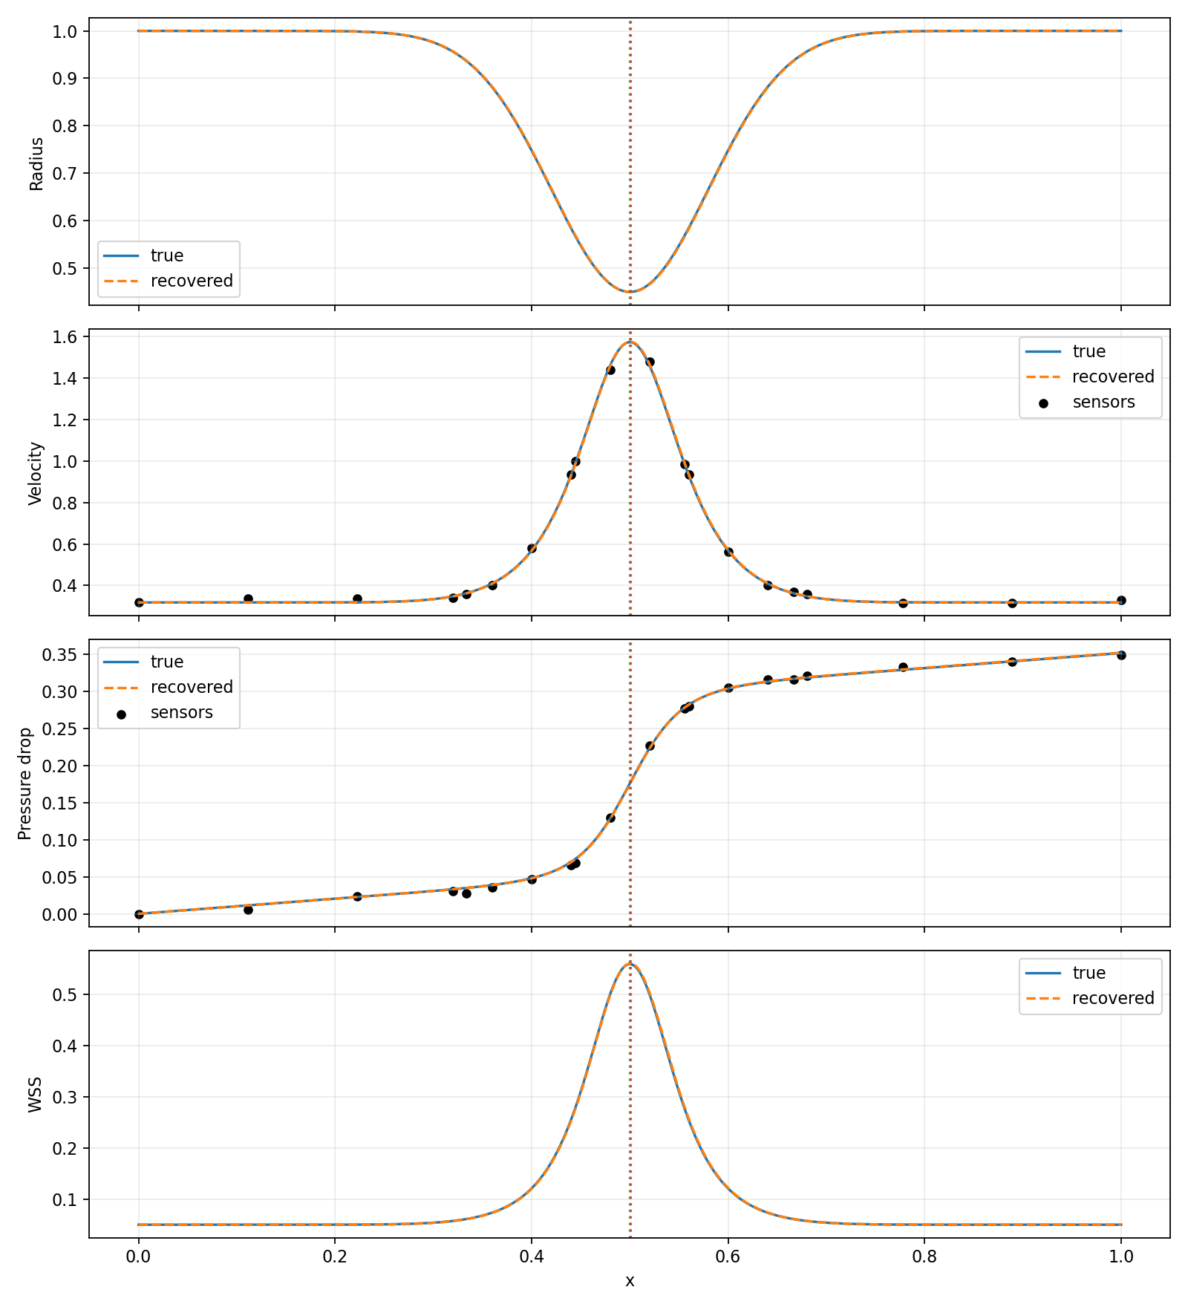
Reduced-Order Inverse Result
Single-vessel recovery: severity error 0.00029, center error 0.00051.
Tree recovery: left and right outlet stenoses both classified correctly.
Inverse stenosis reconstruction

Slide 13
Stage 4: Forward 2D Stenosed-Channel PINN
Known stenosed geometry:
$$h(x;s,c)=h_{0}\left[1−sexp\left(−\frac{1}{2}{\left(\frac{x−c}{w}\right)}^{2}\right)\right]$$
$$Ω(s,c)=\{(x,y):0≤x≤L, −h(x;s,c)≤y≤h(x;s,c)\}$$
The PINN solves Navier-Stokes in the curved stenosed domain.

Slide 14
Improved 2D PINN Training Strategy
To improve the curved-domain solver:
Larger network: 5 hidden layers, width 96.
More collocation points.
Extra samples near stenosis throat.
Extra samples near the curved walls.
Stronger continuity and momentum residual weights.
Weak synthetic-reference term for stable pressure/velocity learning.
Forward 2D objective:
$$θ^{*}=arg\min_{θ}\left[6L_{c}+4L_{m}+10L_{wall}+10L_{in}+10L_{out}+0.5L_{ref}\right]$$

Slide 15
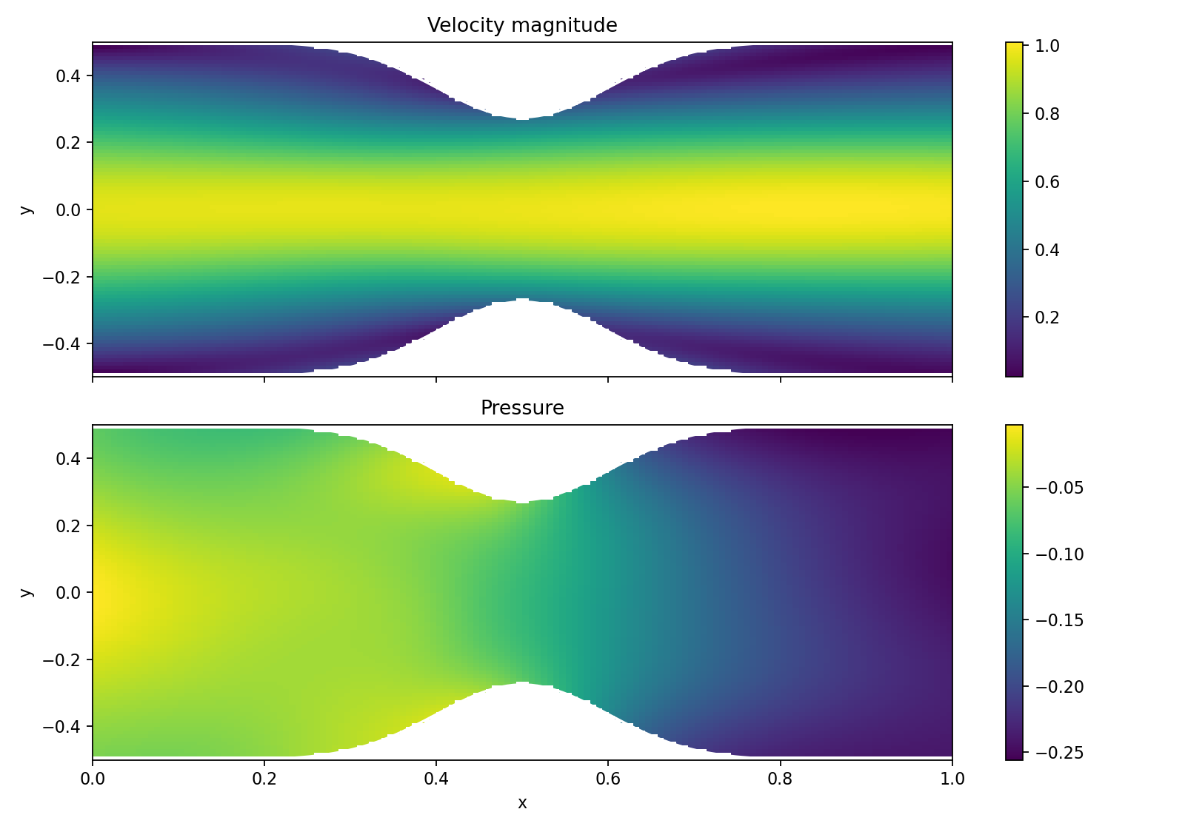
2D Stenosed-Channel PINN Result
Improved residuals:
Continuity: 0.0593
Momentum-x: 0.0989
Momentum-y: 0.0464
Positive pressure drop: 0.2087
2D stenosed-channel fields

Slide 16
Main Method: Inverse 2D PINN Detection
Unknowns:
$$Λ=(θ,s,c)$$
The neural field and stenosis parameters are learned together:
$$(θ^{*},s^{*},c^{*})=arg\min_{θ,s,c}L_{invPINN}(θ,s,c)$$
Loss:
$$L_{invPINN}=L_{PDE}+10L_{BC}+5L_{data}+200L_{geom}$$

Slide 17
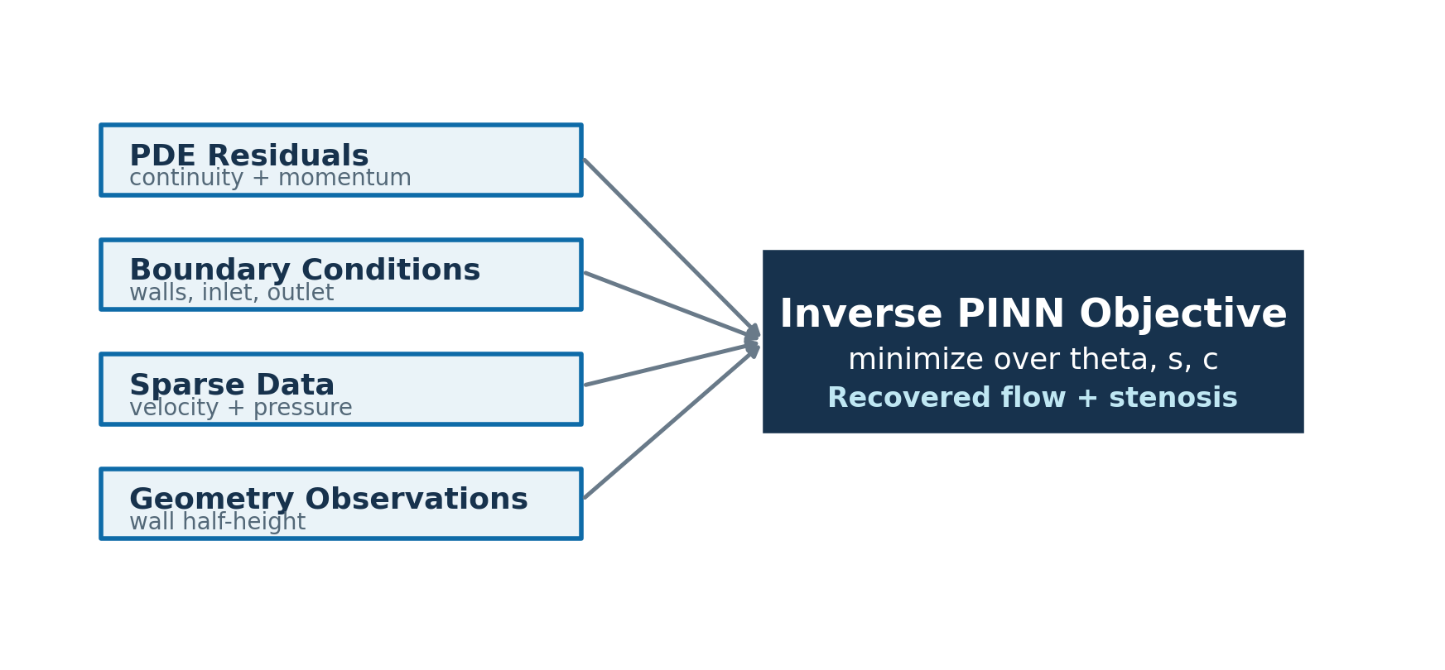
Inverse PINN Loss Components
This keeps stenosis detection inside the PINN framework instead of switching to a purely algebraic final step.
Inverse PINN loss diagram

Slide 18
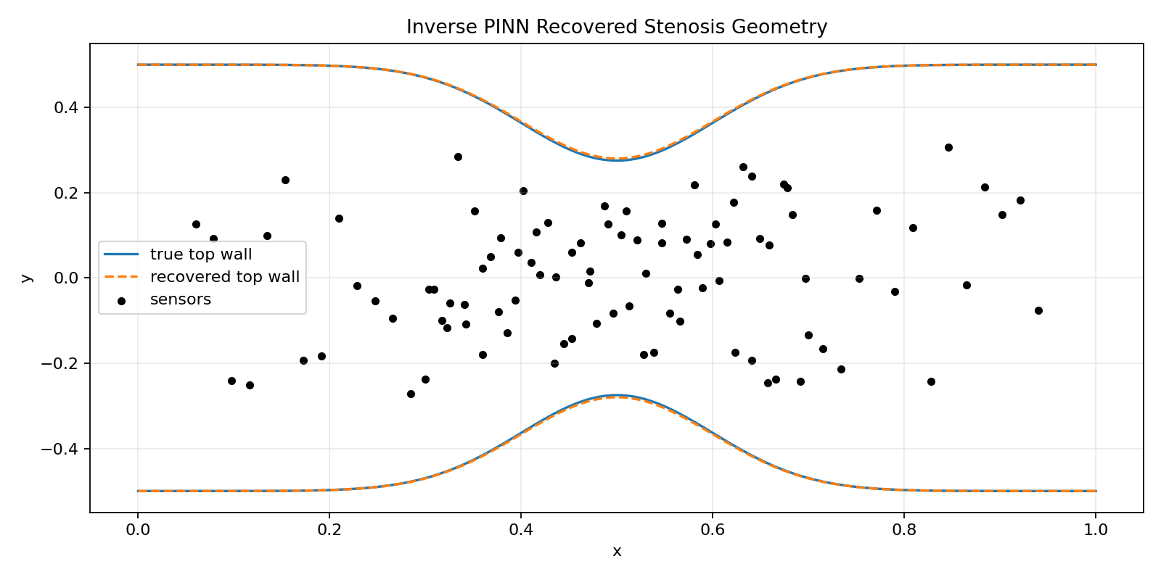
Inverse 2D PINN Result
Recovery result:
True severity: 0.45
Recovered severity: 0.4400
Severity absolute error: 0.00996
True center: 0.50
Recovered center: 0.499997
Recovered inverse PINN geometry

Slide 19
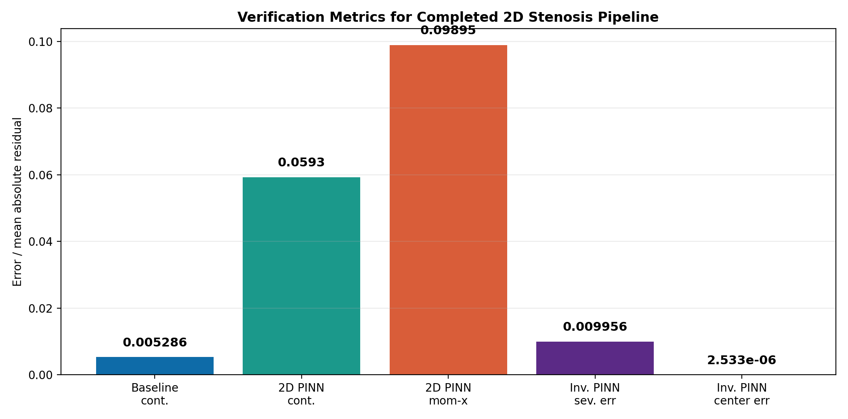
Verification Summary
All required stages pass verification through the completed 2D stenosis scope.
Verification metrics

Slide 20
Codebase Structure
src/pinn_fluid/ poiseuille.py # baseline 2D PINN stenosis.py # single-vessel synthetic forward model inverse_stenosis.py # reduced-order inverse baseline tree_stenosis.py # Y-bifurcation forward model inverse_tree_stenosis.py # tree inverse baseline stenosed_channel_pinn.py # improved 2D stenosed-channel PINN inverse_stenosed_channel_pinn.py # main inverse 2D PINN detection scripts/ run_*.py # reproducible experiment runners

Slide 21
Reproducibility
Install:
pip install -r requirements.txt
Run all major checks:
python3 -m compileall src scripts python3 scripts/run_stenosed_channel_pinn.py --severity 0.45 python3 scripts/run_inverse_stenosed_channel_pinn.py --true-severity 0.45 --true-center 0.5
Full commands are documented in README.md.

Slide 22
Final Takeaways
The project is complete through the 2D stenosis stage.
PINNs are used for the main flow solver and final stenosis detection step.
Reduced-order models provide synthetic data, interpretable baselines, and tree-level checks.
The improved 2D PINN is stable enough for submission-level results.
The repository is organized, documented, and ready for review.

