Slide 1


How data science is helping against corona virus
NAYYAN MUJADIYA

Slide 2
outline
Introduction
How machine learning is helping us ?
Indian Context
How You can contribute ?
Q&A
References

Slide 3
Introduction
Viral pandemics are a serious threat. COVID-2019 is not the first, and it won't be the last. E.g. spanish flu (1918)
We are collecting and sharing what we learn about the virus.
Hundreds of research team around the world are working on that.

Slide 4
How machine learning is helping us ?
Identify who is at risk
Diagnose or Screening patients
Develop drugs faster
Finding existing drugs that can help
Predicate the spread of the disease
Understand viruses better
Map where viruses come from
Predict the next pandemic
Educate people

Slide 5
Identify who is at risk
Infection risk: What is the risk of a specific individual or group getting COVID-2019?
Severity risk: What is the risk of a specific individual or group developing severe COVID-2019 symptoms or complications that would require hospitalization or intensive care?
Outcome risk: What is the risk that a specific treatment will be ineffective for a certain individual or group, and how likely are they to die?
Machine learning can potentially help predict all three risks.

Slide 6
Diagnose or Screening patients
Using face scans to identify symptoms, such as whether or not the patient has a fever
Using wearable technology such as smart watches to look for tell-tale patterns in a patient’s resting heart rate
Using machine learning-powered chatbots to screen patients based on self-reported symptoms. - Aarogya Setu
machine learning algorithm that can quickly and accurately detect COVID-2019, it will need to be robust enough to handle mutations.

Slide 7
Speeding up drug development
it’s critical to come up with a vaccine, a reliable diagnostic method, and a drug for treatment – fast.
It can take months to isolate even one viable vaccine candidate.
Machine learning can speed up this process significantly without sacrificing quality control.
In situations like the COVID-2019 pandemic, where a virus is spreading rapidly, getting more accurate scores faster is critical to speeding up drug development.

Slide 8
Identifying effective existing drugs
Pharma Companies need to be as sure as they possibly can that these drugs won’t have unexpected, harmful side effects.
One alternative is to repurpose drugs that have already been tested and used to treat other diseases. (hydroxychloroquine ?)
Machine learning can help us prioritize drug candidates much faster by automatically: Building knowledge graphs & Predicting interactions between drugs and viral proteins.
E.g. https://spike.covid-19.apps.allenai.org/search/covid19
Notes:
natural language processing (machine learning applied to text) to read and interpret a large number of scientific articles and build biomedical knowledge graphs, which are structured networks that meaningfully connect different entities, such as drugs and proteins).

Slide 9
Predicate the spread of the disease
We need to answer questions like “How many people are infected?” and “Where are these people?”
By interpreting the content of public interactions on social media, a machine learning model assesses the likelihood of novel virus contamination.
Google and Apple announce the Contact Tracing API

Slide 10
Understanding viruses through proteins
To understand a virus such as COVID-2019 is to understand its proteins
whether and how we get sick depends entirely on how these proteins interact with our bodies. It is difficult task.
machine learning can help improve our understanding of viruses by analyzing their proteins. - Protein-protein interactions & Predicating protein folding
Using artificial neural networks, research groups have successfully built models that can predict protein structures.

Slide 11
Figuring out how to attack the virus
Epitopes are clusters of amino acids found on the outside of a virus.
Antibodies bind to epitopes, which is how our immune system recognizes and eliminates the virus.
locating epitopes faster speeds up the process of developing effective vaccines.
This is where machine learning can help. Support vector machines (SVM), hidden Markov Models, and artificial neural networks (specifically deep learning) have all proven to be faster and more accurate at identifying epitopes.

Slide 12
Identifying hosts in the natural world
COVID-2019, originates in a different species (such as bats) and spreads to humans.
Using Machine learning, we can pinpoint the species that most likely acted as hosts for the disease.

Slide 13
Predicting the risk of new pandemics
Accurately predicting whether a strain of influenza is going to make a zoonotic leap (jumping from one species to another) can help doctors and medical professionals.
As one example, Influenza A exists primarily in the avian (bird) population, but it has the potential to jump to human hosts.

Slide 14
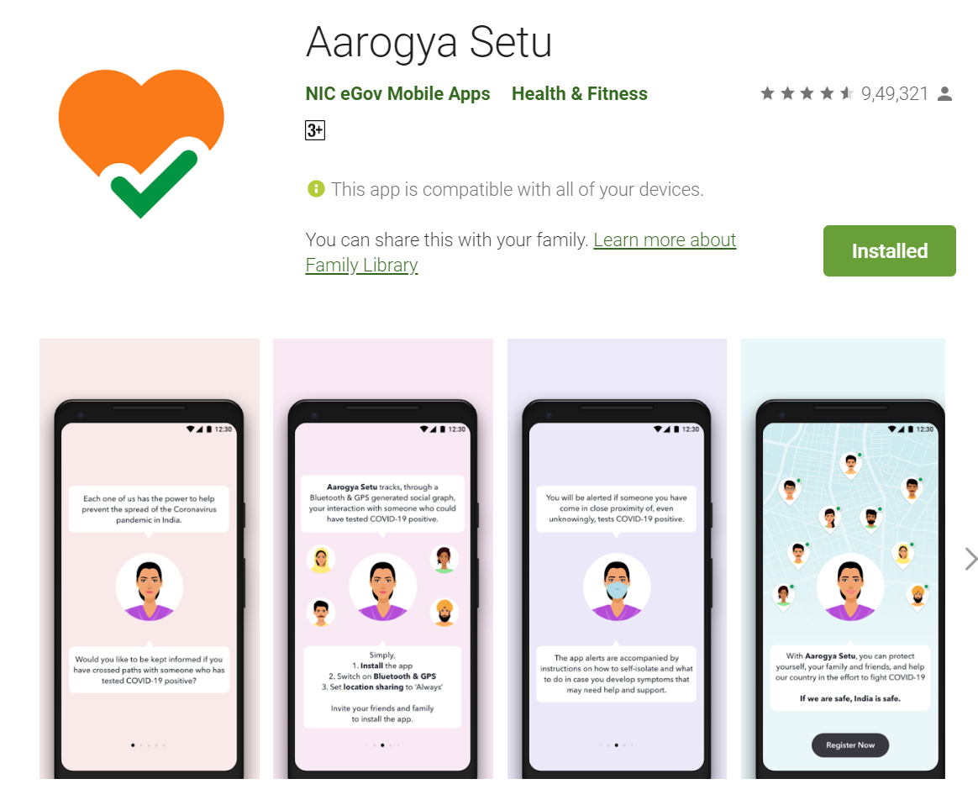
Indian Context / Educate people
Aarogya Setu
IIIT-Hyderabad

Slide 15
Conclusion
Machine learning is an important tool in fighting the current pandemic.
If we take this opportunity to collect data, pool our knowledge, and combine our skills, we can save many lives – both now and in the future.

Slide 16
How You can contribute ?
White House & Partners Launch COVID-19 AI Open Research Dataset Challenge on Kaggle.

Slide 17
Q&A
Stay Home , Stay Safe

Slide 18
References
https://www.datarevenue.com/en-blog/
Data Modelling & Analysing Coronavirus (COVID19) Spread using Data Science & Data Analytics in Python Code

Slide 19
Reach Me
@nayaneye
https://nayyanmujadiya.in/

