Slide 1

Python libraries for Machine Learning
NAYYAN MUJADIYA

Slide 2

My Intro
Masters from IIIT-Hyderabad
10+ Years of industry experience 6 Years of teaching experience
Conducted 60 + IoT/ML classes and workshops
Web: https://nayyanmujadiya.in/

Slide 3
Outline
Introduction to ML
Python Libraries
Hands-On
Q&A
References

Slide 4
What is Machine Learning?
Machine Learning is the science (and art) of programming computers so they can learn from data.
ML is the field of study that gives computers the ability to learn without being explicitly programmed.
A computer program is said to learn from experience E with respect to some task T and some performance measure P, if its performance on T, as measured by P, improves with experience E.
Are we machine or human?

Slide 5
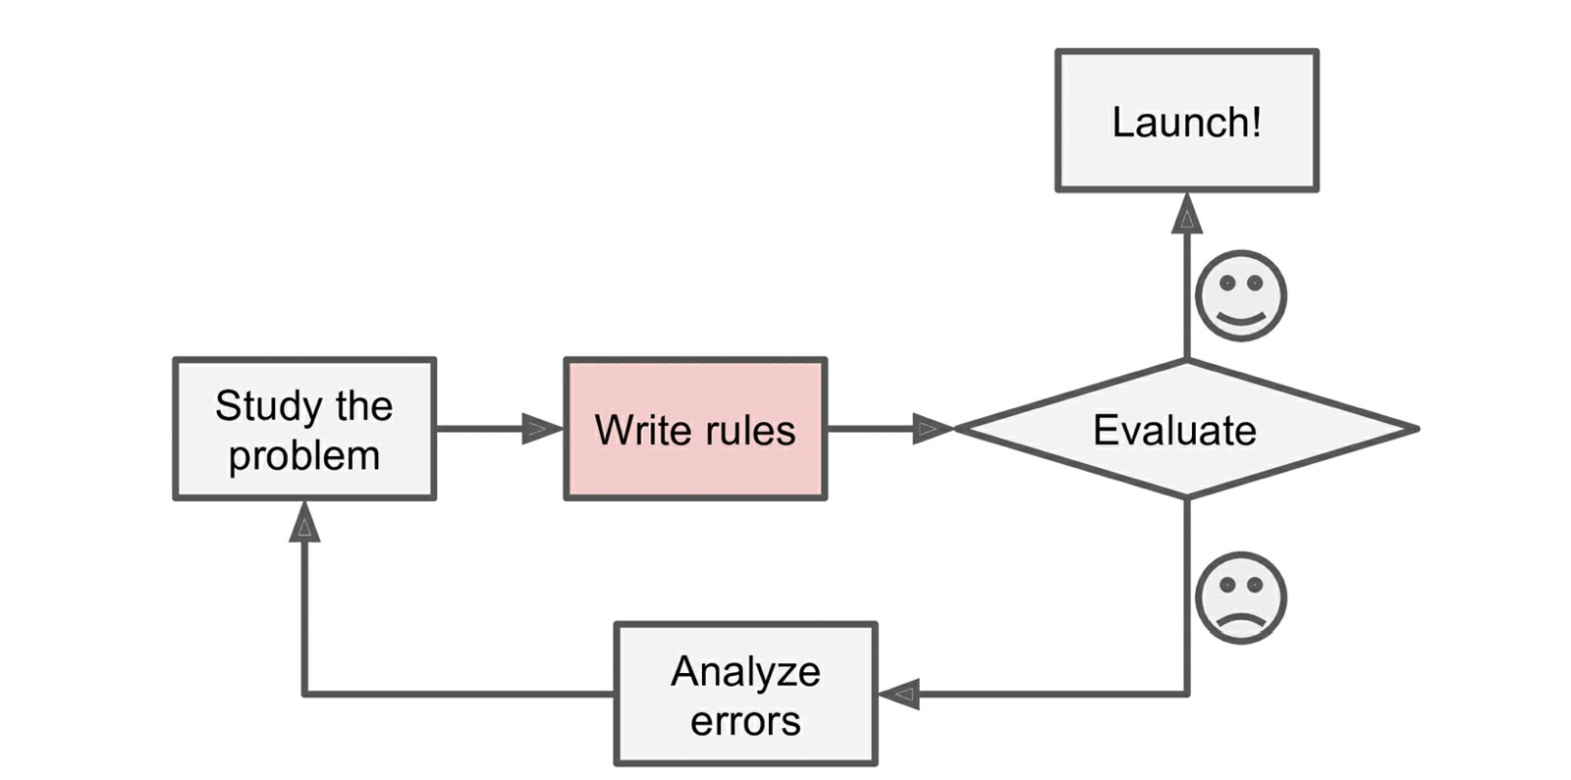
The Traditional approach

Slide 6
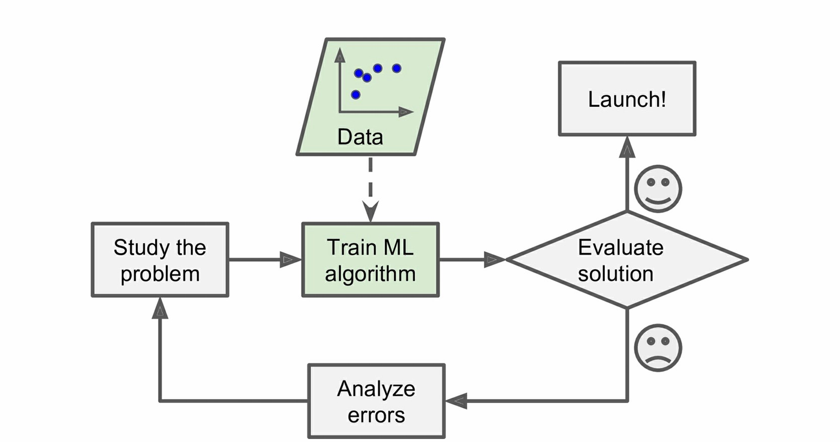
ML approach

Slide 7
libraries for Machine Learning
How many of you are using/writing sort function ?
Some libraries
Numpy
Scipy
Scikit-Learn
Theano
TensorFlow
Keras
Pytorch
Pandas
Matplotlib

Slide 8
Numpy
Very popular python library for large multi-dimensional array and matrix processing
Particularly useful for linear algebra, fourier transform, and random number capabilities.
TensorFlow uses NumPy internally for manipulation of Tensors.
Notes:
A tensor is just a machine that takes in some number of vectors and spits out some other vectors in a linear fashion. For example, the dot product can be viewed as a tensor that takes two vectors in and spits out a number. Tensors don't really have one interpretation to them.

Slide 9
SciPy
It contain different modules for optimization, linear algebra, integration and statistics.

Slide 10
Skikit-Learn
ML libraries for classical ML algorithms.
Build on top of NumPy and Scipy
It supports most of the supervised and unsupervised learning algorithms.
It is also, useful for data-mining and data analysis.

Slide 11
Theano
ML is basically mathematics and statistics.
It is used to define, evaluate and optimize mathematical expressions involving multi-dimensional arrays in an efficient manner.

Slide 12
TensorFlow
Very popular open-source library for high performance numerical computation developed by the Google Brain team in Google.
Tensorflow is a framework that involves defining and running computations involving tensors.
It can train and run deep neural network that can be used to develop several AI applications.
Tensorflow is widely used in the field of deep learning research and application.

Slide 13
Keras
t is a high-level neural networks API capable of running on top of TensorFlow, CNTK, or Theano. It can run seamlessly on both CPU and GPU.
Keras makes it really for ML beginners to build and design a Neural Network.
One of the best thing about Keras is that it allows for easy and fast prototyping.

Slide 14
Pytorch
PyTorch is a popular open-source Machine Learning library for Python based on Torch, which is an open-source Machine Learning library which is implemented in C with a wrapper in Lua.
It has an extensive choice of tools and libraries that supports on Computer Vision, Natural Language Processing(NLP) and many more ML programs.
It allows developers to perform computations on Tensors with GPU acceleration and also helps in creating computational graphs.

Slide 15
Pandas
Pandas is a popular Python library for data analysis. It is not directly related to Machine Learning.
As we know that the dataset must be prepared before training.
In this case, Pandas comes handy as it was developed specifically for data extraction and preparation.
It provides high-level data structures and wide variety tools for data analysis. It provides many inbuilt methods for groping, combining and filtering data.

Slide 16
Matplotlib
Matpoltlib is a very popular Python library for data visualization.
Like Pandas, it is not directly related to Machine Learning. It particularly comes in handy when a programmer wants to visualize the patterns in the data. It is a 2D plotting library used for creating 2D graphs and plots.
A module named pyplot makes it easy for programmers for plotting as it provides features to control line styles, font properties, formatting axes, etc. It provides various kinds of graphs and plots for data visualization, viz., histogram, error charts, bar chats, etc,

Slide 17
Thank You
Q&A

Slide 18
References
https://www.geeksforgeeks.org/best-python-libraries-for-machine-learning/
https://towardsdatascience.com/best-python-libraries-for-machine-learning-and-deep-learning-b0bd40c7e8c
https://www.upgrad.com/blog/top-python-libraries-for-machine-learning/
https://hackernoon.com/top-8-python-libraries-for-machine-learning-and-artificial-intelligence-y08id3031
https://stackabuse.com/the-best-machine-learning-libraries-in-python/

