Slide 1
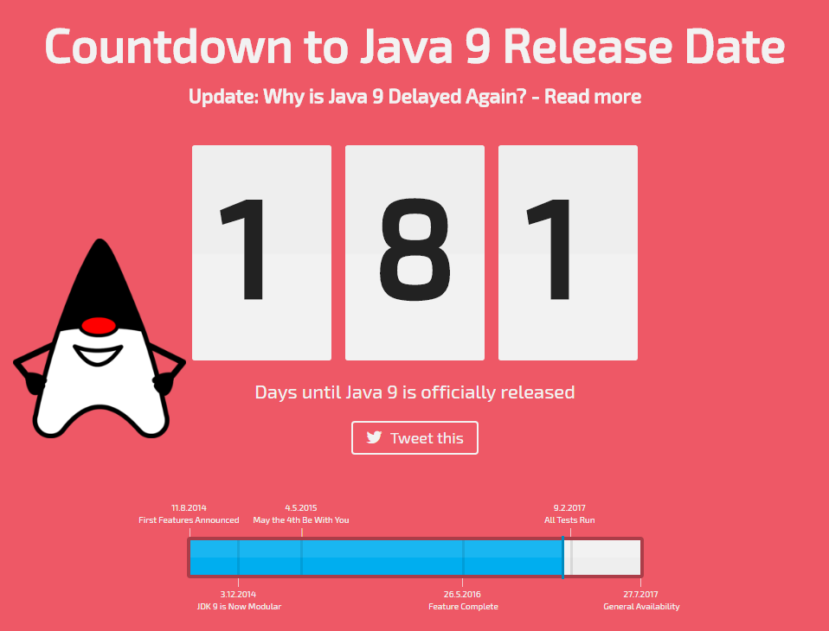
Introduction to Java 8
Lambdas, Streams and other cool stuff!
Notes:
Why learn Java8? Cause Java 9 is almost here :D

Slide 2

Java 8 History
Java is a general-purpose computer programming language that is concurrent, class-based, object-oriented,^{[14]} and specifically designed to have as few implementation dependencies as possible. It is intended to let application developers "write once, run anywhere" (WORA),^{[15]} meaning that compiled Java code can run on all platforms that support Java without the need for recompilation.^{[16]} Java applications are typically compiled to bytecode that can run on any Java virtual machine (JVM) regardless of computer architecture. As of 2016, Java is one of the most popular programming languages in use,^{[17][18][19][20]} particularly for client-server web applications, with a reported 9 million developers.^{[21]} Java was originally developed by James Gosling at Sun Microsystems (which has since been acquired by Oracle Corporation) and released in 1995 as a core component of Sun Microsystems' Java platform. The language derives much of its syntax from C and C++, but it has fewer low-level facilities than either of them.
The original and reference implementation Java compilers, virtual machines, and class libraries were originally released by Sun under proprietary licences. As of May 2007, in compliance with the specifications of the Java Community Process, Sun relicensed most of its Java technologies under the GNU General Public License. Others have also developed alternative implementations of these Sun technologies, such as the GNU Compiler for Java (bytecode compiler), GNU Classpath (standard libraries), and IcedTea-Web (browser plugin for applets).
The latest version is Java 8, which is the only version currently supported for free by Oracle, although earlier versions are supported both by Oracle and other companies on a commercial basis.
Notes:
You’re not meant to read this ☺

Slide 3
Lambdas
What is a Lambda Expression?
Functional Interfaces and how to create yours.
Lambda expression syntax examples.
Testing Lambdas
Simplifying exiting code using Lambdas
Method references

Slide 4
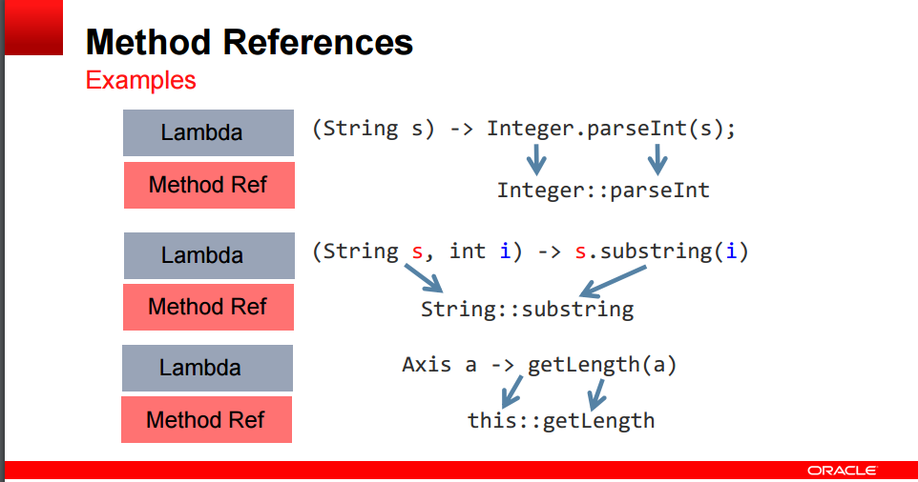
Format: target_reference::method_name
Three kinds of method reference
– Static method
– Instance method of an arbitrary type
– Instance method of an existing object

Slide 5
Streams
What is a Stream?
Serial vs Parallel Streams.
Lazy evaluation with Streams
Infinite Streams can produce elements “forever.”
JDK8 Stream sources and to create yours
Simplifying existing code using Streams
Debugging Streams

Slide 6
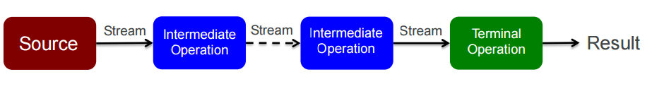
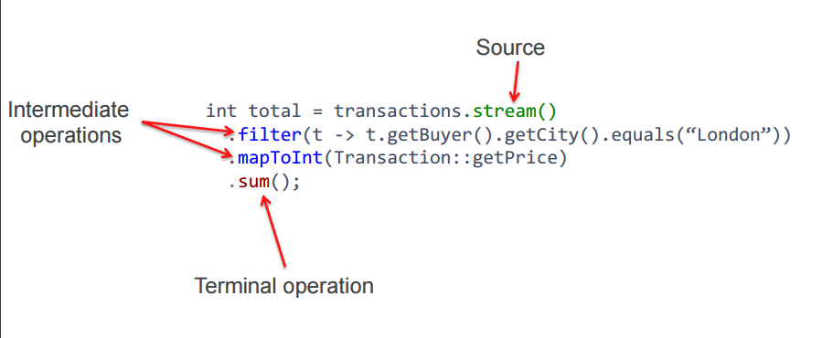
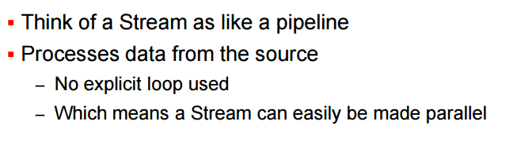
Stream Overview

Slide 7
Other Cool Stuff…
Optionals
Default methods in Interfaces
Good practices when using Lambdas and Streams

Slide 8


