Slide 1
Lecture 4
TIES445 Data mining
Nov-Dec 2007
Sami Äyrämö

Slide 2
Definitions for data mining
”Data mining is a step in the KDD process consisting of particular data mining algorithms that, under some acceptable computational efficiency limitations, produces a particular enumeration of patterns E_{j} over database F.”
”Data mining is the analysis of (often large) observational data sets to find unsuspected relationships an to summarize the data in novel ways that are both understandable and useful to the data owner.”
  Enumeration of patterns involves some form of search in the (often infinte) space of patterns
  Note that also global models are searched
  The computational efficiency constraints place several limits on the subspace that can be explored by the algorithm

Slide 3
Definition of Knowledge Discovery in Databases
”KDD Process is the process of using data mining methods (algorithms) to extract (identify) what is deemed knowledge according to the specifications of measures and thresholds, using database F along with any required preprocessing, subsampling, and transformation of F.”
”The nontrivial process of identifying valid, novel, potentially useful, and ultimately understandable patterns in data”
Goals (e.g., Fayyad et al. 1996):
  Verification of user’s hypothesis (this against the EDA principle…)
  Autonomous discovery of new patterns and models
  Prediction of future behavior of some entities
  Description of interesting patterns and models

Slide 4
KDD Process
In a multistep process many decisions are made by the user (domain expert):
Iterative and interactive – loops between any two steps are possible
Usually the most focus is on the DM step, but other steps are of considerable importance for the successful application of KDD in practice

Slide 5
KDD versus DM
DM is a component of the KDD process that is mainly concerned with means by which patterns and models are extracted and enumerated from the data
  DM is quite technical
Knowledge discovery involves evaluation and interpretation of the patterns and models to make the decision of what constitutes knowledge and what does not
  KDD requires a lot of domain understanding
It also includes, e.g., the choice of encoding schemes, preprocessing, sampling, and projections of the data prior to the data mining step
The DM and KDD are often used interghangebly
Perhaps DM is a more common term in business world, and KDD in academic world

Slide 6
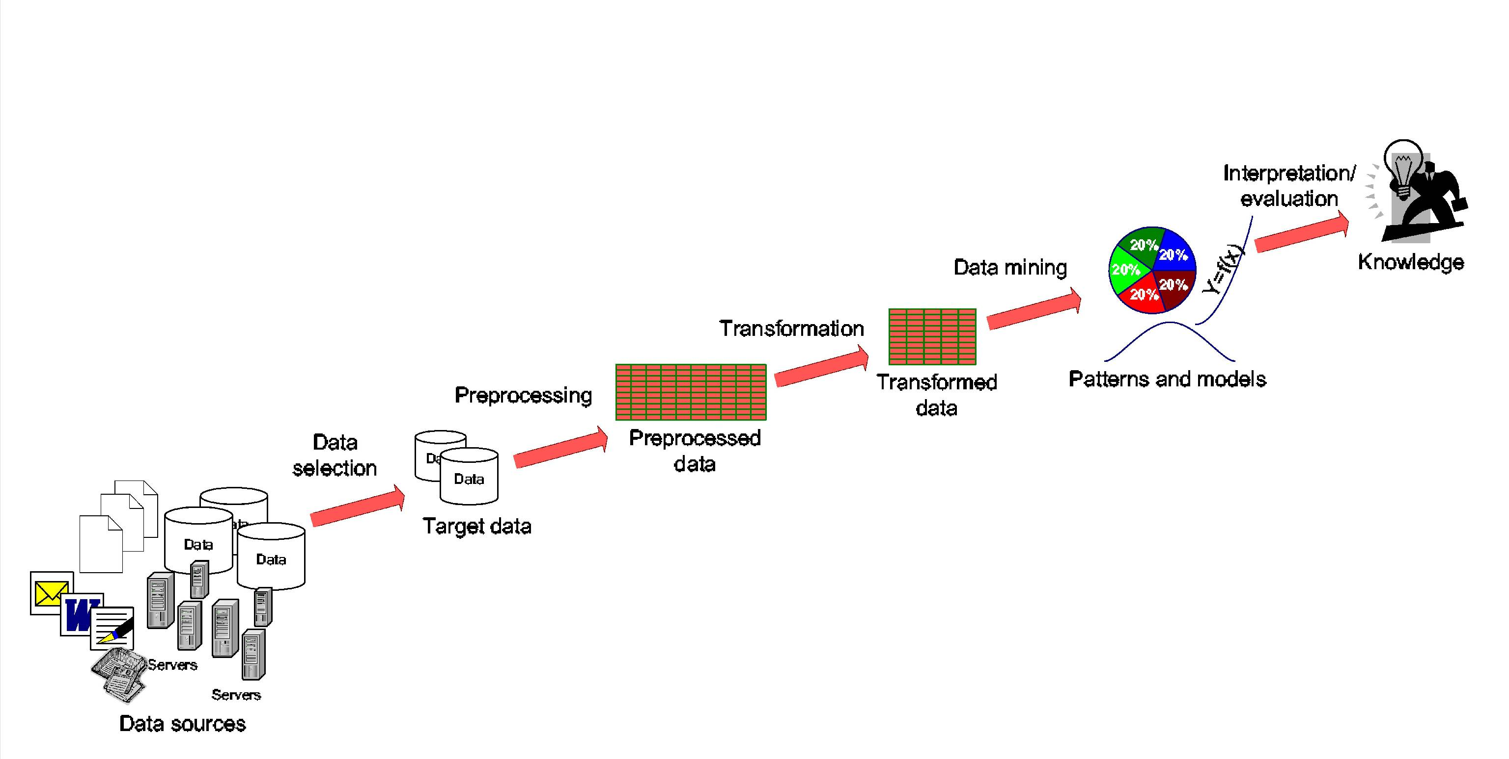
The main steps of the KDD process

Slide 7
Refined steps of KDD Process
Domain understanding and goal setting
Creating a target data set
Data cleaning and preprocessing
Data reduction and projection
Data mining
  Choosing the data mining task
  Choosing the data mining algorithm(s)
  Use of data mining algorithms
Interpretation of mined patterns
Utilization of discovered knowledge

Slide 8
1. Domain analysis
Development of domain understanding
Discovery of relevant prior knowledge
Definition of the goal of the knowledge discovery
In the applied research projects at JYU this step has been supported by so-called genre-based domain analysis
  Assists to recognize the most important information sources and their current owners
    Including related metadata such as data amounts, formats, and users
  Examines information communicated by capturing all information flows including
    Verbal communication
    IT systems
    Paper and eletronic documentation
  Maps different data sources
  As a result, perhaps the most interesting non-digital information can be digitized prior to the actual KDD activities
  Public defence of PhD thesis: Turo Kilpeläinen, December, 2007!!

Slide 9
2. Data selection
Selection and integration of the target data from possibly many different and heterogeneous sources
Interesting data may exist, e.g., in relational databases, document collections, e-mails, photographs, video clips, process database, customer transaction database, web logs etc.
Focus on the correct subset of variables and data samples
  E.g., customer behavior in a certain country, relationship between items purchased and customer income and age
Possibly interesting non-electronic sources (”indirectly- or non-mineable” data) should be concerned
  For example, faxes, letters, video tapes, can be of interest and their digitizing can be considered
  cf. the genre-based analysis of the application domain

Slide 10
3. Data cleaning and preprocessing
Today’s datasets are incomplete (missing attribute values), noisy (errors and outliers), and inconsistent (discrepanciens in the collected data)
Dirty data can confuse the mining procedures and lead to unreliable and invalid outputs
Complex analysis and mining on a huge amount of data may take a very long time
Preprocessing and cleaning should improve the quality of data and mining results by enhancing the actual mining process
The actions to be taken includes
  Removal of noise or outliers
  Collecting necessary information to model or account for noise
  Using prior domain knowledge to remove the inconsistencies and duplicates from the data
  Choice or usage of strategies for handling missing data fields

Slide 11
4. Data reduction and projection
Finding useful features to represent the data depending on the goal of the task
  Data becomes more appropriate for mining
  For example, in high-dimensional spaces (the large number of attributes) the distances between objects may become meaningless
  Dimensionality reduction and transformation methods reduce the effective number of variables under consideration or find invariant representations for the data
Data transformation techniques
  Smoothing (binning, clustering, regression etc.)
  Aggregation (use of summary operations (e.g., averaging) on data)
  Generalization (primitive data objects can be replaced by higher-level concepts)
  Normalization (min-max-scaling, z-score)
  Feature construction from the existing attributes (PCA, MDS)
Data reduction techniques are applied to produce reduced representation of the data (smaller volume that closely maintains the integrity of the original data)
  Aggregation
  Dimension reduction (Attribute subset selection, PCA, MDS,…)
  Compression (e.g., wavelets, PCA, clustering,…)
  Numerosity reduction
    parametric models: regression and log-linear models
    non-parametric models: histograms, clustering, sampling…
  Discretization (e.g., binning, histograms,cluster analysis,…)
  Concept hierarchy generation (numeric value of ”age” to a higher level concept ”young, middle-aged, senior”)

Slide 12
5. Choice of data mining task
Define the task for data mining
  Exploration/summarization
    Summarizing statistics (mean, median, mode, std,..)
    Class/concept description
    Explorative data analysis
      Graphical techniques, low-dimensional plots,…
  Predictive
    Classification or regression
  Descriptive
    Cluster analysis, dependency modelling, change and outlier detection
  Mining of associations, rules and sequential patterns

Slide 13
6. Choosing the DM algorithm(s)
Select the most appropriate methods to be used for the model and pattern search
Includes also the decisions about the appropriate models, patterns, parameters, and score functions (aka evaluation criteria)
  A cluster model or probabilistic mixture model?
  Prototype or dendogram representation of the cluster patterns?
  K-means (fast) or K-medoid (robust) algorithm?
  Parameters of chosen algorithm (e.g., number of clusters)?
Matching the chosen method with the overall goal of the KDD process (necessites communication between the end user and method specialists)
Note that this step requires understanding in many fields, such as computer science, statistics, machine learning, optimization, etc.

Slide 14
7. Use of data mining algorithms
Application of the chosen DM algorithms to the target data set
Search for the patterns and models of interest in a particular representational form or a set of such representations
  Classification rules or trees, regression models, clusters, mixture models…
Should be relatively automatic
Generally DM involves:
  Establish the structural form (model/pattern) one is interested
  Estimate the parameters from the available data
  Interprete the fitted models

Slide 15
8. Interpretation/evaluation
The mined patterns and models are interpreted
  Patterns are local structures that makes statements only about restricted regions of the space spanned by the variables, e.g., P(Y>y₁|X>x₁)=p₁
    Anomaly detection applications: fault detection in industrial process or fraud detection in banking
  Models are global structures that makes statements about any point in measurement space, e.g., Y = aX+b (linear model)
    Models can assign a point to a cluster or predict the value of some other variable
The results should be presented in understandable form
Visualization techniques are important for making the results useful – mathematical models or text type descriptions may be difficult for domain experts
Possible return to any of the previous step

Slide 16
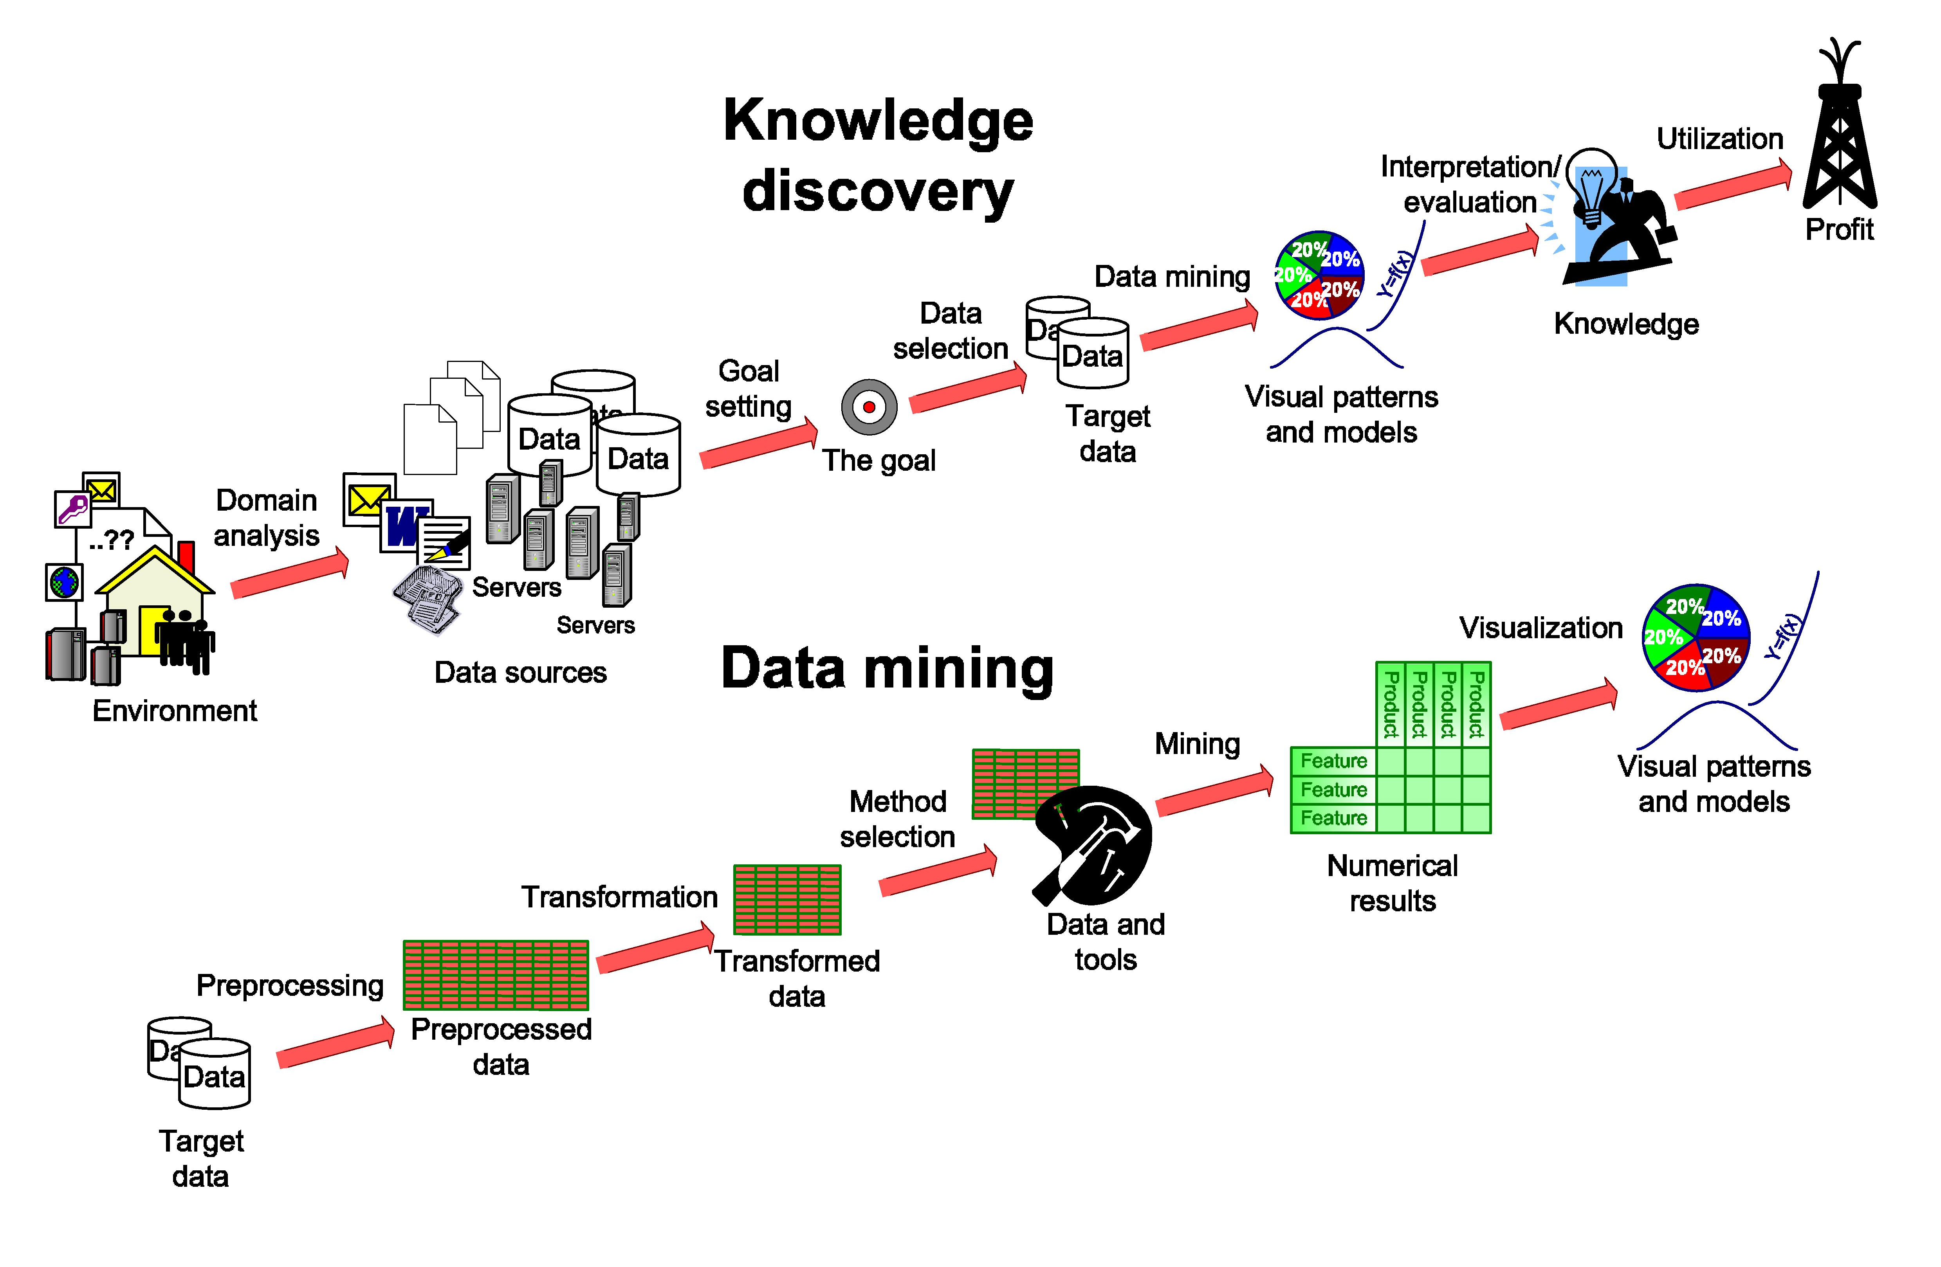
Knowledge Mining (KM) process

