Slide 1
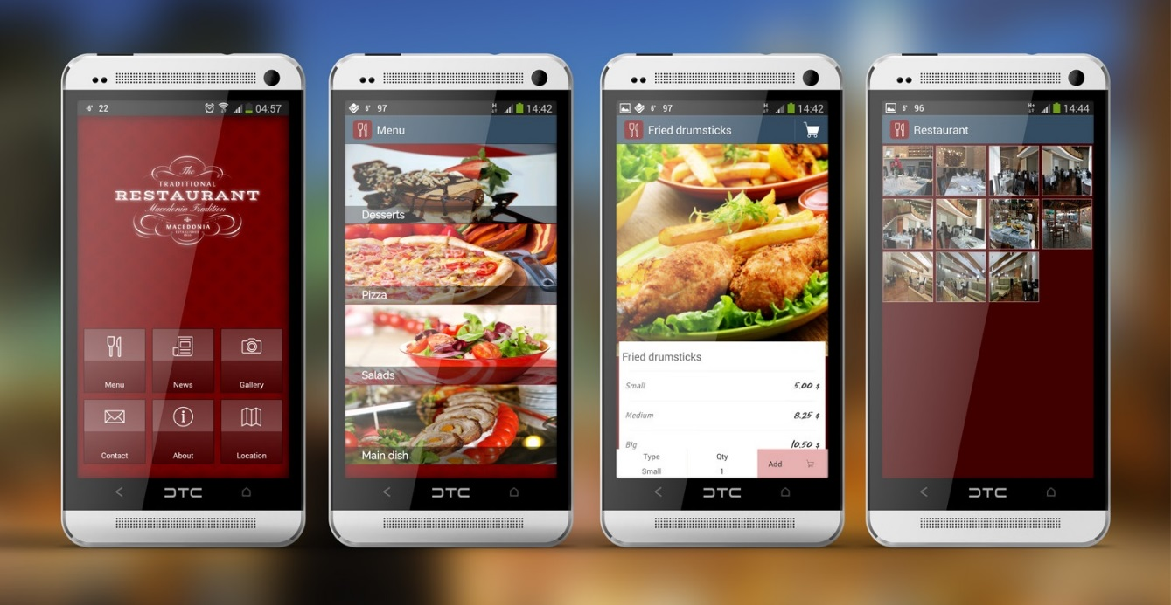
Mobile Website for Restaurant
Imaging that you are using this for a restaurant to check menu
Use some assets from some restaurant that may purchase your solution
Database support is NOT a must (better to have it)

Slide 2

How to make the app
Design the function and page
Develop all the html pages first without worrying about navigations
Work on the navigations
Work on the CSS theme and polish the app

