Slide 1
BUILT ON STELLAR
Kredito.
Decentralized Microfinance
for the Underbanked
Blockchain-Powered Credit Passport
Presented by Tirso Benedict Naza

Slide 2
THE PROBLEM
Financial Access in the Philippines Is Still Broken
44%+
₱300B+
5–10×
of Filipinos
underbanked
informal lending
market (PH)
higher rates from
loan sharks
Why people stay unbanked:
Traditional banks require formal credit history — most Filipinos have none
Small vendors, freelancers, and gig workers are excluded from fair loan access
High-interest informal lending traps vulnerable borrowers in debt cycles
Financial systems ignore users without traditional banking relationships

Slide 3




THE SOLUTION
Kredito: A Portable On-Chain
Credit Identity
"Financial access should not require
traditional banking privilege."
Credit Passport
Borrow XLM
On-chain identity built from real transaction behavior, not bank records
Instant loan disbursement to your Stellar wallet based on your tier
Build Reputation
Stake & Earn
Repay on time → score improves → unlock higher limits and lower fees
Lenders, NGOs, and DAOs fund the pool and earn yield from loan fees

Slide 4
MARKET OPPORTUNITY
A Massive Underserved Market
Global Microfinance
$300B+
Worldwide unbanked population: 1.4B
Southeast Asia Fintech
$38B
Digital lending market by 2025, growing 25% YoY
Philippines Underbanked
$2.4B
50M+ unbanked Filipinos × avg. micro-loan need
Kredito targets early adopters in the Philippines with a proven product before expanding across SE Asia.

Slide 5
ARCHITECTURE
How Kredito Works
SEP-10 Auth · Horizon API · Stellar SDK
User
Wallet
Next.js
Frontend
Express
Backend API
Soroban
Smart Contracts
Stellar
Mainnet
→
→
→
→
credit_registry
lending_pool
Stores borrower reputation
Score tiers (Bronze → Diamond)
Repayment behavior history
KYC verification status
Handles borrow & repayment
Manages staking liquidity
Distributes fee rewards
Enforces tier-based limits

Slide 6
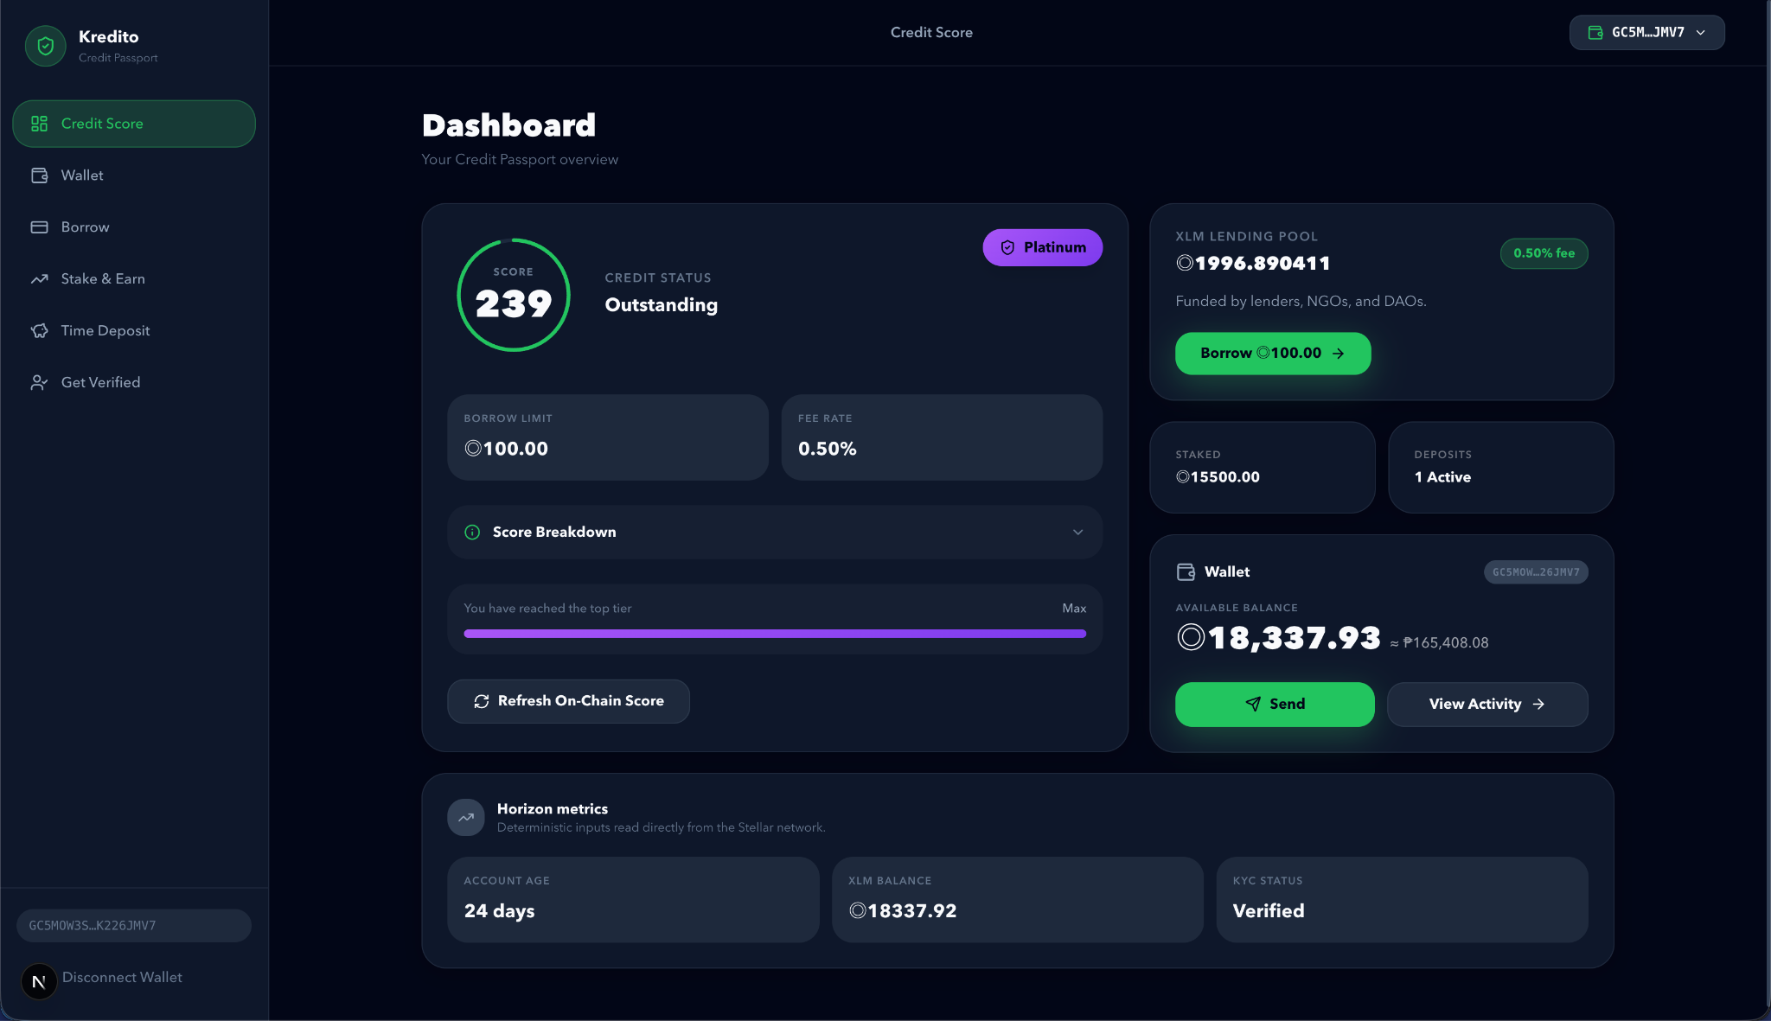
PRODUCT
Live Product — Credit Passport Dashboard
On-Chain Score
Score built from real Stellar transaction history — not bank records
Credit Tiers
Bronze → Silver → Gold → Platinum → Diamond, each unlocking higher limits
Instant Limits
Borrow limit and fee rate enforced directly via smart contract
KYC Boost
Verified identity unlocks Diamond tier — highest limits, lowest fees

Slide 7
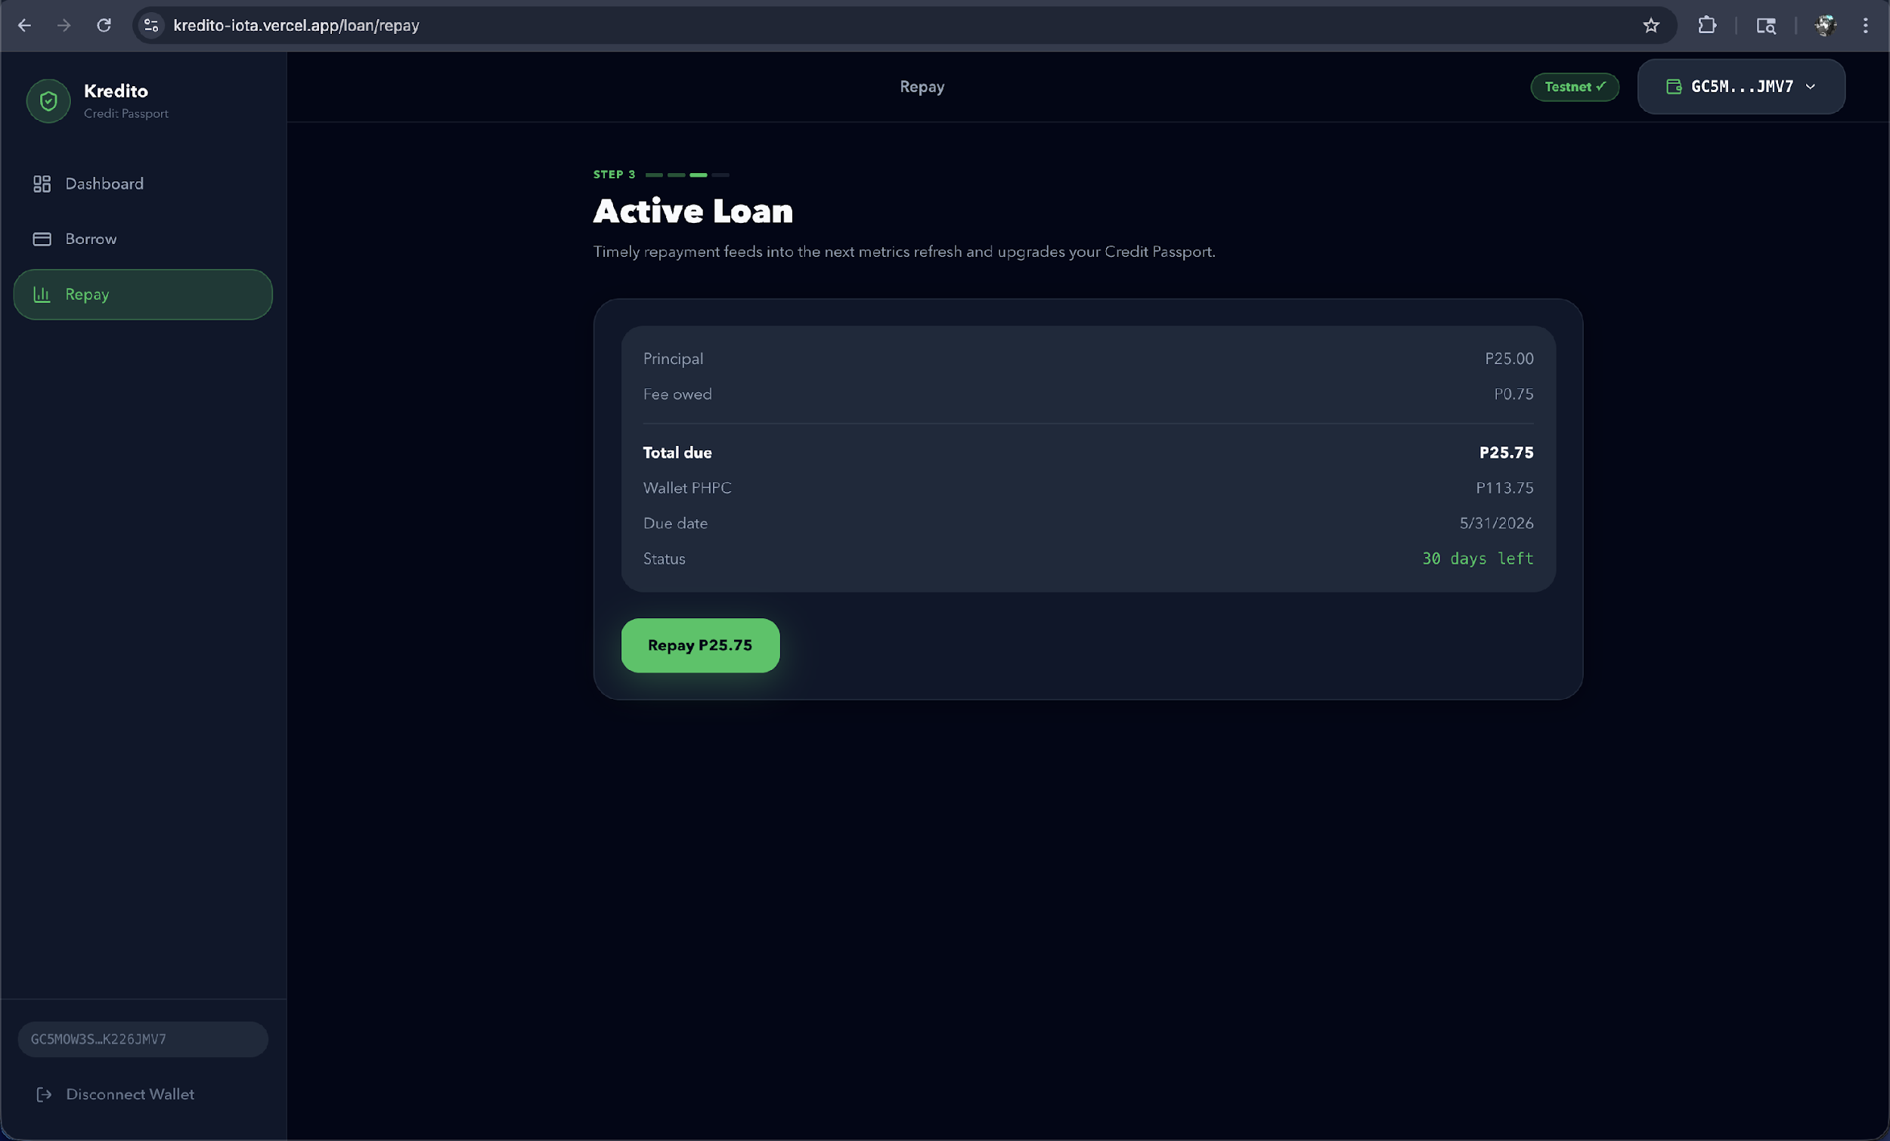
PRODUCT
End-to-End Lending Flow
1
Borrow — tier-gated eligibility enforced on-chain
2
Review & Confirm — transparent fee breakdown
3
Funds Released — instant disbursement to wallet
4
Repaid on Time — score updates, tier may advance
1.50% flat fee · 30-day term · No principal deduction

Slide 8
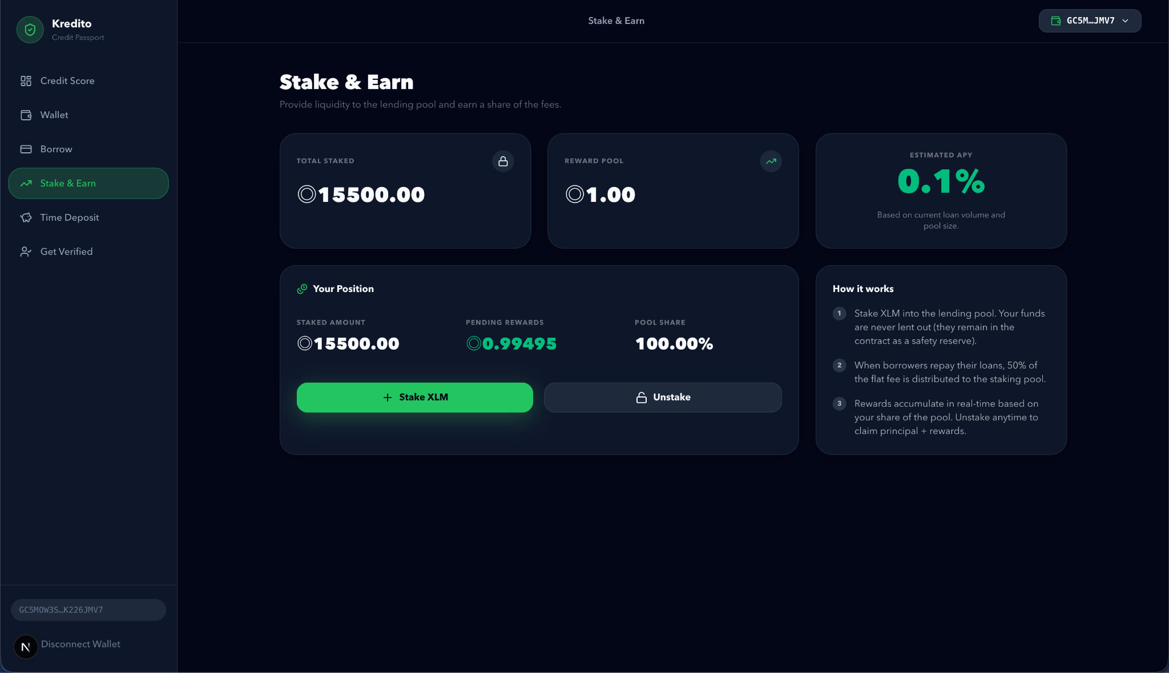
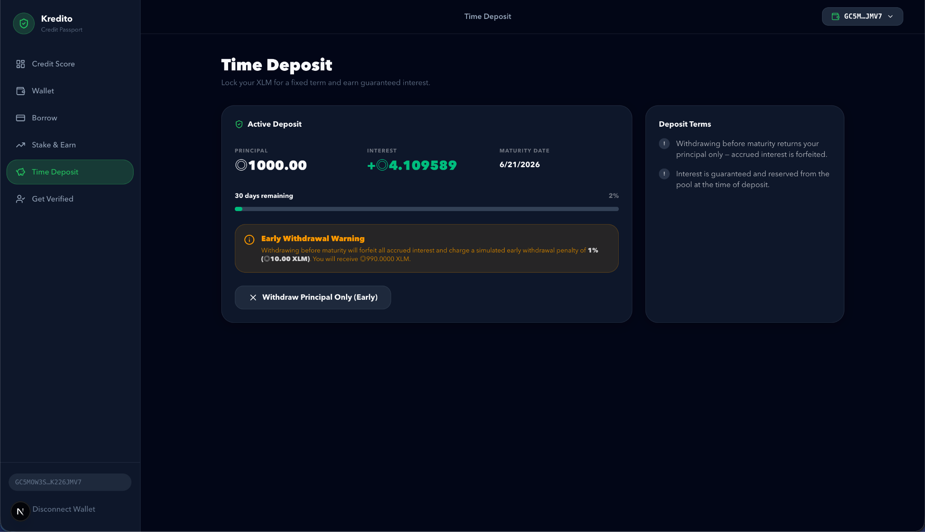
PRODUCT
For Lenders & Savers — Stake, Earn, Deposit
Stake & Earn
Time Deposit & KYC Verification
Stake XLM into the lending pool · Earn 50% of all loan fees · Unstake anytime
Lock XLM for fixed term · Guaranteed interest reserved at deposit · KYC unlocks Diamond tier

Slide 9



BUSINESS MODEL
How Kredito Makes Money
1.50%
50%
~1%
Loan Origination Fee
Protocol Fee Share
Time Deposit Spread
Flat fee collected on repayment (not deducted from principal). Scales with loan volume.
50% of all loan fees go to the staking pool (lenders/NGOs/DAOs). 50% retained as protocol revenue.
Guaranteed interest offered to depositors is funded by pool yield; spread is protocol income.
Unit Economics Example
100 borrowers × avg. 20 XLM × 1.50% fee = 30 XLM/cycle · 50% to stakers · 50% protocol revenue · Scales with user growth and higher tier adoption.

Slide 10


TRACTION
What's Been Built
Full Next.js + Express stack deployed
Time Deposit with maturity enforcement + early withdrawal
Soroban smart contracts: credit_registry + lending_pool
KYC verification (Diamond tier unlock)
SEP-10 wallet authentication (Freighter/Lobstr support)
Mainnet deployment & security audit
Credit scoring engine (Horizon API + on-chain data)
GCash on-ramp integration
Borrow / Repay flow with instant XLM disbursement
Public beta launch (PH)
Stake & Earn with real-time reward accumulation
✅ Fully functional on Stellar Testnet and Mainnet

Slide 11





TECHNOLOGY
Why We Built on Stellar
~5 sec
< $0.001
120M+
Fast Finality
Extremely Low Fees
Financial Inclusion
Transactions settle in seconds — critical for real-world loan disbursement.
Accessible even for micro-transactions in emerging markets.
Stellar's mission directly aligns: built for underserved communities.
WASM
SEP-10
1,000 TPS
Soroban Smart Contracts
SEP Standards
Scalable Infrastructure
Programmable, auditable contracts for trustless credit logic.
Wallet interoperability with Freighter, Lobstr, and others out of the box.
Production-ready for mass adoption without congestion.

Slide 12

TEAM
The Team Behind Kredito
Mission-Driven Development
TBN
Kredito was built because the problem is real and personal — financial exclusion affects millions of Filipinos every day.
Every design decision — from on-chain credit identity to transparent fee structures — was made to protect borrowers, not extract from them.
Tirso Benedict Naza
Founder & Full-Stack Developer
Next.js · Node.js · Stellar/Soroban
Designed and built the full Kredito platform
Blockchain microfinance architecture
Actively seeking co-founders, advisors, and Stellar ecosystem partners.

Slide 13
ROADMAP
The Path to Scale
Phase 1
Phase 2
Phase 3
Now → Q3 2026
Q4 2026 → Q1 2027
2027+
Security audit & mainnet deployment
Philippines beta launch
50 early adopter borrowers
NGO/DAO lender onboarding
GCash on-ramp integration
Alternative Credit Identity sharing
Merchant payment pilot
500 active borrowers
Southeast Asia expansion
Stablecoin lending (USDC)
B2B API for NGOs/cooperatives
10,000+ credit passport holders

Slide 14



THE ASK
What We're Seeking from Stellar
Stellar Community Fund (SCF)
Grant Application
Use of Funds
Smart contract audit (40%)
Infrastructure & hosting (25%)
Legal & compliance PH (20%)
Marketing / community (15%)
Seeking grant funding to complete security audit,
mainnet deployment, and Philippines beta launch.
What This Delivers for the Stellar Ecosystem:
Real-world Soroban adoption — actual loan and credit transactions on-chain
Financial inclusion impact in Southeast Asia's largest unbanked market
NGO and DAO liquidity partners integrating XLM-native lending pools
Open-source credit infrastructure other Stellar builders can extend

Slide 15
“
Kredito transforms blockchain
from speculation into accessible
financial infrastructure.
— Kredito · Built on Stellar · 2026
Let's Build Together →

Slide 16
BUILT ON STELLAR
Thank You.
Tirso Benedict Naza
Founder, Kredito
GitHub
Email
Web
https://github.com/nazakun021/kredito
benedictnaza@gmail.com
kredito-iota.vercel.app
Kredito · Decentralized Microfinance on Stellar · Philippines

