Slide 1
Aptamer-Based Detection of Enteric Viruses in Faecal Samples: A Novel Platform to Assess the Viral Risk of Faecal Microbiota Transplants
Nazanin KHAZALI
PhD student
Supervisor: Dr. Leslie OGORZALY
Notes:
[0:20]
Good morning. My name is Nazanin.
I work on faecal microbiota transplantation, or FMT. In FMT we take stool from a healthy donor and give it to a patient.
My question today is simple. The donor is screened. But is the donation we use today really safe?

Slide 2
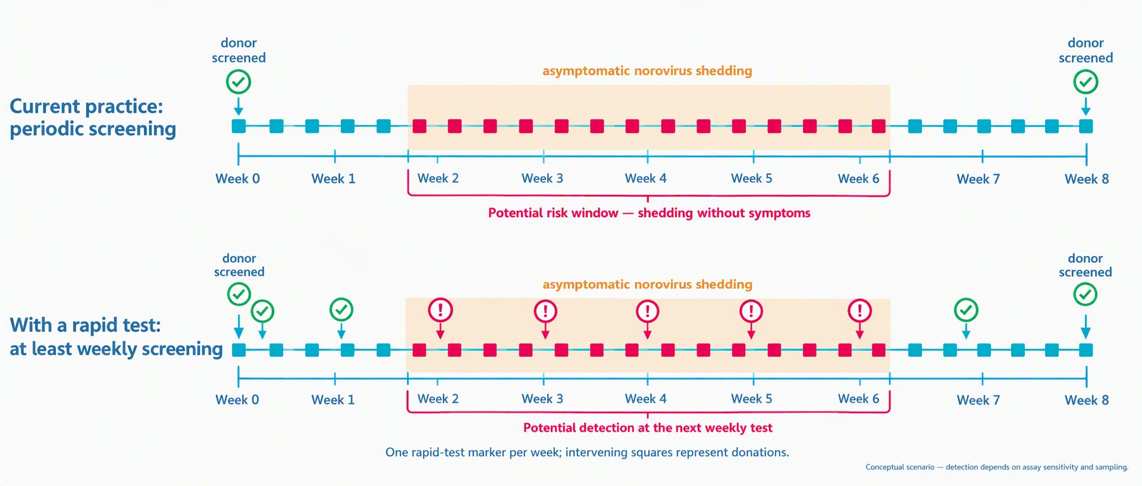
Why we need a rapid test?
Notes:
[0:55]
This is how donors are screened now.
We test them at the start of a donation period, and again at the end. Between these two tests, nothing is checked.
Now look at the red zone. A donor can catch norovirus, shed it for several days, and recover — all inside that window. And very often there are no symptoms at all.
So the donations made during this period go to patients without being tested.
If instead we test at every donation — that is the lower line — we find the problem in days, not in weeks. This is the gap I want to close.

Slide 3
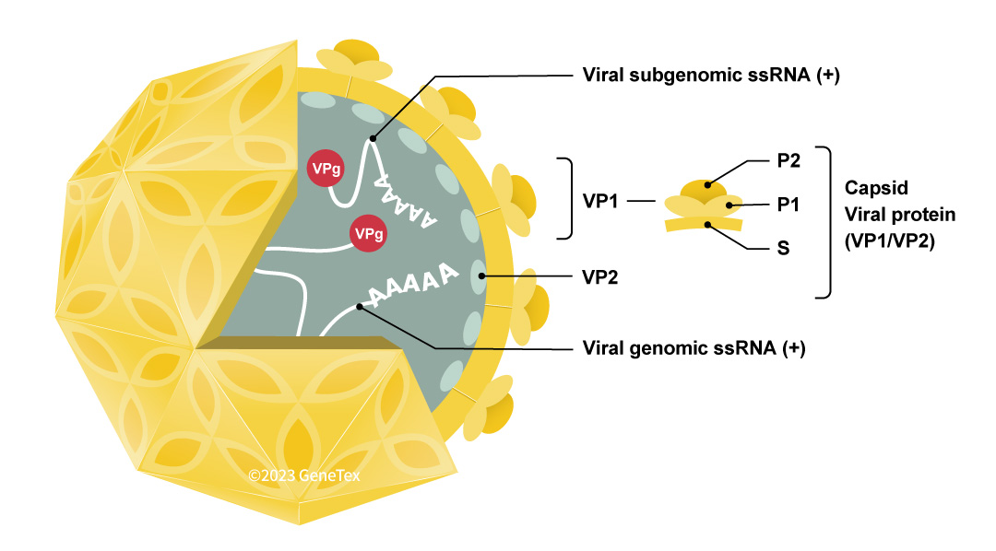
Why norovirus?
Global leading cause
of acute gastroenteritis across all age groups
Outbreak hotspots
hospitals, care homes, schools, cruise ships, military & food industry
Extremely low infectious dose
as few as ~18 viral particles can cause infection
Massive viral shedding
billions of copies per gram of stool
Notes:
[0:40]
Why norovirus? Four reasons.
It is the leading cause of acute gastroenteritis in the world.
It spreads very easily in hospitals and care homes — exactly where FMT patients are.
The infectious dose is extremely low. About eighteen virus particles are enough.
And an infected person sheds billions of copies per gram of stool.
So even a small contamination is a real risk — especially for FMT patients, who are often elderly or immunocompromised.

Slide 4
Three work packages
WP1
WP2
WP3
How much does the viral picture change across the interval?
How do our aptamers recognise the virus — in buffer and in stool?
Can that recognition become a visible line on a strip?
how large is the gap
the recognition
the test
Notes:
[0:25]
My project has three work packages.
Work package one measures the real viral risk in healthy donors.
Work package two finds a molecule that can recognise the virus in stool.
Work package three turns that molecule into a rapid test.
Today I will focus mostly on work package two, because this is where I am now.

Slide 5
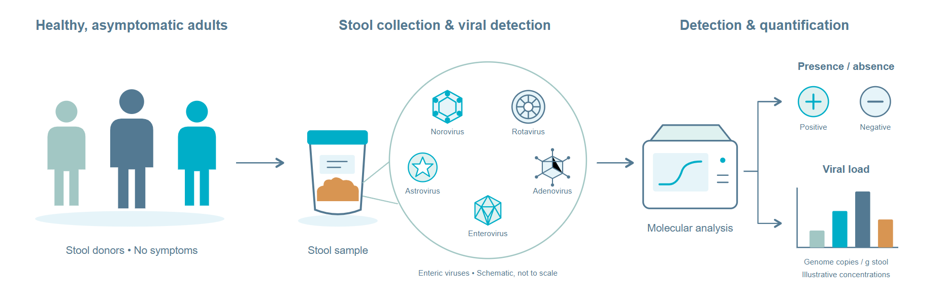
Work package 1: How much does the viral picture change across the interval?
Notes:
[0:40]
In work package one, we follow healthy adults who have no symptoms.
We collect their stool, and we look for enteric viruses. We do not only ask if the virus is there. We also measure how much.
This gives me two things. First, the real level of risk in healthy donors. Second, naturally positive samples that I can use later to test my assay.
Without these numbers, I cannot know how sensitive my test needs to be.

Slide 6
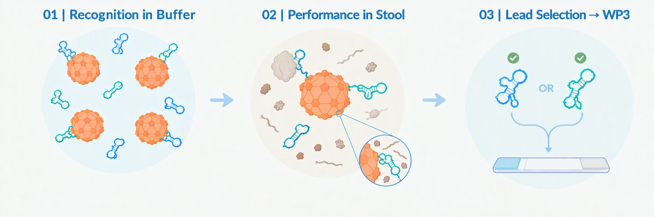
How do our aptamers recognise the virus — in buffer and in stool?
Notes:
[0:35]
Work package two has three steps.
First, I check if my aptamers recognise the virus in a clean buffer.
Second, I test them in stool, which is a much more difficult sample.
Third, I select the best one and pass it to work package three.
One word about aptamers. An aptamer is a short DNA strand. It folds into a shape, and this shape binds the target — like an antibody, but chemical.

Slide 7






Which aptamer to choose? Four selection strategies
How the candidate aptamers were generated — my panel deliberately spans all four
Recombinant P-domain
1
Whole VP1 capsid protein
2
The most antigenically variable part of the capsid — easy to express & purify as a target
His-tagged full capsid — the aptamer sees the entire fold, including the conserved S-domain
M1
M6-2
Buf-2
Beier
broadest genotype reactivity
Whole virus from stool
3
Parallel SELEX + redesign
4
Selected on real stool particles — the most clinically realistic context in the literature, no recombinant stand-in
Two genotypes selected at once, then winning sequences computationally re-engineered
SMV-series
SMV25
AP4-2
AP17-4
AP4-11
Selex against the whole extracted human norovirus
Notes:
[0:55]
These aptamers already exist in the literature. But they were not made in the same way. There are four strategies.
In the first, the aptamer was selected against the P-domain — the most variable part of the virus shell.
In the second, against the whole capsid protein. So the aptamer also sees the conserved part.
In the third, against whole virus taken directly from stool. This is the most realistic situation.
And in the fourth, two genotypes were used at the same time, and the best sequences were then redesigned by computer.
My panel covers all four approaches on purpose. This is a strength. But as you will see, it is also a problem.

Slide 8
Six candidate with sequences
# | Name | Sequence (5′→3′) | Length
1 | Beier | GTCTGTAGTAGGGAGGATGGTCCGGGGCCCCGAGACGACGTTATCAGGC | 49 nt
2a | SMV25 (FL) | AGTATACGTATTACCTGCAGCCATCTGTGTGAAGACTATATGGCGCTCACATATTTCTTTCCGATATCTCGGAGATCTTGC | 81 nt
2b | SMV25 (VR) | CATCTGTGTGAAGACTATATGGCGCTCACATATTTCTTTCC | 40 nt
3 | AP4-11 | AACACGACCCACGTACCTGTGCGAGACACAGACCACCAAGGTGGGC | 46 nt
4 | AP17-4 | GGAACACGACCCGTCTGTGGCCATCACAGTACAGCATCGTCGTG | 44 nt
5 | Buf-2 | GAAATTGGGTTCGGGTTTGGGTTGGGATTACTTAGCGATG | 40 nt
6a | M6-2 (FL) | AGTATACGTATTACCTGCAGCTGGGAAGAGGTCCGGTAAATGCAGGGTCAGCCCGGAGAGCGATATCTCGGAGATCTTGC | 80 nt
6b | M6-2 (VR) | TGGGAAGAGGTCCGGTAAATGCAGGGTCAGCCCGGAGAG | 39 nt
Notes:
[0:25]
These are my six candidates, with their sequences.
They are between forty and ninety nucleotides long. Some of them exist in two versions, a full length and a shorter one.
All of them are ordered with the same modification, so I can use them in the same assay format.

Slide 9
Result of the elasa experiments
Notes:
[0:45]
[BLANK SLIDE — add your ELASA figure, then adapt this script.]
Here are my first results, from the ELASA assay.
Each bar is the signal of one aptamer against its target, divided by the background. Each value is the average of three independent experiments.
[Say what the figure shows — for example: these two aptamers give a clear signal; this one does not bind above background.]
What I want you to remember is [your main message].
And these are measurements in buffer. In clean, controlled conditions.

Slide 10
Why comparing is difficult?
Notes:
[0:50]
[BLANK SLIDE — one figure would help here: six numbers that look rankable, and the conditions hiding behind them.]
Now the difficult part.
I would like to simply rank these six aptamers, and choose the best one. But I cannot.
Each one comes from a different laboratory, with a different buffer, a different target, and a different measurement method.
And an aptamer is not a rigid object. It is flexible. It changes its shape with the salt, the magnesium and the pH around it.
So the number I measure does not belong only to the sequence. It belongs to the sequence and to its solution, together.
Comparing published values is comparing apples and oranges.

Slide 11
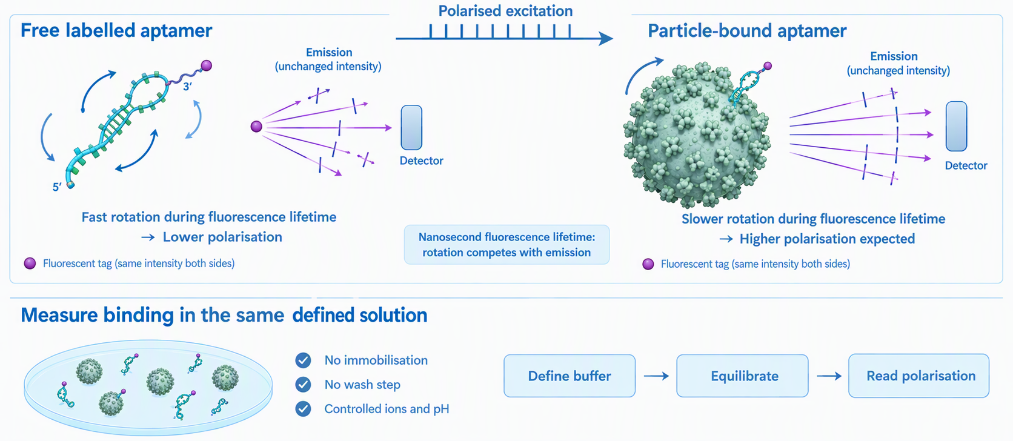
Fluorscence polarization
Notes:
[0:50]
This is my answer: fluorescence polarisation.
I put a small fluorescent tag on the aptamer, and I excite it with polarised light.
When the aptamer is free, it is small and it rotates very fast. The light we collect is scrambled, so the polarisation is low.
When it binds the virus particle, it becomes big and slow. The light keeps its direction, so the polarisation is high. This rise is my binding signal.
The important point is at the bottom of the slide. Everything happens in solution. Nothing is fixed on a surface. There is no washing step. And I control the ions and the pH myself.
So I can test all six aptamers with one method, and change only the solution.

Slide 12
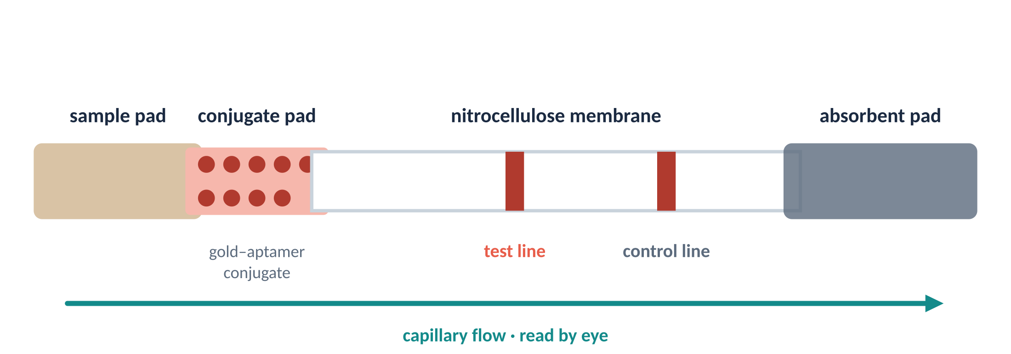
From recognition to a visible line on a strip
Notes:
[0:35]
The last step is work package three.
The best aptamer goes onto a paper strip, like a pregnancy test. The sample moves along the strip. The aptamer carries gold nanoparticles. If the virus is present, a red line appears.
The goal is a result in about fifteen minutes, read with the eye.
It will not replace PCR. Its role is to flag suspicious donations, so they can be confirmed in the laboratory.

Slide 13
thank you
Notes:
[0:10]
So: the donor is screened — but the donation of today is not. That is what I want to change.
Thank you for your attention. I am happy to take your questions.

Slide 14
Identifying aptamers suitable for stool testing
Determine whether our aptamers can recognise the target viruses specifically and retain useful binding in a complex faecal matrix.
Expected contribution
Establish a modular platform
Validate the norovirus assay, assess multiplex feasibility and explore performance on naturally positive samples.
General approach
Build, optimise and validate
Develop the prototype, resolve stool-related flow and background problems, and evaluate analytical performance against RT-qPCR.
Purpose
Translate recognition into detection
Integrate the selected aptamers into a strip-based assay that generates a visible detection signal.

Slide 15
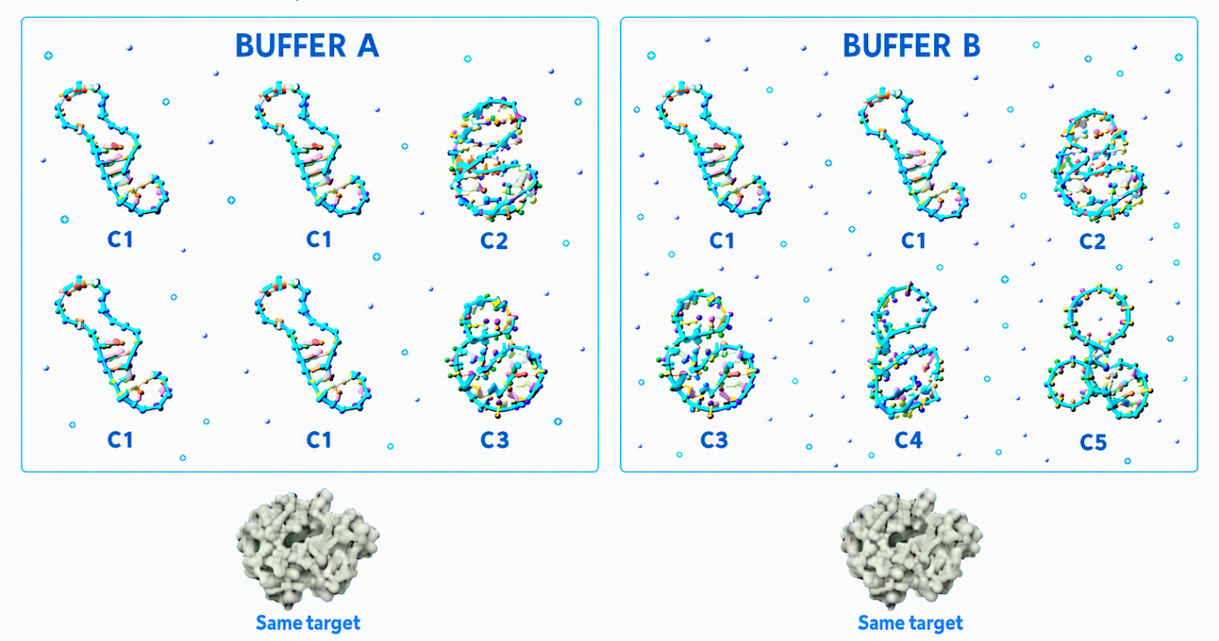
How to make them comparable?
the buffer can affect the structure of the aptamer

Slide 16
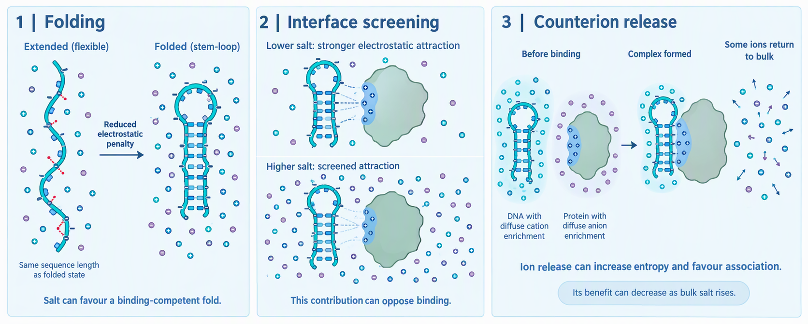
How does salt affect aptamer binding?

Slide 17
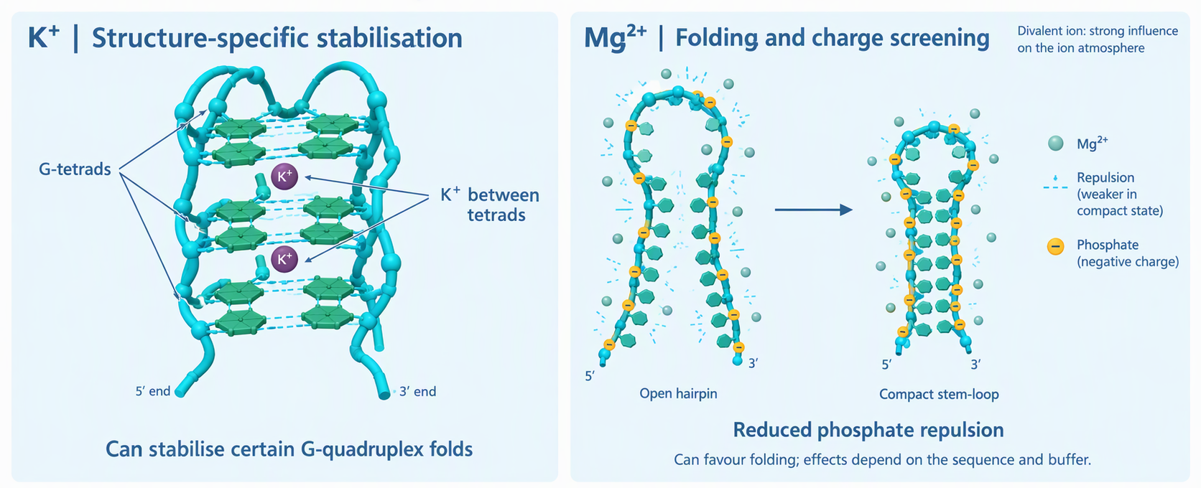
The type of the ion matter

Slide 18
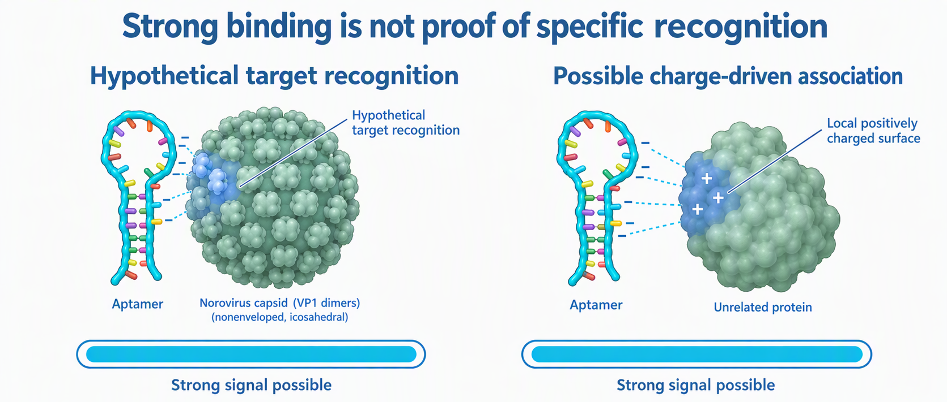

Slide 19
Assessing viral risk in healthy adults’ stools
Establish the biological context for the rapid test: which viruses need to be detected, and at what levels?
General approach
Targeted and broader screening
Use RT-ddPCR for selected viruses and viral metagenomics on a subset to explore viruses beyond the targeted panel.
Expected contribution
Inform diagnostic needs
Provide viral-load data and naturally positive samples to inform the development and evaluation of the rapid assay.
Purpose
Characterise the viral burden
Assess the presence and viral loads of enteric viruses in stool samples from healthy, asymptomatic adults.

Slide 20
Selecting aptamers that can work in stool
Before building a rapid test, we need recognition tools that remain functional in the sample we actually want to test.
Expected contribution
Prepare the inputs for WP3
Select lead aptamers and workable sample conditions, supported by testing on naturally positive samples where available.
01 · ESTABLISH
Recognition in buffer
Compare candidate aptamers for target binding and specificity under controlled conditions.
02 · CHALLENGE
Performance in stool
Determine whether binding is retained when the faecal matrix is introduced.

