Slide 1
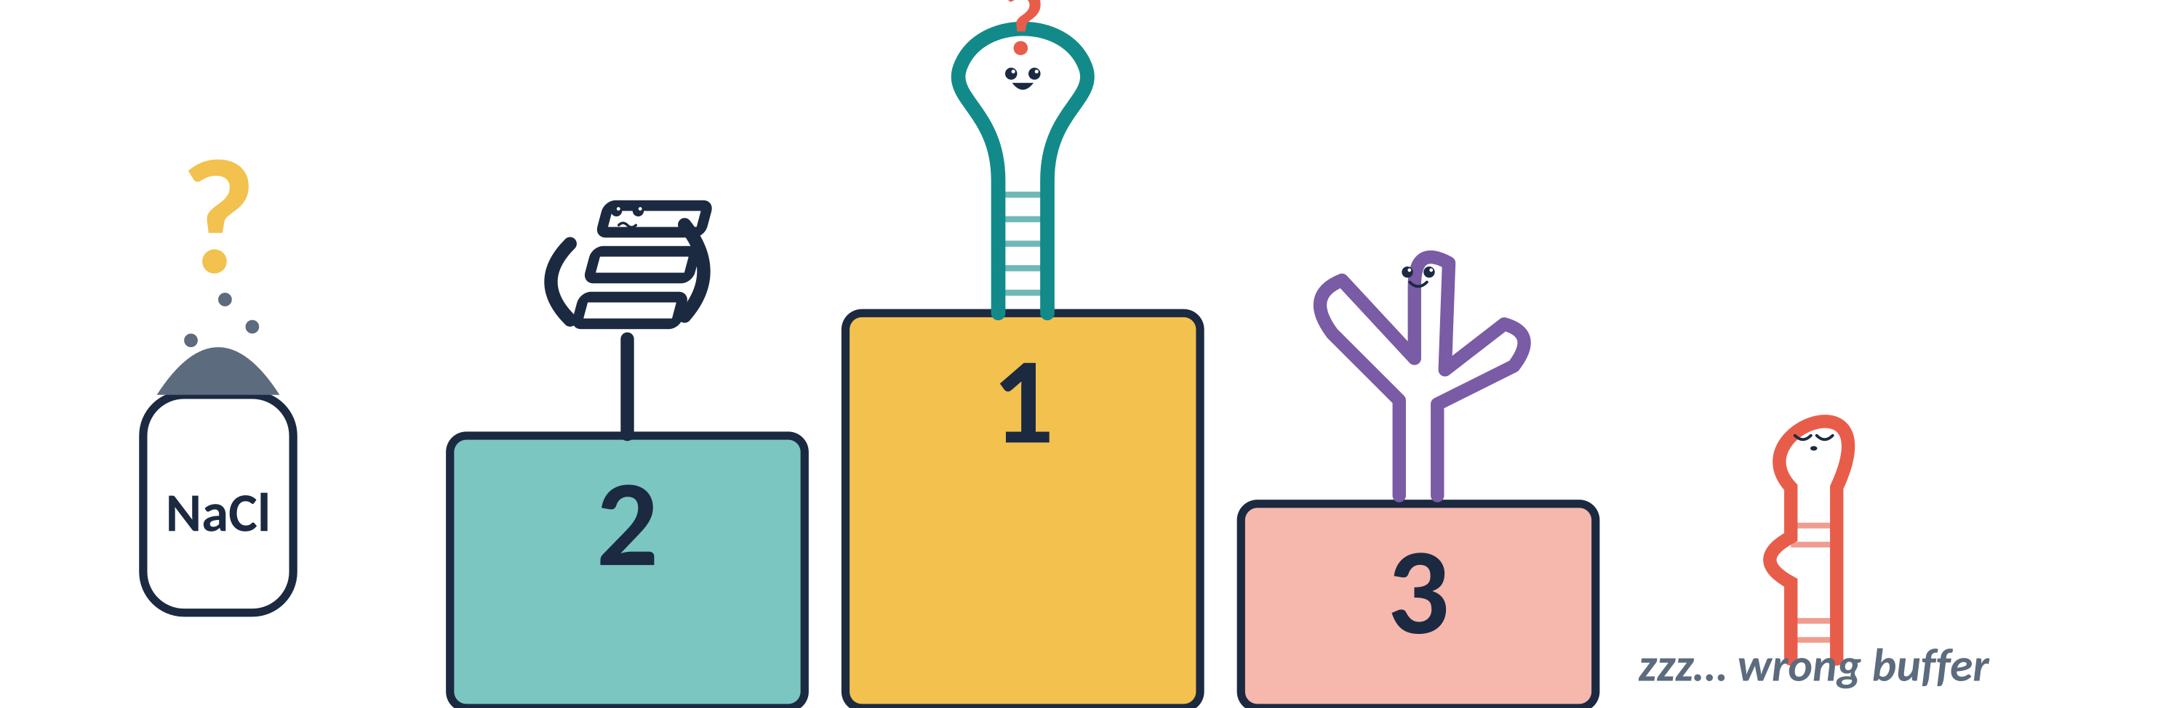
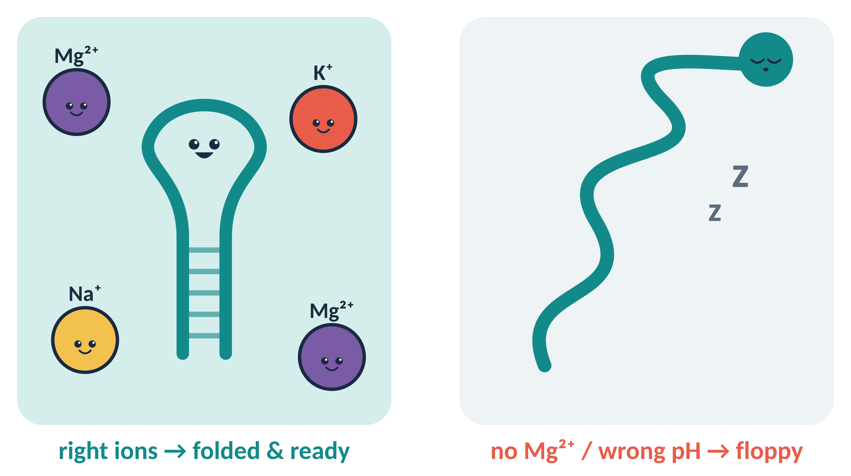
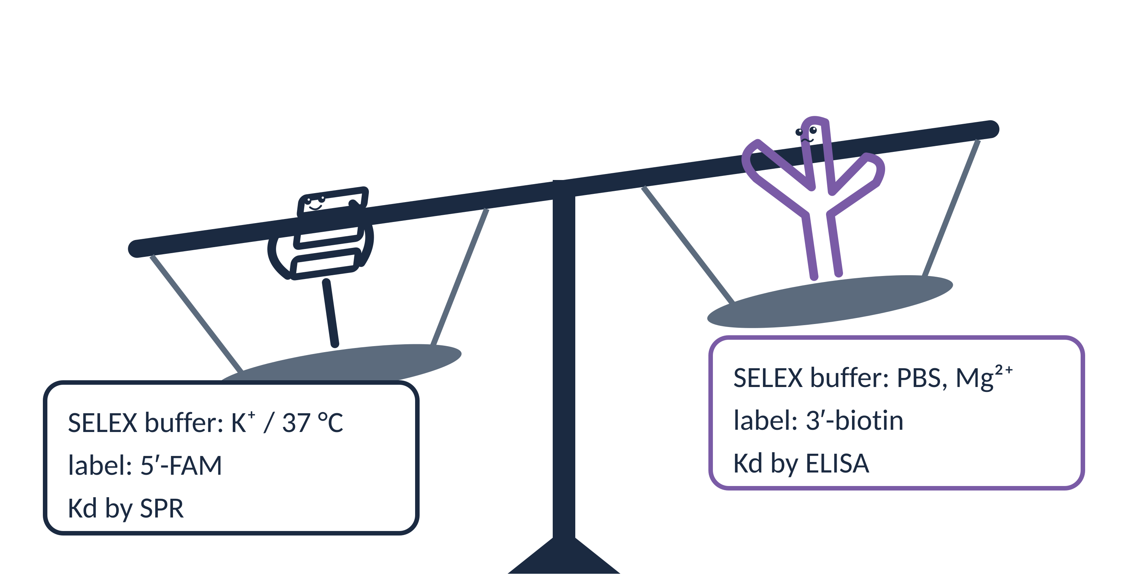
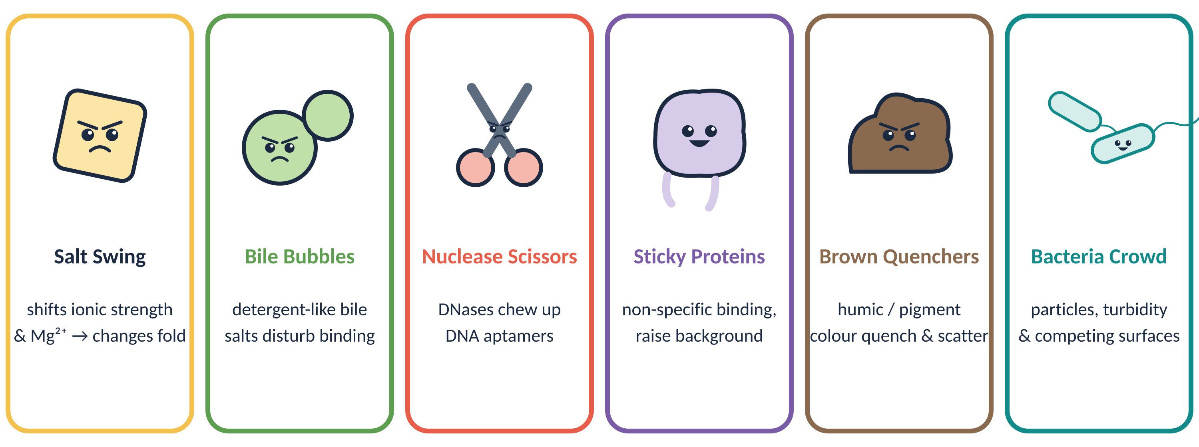
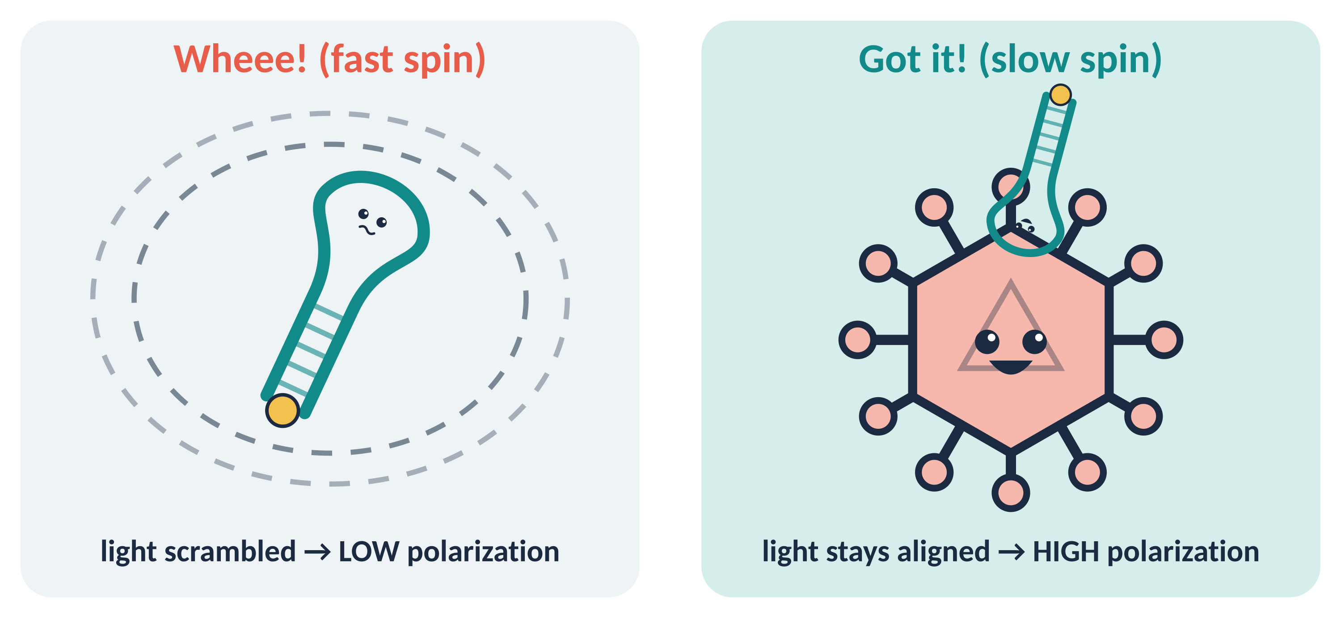
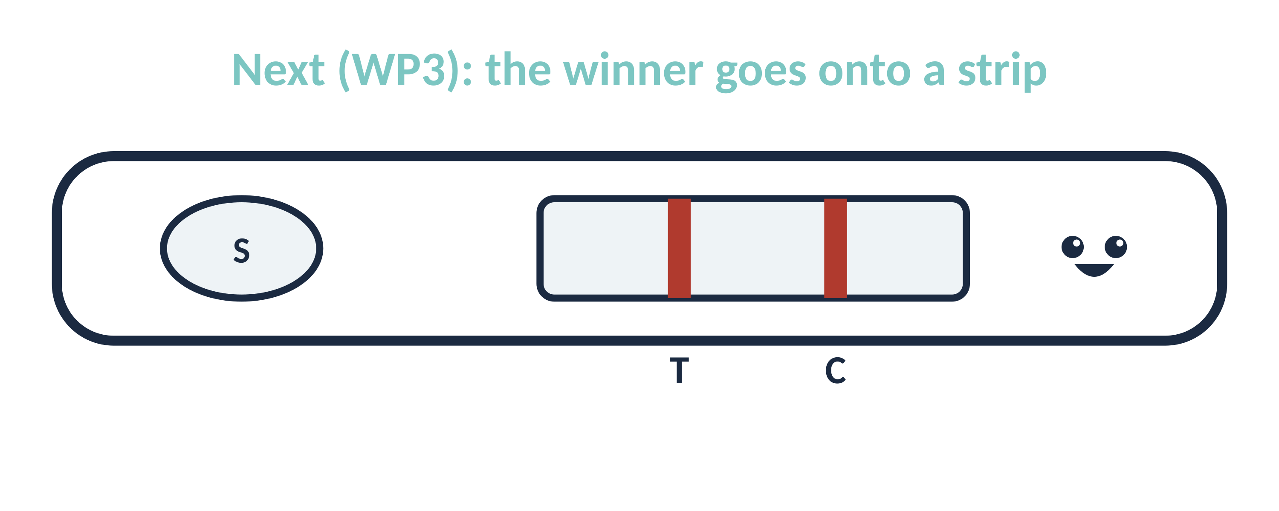
Which aptamer wins?
It depends on the salt.
[QR code: talk slides / contact]
Why comparing aptamers for rapid virus detection in stool is hard — and how fluorescence polarization helps
[Your name] · [Lab, Institute] · [email] · PhD Retreat 2026
The question
Several published aptamers bind my target virus [name]. Which one should go on the rapid strip test?
The catch
Their ranking changes with salt, method and matrix — so a fair comparison needs a fair method.
1
Aptamers are shape-shifters
2
Apples vs oranges
Mg²⁺ & Na⁺ shield the negative backbone so the strand can fold
K⁺ specifically stabilises G-quadruplexes; pH & temperature matter too
No fold → no binding pocket → no binding
Each aptamer was selected (SELEX) in its own buffer
Labels & linkers differ (FAM, biotin, spacers) and can change binding
Published Kd values come from different methods → not directly comparable
3
Meet the stool matrix gang
Why it hits every assay
Stool composition varies between donors and days, so salt and Mg²⁺ — and with them the aptamer fold — are never fixed.
Watch-out for optics
Pigments & particles absorb and scatter light — they can fake a signal in colour and fluorescence assays alike.
4
ELISA: lessons learned
5
Fluorescence polarization to the rescue
What we saw | Why it happens
[Weak / patchy signal] | Washes strip aptamers that unbind fast
[Ranking ≠ literature] | Surface tethering changes folding & access
[Result shifts with wash buffer] | One buffer is unfair to aptamers selected in other salts
[High background in stool] | Matrix & blockers stick to plate and DNA
Planned experiment matrix
 | Own SELEX buffer | Shared buffer | NaCl series | Mg²⁺ series | K⁺ (G4) | Stool 1:[x]
Apt-A | ● | ● | ● | ● | ○ | ●
Apt-B | ● | ● | ● | ● | ● | ●
Apt-C | ● | ● | ● | ● | ○ | ●
Apt-D | ● | ● | ● | ● | ○ | ●
Homogeneous: no surface, no washes
True equilibrium Kd, minutes per plate
Same plate, many buffers → fair comparison
Ratiometric → less sensitive to intensity loss
Readout → Kd
titrate target, fit mP to a 1:1 binding model
Controls
scrambled sequence · dye only · stool-only blank · unlabelled competitor
Watch-outs
stool scatter/autofluorescence → red dye + blanks · dye/linker can alter binding
Bottom line: ELISA scored the assay, not the aptamer.
Let's discuss!
Which buffer is ‘fair’ — each aptamer's own, or one common buffer?
How much stool dilution is acceptable for a rapid test?
Your experience with FP in complex matrices?

