Slide 1
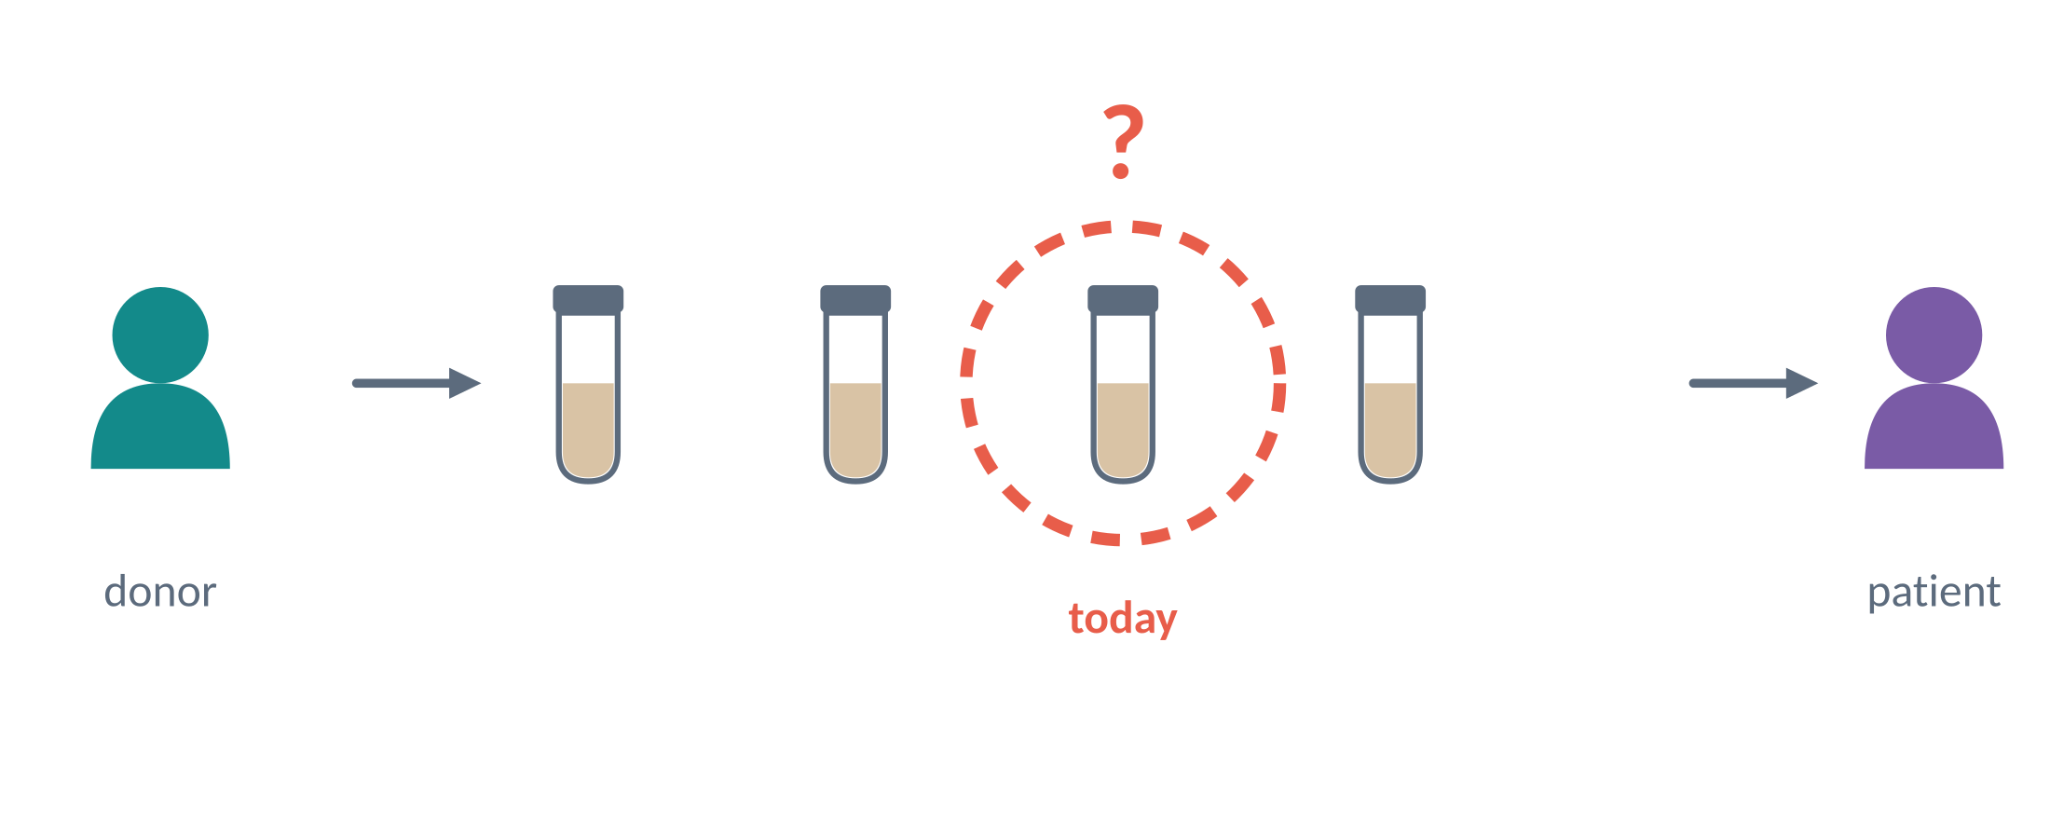
The donor has been screened — but what about the donation made today?
A rapid aptamer-based test for enteric viruses in FMT donor stool
[Your name] · [Lab / supervisors] · PhD Retreat 2026
Notes:
[0:25] I want to start with the question that drives my whole project: the donor has been screened — but what about the donation made today? To explain why that question matters, let me set the scene.

Slide 2
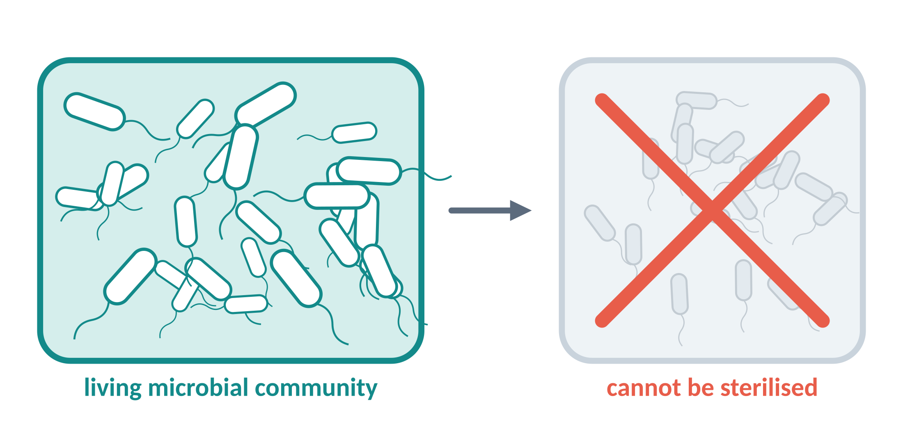
The donation cannot be sterilised — the microbes are the medicine
FMT in one line
A healthy donor's gut microbiota is transferred to a patient
Who receives it
Often elderly, on antibiotics or immunocompromised — an infection passed on can be serious
So the donor screen is the main safety barrier
Notes:
[0:50] Faecal microbiota transplantation transfers a healthy donor's gut microbiota to a patient. The recipients are often elderly, on antibiotics or immunocompromised, so an infection passed on through the donation can be serious. And here is the thing that makes this different from most other transplanted material: you cannot sterilise it. The living microbial community is the active ingredient — if you kill it, you have no medicine. That means the donor screen is the main safety barrier.

Slide 3
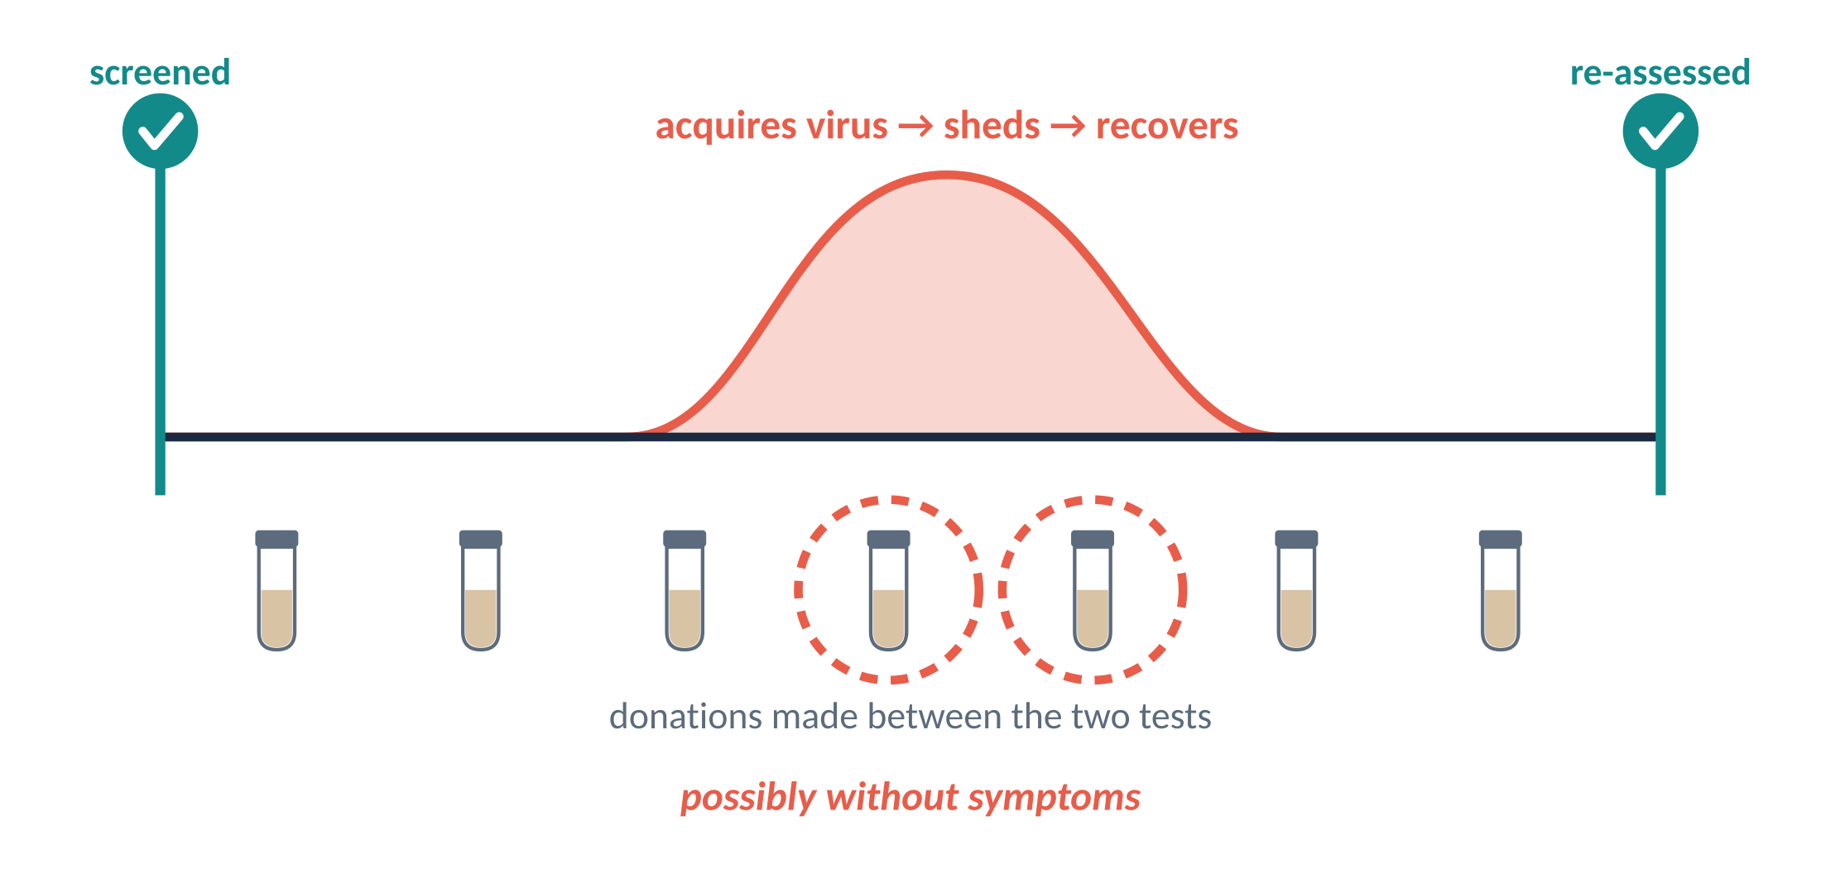
Screening brackets a donation period — the donations in between are untested
Before donating
Questionnaire on health, medication, symptoms, travel, exposure + blood and stool tests
Then
Screened at the start of the period, re-assessed at the end [schedule varies by stool bank]
The gap
A donor can acquire a virus, shed it, and recover between the two tests
Notes:
[1:10] So how are donors screened? Before someone becomes a donor they fill in a questionnaire about health, medication, symptoms, travel and possible exposure to infection, and then blood and stool samples are tested for relevant pathogens. But passing those tests does not guarantee that every later donation is free from infection. In the workflow I'm discussing, testing brackets a donation period: donors are screened at the beginning and re-assessed at the end, and the exact schedule varies between stool banks. Between those two points a donor could acquire an enteric virus, shed it in a donation, and recover before the next assessment. They might even shed without any symptoms. The donor has been screened — but the donation made today has not been tested.

Slide 4
RT-qPCR is excellent — but not for every single donation
Sensitive
detects very low viral loads
Sample preparation
extraction, reagents, hands-on time
Specific
identifies the virus precisely
Equipment & trained staff
a laboratory, not a donation room
Time
the donation waits for the result
That is exactly why screening happens at intervals rather than per donation
Notes:
[0:45] Why don't we simply test every donation with the confirmatory method? RT-qPCR is sensitive and specific — it is the right tool for a definitive answer. But it needs sample preparation, equipment, trained staff and time. It is not practical to run on every single donation, and that is precisely why screening happens at intervals instead.

Slide 5
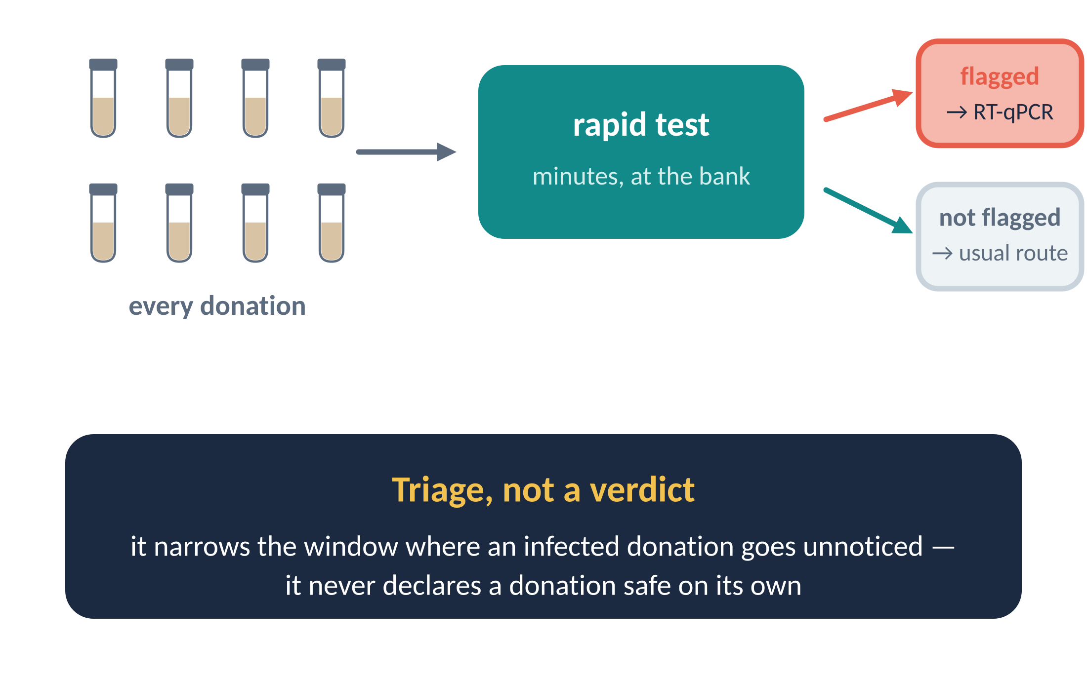
What a rapid test adds: triage, not a verdict
Notes:
[0:50] So what would a rapid test actually add? A fast, simple test applied donation by donation could flag suspicious donations for further testing before they are used. I want to be precise about this, because it is easy to oversell: it would not replace laboratory confirmation, and it would not declare a donation safe by itself. Its job is triage — narrowing the window in which an infected donation can go unnoticed.

Slide 6
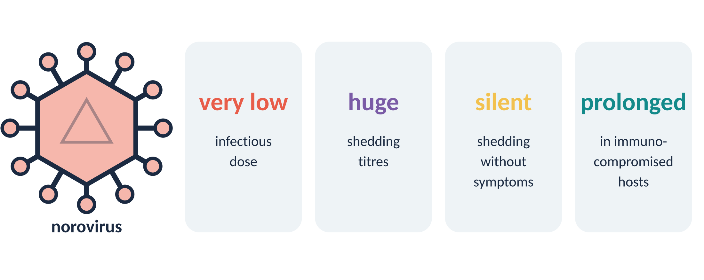
Why norovirus
Major cause
of acute gastroenteritis
Rapid antigen tests
perform poorly for it compared with other enteric viruses
Aptamers exist
several published candidates
Notes:
[1:00] Why norovirus? It is a major cause of acute gastroenteritis and a good example of exactly this problem. It can be shed in very large quantities, it needs a very low infectious dose, and it can be shed without symptoms or after someone has recovered. In immunocompromised recipients, infection may become prolonged. On top of that, existing rapid antigen tests perform poorly for norovirus compared with other enteric viruses — so there is a real gap to fill. And conveniently, several aptamers already exist that could serve as recognition elements.

Slide 7
Three work packages
WP1
WP2
WP3
How much does the viral picture change across the interval?
How do our aptamers recognise the virus — in buffer and in stool?
Can that recognition become a visible line on a strip?
how large is the gap
the recognition
the test
Notes:
[0:20] My project has three work packages. First, measure how much the viral picture actually changes across a screening interval. Second, understand how aptamers recognise the virus, in buffer and then in stool. Third, turn that recognition into a test.

Slide 8
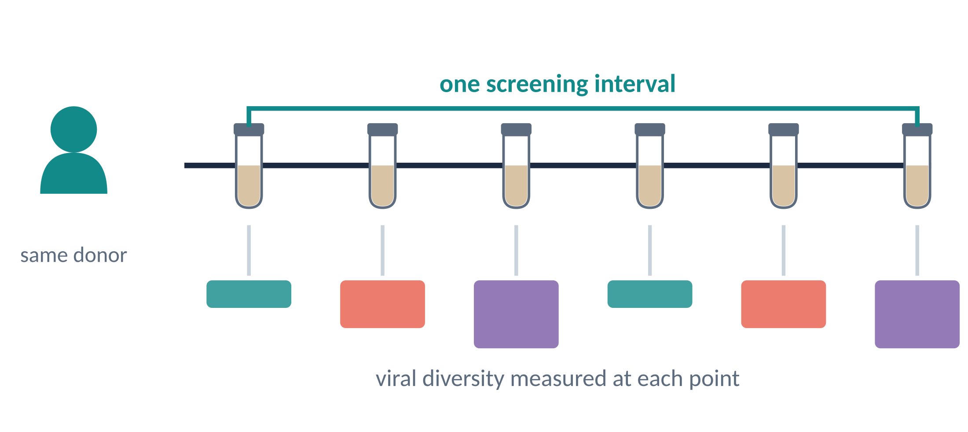
WP1: how much changes inside the interval?
1
2
3
Design
Stool samples from the same person across a screening interval
Question
How does the diversity of viruses present change over time?
Why it matters
Does the picture at the start still describe the donations made later?
Planned — [n donors × n time points, method]. This tells us how large the gap really is.
Notes:
[1:00] We do not yet know how much changes inside that interval — and that is Work Package 1. We plan to study stool samples collected from the same person across a screening interval, and look at how the diversity of the viruses present changes over time. The point is to find out whether the viral picture at the start of the interval still describes the donations made later. In other words, WP1 measures how large the gap really is. This is planned work, so I have no results to show you yet.

Slide 9
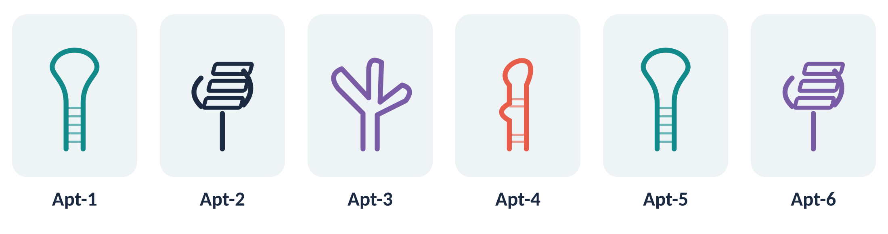
WP2: can our aptamers recognise their targets reliably?
1
2
3
Binding strength
how tightly each one holds
Specificity
the target and not its neighbours
Genotypes
for norovirus: can it recognise different genotypes?
Start in buffer, where conditions are controlled · Norovirus is the priority; astrovirus, rotavirus and adenovirus aptamers are also investigated
Notes:
[1:00] In WP2 we first ask whether our aptamers can recognise their viral targets reliably. We begin in buffer, where conditions are controlled, and compare the candidates to understand their binding strength, their specificity, and — for norovirus — their ability to recognise different genotypes. Norovirus is our priority, while aptamers for astrovirus, rotavirus and adenovirus are also investigated.

Slide 10
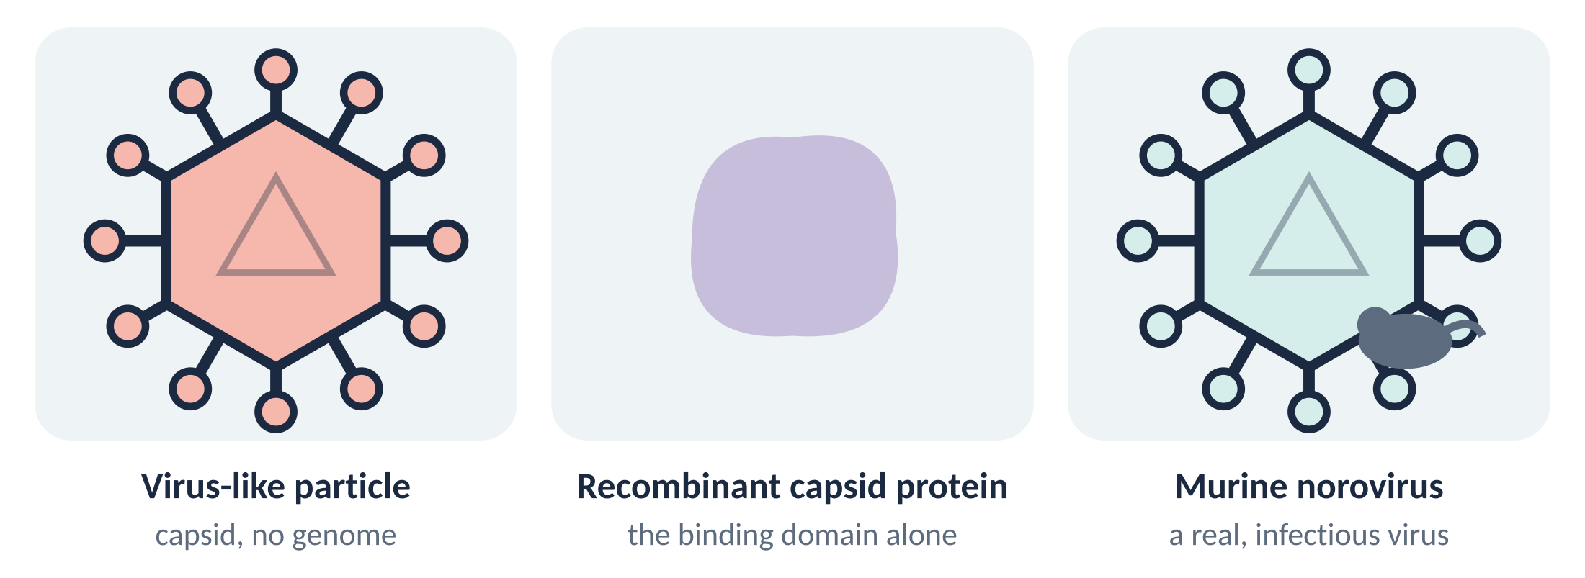
Recognising what, exactly? The target itself is a choice
1
2
3
The form of the target influences recognition — so we compare the models rather than assume they agree
Notes:
[0:50] But recognising a target in buffer is only the beginning — and "the target" is not one single thing. We compare different target models: virus-like particles, recombinant capsid protein, and murine norovirus. Each is a different compromise between how easy it is to work with and how close it is to the real virus, and the form of the target influences recognition. So rather than assume they agree, we compare them.

Slide 11
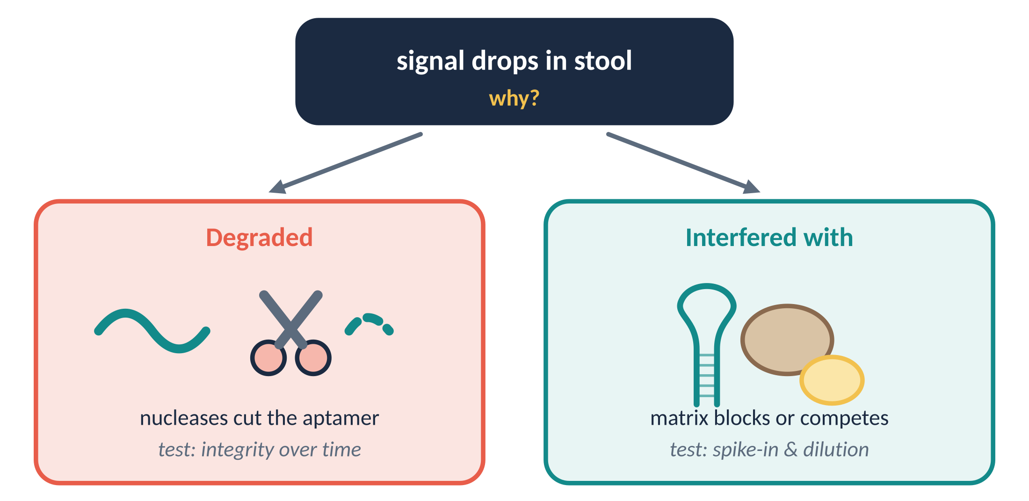
Then into stool — and the signal drops. Degraded, or interfered with?
1
2
3
Rather than adjusting conditions until the signal improves, we investigate the mechanism behind the loss
Notes:
[1:10] Then we move into stool, where the challenge becomes more complex. The signal decreases — but why? Is the aptamer being degraded, or are stool components interfering with its binding? These two explanations look the same on a plate reader, but they call for completely different solutions. So rather than simply adjusting conditions until the signal improves, we investigate the mechanisms behind that loss. Degradation we can test by following the integrity of the aptamer over time; interference we can probe with spike-in and dilution experiments. Understanding which one we are facing should help us identify suitable strategies to preserve aptamer function.

Slide 12
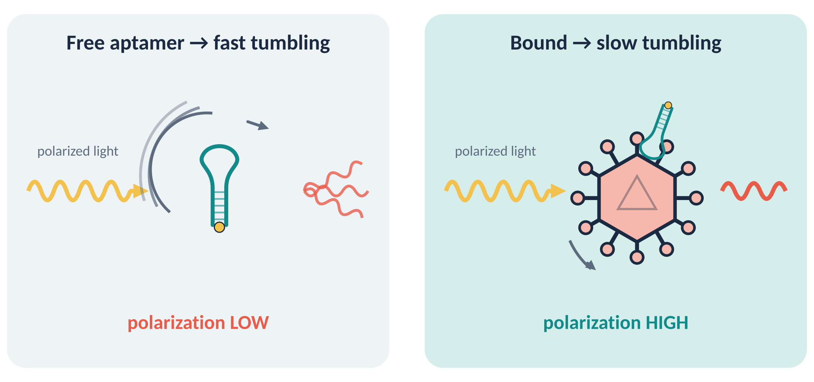
To compare them fairly, the solution must be the only variable
1
2
3
Nothing is immobilised
everything happens in solution
No wash step
one defined buffer from start to finish
Equilibrium measurement
the number we fit means something
One plate, many conditions
ion identity, concentration and pH for every aptamer
Paired with circular dichroism, it helps separate a change in fold from a change at the interface
Notes:
[1:10] All of this needs a method where the solution is the only thing that changes. Fluorescence polarization gives us that. We put a fluorescent tag on the aptamer and excite it with polarized light. The polarization reflects how fast the molecule tumbles: a free aptamer is small and tumbles fast, so polarization is low; bound to the large norovirus particle it tumbles slowly, so polarization rises. That rise is the binding signal. Why it suits this question: everything happens in solution, with nothing immobilised and no surface to stick to. There is no wash step, so the aptamer stays in one defined buffer from start to finish and the measurement is an equilibrium. And the same plate can scan ion identity, concentration and pH for every aptamer under one method. Paired with circular dichroism, it helps us separate a change in fold from a change at the interface. That last point is the subject of my poster.

Slide 13
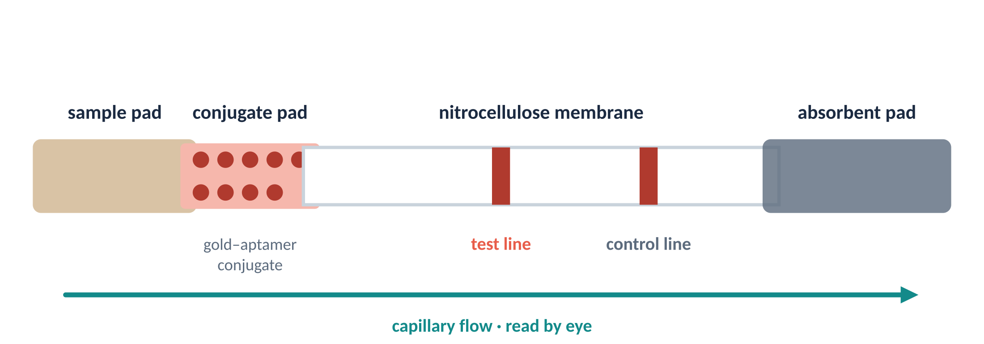
WP3: turning recognition into a visible line
1
2
3
Immobilise
aptamers on the membrane
Survive drying
keep binding after the strip dries
Gold readout
nanoparticles make the line visible
Benchmark
LOD vs RT-qPCR and WP1 viral loads
Minimum objective: a validated norovirus assay. Next goal: a second test line. Ambitious extension: naturally positive samples.
Notes:
[1:00] WP3 takes that knowledge and turns it into a practical detection platform: a lateral flow assay, aiming to translate aptamer–virus binding into a visible coloured signal on a test strip, starting with norovirus. We investigate how to immobilise the aptamers on the membrane, how to preserve their binding after drying, and how to use gold nanoparticles to generate the readout. Then we optimise the assay for stool and assess whether its detection limit is compatible with the viral loads observed in WP1, benchmarking against RT-qPCR. If the results from WP2 support it, we add a test line for a second virus. A validated norovirus assay is the minimum technological objective; multiplex detection is the next goal, and testing on naturally positive samples is the ambitious extension.

Slide 14
Take-home
WP1
First measure how the viral picture changes across the interval
WP2
Understand the recognition — in buffer, in stool, and in between
WP3
Then build a test that says something about each donation
Why salt makes the comparison hard → my poster [#__]
The donor has been screened — but what about the donation made today?
Notes:
[0:40] To bring it together: we will first measure how the viral picture changes across the screening interval; then understand how our aptamers recognise the virus, in buffer and in stool; and then build a test that can say something about each individual donation — as triage, not as a verdict. Which brings me back to where I started: the donor has been screened — but what about the donation made today? If you want to hear why comparing six aptamers fairly is harder than it sounds, and what salt has to do with it, come to my poster.

Slide 15
Thank you — questions?
[Supervisors] · [Lab members] · [Collaborators / stool bank] · [Funding]
[email]
Notes:
[0:10] Thank you — I'm happy to take questions.

Slide 16
Backup: how fluorescence polarization becomes a Kd
Polarization
P = (I∥ − G·I⊥) / (I∥ + G·I⊥) reported as mP = 1000·P
Anisotropy r = (I∥ − G·I⊥) / (I∥ + 2G·I⊥)
Fraction bound (ligand depletion; labelled aptamer L, target T)
f = [(L+T+Kd) − √((L+T+Kd)² − 4·L·T)] / (2·L)
r_obs = r_free + f·(r_bound − r_free) — correct for a brightness change on binding if present
Controls under matched conditions
scrambled sequence · motif mutant · unrelated viral particles · norovirus-negative stool · dye-only blank

Slide 17
Backup: the six aptamer candidates
Aptamer | Target | Selection method | SELEX buffer | Published Kd (method) | Source
Apt-1 | [ ] | [ ] | [ ] | [ ] ([ ]) | [ ]
Apt-2 | [ ] | [ ] | [ ] | [ ] ([ ]) | [ ]
Apt-3 | [ ] | [ ] | [ ] | [ ] ([ ]) | [ ]
Apt-4 | [ ] | [ ] | [ ] | [ ] ([ ]) | [ ]
Apt-5 | [ ] | [ ] | [ ] | [ ] ([ ]) | [ ]
Apt-6 | [ ] | [ ] | [ ] | [ ] ([ ]) | [ ]
Published affinities come from different labs, techniques, targets and buffers — they are not directly comparable, which is why we re-measure all six by one method.

Slide 18
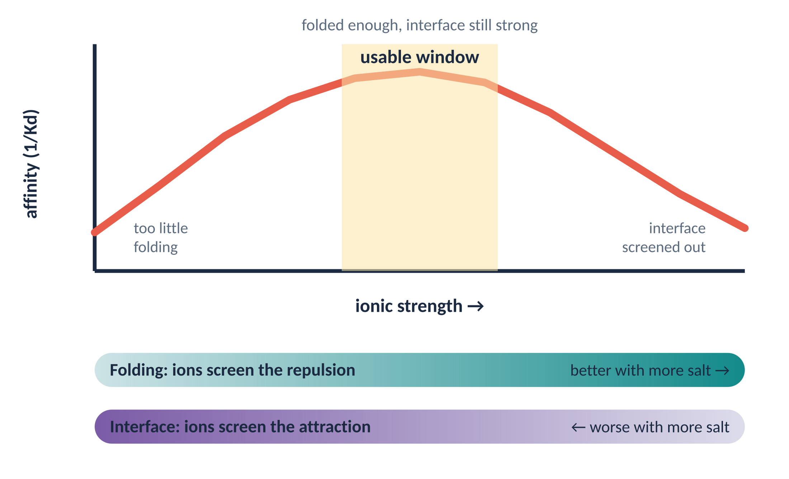
Backup: what salt does, in one slide
Folding needs ions; the interface is weakened by them; counterion release adds entropy. The binding we measure belongs to the sequence and its solution together.

