Slide 1
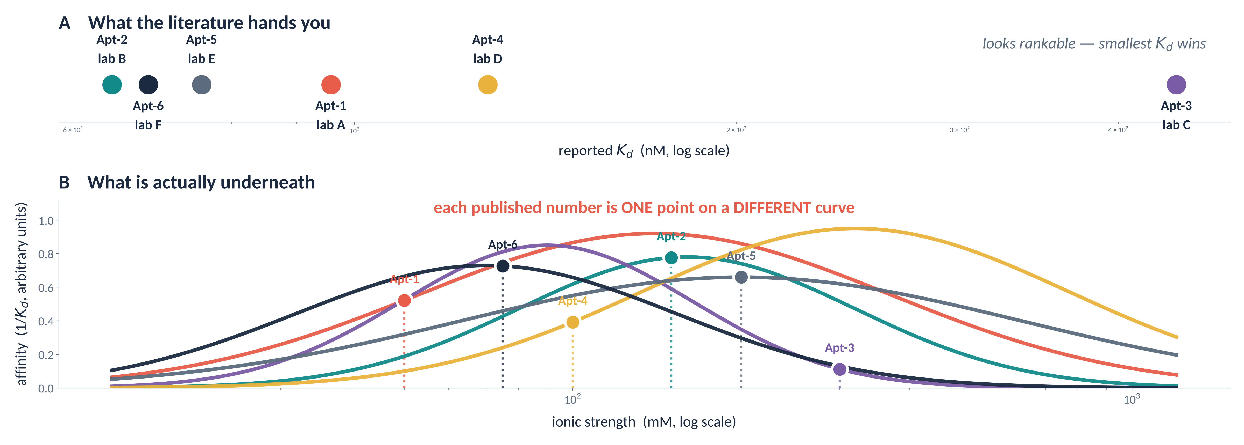
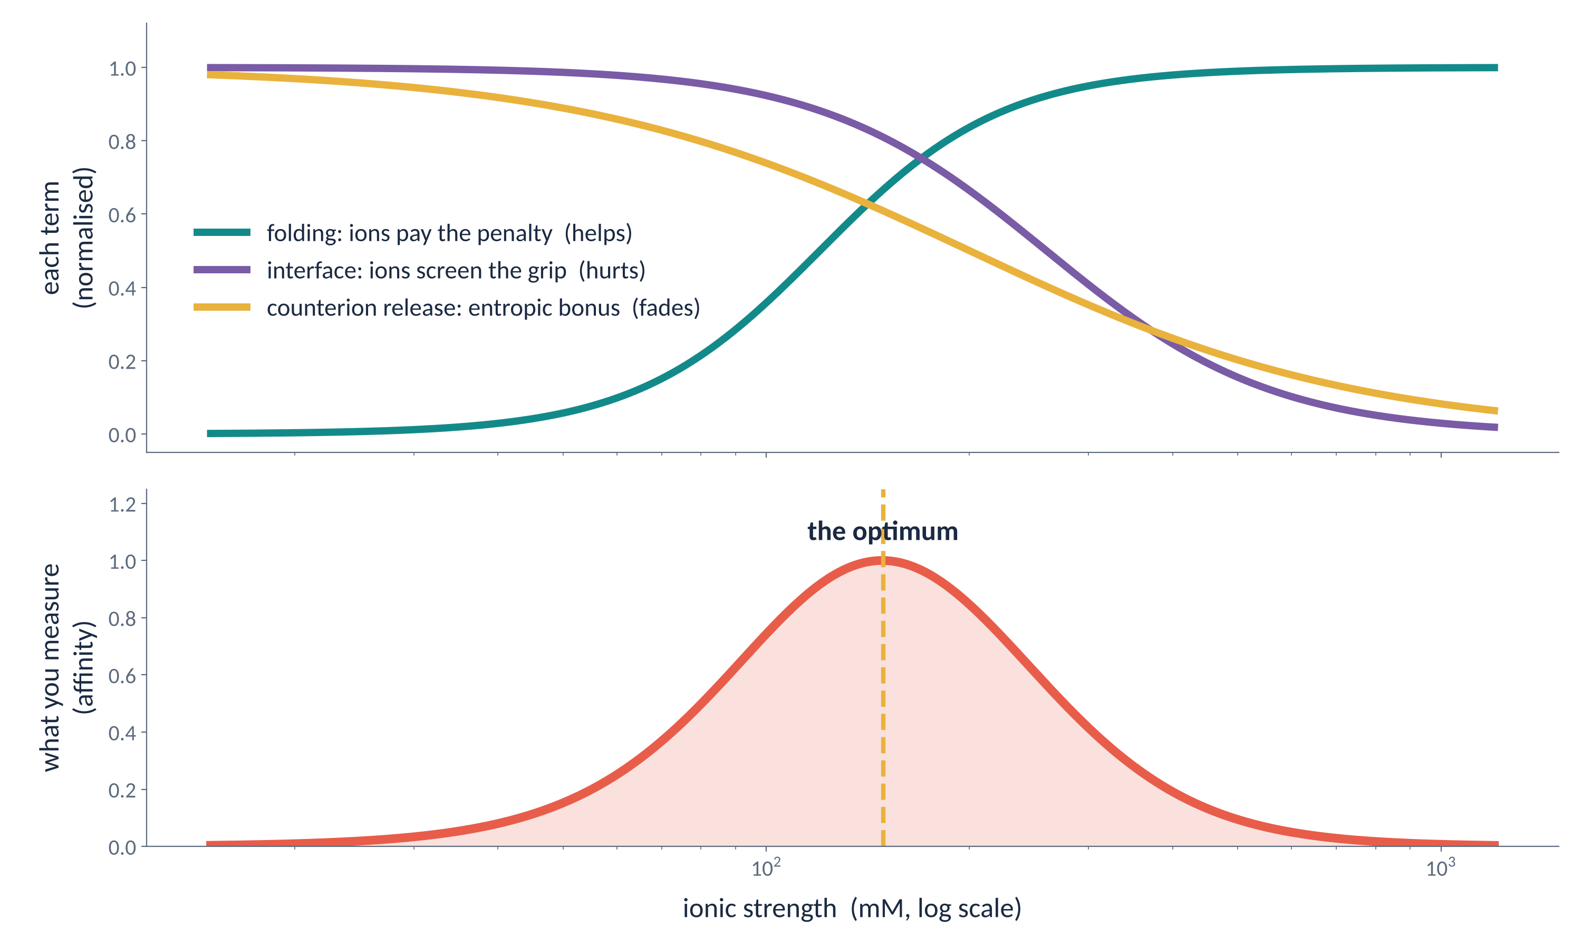
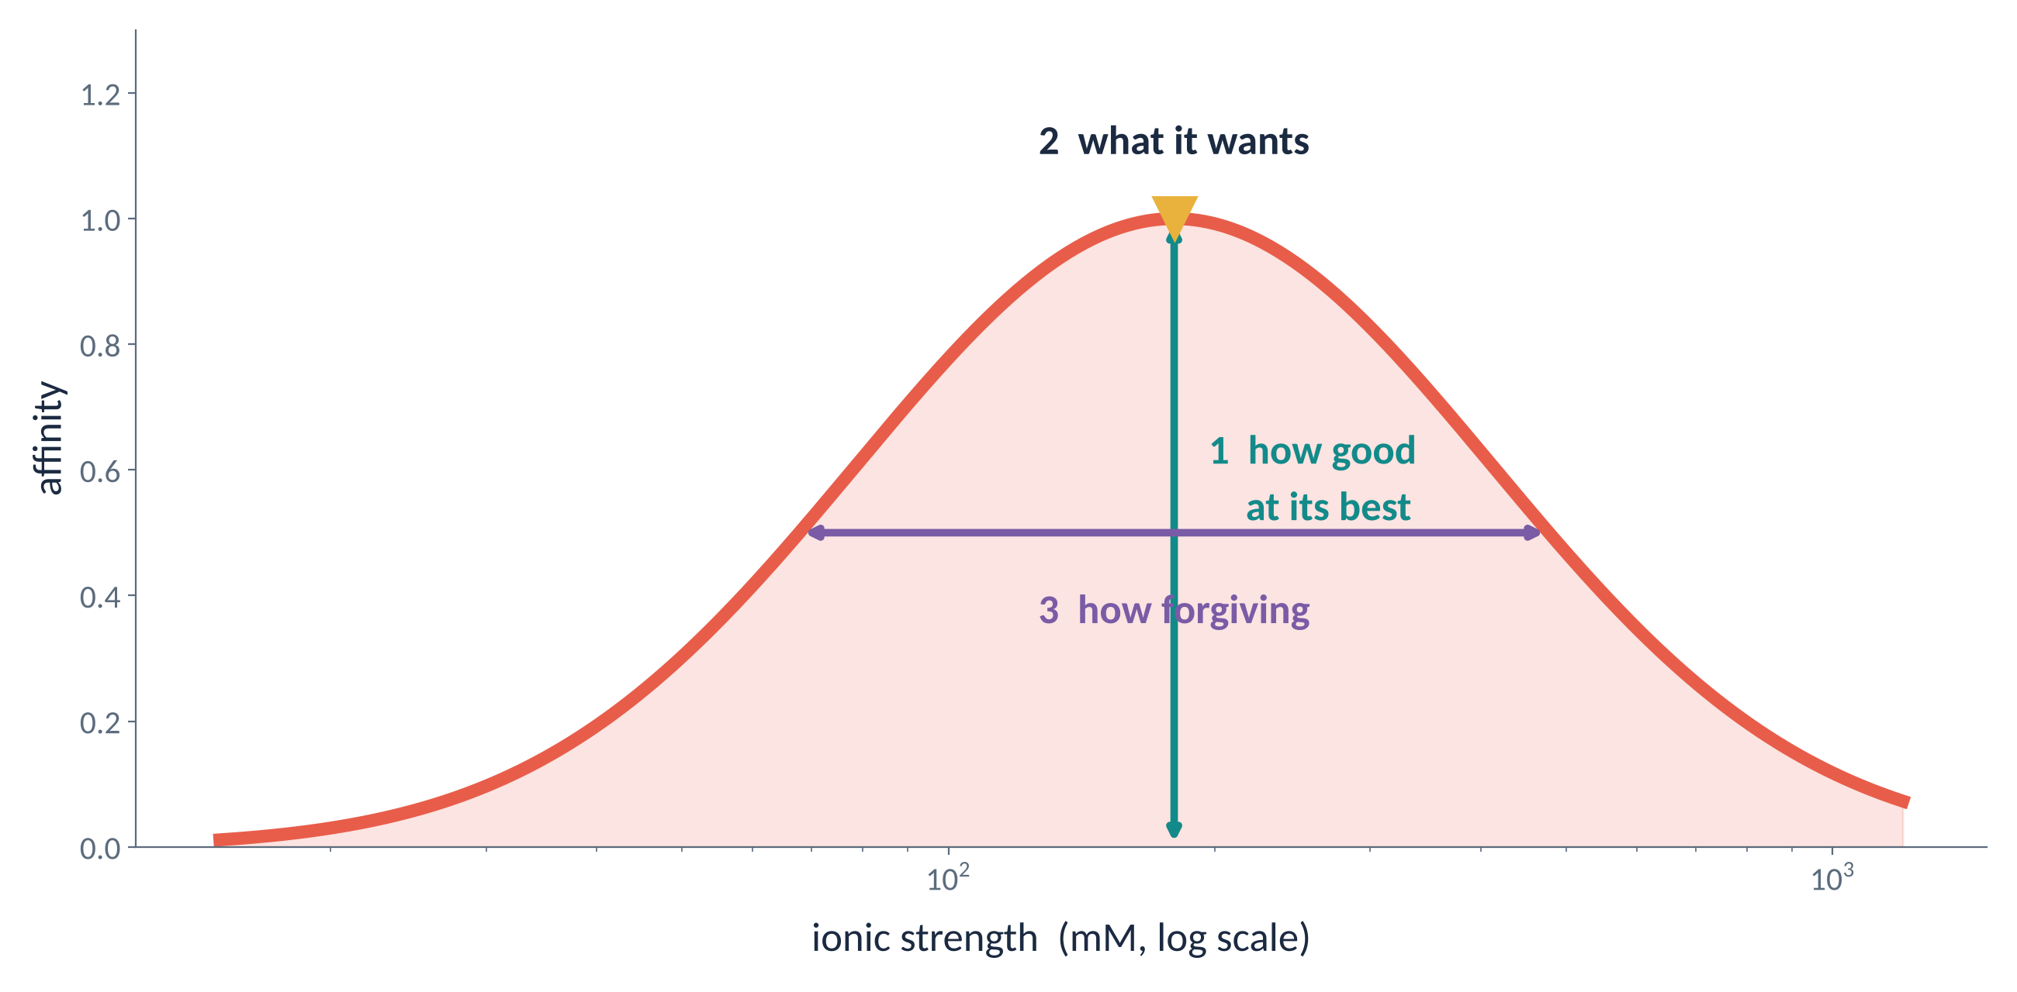
Six aptamers. Six numbers. One problem.
[Your name]
[Lab, Institute]
[email]
Every published affinity is a single point on a curve nobody measured — and each aptamer sits on a different curve.
[QR]
1
The ranking that is not a ranking
illustrative data — shows the shape of the problem, not results
Each lab selected and measured its aptamer in its own buffer, so each number sits at a different, unknown place on its own curve. The literature ranking is partly a ranking of whose buffer was luckiest.
2
Folding costs charge
3
The same ions weaken the grip
4
Binding spends ions
Every phosphate is negative. Folding pulls those charges together — an electrostatic penalty. Counterions gather and screen it: a diffuse, mobile atmosphere, not fixed bound ions. The folded state holds a denser atmosphere, so folding and ion uptake are coupled.
The aptamer binds a positively charged patch on the target. That attraction is electrostatic too, and screening does not know which attraction it is cancelling. More salt, weaker contact.
Ions crowd both partners before binding. On association some are released into bulk and gain freedom — an entropic gain. The gain depends on the contrast with bulk, so it shrinks as salt rises.
salt HELPS
salt HURTS
the bonus FADES
5
Add them up: a curve, not a number
6
And “same salt” is not the same condition
K⁺ can occupy a structural site in a G-quadruplex — not general screening. Mg²⁺ shapes nucleic-acid structure strongly and competes with monovalent ions. Even anions differ: swapping chloride for glutamate shifts affinity in some systems.
ionic strength, ion identity and pH are three variables, not one
So one shared buffer is fair in procedure, not in physics: it measures every aptamer at an arbitrary point on its own curve.
7
Measure the curve, not the point
Fluorescence polarisation lets the solution be the only variable:
• nothing immobilised, no surface to stick to
• no wash step — one buffer start to finish, at equilibrium
• one plate scans ion identity, concentration and pH for all six
• with circular dichroism: tells a change in fold from a change at the interface
Salt prepares the hand and weakens the handshake — so the binding we measure belongs to the sequence and its solution together.
What salt dependence does not tell us
A steep fall with rising salt suggests a charge-driven interaction. It does not tell us how many ions were released: structural change, hydration and other contacts contribute too. We treat the salt response as a clue, not a full explanation.
Controls, under matched conditions
scrambled sequences · motif mutants · unrelated viral particles · norovirus-negative stool

