Slide 1
Project Proposal: Graph Neural Network-based Clustering Enhancement in VANET for Cooperative Driving
Presenter: Nazanin Mehregan

Slide 2
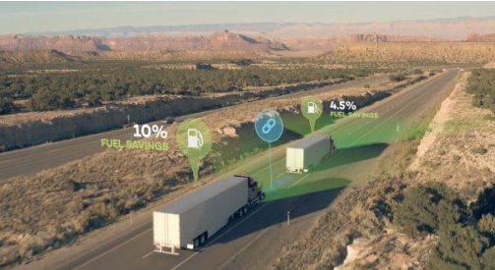
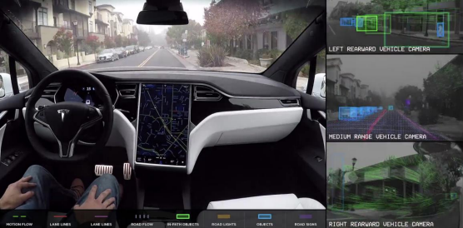
Motivation and Background
VANET clustering benefits:
Transportation network: traffic capacity, safety, and cooperative driving enhancement
Air Environment: fuel efficiency improvement and exhaust emissions reduction
Platooning improves traffic capacity, fuel economy, and safety
Cooperative driving facilitates safety in autonomous driving

Slide 3
Challenges of VANET Clustering
Clustering Algorithm | Weight-based Clustering | ML-based Clustering | GNN-based Clustering
Formation Strategy | Distributed | Centralized | Centralized
Complexity | High | Low | Low
Information Utilization | Node Feature | Node or Graph Feature | Node and Graph Feature
Learnability | No | No | Yes
State-of-the-art VANET clustering Algorithms
Distributed clustering approaches
High control message overhead
Manually select hyperparameters
Not intelligent and learnable
Machine learning-based clustering approaches
Leverage only a single feature
Not learnable

Slide 4
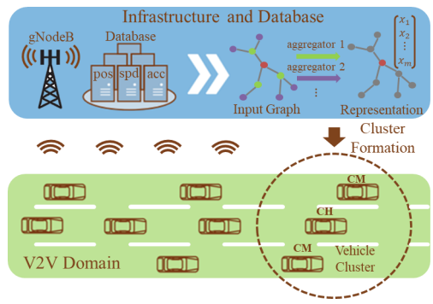
Goal and Proposal Summary
Goal: enhance the vehicle system’s stability and optimize the average lifetime of all clusters
Why we choose GNN
Fits naturally to solve clustering type of graph problem
Uses both node feature and graph information
Centralized approach and offloads the computation to BS
It’s the very first attempt to apply GNN to solve the clustering problem in VANET

Slide 5
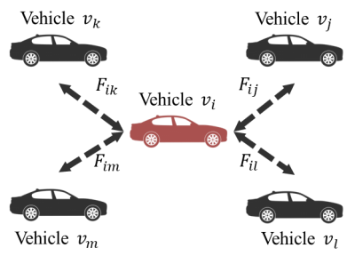
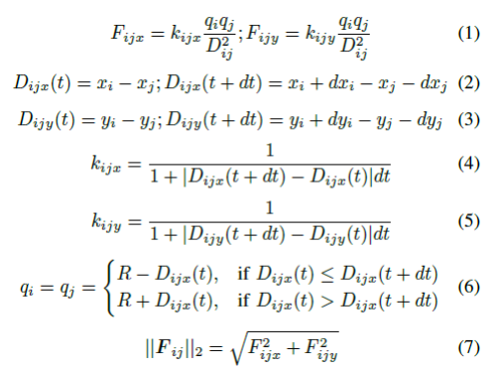
Graph Construction
Graph is modeled by force-directed algorithm:
Relative force among vehicle interconnection weighs the similarity between the movement patterns of 2 vehicles
The greater the positive forces among nodes are, the more similar the moving pattern is

Slide 6
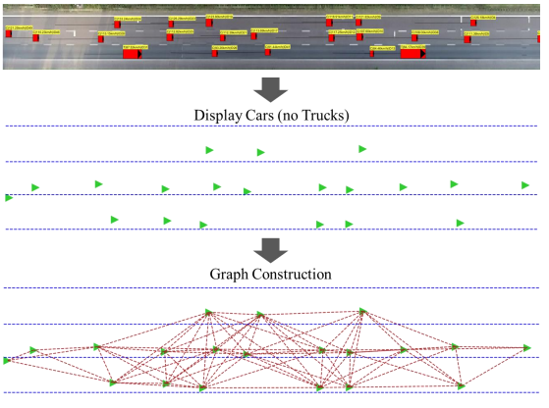
Graph Construction Visualization
Open-source highD traffic dataset
Naturalistic vehicle trajectory recordings on German highways
Cover about 420 m road segment. The median duration of visible vehicles is 13.6s
Traffic information includes vehicle trajectory, type, size, etc. The Position error is typically less than 10 cm
Apply force-directed algorithm to highD dataset to customize our graph dataset

Slide 7
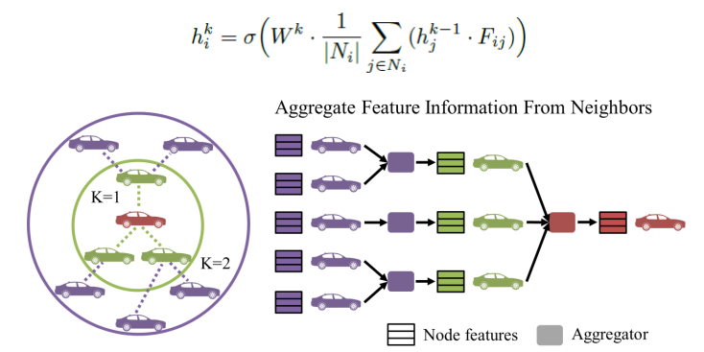
Design of GNN Clustering Algorithm
Spatial-based convolutional graph neural network
Input is vehicle feature and graph; output is useful node embedding
Apply SAGE convolutional layer
Apply Mean aggregator and search depth 𝐾 = 2

Slide 8
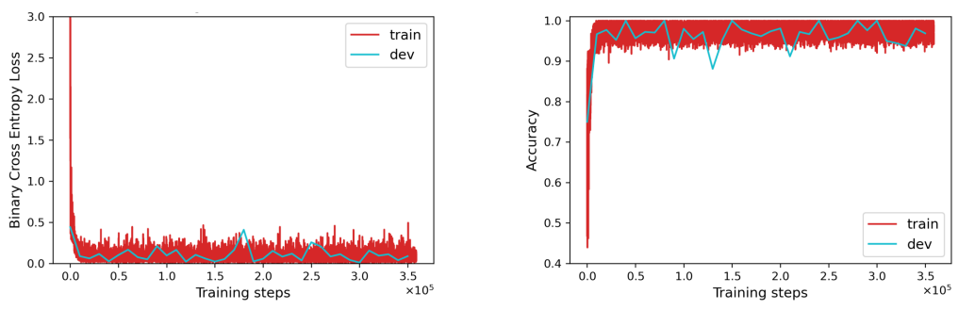
Model Training
Graph-based loss function in unsupervised learning
Guidance is the edges existent or non-existent
Forward propagation
Calculate node representations via GNN model
Apply node embeddings to compute pairwise probability among nodes
Backward propagation
Calculate loss and update model parameters via stochastic optimization
 | Training Set | Validation Set | Testing Set
Loss | 0.041 | 0.084 | 0.063
Acc | 0.986 | 0.969 | 0.978

Slide 9
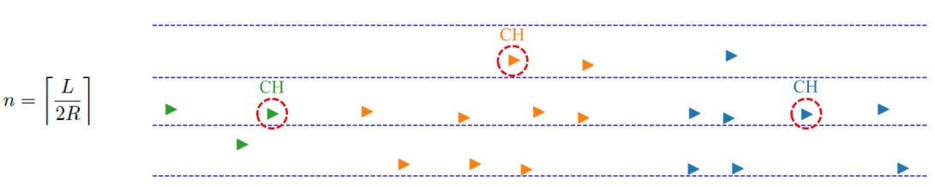
Clustering Visualization
GNN-based clustering steps
Apply the trained GNN model on a graph to calculate node embeddings
Obtain the clustering results by running 𝑘-means on node embeddings
A visual example of clustering results

Slide 10
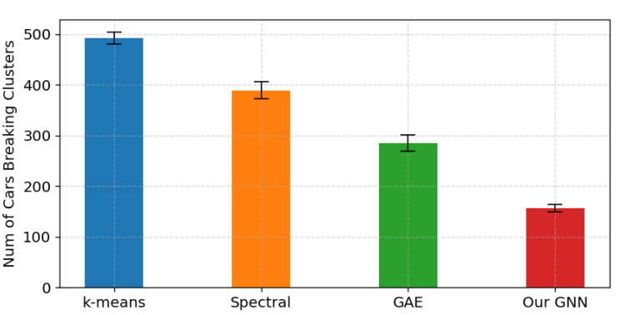
Performance Evaluation
GNN-based algorithm corresponds to the minimum number of vehicles breaking the initial clusters

Slide 11
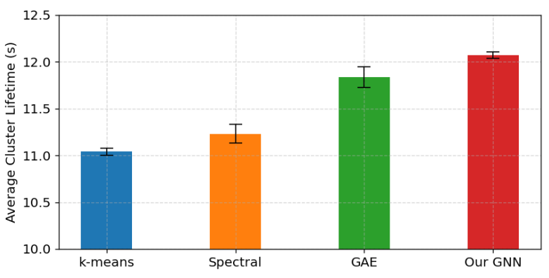
Average Cluster Lifetime Evaluation
Average cluster lifetimes of GNN-based method is 12.069±0.037s with confidence 95%. Compared with baseline algorithms, it has the longest average cluster lifetime

Slide 12
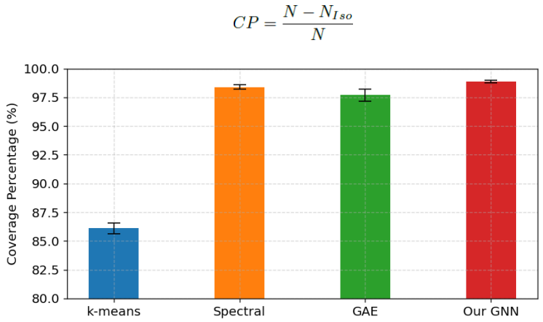
Coverage Percentage Evaluation
Cluster efficiency of GNN-based algorithms achieve 98.927±0.111% with confidence 95%

Slide 13
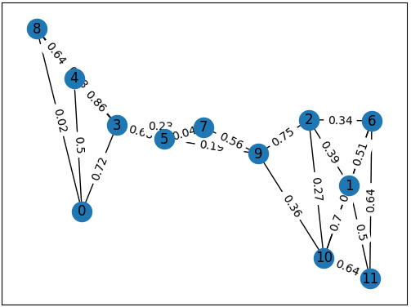
Graph Construction
I extracted all the vehicles in the first frame of the HighD dataset.
Each node is a vehicle that has the same features as the original DataFrame: x, y, width, height, xVelocity, yVelocity, xAcceleration, yAcceleration.
To connect the neighbors, the x and y positions are used to determine which nodes are near each other. The distances between cars are calculated, and each car is connected to the four nearest cars using undirected edges.
Next, random weights (forces) are assigned to the edges between 0 and 1 with 2 floating points. This graph with nodes and their features, edges and their weights forms the basis for the clustering algorithms.

Slide 14
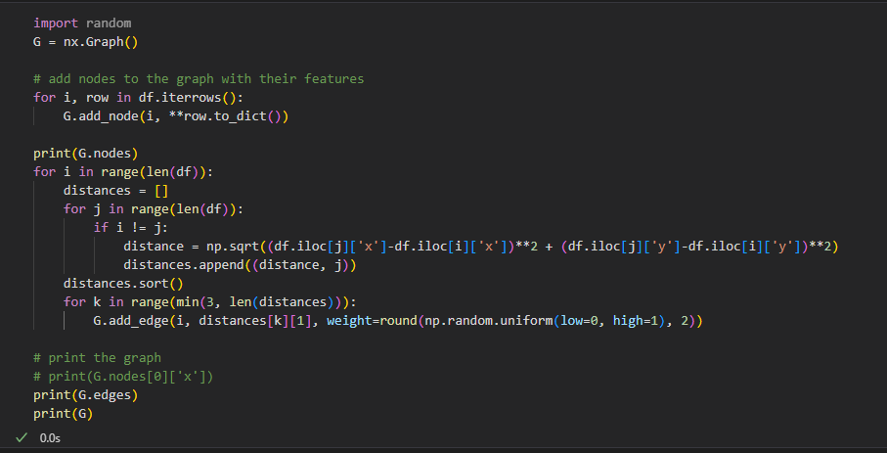

Slide 15
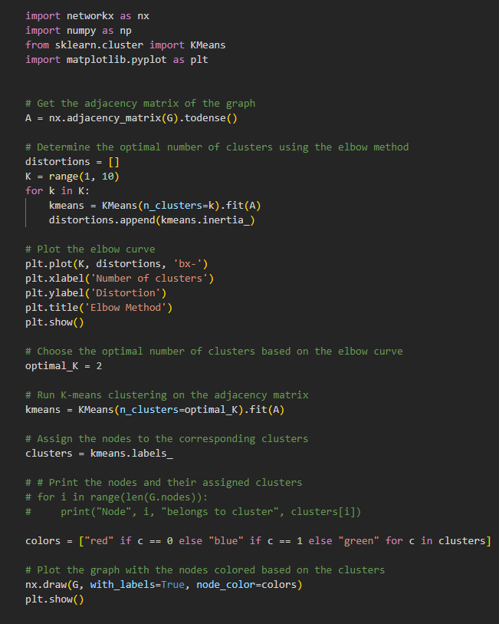
K-Means Clustering
The K-Means clustering algorithm is used to cluster the vehicles in the HighD dataset. The algorithm partitions the nodes into K clusters based on the similarity of their features. The number of clusters K is chosen based on an elbow method, where the optimal K value is chosen based on the point where the decrease in the sum of squared distances between the data points and their cluster centroids starts to level off.

Slide 16
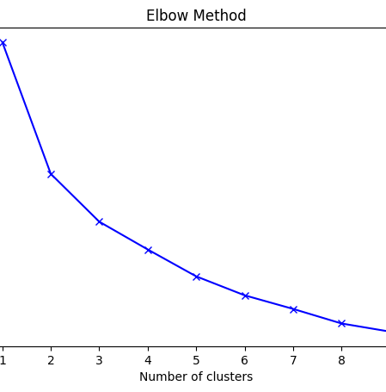
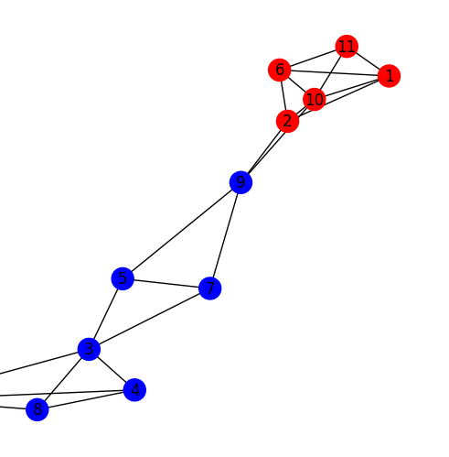

Slide 17
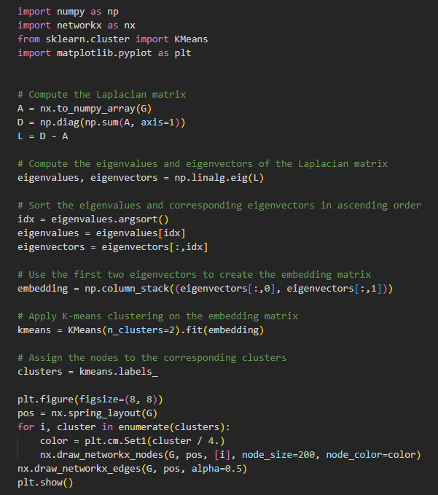
Spectral Clustering
The Spectral Clustering algorithm is used to cluster the vehicles in the HighD dataset. The algorithm uses the graph constructed earlier to create a Laplacian matrix, which is then used to perform eigenvalue decomposition. The resulting eigenvectors are used to project the nodes into a lower-dimensional space, where they can be clustered using K-Means clustering.

Slide 18
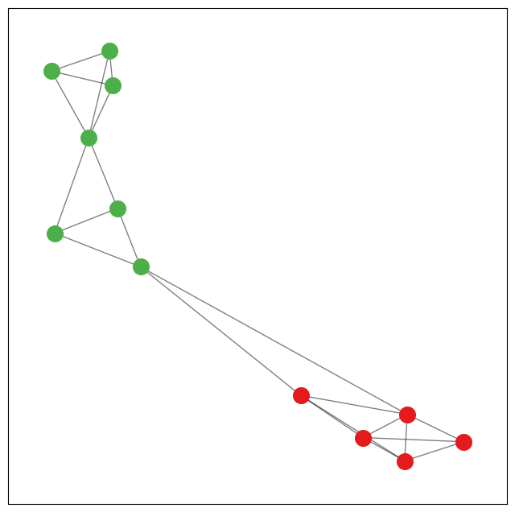

Slide 19
GraphSAGE GNN Clustering Algorithm
We perform graph clustering using the GraphSAGE model and KMeans clustering algorithm. The feature vectors are created for each node using an identity matrix. Then, the GraphSAGE model is initialized and trained using a Cross-Entropy loss function and Adam optimizer.
During training, the embeddings of the nodes are computed using the trained GraphSAGE model. KMeans clustering algorithm is then applied on the embeddings to cluster the nodes into K clusters. The cluster labels are then used to compute the loss and update the parameters of the GraphSAGE model.
After training, the cluster labels are assigned to each node, and the graph is plotted with the nodes colored based on the assigned clusters.

Slide 20
import numpy as np
import networkx as nx
from sklearn.cluster import KMeans
from torch_geometric.nn import SAGEConv
from torch_geometric.utils import from_networkx
import torch
import matplotlib.pyplot as plt
# Create feature vectors for each node
num_nodes = G.number_of_nodes()
features = torch.eye(num_nodes)
# Convert the NetworkX graph to a PyTorch-Geometric Data object
data = from_networkx(G)
# Define the Graph SAGE model
class GraphSAGE(torch.nn.Module):
def __init__(self, in_channels, hidden_channels, out_channels):
super(GraphSAGE, self).__init__()
# Define the first Graph SAGE layer
self.conv1 = SAGEConv(in_channels, hidden_channels)
# Define the second Graph SAGE layer
self.conv2 = SAGEConv(hidden_channels, out_channels)
def forward(self, x, edge_index):
# Apply the first Graph SAGE layer
x = self.conv1(x, edge_index)
x = torch.nn.functional.relu(x)
# Apply the second Graph SAGE layer
x = self.conv2(x, edge_index)
return x
# Initialize the Graph SAGE model
model = GraphSAGE(in_channels=12, hidden_channels=16, out_channels=8)
# Define the loss function
criterion = torch.nn.CrossEntropyLoss()
# Define the optimizer
optimizer = torch.optim.Adam(model.parameters(), lr=0.01)
# Train the Graph SAGE model
for epoch in range(200):
# Zero the gradients
optimizer.zero_grad()
# Perform a forward pass
embeddings = model(features, data.edge_index)
# Apply KMeans clustering on the embeddings
kmeans = KMeans(n_clusters=2).fit(embeddings.detach().numpy())
# Compute the loss
# labels = torch.tensor(kmeans.labels_)
labels = torch.tensor(kmeans.labels_).long()
loss = criterion(embeddings, labels)
# Perform a backward pass
loss.backward()
# Update the parameters
optimizer.step()
# Print the nodes and their assigned clusters
for i in range(len(G.nodes)):
print("Node", i, "belongs to cluster", kmeans.labels_[i])
# Plot the graph with node colors based on the assigned clusters
colors = ['r', 'g', 'b', 'y']
node_colors = [colors[label] for label in kmeans.labels_]
nx.draw(G, with_labels=True, node_color=node_colors)
plt.show()

Slide 21
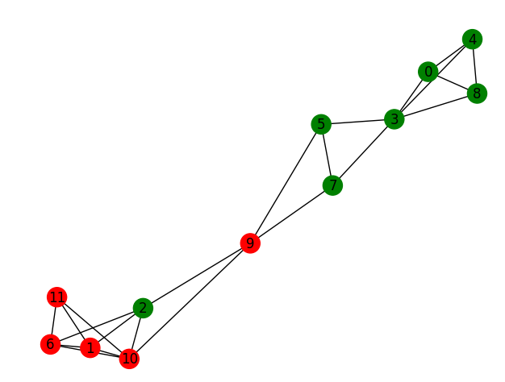
GraphSAGE GNN Clustering Output

Slide 22
Conclusions and Future Works
High performance GNN-based VANET clustering on open-source highD traffic dataset
Average cluster lifetime (12.069±0.037s)
Coverage percentage (98.927±0.111%)
Future works
Study other traffic scenarios like urban environment
Simulation of Urban Mobility (SUMO) for long-term performance

