Slide 1

COVID-19 Classification via CT-Scan Images leveraging Deep Learning Methods
UNIVERSITY OF CHICAGO: MSCA
DEEP LEARNING & IMAGE RECOGNITION COURSE (37011-2)
TEAM MEMBERS: VINCE LEE, NAZARAT HOSSAIN & JOE COSTELLO

Slide 2
COVID-19 Background
Problem & Opportunity Definition
Agenda
Data Description
Data Preprocessing
Analysis Approach
Model & Performance Evaluation
Conclusion & Next Steps

Slide 3
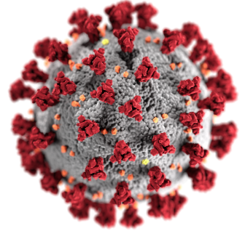
COVID-19 BACKGROUND
Naming Convention
Coronavirus Disease 2019 (COVID-19)
‘CO’ stands for ‘corona,’ ‘VI’ for ‘virus,’ and ‘D’ for disease
Etymology - “Corona” name due to crown-like structure
“Novel” & often confused with other coronaviruses
(ex. Common Cold with mild symptoms)
Appearing 2-14 days after exposure
Fever or Chills,
Cough
Shortness of Breath or difficulty breathing
Fatigue, Muscle or Body Aches
Headache
Sore throat, new loss of taste or smell & etc.
Symptoms
https://www.cdc.gov/coronavirus/2019-ncov/faq.html#Coronavirus-Disease-2019-Basics

Slide 4
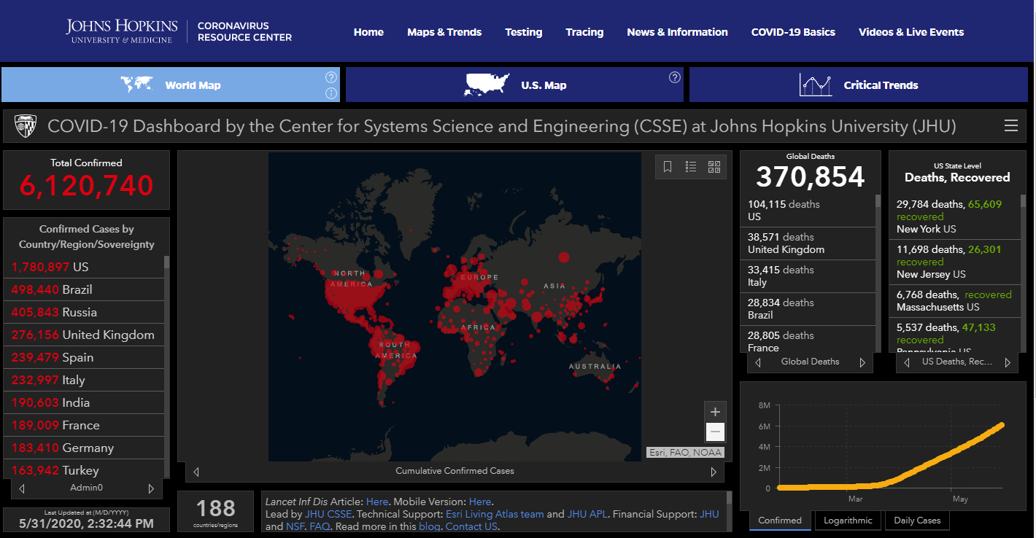
COVID-19 Impact
Disease World-Wide Tracking:
John Hopkins University
Human Impact
Confirmed Cases
> 6M* world-wide
> 1.7* United States
Deaths (COVID-19 was a factor)
> 370K* deaths worldwide
> 100K* deaths in the US
https://coronavirus.jhu.edu/map.html
* Statistics as of 2020-05-31

Slide 5
COVID-19 Background
Problem & Opportunity Definition
Agenda
Data Description
Data Preprocessing
Analysis Approach
Model & Performance Evaluation
Conclusion & Next Steps

Slide 6
COVID-19 DIAGNOSTIC CHALLENGES & OPPORTUNITIES
Challenge
Opportunity
Unavailable, Inaccurate, & Delayed
COVID -19 identification contributes to:
Delayed & suboptimal treatment interventions for patients lead to poor health outcomes with a potential prognosis of death.
Inaccurate disease tracking to isolate patients to mitigate the spread of the disease
Ancillary COVID-19 deep learning diagnostic methods leveraging CT-images in concert with standard testing protocols (blood, saliva, etc.) will:
improve testing accuracy
drive quick & optimal patient treatment options
improve patient health outcomes
reduction of disease spread

Slide 7
COVID-19 Background
Problem & Opportunity Definition
Agenda
Data Description
Data Preprocessing
Analysis Approach
Model & Performance Evaluation
Conclusion & Next Steps

Slide 8
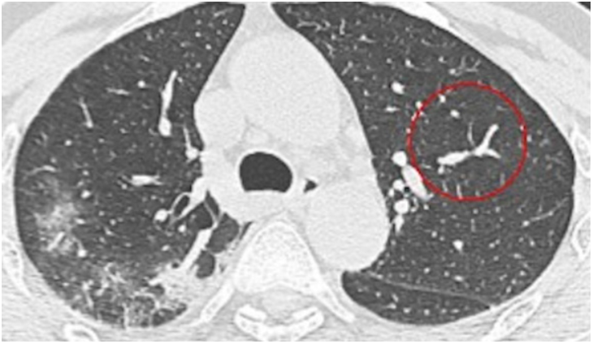
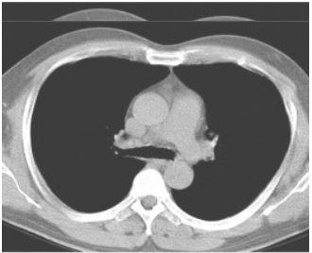
COVID-19 CT Grand Challenge Dataset
Source
CT Scans via patients from Tongji Hospital, Wuhan China
Data
CT Images are scanned into medical journals
Couple key CT slices of the patient’s lungs were copied
Phone photo capture of the journal CT scans
743 total images: Positive COVID-19 = 346 & Non-COVID-19 = 397
Ground Truth
Senior Radiologist with large amount of COVID-19 identification & treatment of patients in Wuhan, China
Challenges
Phone capture of CT images from journals reduces quality
Limited key CT slices are passed to the journals
COVID-19
Non-COVID-19

Slide 9
COVID-19 Background
Problem & Opportunity Definition
Agenda
Data Description
Data Preprocessing
Analysis Approach
Model & Performance Evaluation
Conclusion & Next Steps

Slide 10
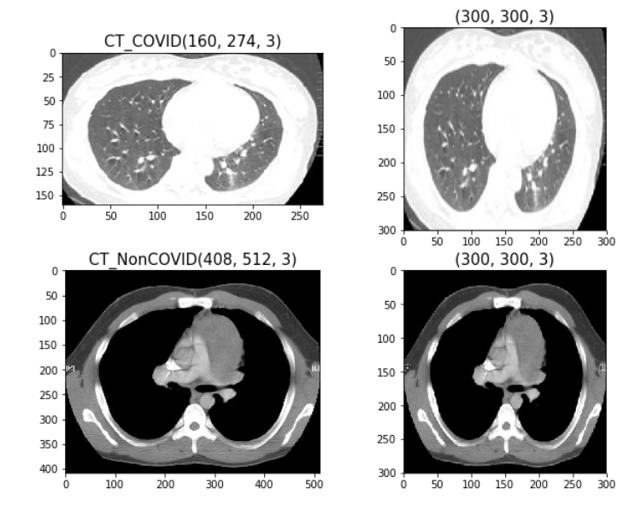
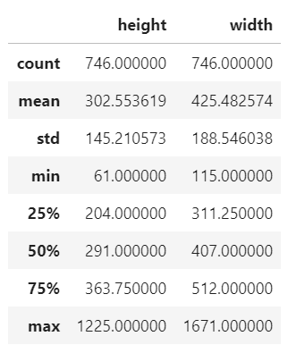
Data Preprocessing (1)
1. Check the image size of all images
Standardize image sizes around the mean (300) for height and width
Notes:
Images have different sizes. So, it's better to standardize them around the mean. 300 seems to be an appropriate choice for height and width.

Slide 11
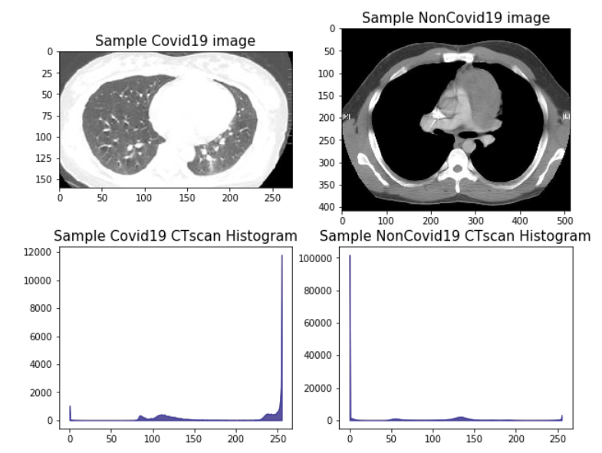
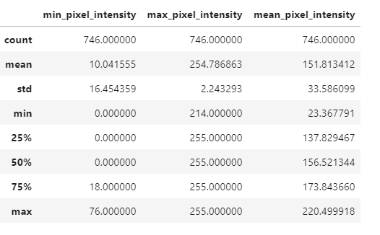
Data Preprocessing (2)
2. Check pixel intensities on COVID and Non-COVID images
CT scan images are in gray scale and do not have red/blue/green color intensities
Lighter and darker images in the data set
Notes:
Images are in gray scale and do not have much red/blue/green color intensities as they are CT scan images

Slide 12
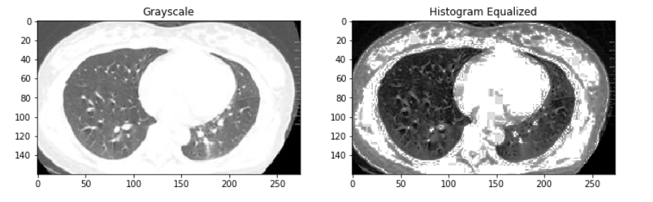
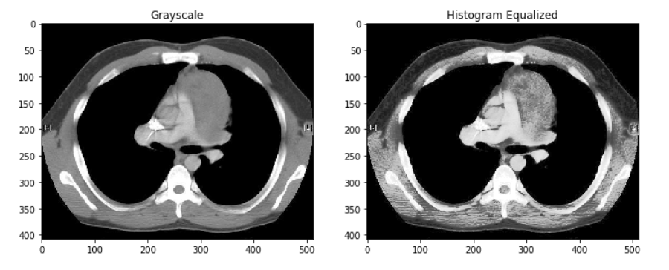
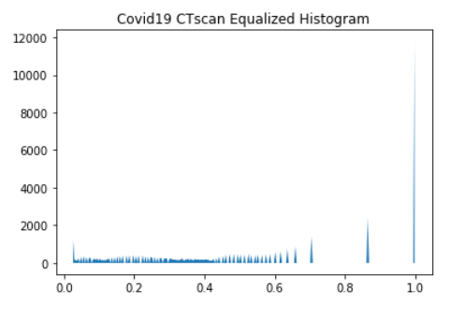
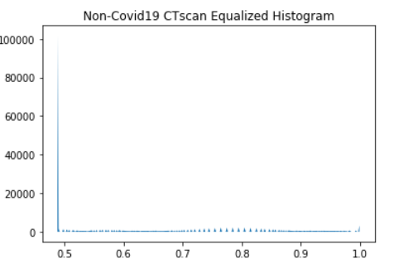
Data Preprocessing (3)
3. Equalizing pixels on COVID and Non-COVID images
Equalization is not be applicable due to the grayscale image
Notes:
Equalization may not be applicable due to the greyscale image with quite balanced colors
As some images are really dark and have their histogram concentrated on the lower values of the intensity. So we try to enhance the contrast of the image by equalizing the histogram.
It is not necessary that contrast will always be increase in this. There may be some cases were histogram equalization can be worse. In that cases the contrast is decreased.

Slide 13
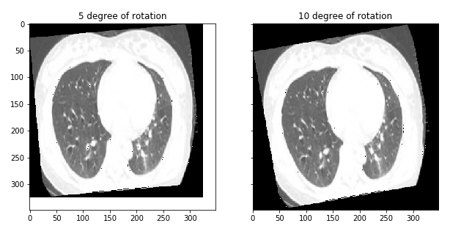
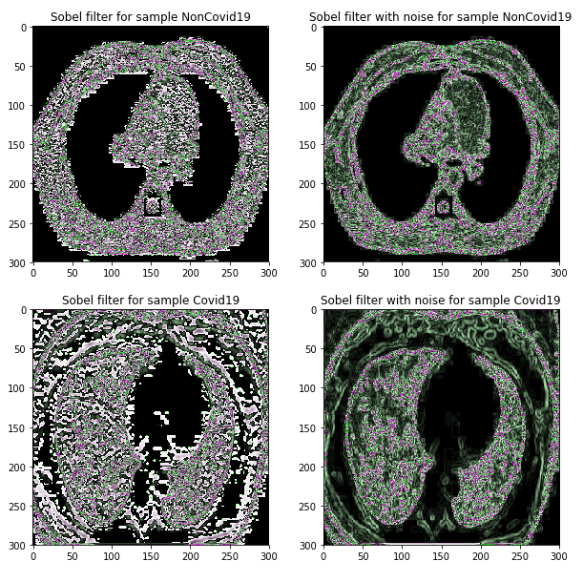
Data Preprocessing (4)
4. Check the significance of rotate data
5. Edge detection
There is not much difference to the image as when the focus is on the content of the lungs instead of the shape.
Notes:
There is not much difference to the image as when the focus is on the content of the lungs instead of the shape.
Most of the shape information of an image is enclosed in edges. So first we try to detect edges using these sobel filter and enhance those areas of image which contains edges. We expect that sharpness of the image will increase and image will become clearer. But it does not work well.
Most of the shape information of an image is enclosed in edges. So first we detect these edges in an image and by using these filters and then by enhancing those areas of image which contains edges, sharpness of the image will increase and image will become clearer.

Slide 14
Data Preprocessing (5)
6. Format Data
Normalize pixel values between 0 and 1
Perform label encoding for 2-class labelling: 'CT_COVID’, 'CT_NonCOVID'
7. Train/Test split : 80/20
Train Images 596
Test Images 150
Notes:
We normalize the pixel values so that each pixel value has a value between 0 and 1. Then images can be viewed normally. This can be achieved by dividing all pixels values by the largest pixel value; that is 255
We split the data into training and test sets, with an 80-20 split. Finally we get 596 train images and 150 test images.

Slide 15
COVID-19 Background
Problem & Opportunity Definition
Agenda
Data Description
Data Preprocessing
Analysis Approach
Model & Performance Evaluation
Conclusion & Next Steps

Slide 16
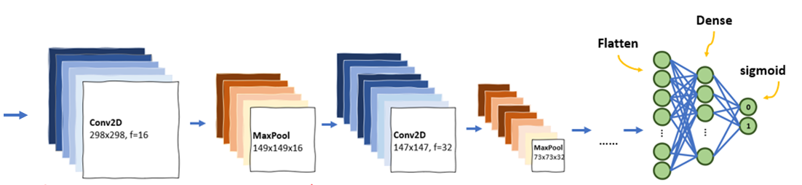
Analysis Approach
COVID-19 Classification using Convolutional Neural Network (CNN)
Conv2D
300X300
MaxPool
150X150
Conv2D
150X150
MaxPool
75X75
Input Shape:
300X300
1st layer
2nd layer …………..
Using Image augmentation techniques ( rotation, shifting, flipping, color space etc.) are used on the training set to add variation
Adding convolutional layer, changing filter size etc.
Using regularization techniques
Using transfer learning
Using different optimizers to evaluate the performance of models

Slide 17
COVID-19 Background
Problem & Opportunity Definition
Agenda
Data Description
Data Preprocessing
Analysis Approach
Model & Performance Evaluation
Conclusion & Next Steps

Slide 18
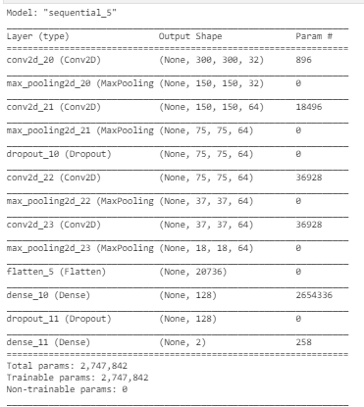
CNN Model 1
Model 1 Description
Model 1 Summary
4 convolutional layers
- 1st layer:
32 filters, kernel size = 3x3, same padding,
activation= relu, max pool size =2,2
- 2nd, 3rd and 4th layer:
64 filters, kernel size = 2X2, same padding,
activation= relu, max pool size =2,2
Flatten out the feature outputs
Dense Layer: 128 neurons, activtion=relu
Dropout
Output: 2, activation=softmax

Slide 19
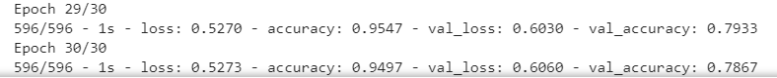
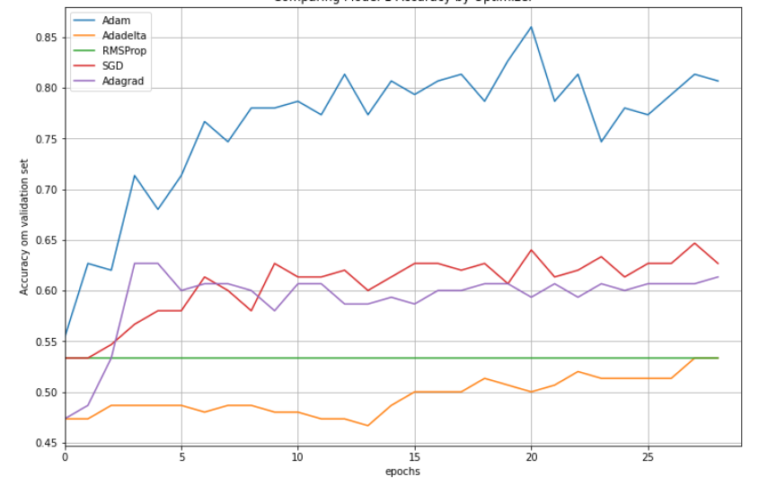
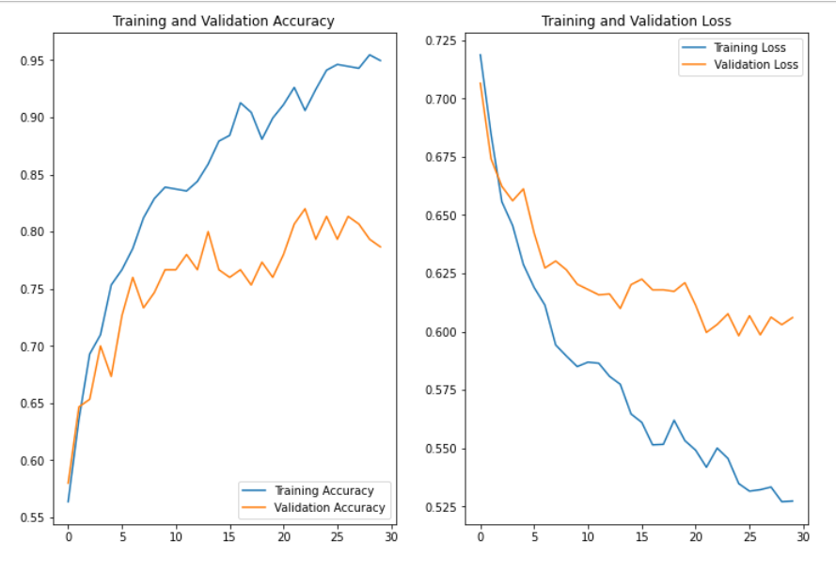
Analysis of the CNN Model 1
Optimizers comparison of Model 1
“Accuracy” and “Loss” of both Training and Validation
Adam performs the best for Model 1. Accuracy improves after reducing epoch from 30 to 29. (Loss: 60.0%, Accuracy: 80.67%)
At the end of the 30th epoch, the trained CNN model 1 has a validation loss of 60.6% and accuracy of 78.67%.
Notes:
Among the 5 optimizers, Adam performs the best for Model 1. Accuracy improves after reducing epoch from 30 to 29.

Slide 20
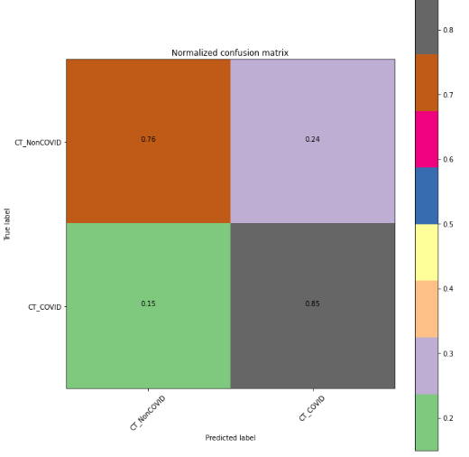
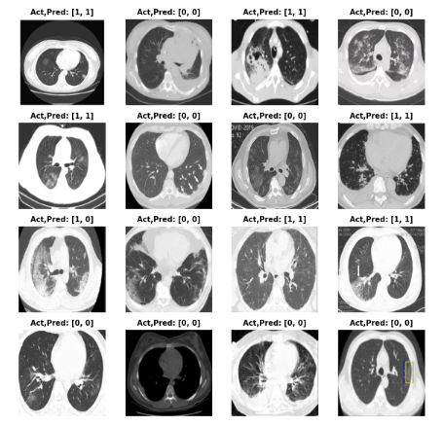
Performance of the CNN Model 1
Visualization of predictions
Normalized Confusion Matrix
Evaluation Metrics
Precision | 0.80
Recall | 0.85
F1 Score | 0.82
ROC AUC | 0.80
TN 0.76
FN 0.24
FP 0.15
TP 0.85
False Negative

Slide 21
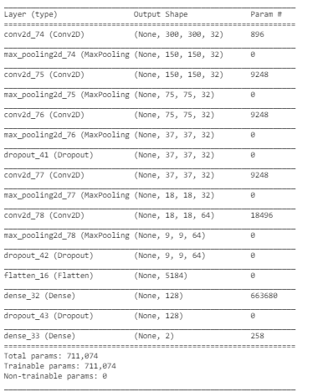
CNN Model 2
Model 2 Description
Model 2 Summary
5 convolutional layers (add 1 layer and reduce filters)
- 1st, 2nd, 3rd and 4th layer:
32 filters, kernel size = 3x3, same padding,
activation= relu, max pool size =2,2
- 5thth layer:
32 filters, kernel size = 3X3, same padding,
activation= relu, max pool size =2,2
Flatten out the feature outputs
Dense Layer: 128 neurons, activtion=relu
Dropout
Output: 2, activation=softmax
Notes:
Try another model with additional 1 convolutional layer and reduce the filters of 2nd, 3rd, and 4th layer from 64 to 32.
- 5 convolutional layers
- 1st layer: 32 filters, kernel size = 3x3, same padding, activation= relu, max pool size =2,2
- 2nd layer: 32 filters, kernel size = 3X3, same padding, activation= relu, max pool size =2,2
- 3rd layer: 32 filters, kernel size = 3X3, same padding, activation= relu, max pool size =2,2
- Dropout
- 4th layer: 32 filters, kernel size = 3X3, same padding, activation= relu, max pool size =2,2
- 5th layer: 64 filters, kernel size = 3X3, same padding, activation= relu, max pool size =2,2
- Dropout
- Flatten out the feature outputs
- 6th layer: Dense - 128 neurons, activtion=relu
- Dropout
- Output: 2, activation=softmax

Slide 22

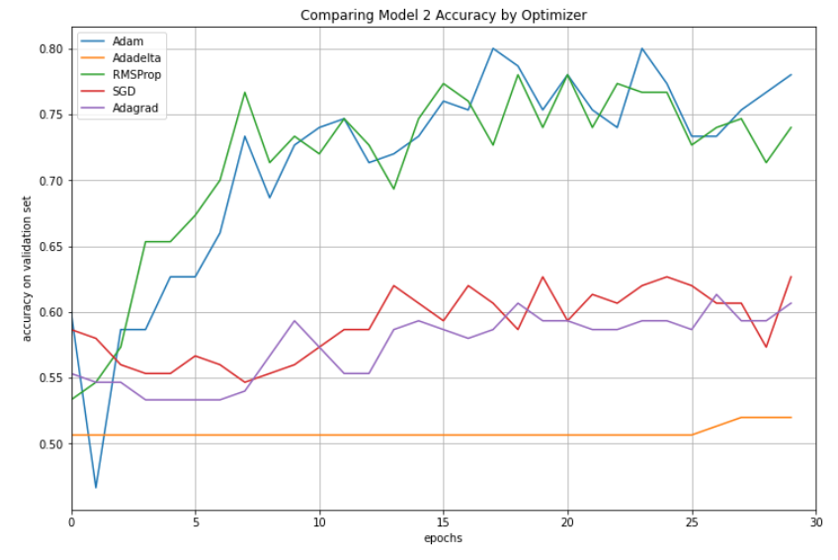
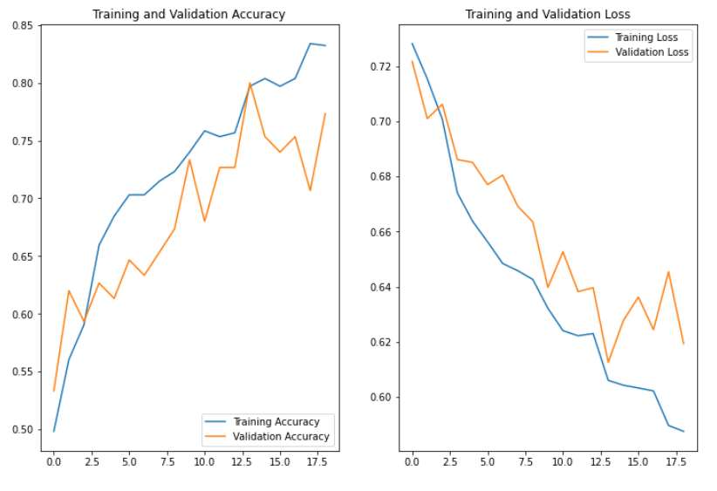
Analysis of the CNN Model 2
Optimizers comparison of Model 2
“Accuracy” and “Loss” of both Training and Validation
Adam performs the best for Model 2, also. (Loss: 61.7%, Accuracy: 78%)
At the end of the 9th epoch, the trained CNN model 2 has a validation loss of 62.3% and accuracy of 76.67%.
Notes:
Among the 5 optimizers, Adam performs the best for Model 2

Slide 23
Performance of the CNN Model 2
Visualization of predictions
Normalized Confusion Matrix
Evaluation Metrics
Precision | 0.77
Recall | 0.84
F1 Score | 0.80
ROC AUC | 0.78
TN 0.71
FN 0.29
FP 0.16
TP 0.84
False Negative

Slide 24
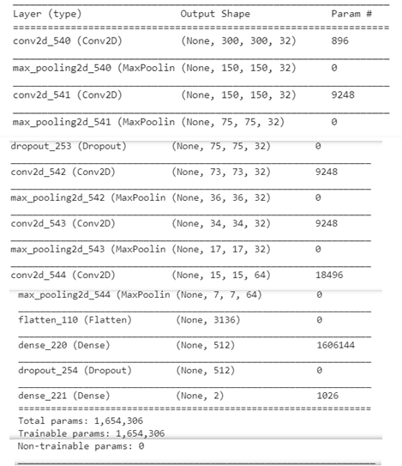
CNN Model 3
Model 3 Description
Model 3 Summary
5 convolutional layers (add 1 layer and reduce filters)
- 1st, 2nd, and 3rd :
32 filters, kernel size = 3x3, same padding,
activation= relu, max pool size =2,2
- 4th layer and 5th layer:
32 filters and 64 filters, kernel size = 3X3,
same padding, activation= relu, max pool size =2,2,
Applying kernel L2 regularization onto last 2 convolutional
layers (to add L2 penalty/constrain on the weights, forces the
weights to decay towards zero to avoid overfitting on the
training set)
Flatten out the feature outputs
Dense Layer: 512 neurons, activtion=relu
Dropout
Output: 2, activation=softmax
Notes:
Try third model by applying kernel L2 regularization unto last 2 convolutional layers (to add L2 penalty/constrain on the weights, forces the weights to decay towards zero to avoid overfitting on the training set) and increase neurons in Dense layer.
- 5 convolutional layers
- 1st layer: 32 filters, kernel size = 3x3, same padding, activation= relu, max pool size =2,2
- 2nd layer: 32 filters, kernel size = 3X3, same padding, activation= relu, max pool size =2,2
- Dropout
- 3rd layer: 32 filters, kernel size = 3X3, same padding, activation= relu, max pool size =2,2
- 4th layer: 32 filters, kernel size = 3X3, same padding, activation= relu, max pool size =2,2, L2 regularizers at kernel
- 5th layer: 64 filters, kernel size = 3X3, same padding, activation= relu, max pool size =2,2, L2 regularizers at kernel
- Dropout
- Flatten out the feature outputs
- 6th layer: Dense - 512 neurons, activtion=relu
- Dropout
- Output: 2, activation=softmax

Slide 25

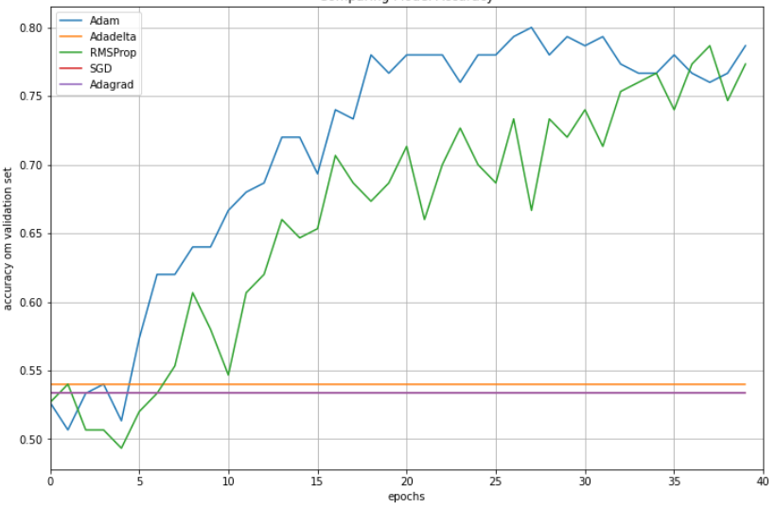
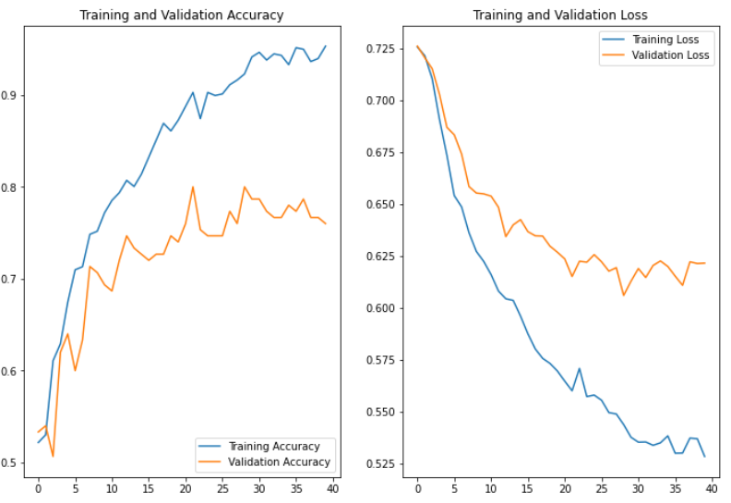
Analysis of the CNN Model 3
Optimizers comparison of Model 3
“Accuracy” and “Loss” of both Training and Validation
Adam performs the best for Model 3 followed by RMSProp. (Loss: 71.7, Accuracy: 78.7%)
At the end of the 40th epoch, the trained CNN model 3 has a validation loss of 61.1% and accuracy of 79.33%.

Slide 26
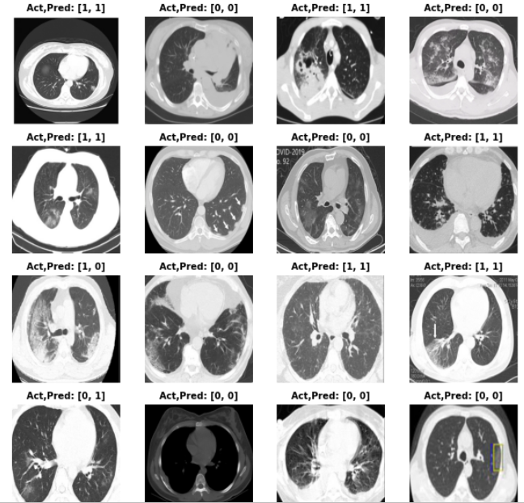
Performance of the CNN Model 3
Visualization of predictions
Normalized Confusion Matrix
Evaluation Metrics
Precision | 0.80
Recall | 0.80
F1 Score | 0.80
ROC AUC | 0.79
TN 0.77
FN 0.23
FP 0.20
TP 0.80
False Negative
False Positive

Slide 27

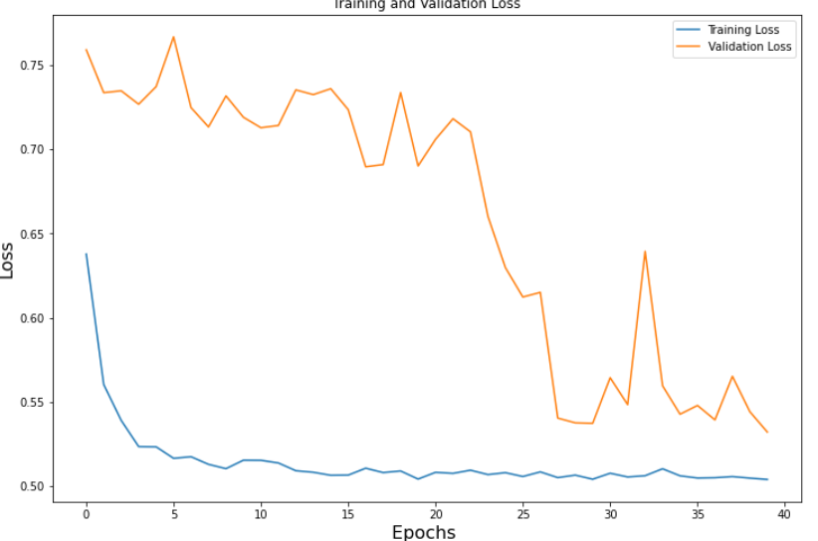
CNN ResNet18 Model
CNN ResNet18 Model Description
CNN ResNet18 Model Summary
11 mil trainable parameters
convolutional layers with 3X3 filters (like VGGNet)
2 pooling layers at the beginning and end
Benefits: Shortcut connections are used to solve vanishing gradient problem, less parameters than VGGNet
Fine tuning model using Global Average Pooling2D (to minimize overfitting by reducing the total number of parameters in the model) at end of ResNet18 before output layer
“Loss” of Training and Validation
Notes:
Fine tuning model using Global Average Pooling2D (to minimize overfitting by reducing the total number of parameters in the model) at end of ResNet18 before output layer
Global Average Pooling 2D (GAP)
- Similar to max pooling layers, GAP layers are used to reduce the spatial dimensions of a three-dimensional tensor. However, GAP layers perform a more extreme type of dimensionality reduction, where a tensor with dimensions h×w×d is reduced in size to have dimensions 1×1×d. GAP layers reduce each h×w feature map to a single number by simply taking the average of all hw values.

Slide 28
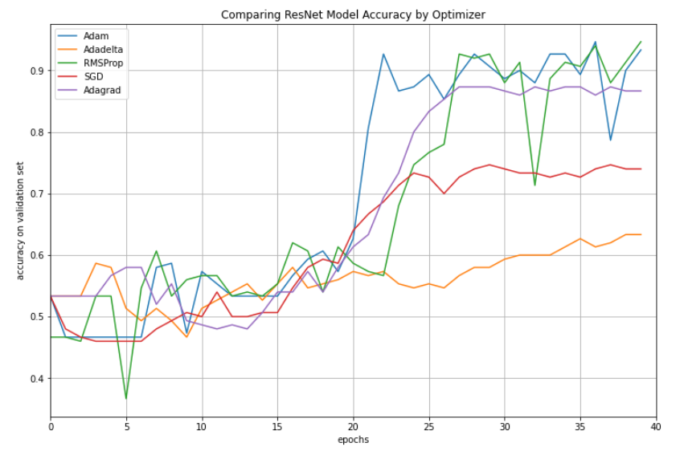
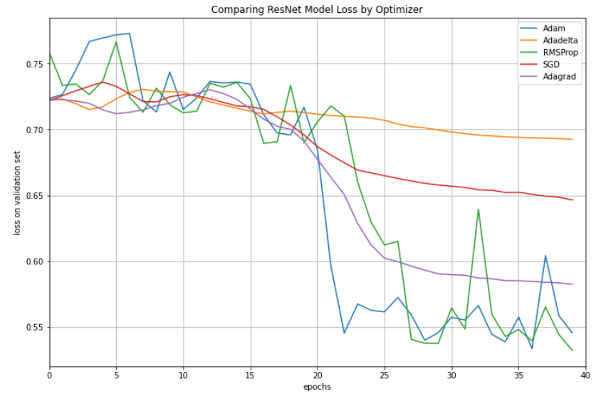
Analysis of the CNN ResNet18 Model
Comparison of CNN ResNet Model Accuracy by Optimizers
Comparison of CNN ResNet Model Loss by Optimizers
In terms of validation accuracy and loss, RMSProp performs the best, followed by Adam.

Slide 29
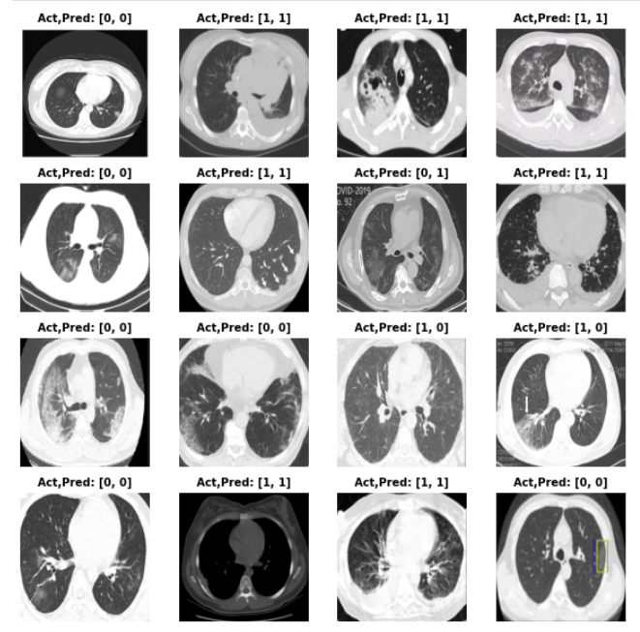
Performance of the CNN ResNet18 Model
Visualization of predictions
Normalized Confusion Matrix
Evaluation Metrics
Precision | 0.96
Recall | 0.94
F1 Score | 0.95
ROC AUC | 0.95
TN 0.96
FN 0.04
FP 0.06
TP 0.94
All of 16 samples are accurately predicted now

Slide 30
Comparison of CNN Models Performance
 | Evaluation Metrics
CNN Models | Precision | Recall | F1 Score | ROC AUC | Accuracy
Model 1 | 0.80 | 0.85 | 0.82 | 0.80 | 80.7%
Model 2 | 0.77 | 0.84 | 0.80 | 0.78 | 78.0%
Model 3 | 0.80 | 0.80 | 080 | 0.79 | 78.7%
ResNet18 | 0.96 | 0.94 | 0.95 | 0.95 | 94.7%
ResNet-18 CNN performs better in terms of recall as we want to reduce the risk of false negative (actual Covid but predicted as non-Covid).

Slide 31
COVID-19 Background
Problem & Opportunity Definition
Agenda
Data Description
Data Preprocessing
Analysis Approach
Model & Performance Evaluation
Conclusion & Next Steps

Slide 32
Conclusion & next steps
CNN ResNet18 Model performs better than any other non-pretrained models. There is a benefit of applying transfer learning on COVID19 CT scan images.
In comparing the models, there should be an increased emphasis on the recall metric to minimize the spread of disease and drive responsive treatment options.
Received enhance quality and high fidelity images from various imaging techniques: CT scans, MRI etc. and the option to add color

Slide 33
Supplemental Slides

