Slide 1
Semantic Reasoner
Artem Nazarenko, Joao Sarraipa

Slide 2
Architecture of Semantic Reasoner
Notes:
This slide introduces the Semantic Data Management Component (SDMC). As already mentioned it has two core parts Storage and Harmonisation. The storage uses a NoSQL graph database and Harmonisation module is developed using the Node.js framework. The SDMC component offers a set of services to outside, in particular to Data Analytics Component. The input for SDMC, as well as the output, is a nested JSON document with a data model. Moreover the SDMC can be enriched with imported ontologies and data models, developed by the third parties.

Slide 3
Semantic Reasoner
Some definitions of the SDMC:
Harmonisation module – has several responsibilities:
Messaging – implements functionalities to query Neo4j;
Data Clearing – extracts the needed information from the graph DB output;
Composition – allowing construct the complex output document.
Storage – is a NoSQL graph DB, used not only for storing the data, but, extended with plugin (APOC) with some ready-to-use graph algorithms.
Set of Services – the examples of service are described in further parts of particular course.
Input – curl query that, depending on the service, can contain the nested JSON document with data model and/or imported ontologies and external data models.
Output – depending on the service, can be represented as a nested JSON document containing the results produced by a certain service, which was used.
Notes:
SDMC receives the input from some external applications or other vf-OS components, proceeding it further to Harmonisation module, which, based on the chosen service, initiates the necessary actions within the Storage module, whereas returning nested output. Storage module in SDMC is used for more than just storing the data, but also enabling usage of wide range of algorithms through adding the corresponding plugin. Among the most important algorithms are, for instance, path finding.

Slide 4


Technological Solutions
Harmonisation module (Node.js):
Official supported by Neo4j, possesses the apropriate libraries
Supports the BOLT protocol (is used to connect to Neo4j)
Supports the modular way of developing.
Storage (Neo4j):
Graph-DB
Various plugins extending functionality, including algorithms
Supports integration of data in various formats (RDF, Turttle, JSON, .CSV, etc.)
Efficiently processing large amount of data
Cypher querying language, as a main tool to explore the database.

Slide 5
Enabled Services
Service | Description | URL Parameters | Payload | Method
getConcept | Returns the equested concept | /ontology/name | NO | GET
getAllConcepts | Returns all available con concepts | /ontology/ | NO | GET
getRecommendation | Returns recommendation between a specific concept and another concept of a certain type with a sepcific parent. | /ontology/name_1/name_2/type | NO | GET
createConcept | Creates a single concept | /ontology/name | NO | POST
createLink | Creates a link between two concepts | /ontology/name_1/name_2 | NO | POST
postModel | Maps two data models „origin“ and „target“ ones and produces the structured output with a set of suggestions from the target model for each concept in origin. | /ontology/ | YES | POST
updateLinkValue | Updates the weight of a relationship link between two concepts. | /ontology/name_1/name_2 | NO | PUT
putValuePairs | Enables insertion of several concepts in the form of origin/target concepts. | /ontology/ | YES | PUT
deleteConcept | Deletes a particular concept. | /ontology/name_1/name_2 | NO | DELETE
deleteLink | Deletes a link between two specific concepts. | /ontology/name | NO | DELETE
deleteAll | Deletes all concepts. | /ontology/ | NO | DELETE

Slide 6
PostModel Service
Goal:
Mapping of two data models, by finding the „closeness“ of the concept in „Origin“ sub-model to the concepts delivered in „Target“ sub-model.
Mechanisms:
The parameters delivered with payload are converted to concepts and relationships, in the definitions of the graph DB – nodes and relations. Thus there is a possibility to apply the path finding algorithm, in this case “Dijkstra”, to the content.
Using weighted path finding algorithm , the “Semantic Distance” between two concepts is calculated.

Slide 7
Example of PostModel Service
Structure of the Input:
Insertion of the nodes and links between the nodes into the Neo4j.
Every node is a concpet. A concept can be everything, student, study subject, learning material, etc.
The service returns several suggestions with the shortest path from the concept (defined under the „label“ in JSON structure) in origin to the concepts in target.
Items in the „tag“ will be also inserted as „nodes“, as well as parent node of the concept specified under the „xpath“ will be created or if exist the link will be updated.
Moreover, the filed type can be used to specify the type of the node, which can be utilized by other services.
{
"origin":[
{"label":"John",
"tag":["programming", "algorithms", "discrete mathematics"],
"type":"",
"xpath":["student", "informatics"]
},
{"label":"Jane",
"tag":["algebra","algorithms","graph theory"],
"type":"",
"xpath":["student", "mathematics"]
},
{"label":"Kate",
"tag":["programming","algebra","mechanics"],
"type":"",
"xpath":["student","engineering"]
},
],
"target":[
{"label":"informatics",
"tag":["algorithms", "programming", "operating systems", "databases"],
"type":"",
"xpath":["study course"]
},
{"label":"mathematics",
"tag":["algebra", "graph theory", "discrete mathematics"],
"type":"",
"xpath":["study course"]
},
{"label":"physics",
"tag":["mechanics", "optics", "electromagnetism"],
"type":"",
"xpath":["study course"]
},
]
}

Slide 8
Example of PostModel Service
[
{
"origin": [
{
"label": "informatics",
"xpath": [
"study course"
]
},
{
"suggestion": {
"label": "REST_API_with_Nodejs",
"score": 2,
"xpath": [
"video",
"learning material",
"programming"
],
"rank": 1
},
"graph": [
{
"start": "informatics",
"weight": "1",
"end": "programming"
},
{
"start": "programming",
"weight": "0.6000000000000001",
"end": "REST_API_with_Nodejs"
}
]
},
{
"suggestion": {
"label": "NoSQL_graph_databases",
"score": 2,
"xpath": [
"video",
"learning material",
"databases"
],
"rank": 2
},
…
]
Structure of the Output:
The PostModel service will return a ranked set of suggestions for each origin node.
In the presented example suggestion name is specified in the field „label“
The score specifies number of nodes in-between the target and origin (will be changed for the cumulative sum of all weights on the path between origin and target).
Rank stands for the rank of suggestion, which is caluclated based on the weights of relation between the nodes on the path between origin and target.
Graph stands for the path between the origin and target.
Xpath indicates the related and parent nodes.

Slide 9
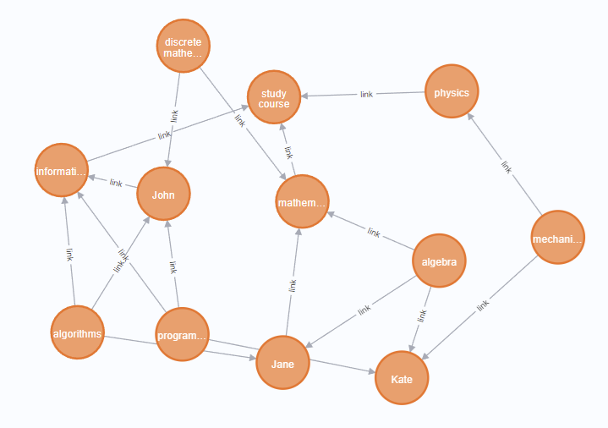
Example of PostModel Service
The mapping of origin and target concepts introduced in the slide 7 presented here:
There are 3 origin concepts, which are students (John, Jane, Kate).
And 3 target concepts that are the study courses (informatics, physics, mathematics).
Here are the target suggestions for the student „John“, namely the first suggestion is „informatics“ with the weight 0.6, second suggestions is „mathematcis“ with weight 1.2, as John is also subscribed to „discrete mathematics“, which is one of the „mathematics“ topic, and the last suggestion 1,817 is „physics“ through the common parent node „study course.
{rank: 1, weight: 0.6000000000000001, origin: (:concept {name: "John",
│type: ""}), path: (:concept {name: "John",type: ""})-[:link {Weight: 0
│.6000000000000001}]->(:concept {name: "informatics",type: ""})}
├────────────────────────────────────────────────────────────┤
│{rank: 2, weight: 1.2000000000000002, origin: (:concept {name: "John",
│type: ""}), path: (:concept {name: "John",type: ""})<-[:link {Weight:
│0.6000000000000001}]-(:concept {name: "discrete mathematics"})-[:link
│{Weight: 0.6000000000000001}]->(:concept {name: "mathematics",type: ""
│})}
├────────────────────────────────────────────────────────────┤
│{rank: 3, weight: 1.8176470588235296, origin: (:concept {name: "John",
│type: ""}), path: (:concept {name: "John",type: ""})-[:link {Weight: 0
│.6000000000000001}]->(:concept {name: "informatics",type: ""})-[:link
│{Weight: 0.6176470588235294}]->(:concept {name: "study course"})<-[:li
│nk {Weight: 0.6000000000000001}]-(:concept {name: "physics",type: ""})
│}

Slide 10
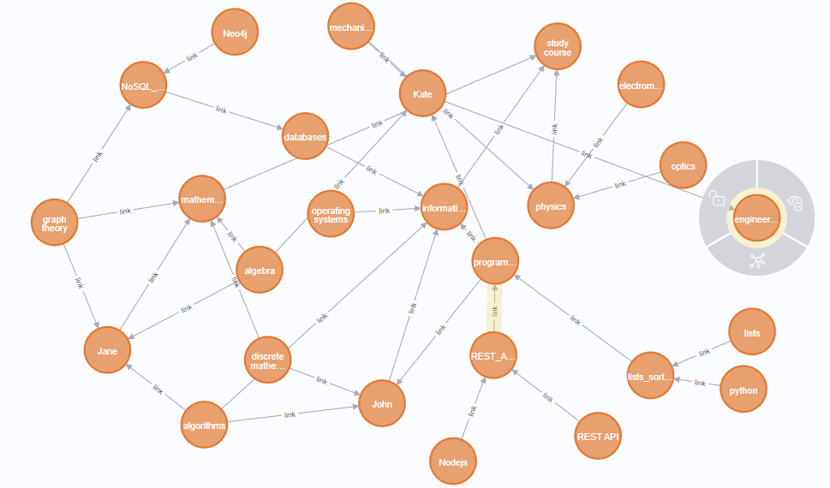
Graph in Neo4j after Model insertion

Slide 11
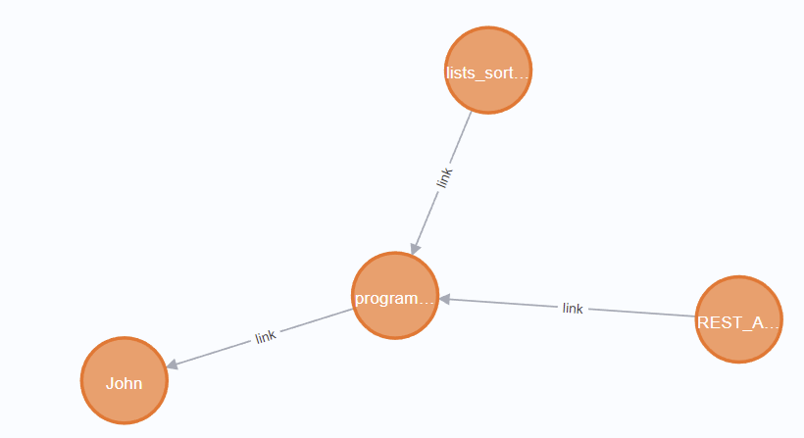
Get Recommendations
Example:
John is a student, who is subscribed to the course of programming.
Neo4j contains several videos that directly linked to the programming course.
Based on the studying courses subscriptions, a set of video suggestions is offered to John.
Compared to the PostModel service, this service offers direct matching of the concpets based on the type of the node.
(:concept {name: "John",type: ""})<-[:link {Weight: 0.6000000000000001│
│}]-(:concept {name: "programming"})<-[:link {Weight: 0.625}]-(:concept│
│ {name: "REST_API_with_Nodejs",type: "video"}) │
├─────────────────────────────────────────────────────────┤
│(:concept {name: "John",type: ""})<-[:link {Weight: 0.6000000000000001│
│}]-(:concept {name: "programming"})<-[:link {Weight: 0.625}]-(:concept│
│ {name: "lists_sorting_in_Python",type: "video"})

Slide 12
Thank you for your attention!

