Slide 1
PurchasePerfect Intro

Slide 2
The Solution: PurchasePerfect
PurchasePerfect is a procurement solution that helps Companies control spending, manage suppliers, and automate internal workflows

Slide 3
Solution
Features
ERP purchasing modules
Workflow Editor
Budget Control
Operate from a private cloud
Solution
Features
Best practices
in the region
Customization & Integration
English &
Arabic
Interface
ع
Supplier
Management
E
Process
Automation

Slide 4
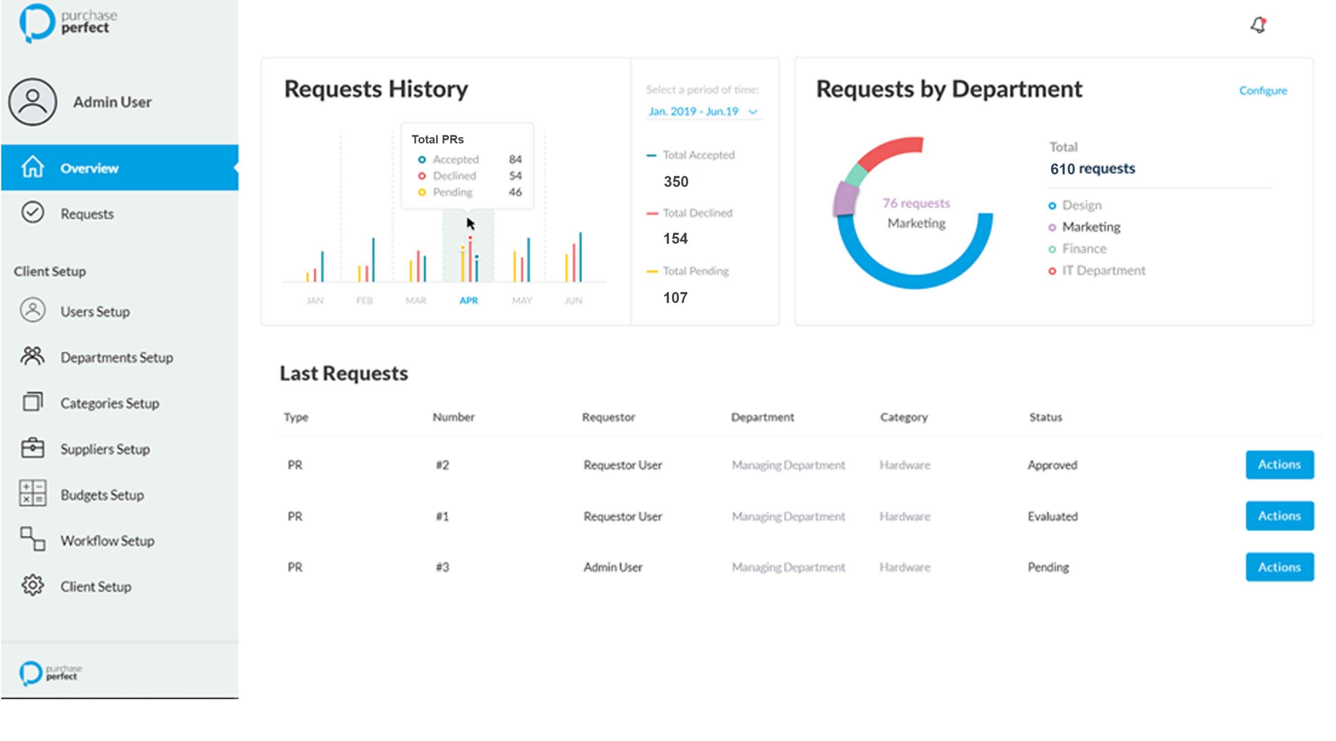
Company Overview

Slide 5
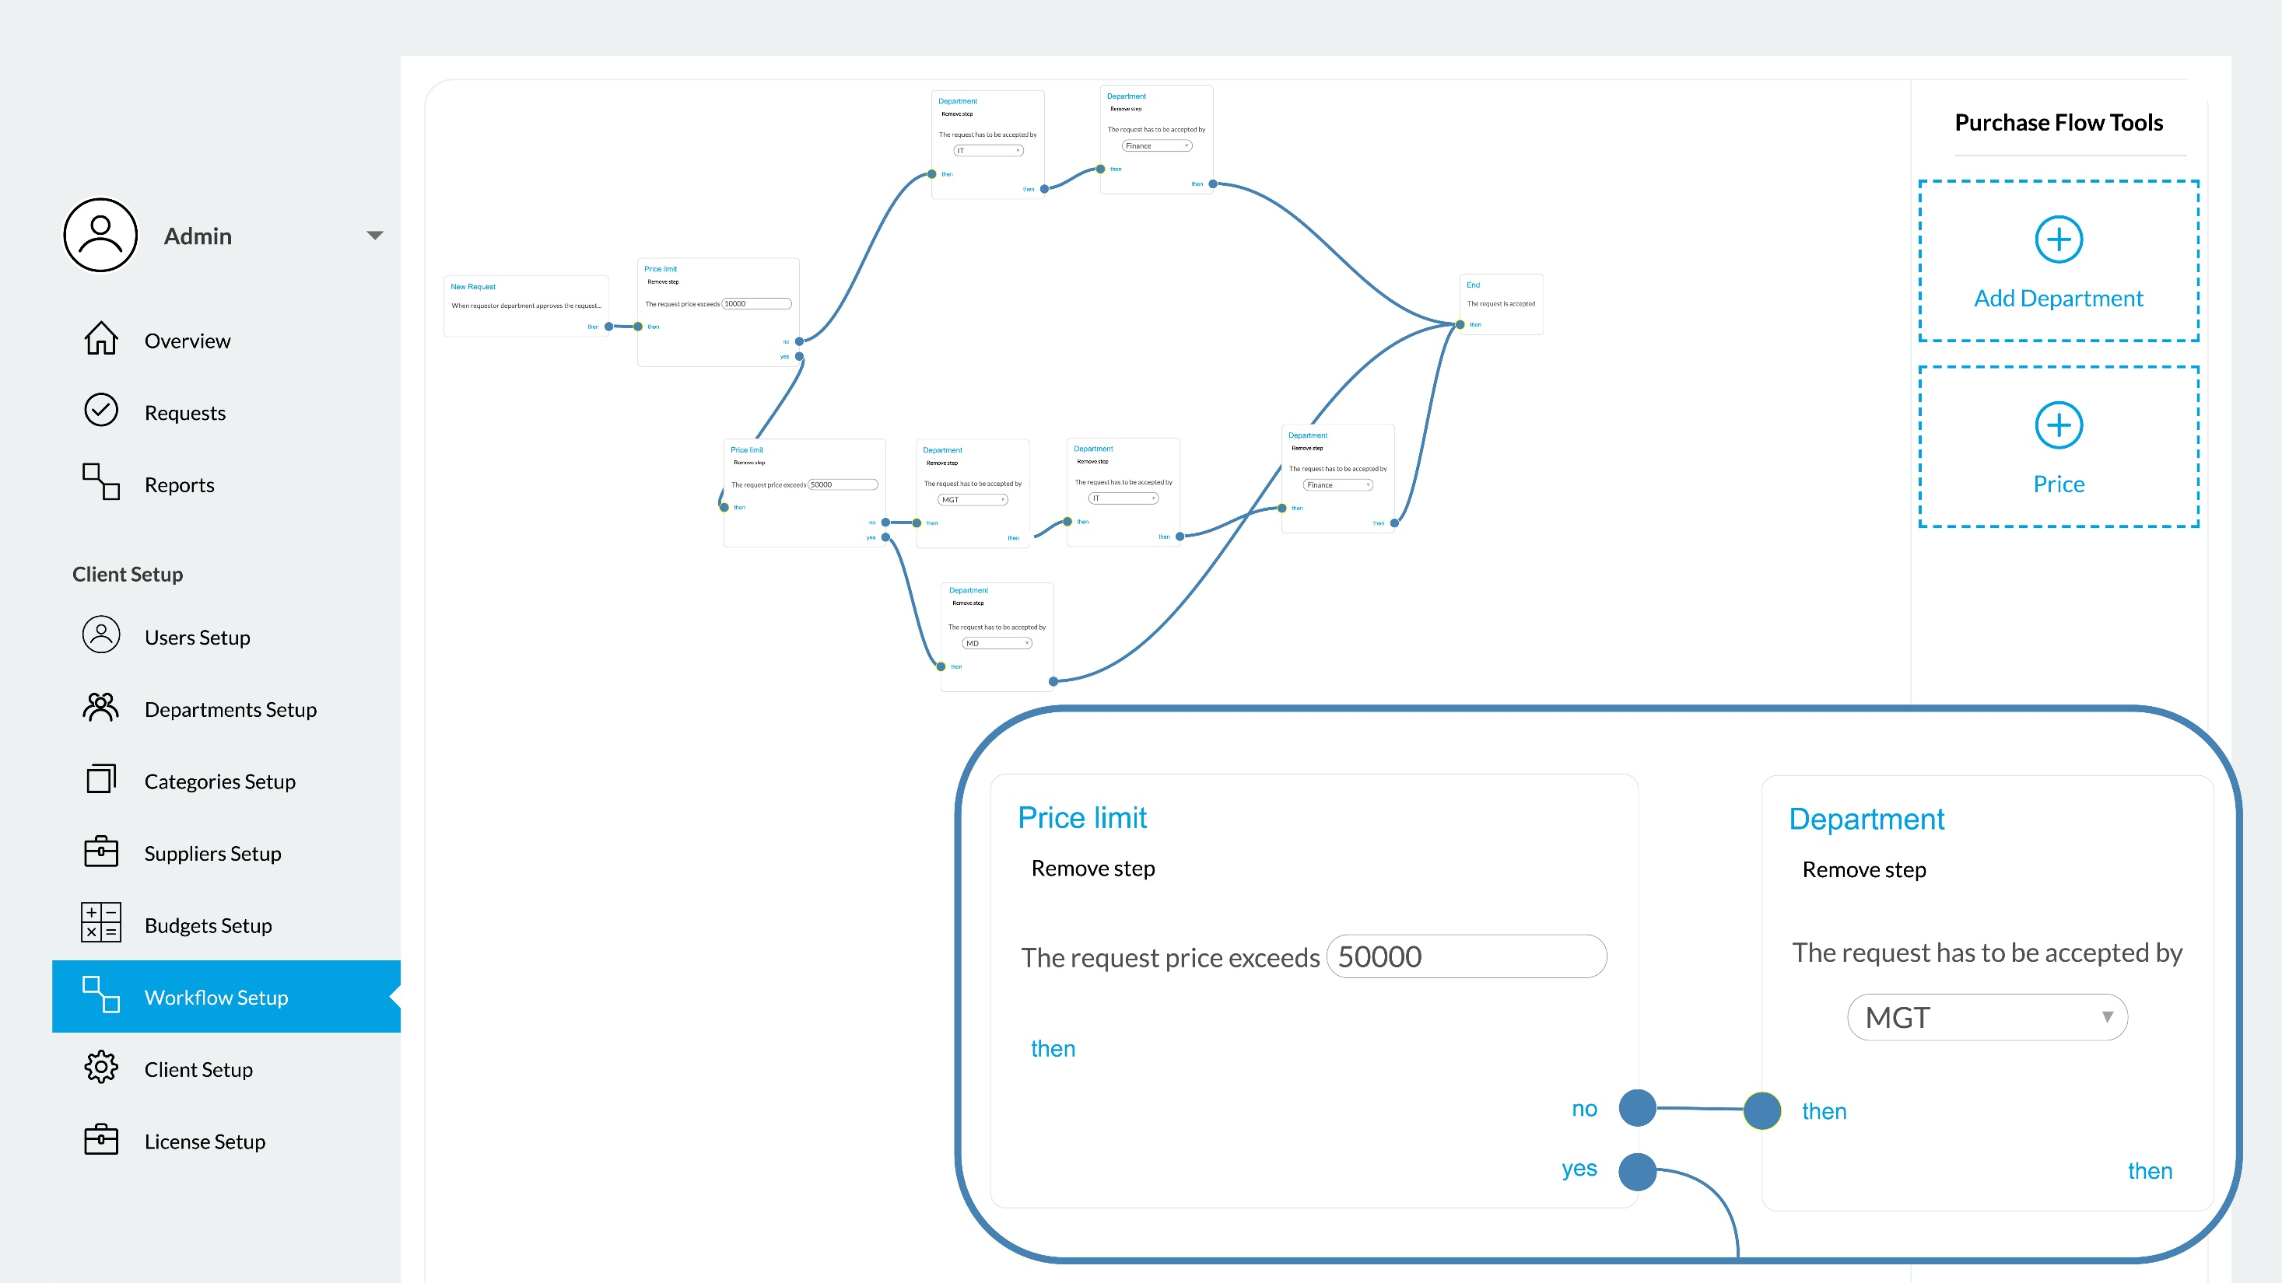
Budget
Checks
Multiple Approvals
If/Then/Else Logic
Workflow Editor

Slide 6
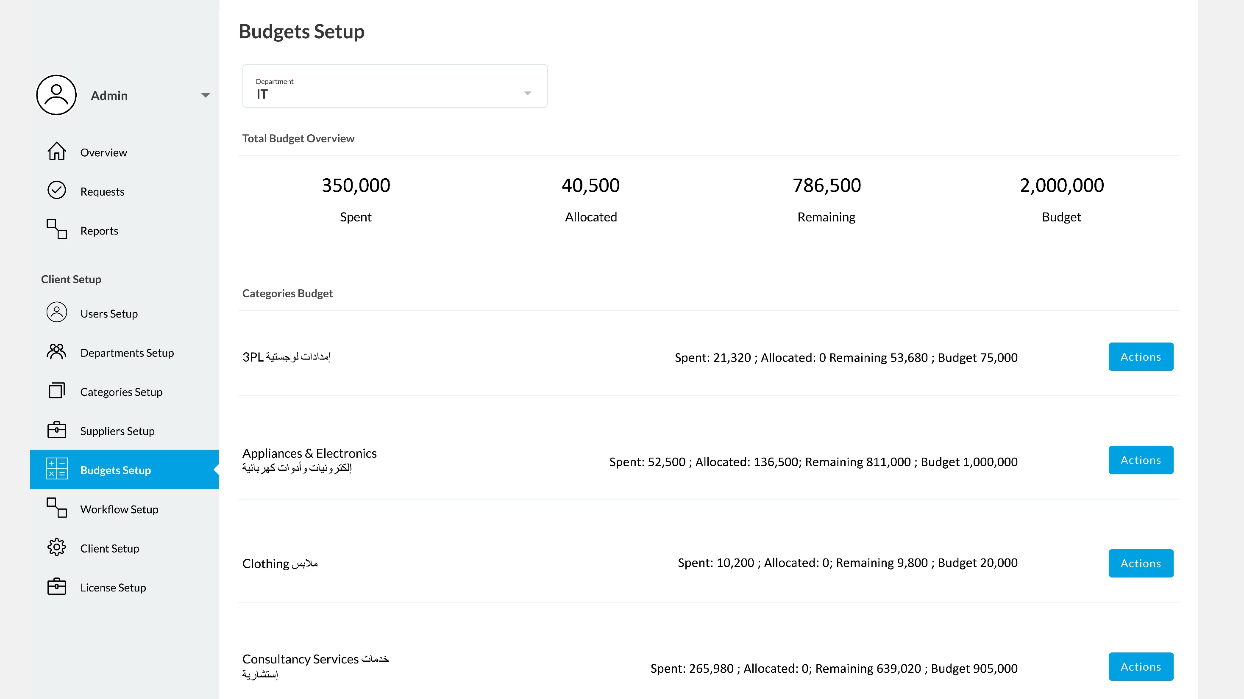
Budget Overview

Slide 7
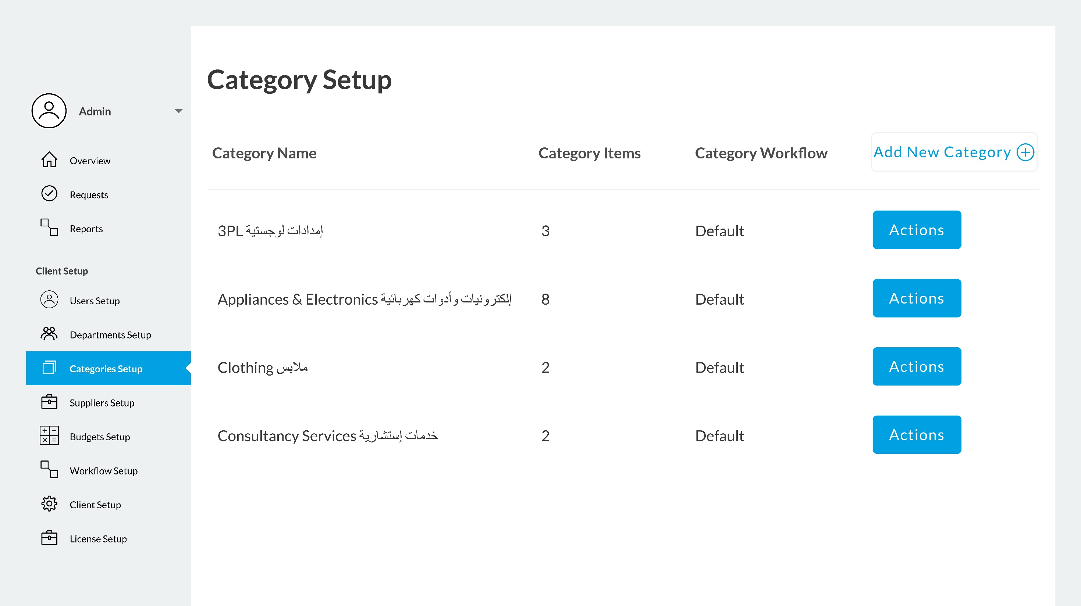
Spend Pools

Slide 8





Team Credentials
Ali AlZain, CEO of the Company.
2002 – 2007
2010 – 2012
17 YEARS
EXPERIENCE
2007 – 2010
2010 – 2017
2018 - Present

Slide 9
Revenue Structure
Licenses are calculated per user per month or annually
Perpetual licensing
model can be discussed if on-premise or private cloud is needed
From AED 350 to AED 500 per user per month depending on number of licenses

Slide 10
THANK YOU!
For more information, please contact:
Ali AlZain, Dafar DMCC CEO
+971 554961997 / +966 504388171
www.purchaseperfect.com

