Slide 1
Spring Boot Actuator
Shahin Nazarov
25 October 2021

Slide 2
Agenda
What is ‘Actuator’?
Why we need ‘Actuator’ in the apps?
Configurations
Endpoints
Health Checks
Metrics
Prometheus and Grafana Stack
ELK Stack
Notes
Credits

Slide 3
What is ‘Actuator’?
An actuator is a manufacturing term that refers to a mechanical device for moving or controlling something. Actuators can generate a large amount of motion from a small change.
Spring Actuator helps to manage and monitor the application(production ready) by using HTTP endpoints or with JMX. Auditing, health, and metrics gathering can also be automatically applied to the application.

Slide 4
Why we need ‘Actuator’ in the apps?
The most used features of Actuator
Ensure the application works properly
CPU / Memory / Disk Size / Network / External resources (db, Kafka and etc.)
Expose endpoint for health checks
Control the application
Shutdown app by API
Show loggers and configure loggers (also expose logging file with API)
Monitor the application in real time
Check beans, properties, env vars, schedulers, extract thread dump / heap dump, startup processes, sessions, httptrace and etc.

Slide 5
Configurations
Server & exposing endpoints
Most of Actuator application server properties are configurable:
base path (default is /actuator )
server address
server port
ssl certification
Endpoints are exposed by JMX and HTTP. By default, almost all endpoints are exposed by JMX but only health endpoint are exposed by HTTP. You can also manage it exposing endpoints below:
management.endpoints.jmx.exposure.exclude=health, metrics
management.endpoints.http.exposure.include=*
Note: By default shutdown endpoint is disabled for making it available you can set this property:
management.endpoint.shutdown.enabled=true

Slide 6
Endpoints
Most used endpoints
beans Displays a complete list of all the Spring beans in your application.
caches Exposes available caches.
configprops Displays a collated list of all @ConfigurationProperties.
env Exposes properties from Spring’s ConfigurableEnvironment.
health Shows application health information.
info Displays arbitrary application info.
loggers Shows and modifies the configuration of loggers in the application.
metrics Shows ‘metrics’ information for the current application.
scheduledtasks Displays the scheduled tasks in your application.
sessions Allows retrieval and deletion of user sessions from a Spring Session-backed session store. Requires a Servlet-based web application using Spring Session.
shutdown Lets the application be gracefully shutdown. Disabled by default.
startup Shows the startup steps data collected by the ApplicationStartup. Requires the SpringApplication to be configured with a BufferingApplicationStartup.
threaddump Performs a thread dump.
heapdump Returns an hprof heap dump file. Requires a HotSpot JVM.
logfile Returns the contents of the logfile (if logging.file.name or logging.file.path properties have been set). Supports the use of the HTTP Range header to retrieve part of the log file’s content.

Slide 7
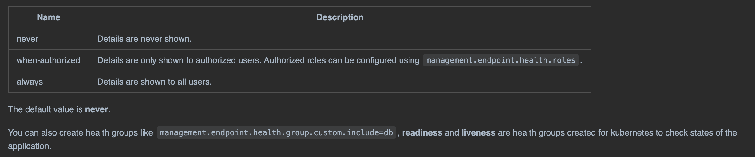
Health Checks
You can use health information to check the status of your running application. It is often used by monitoring software to alert someone when a production system goes down. The information exposed by the health endpoint depends on the management.endpoint.health.show-details and management.endpoint.health.show-components properties which can be configured with one of the following values:

Slide 8
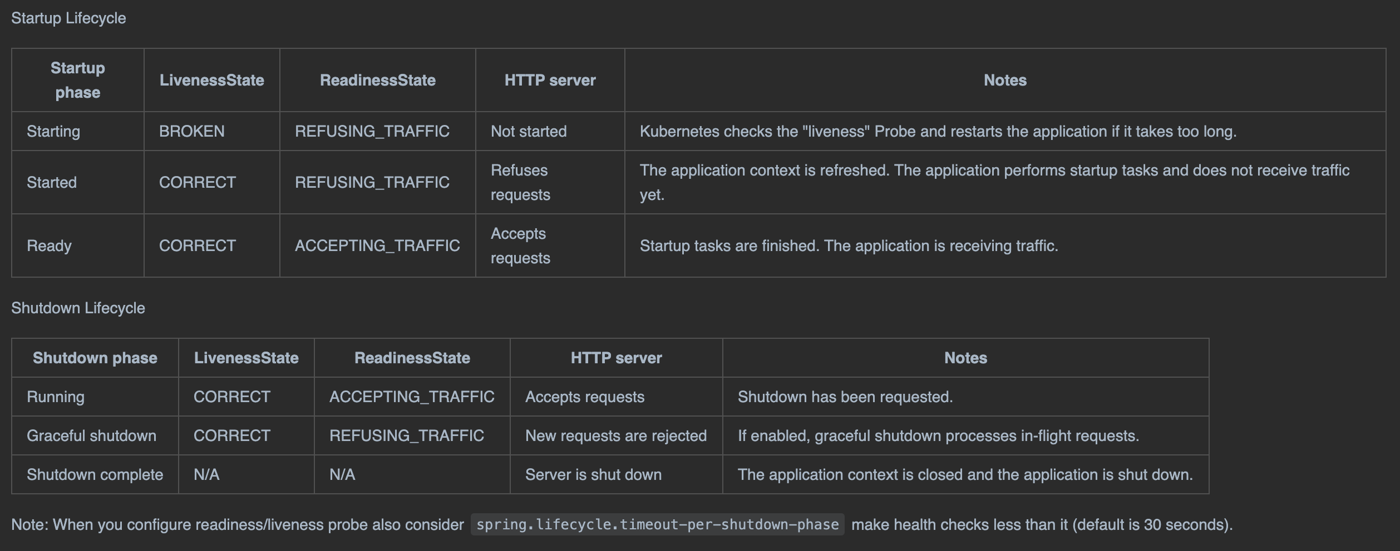
Health Checks 2
Readiness and liveness (kubernetes probes) are default probes which ensures the application is healthy and ready to handle traffic.

Slide 9
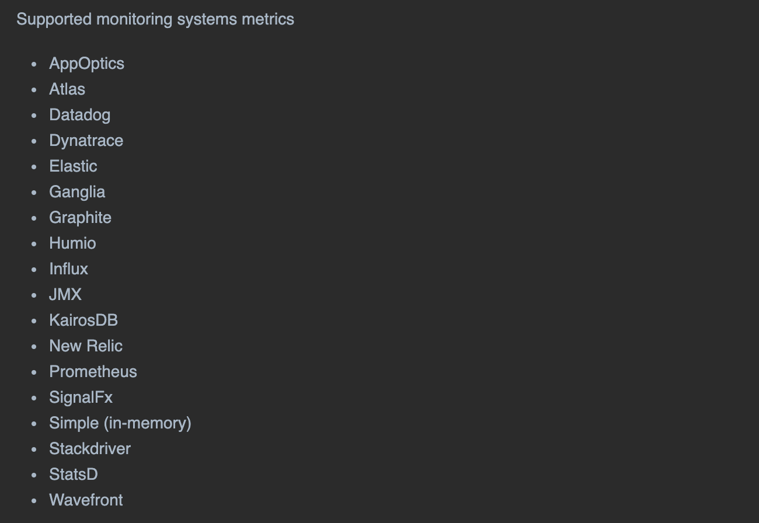
Metrics
Metrics are measures of quantitative assessment commonly used for comparing, and tracking performance or production.

Slide 10
Prometheus and Grafana Stack
Spring boot actuator module provides metrics for Prometheus using micrometer facade.
Micrometer provides a simple facade over the instrumentation clients for the most popular monitoring systems, allowing you to instrument your JVM-based application code without vendor lock-in.
Prometheus An open-source monitoring system with a dimensional data model, flexible query language, efficient time series database and modern alerting approach.
Grafana is the open source analytics & monitoring solution for every database.
Prometheus long polling applications and collects and stores, grafana visualise logs from prometheus.

Slide 11
Prometheus and Grafana Stack 2

Slide 12
ELK Stack
Spring boot actuator module provides metrics for elastic search using micrometer facade.
Micrometer provides a simple facade over the instrumentation clients for the most popular monitoring systems, allowing you to instrument your JVM-based application code without vendor lock-in.
Elasticsearch The fast and scalable search and analytics engine at the heart of the Elastic Stack.
Kibana is a free and open user interface that lets you visualize your Elasticsearch data and navigate the Elastic Stack.
All applications send metrics to elastic search's specific index periodically (configured in app), elastic search indexing and storing data, kibana connecting to elastic search and visualize metrics.

Slide 13
ELK Stack 2

Slide 14
Notes
When exposing HTTP endpoints to public, limit access to actuator endpoints by implementing security or changing management port accepting internal requests only.
Additional health checks can be added for external resources (3rd parties), if a retry mechanism is implemented it is recommended to exclude health checks from readiness and liveness probes (kubernetes will retry if not receive 200 OK from liveness probe).
The most of monitoring systems are aggregating metrics out of the box, example Dynatrace, NewRelic and etc.

Slide 15
Credits
Spring Boot Actuator Docs
Actuator API Docs
Micrometer Docs
Spring Actuator Demo App

