Slide 1
Spring And Confluent Platform
Shahin Nazarov
28 October 2021

Slide 2
Agenda
What is Apache Kafka?
Who is Confluent Platform?
How Apache Kafka Works
How Schema Registry Works
Schema Registry Compatibility types
Why Confluent Schema Registry
Message Formats
Apache Avro
Demo
Notes
Credits

Slide 3
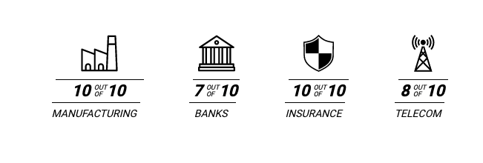
What is Apache Kafka?
More than 80% of all Fortune 100 companies trust, and use Kafka.
Apache Kafka is an open-source distributed event streaming platform used by thousands of companies for high-performance data pipelines, streaming analytics, data integration, and mission-critical applications.

Slide 4
What is Confluent Platform?
Confluent Platform is a streaming platform that enables you to organize and manage data from many different sources with one reliable,
high performance system.
Confluent Platform is a full-scale data streaming platform that enables you to easily access, store, and manage data as continuous, real-time streams. Built by the original creators of Apache Kafka®, Confluent expands the benefits of Kafka with enterprise-grade features while removing the burden of Kafka management or monitoring. Today, over 80% of the Fortune 100 are powered by data streaming technology – and the majority of those leverage Confluent.

Slide 5
What is Confluent Platform? 2
Components of Confluent Platform
The Confluent REST Proxy provides a RESTful interface to a Apache Kafka® cluster, making it easy to produce and consume messages, view the state of the cluster, and perform administrative actions without using the native Kafka protocol or clients. ksqlDB is a database that's purpose-built for stream processing applications.
Connectors leverage the Kafka Connect API to connect Kafka to other systems such as databases, key-value stores, search indexes, and file systems.
Confluent Control Center is a web-based tool for managing and monitoring Apache Kafka®.
Confluent Replicator allows you to easily and reliably replicate topics from one Kafka cluster to another. The confluent-rebalancer tool balances data so that the number of leaders and disk usage are even across brokers and racks on a per topic and cluster level while minimizing data movement. It also integrates closely with the replication quotas feature in Apache Kafka® to dynamically throttle data-balancing traffic.

Slide 6
How Apache Kafka Works?

Slide 7
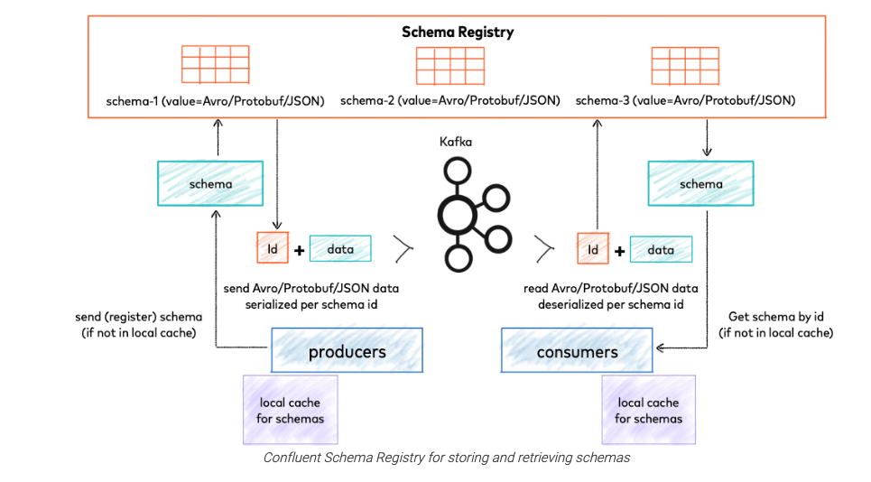
How Schema Registry Works?
Confluent Schema Registry provides a serving layer for your metadata. It provides a RESTful interface for storing and retrieving your Avro®, JSON Schema, and Protobuf schemas.

Slide 8
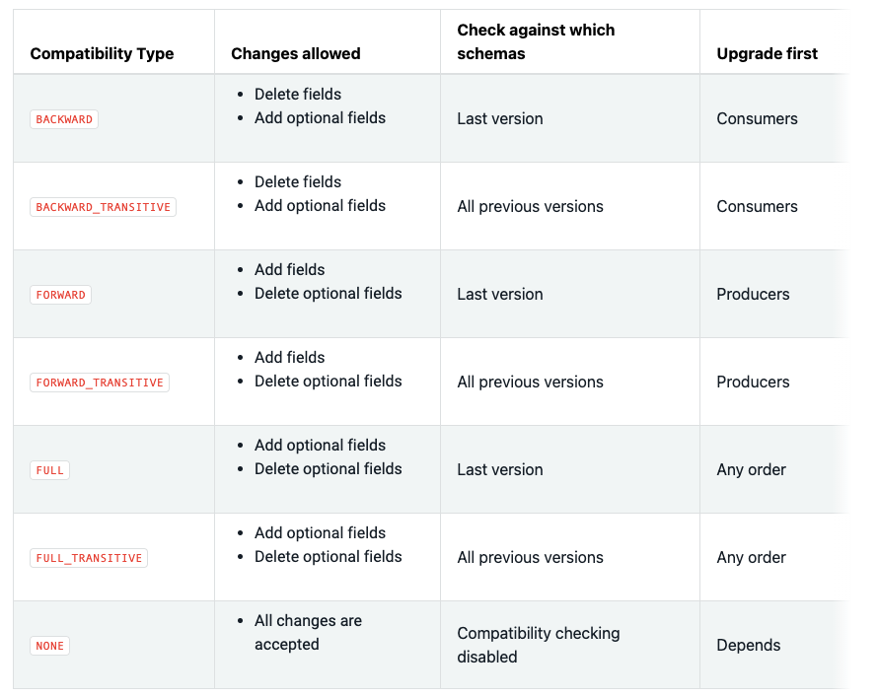
Schema Registry Compatibility Types
The Confluent Schema Registry default compatibility type is BACKWARD.

Slide 9
Why Confluent Schema Registry?
Assigns globally unique ID to each registered schema. Allocated IDs are guaranteed to be monotonically increasing and unique, but not necessarily consecutive.
Kafka provides the durable backend, and functions as a write-ahead changelog for the state of Schema Registry and the schemas it contains. If contract was changed and the compatibility rule was violated you will receive when you produce (screenshot attached below).
Schema Registry is designed to be distributed, with single-primary architecture, and ZooKeeper/Kafka coordinates primary election (based on the configuration).
Decrease chaos of schemas and manage all of events/schemas in one place. To keep schemas stable.

Slide 10
Message Formats
Confluent Platform supports for Protocol Buffers and JSON Schema along with Avro, the original default format for Confluent Platform. Support for these new serialization formats is not limited to Schema Registry, but provided throughout Confluent Platform. Additionally, Schema Registry is extensible to support adding custom schema formats as schema plugins. Benchmark for size/serialization and deserialization.
Proto buff message generated bytes: 56, serialized 4 ms, deserialized: 0 ms
Avro message generated bytes: 59, serialized 3 ms, deserialized: 2 ms
JSON message generated bytes: 138, serialized 7 ms, deserialized: 4 ms
{
"to": [
"me@shahinnazarov.com"
],
"cc": [],
"bcc": [],
"content": "Demo",
"mimeMessage": false,
"attachments": {},
"from": "no-reply@shahinnazarov.com"
}

Slide 11
Apache Avro Message Format
Apache Avro™ is a data serialization system.
Avro is a language-independent serialization library. To do this Avro uses a schema which is one of the core components. It stores the schema in a file for further data processing.
Avro is the best fit for Big Data processing. It's quite popular in Hadoop and Kafka world for its faster processing.
Avro creates a data file where it keeps data along with schema in its metadata section. Above all, it provides a rich data structure which makes it more popular than other similar solutions.
{
"name": "EmailMessage",
"namespace": "com.intellias.email",
"type": "record",
"fields": [
{
"name": "to",
"type": {
"type": "array",
"items": "string"
}
},
{
"name": "cc",
"type": {
"type": "array",
"items": "string"
},
"default": []
},
{
"name": "bcc",
"type": {
"type": "array",
"items": "string"
},
"default": []
},
{
"name": "content",
"type": "string"
},
{
"name": "mimeMessage",
"type": "boolean",
"default": false
},
{
"name": "attachments",
"type": {
"type": "map",
"values": "bytes"
},
"default": {}
},
{
"name": "from",
"type": "string",
"default": ""
}
]
}

Slide 12
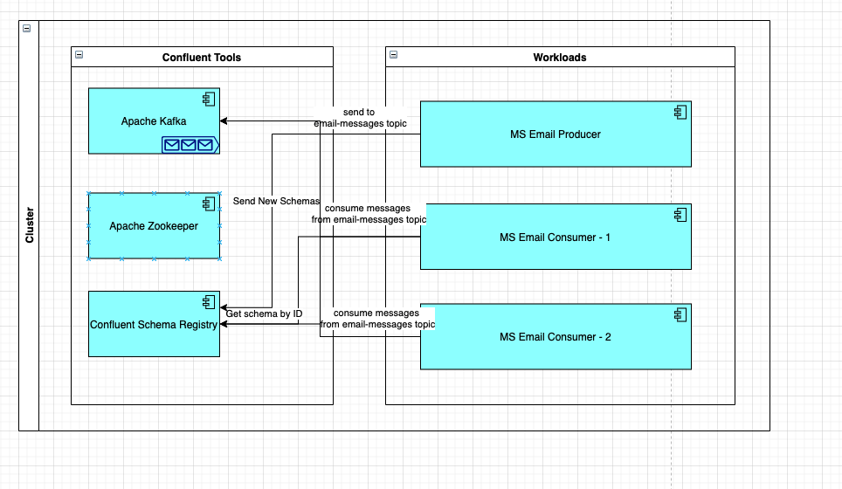
Demo
Email sender with schema registry

Slide 13
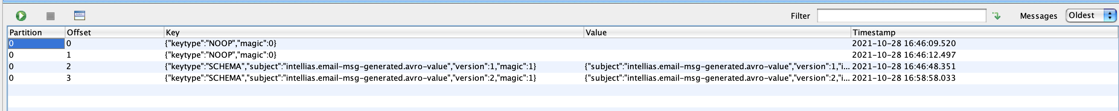

Demo 2
What happens if we change schema?

Slide 14
Notes
Apache Avro provides more features than photo buffers, if you use GRPC services its recommended to you proto buffers. But in all cases Schema Registry and GRPC both support Apache Avro and Proto Buffer formats.
The Schema Registry application itself requires about 1 GB for heap, but other than that, it does not need a lot of CPU, memory or disk. Therefore, to isolate failures, it is best practice to deploy Schema Registry on its own.
Separate schema registries may not stay separated forever. For consistency in schema definitions and operational simplicity, deploy a single global Schema Registry cluster across an entire company, geographical areas, or clusters in a multi-datacenter design.
Securing Schema Registry is just as critical as securing your Kafka cluster, because the schema forms the contract for how different applications and organizations talk to each other through Kafka.

Slide 15
Credits
Spring Boot Kafka Docs
Schema Registry Docs
Apache Avro
Proto Buffers
Schemas, Contracts, and Compatibility
17 Ways to Mess Up Self-Managed Schema Registry
Kafka Avro Schema Registry Example

