Slide 1
Dynamic Programming
CSE 301: Combinatorial Optimization

Slide 2
Fibonacci Numbers
0, 1, 1, 2, 3, 5, 8, 13, 21, 34, 55, 89, …
Computing the n^{th} Fibonacci number recursively:
F(n) = F(n-1) + F(n-2), when n>1
F(0) = 0
F(1) = 1
Top-down (recursive) algorithms
F(n)
F(n-1) + F(n-2)
F(n-2) + F(n-3) F(n-3) + F(n-4)
Algorithm Fibo(n):
if n ≤ 1 then
return n
else
return Fibo(n-1)+Fibo(n-2)

Slide 3
Time Complexity of Top-Down Algorithm
F(9)
F(8)
F(7)
F(7)
F(6)
F(6)
F(5)
h = n
h = n/2
F(6)
F(5)
F(5)
F(4)
F(5)
F(4)
F(4)
F(3)
Time complexity between 2^{n/2} and 2^{n}

Slide 4
Recursion Tree of Top-Down Algorithm
Why is the top-down approach so inefficient?
Recomputes many sub-problems (a.k.a. overlapping subproblem).
F(5) +
F(4) +
F(3) +
F(3) +
F(2) +
F(2) +
F(1)
F(2) +
F(1)
F(1)
F(0)
F(1)
F(0)
F(1)
F(0)
Same subproblem is solved multiple times

Slide 5
A Top-down Algorithm that memorizes previous solutions (memoized top-down approach)
Algorithm Fib(n):
for i = 0 to n
F[i] = -∞
Fib_rec(n)
Algorithm Fib_rec(n):
if F[n]≥0 then
return F[n]
if n ≤ 1 then
F[n] = n
else
F[n] = Fib_rec(n-1)+Fib_rec(n-2)
return F[n]
Time complexity?
Each of the F[i] values (i={0, 1,…, n}) is computed only once. So time is O(n).
//Non-memoized Top-Down Approach
Algorithm Fibo(n):
if n ≤ 1 then
return n
else
return Fibo(n-1)+Fibo(n-2)

Slide 6
Recursion Tree of Memoized Algorithm
Fib(5)
Fib_rec(5) +
Fib_rec(4) +
Fib_rec(3)
Fib_rec(3) +
Fib_rec(2)
Fib_rec(2) +
Fib_rec(1)
Fib_rec(1)
Fib_rec(0)

Slide 7
A Bottom-up (Iterative) Algorithm
Algorithm fib_bu(n):
for i = 0 to n
if i ≤ 1 then
F[i] = i
else
F[i] = F[i-1] + F[i-2]
return F[n]
Time complexity?
The for loop here runs O(n) times and all the other (first and last) statements take O(1) time. So total time is O(n).

Slide 8
Summery
Problem with the recursive Fib algorithm:
Each subproblem was solved for many times!
Solution: avoid solving the same subproblem more than once
(1) pre-compute all subproblems that may be needed later (bottom-up)
(2) Compute on demand, but memorize the solution to avoid recomputing (memoized top-down)
Can you always speedup a recursive algorithm by memoization (memoized top-down) or pre-computation (bottom-up)?
E.g., merge sort
No. since there is no overlap between the two sub-problems

Slide 9
Dynamic Programming
Dynamic Programming (DP) is an algorithm design technique for optimization problems.
Like divide and conquer (D&C), DP solves problems by combining solutions to sub-problems.
Unlike D&C, sub-problems are not independent.
Sub-problems may share sub-sub-problems

Slide 10
Dynamic Programming
The term Dynamic Programming comes from Control Theory, not computer science. Programming refers to the use of tables (arrays) to construct a solution.
In dynamic programming we usually reduce time by increasing the amount of space
We solve the problem by solving sub-problems of increasing size and saving each optimal solution in a table (usually).
The table is then used for finding the optimal solution to larger problems.
Time is saved since each sub-problem is solved only once.

Slide 11
Designing a DP Algorithm
1. Characterize the structure of an optimal solution.
2. Recursively define the value of an optimal solution.
3. Compute the value of an optimal solution in a bottom up fashion.
4. Construct an optimal solution from computed information.

Slide 12
Example: NSU Number
Almost like Fibonacci number; with a simple difference: we take the summation of last three NSU numbers, instead of last two.
Assuming A(n) represents the n-th NSU number,
A(n) = n , if n <= 2
= A(n-1) + A(n-2) +A(n-3) , otherwise
A(0) = 0
A(1) = 1
A(2) = 2
A(3) = 0+1+2 = 3
A(4) = 1+2+3 = 6
A(5) = 2+3+6 = 11
….
Design (i) a memoized top-down algorithm and (ii) a bottom-up algorithm to compute A(n).
Show that the problem of computing A(n) satisfies overlapping subproblem property.

Slide 13
Example: n choose r (combinations)
Given n things, how many different sets of size r can be chosen?
with base cases:
Assuming C(n,r) represents the value of n choose r,
C(n,r) = n , if r =1
= 1 , if r = n or r = 0
= C(n-1,r-1) + C(n-1, r) , otherwise

Slide 14
Combinations: Top Down Algorithm
Algorithm Comb(n,r):
if(r == 1) // base case 1
return n
else if r = n or r = 0 // base case 2
return 1
else //general case
return Comb(n-1, r-1)+Comb(n-1, r)

Slide 15
Top Down Memoized Algorithm
Algorithm Comb(n,r):
for i=0 to n
for j=0 to min(i,r)
C[i,j] = -∞
return rec(n,r)
Algorithm rec(n,r):
if C[n,r] != -∞ then
return C[n,r]
if r = 1 then // base case 1
C[n,r] = n
else if r = n or r = 0 then // base case 2
C[n,r] = 1
else //general case
C[n,r] = rec(n-1, r-1)+rec(n-1, r)
return C[n,r]

Slide 16
Bottom-up Algorithm
Algorithm Combination (n,r):
for i = 0 to n
for j = 0 to min(i,r)
if j = 1 then
C[i,j] = i
else if j = i or j = 0 then
C[i,j] = 1
else //general case
C[i,j] = C[i-1, j-1]+C[i-1, j]
return C[n,r]
Time Complexity:
Θ (nr), for both memorized top-down & bottom-up algorithms

Slide 17
Example: Rod Cutting
You are given a rod of length n ≥ 0 (n in inches)
A rod of length i inches will be sold for p_{i} dollars
Cutting is free (simplifying assumption)
Problem: given a table of prices p_{i} determine the maximum revenue r_{n} obtainable by cutting up the given rod (of length n) and selling the pieces.
Length i | 1 | 2 | 3 | 4 | 5 | 6 | 7 | 8 | 9 | 10
Price p_{i} | 1 | 5 | 8 | 9 | 10 | 17 | 17 | 20 | 24 | 30

Slide 18
Example: Rod Cutting
Problem: given a table of prices p_{i} determine the maximum revenue r_{n} obtainable by cutting the given rod (of length n) and selling the pieces.
Can we use a greedy algorithm (like fractional knapsack) that always takes the length with highest price/length value?
No, for e.g. by greedy algorithm, optimal revenue of a 4 inch rod should be 33+1=34 which we get by cutting a rod of length 3 first (which has the maximum value of 11) and then taking the remaining rod of length 1 (i.e., the cutting lengths here are in order: (3,1)).
However, the optimal cutting is: (2,2) which gives us optimal revenue of 20+20 = 40.
Length i | 1 | 2 | 3 | 4
Price p_{i} | 1 | 20 | 33 | 36
Value p_{i}/i | 1 | 10 | 11 | 9

Slide 19
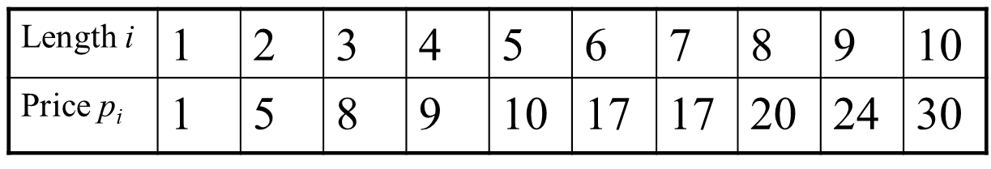
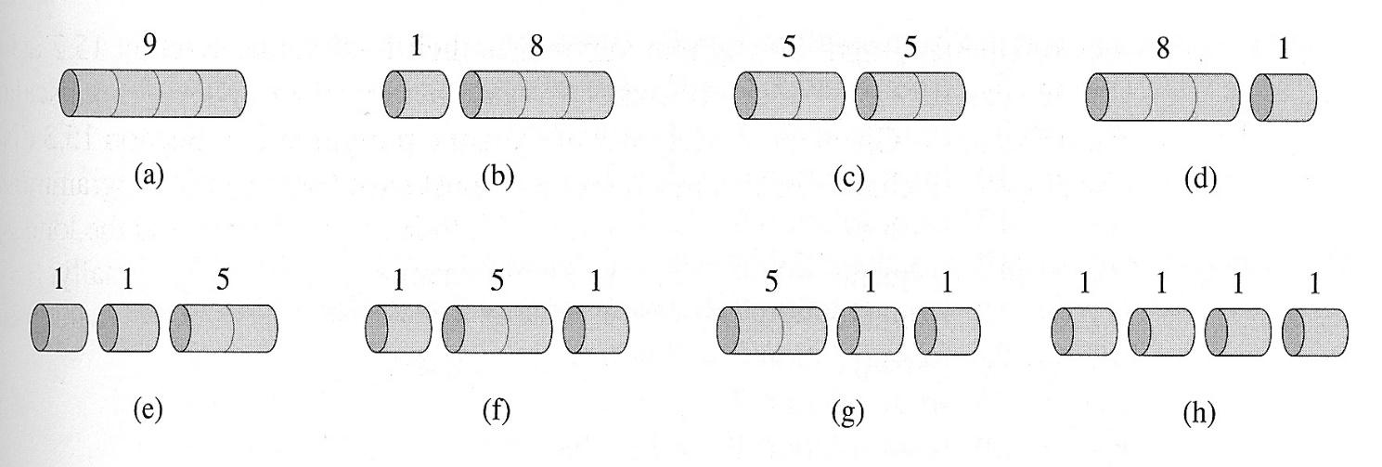
Example: Rod Cutting
Can we use a brute-force/exhaustive algorithm that tries all possible cuts of a rod of length n?
Question: in how many different ways can we cut a rod of length n?
For a rod of length 4:
2⁴ ⁻ ¹ = 2³ = 8
Yes but the cost would be too high!!! There are 2^{n-1} possible ways to cut a rod of length n (Exponential). We cannot try all possibilities for "large“ n; the exhaustive approach isn’t practically feasible.
Notes:
What kind of Notes??

Slide 20
Example: Rod Cutting
Let us find a way to solve the problem recursively:
Let r_{n} = the maximum revenue obtainable from a rod of length n
How can we construct a recurrence relation for r_{n}?
Advice: when you don’t know what to do next, start with a simple example and hope that some idea will click…

Slide 21

Example: Rod Cutting
Maximum revenue obtainable by cutting a rod of length n, r_{n} = ? (for n = 1)
r₁ = p₁ = 1
Notes:
What kind of Notes??

Slide 22
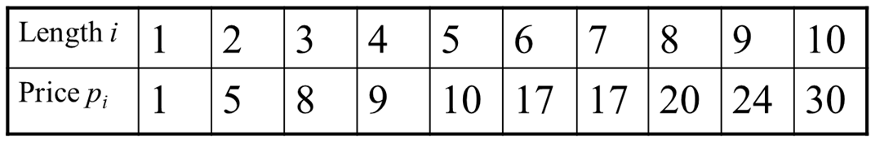


Example: Rod Cutting
Maximum revenue obtainable by cutting a rod of length n, r_{n} = ? (for n = 2)
r₂ = max(p₂, p₁+r₁) = max(5, 1+1) = 5
Notes:
What kind of Notes??

Slide 23



Example: Rod Cutting
Maximum revenue obtainable by cutting a rod of length n, r_{n} = ? (for n = 3)
r₃ = max(p₃, p₁+r₂ , p₂+r₁) = max(8, 1+5, 5+1) = 8
Notes:
What kind of Notes??

Slide 24

Example: Rod Cutting
Maximum revenue obtainable by cutting a rod of length n, r_{n} = ? (for n =4)
r₄ = max(p₄, p₁+r₃, p₂+r₂, p₃+r₁) = max(9, 1+8, 5+5, 8+1) = 10
Notes:
What kind of Notes??

Slide 25
Example: Rod Cutting
In general, for any n:
r_{n} = max(p_{n,} p₁+ r_{n-1,} p₂+ r_{n-2,} p₃+ r_{n-3,} …, p_{n-1}+ r₁)
r_{n} = max(p_{n}+r₀, p₁+ r_{n-1,} p₂+ r_{n-2,} p₃+ r_{n-3,} …, p_{n-1}+ r₁) :[Let, r₀ = 0]
r_{n} = max_{1≤i≤n}(p_{i} + r_{n-i})
In other words,
maximal revenue r_{n} is obtained by cutting the rod into smaller pieces of lengths: i and (n-i), for some value of i (for which p_{i}+r_{n-i} is maximum) where1≤i≤n and
r_{i} = p_{i}, i.e., the piece of length i need no more cut (because cutting it into smaller pieces will not increase its revenue) whereas
the piece of length (n-i) may need more cut; but we have already calculated the maximal revenue, r_{n-i} of a rod of length (n-i) before calculating r_{n.}. We can use that value (r_{n-i}) to calculate r_{n}

Slide 26
Optimal Substructure Property of Rod Cutting Problem
The recurrence relation: r_{n} = max_{1≤i≤n}(p_{i} + r_{n-i}) shows that the Rod Cutting problem has optimal substructure property:
an optimal solution to the problem (here r_{n}) can be calculated using optimal solutions to its sub problems (here r_{n-i}).
This recurrence relation can be implemented as a simple top-down recursive procedure

Slide 27
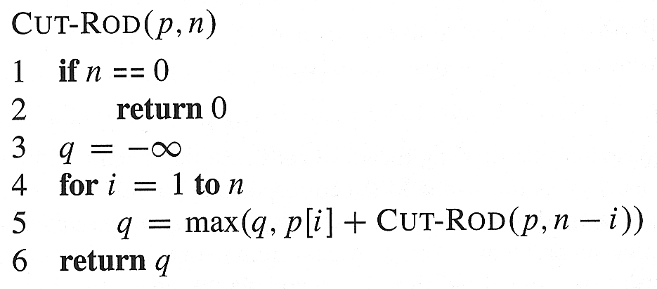
Top Down algorithm for Rod Cutting
Computing the recursion leads to re-computing some numbers (overlapping subproblems) again and again – how many?

Slide 28
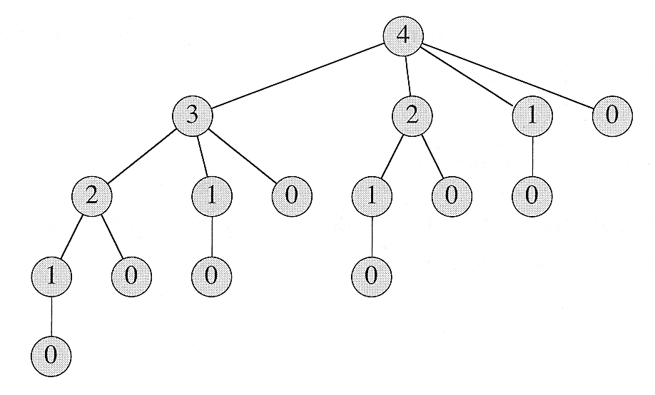
Overlapping subproblem property of Rod Cutting Problem
Let’s call Cut-Rod(p, 4), to see the effects on a simple case:
T(n) = total # of calls made to CUT-ROD for an initial call of CUT-ROD(p,n)
= The # of nodes for a recursion tree corresponding to a rod of size n = ?
Solution: CUT-ROD(p,n) calls CUT-ROD(p, n-i) for i = 1,2,3, …, n, i.e., CUT-ROD(p,n) calls CUT-ROD(p, j) for j = 0,1,2, …, n-1

Slide 29
How to decrease time?
We have a problem: “reasonable size” problems are not solvable in “reasonable time” (but, in this case, they are solvable in “reasonable space”).
Specifically:
Note that navigating the whole tree requires 2^{n} function calls
However, no more than n different values need to be computed or used.
We exploit these observations to come up with two ways to decrease time:
Memoized Top-down algorithm: store the value of r_{k} (once computed by a call of CUT-ROD) in a table and reuse it in later calls of CUT-ROD as needed. This technique allows us to compute r_{k} only once.
The technique of storing and reusing values computed by a previous call of a recursive function is called “memoizing” (i.e., writing yourself a memo).
Bottom Up Algorithm: Compute small subproblems first, then gradually solve larger and larger subproblems by using the pre-computed solutions of smaller subproblems. For e.g., for rod-cutting problem: compute r₀, r₁, r₂, …., r_{n}

Slide 30
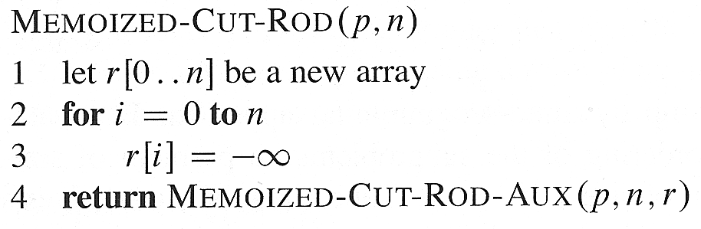

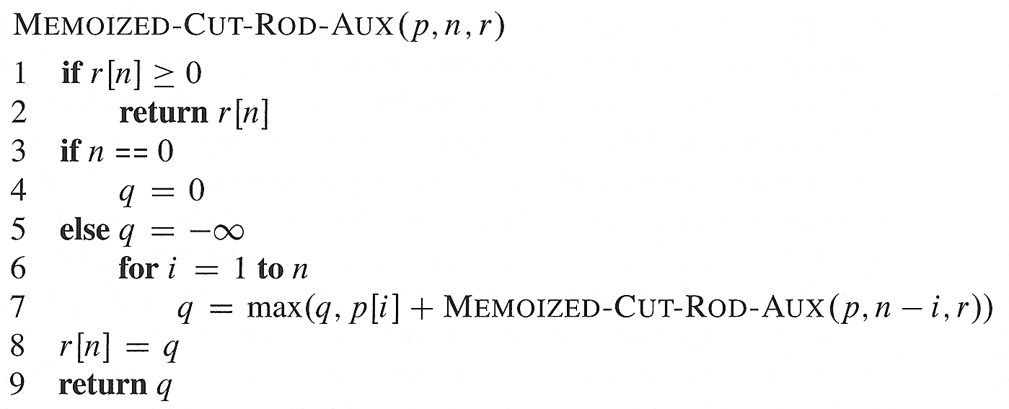
Memoized Top-down Algorithm for Rod-Cutting Problem
X
X
X
X

Slide 31
Memoized Top-down Algorithm for Rod-Cutting Problem
Time: Θ(n²)
Each r[i], for i = 1,2,3, …, n, is computed only once and this
computation takes Θ(n) time (due to the for loop in lines 6-7).
As we compute n values of r[i] (for i=1,2,…,n), total time is Θ(n²)

Slide 32
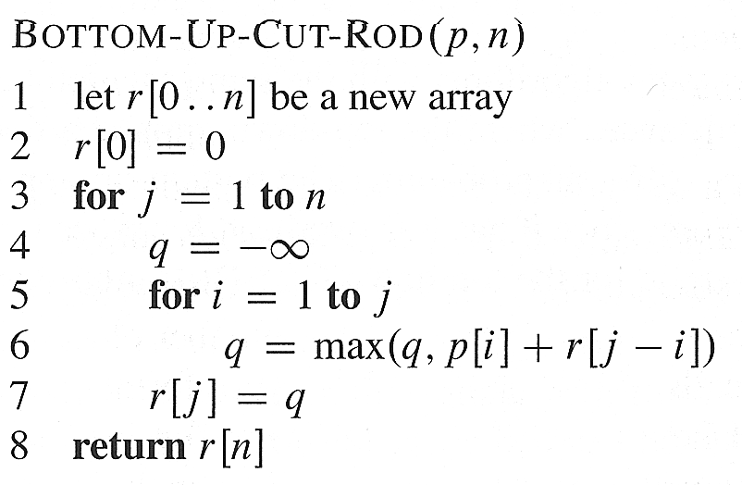
Bottom Up Algorithm
Bottom-up approach also takes Θ(n²) time.
Why??
The most heavily executed statement in bottom-up approach is line 6 which is executed j times for each value of jɛ {1, 2,…, n}. So it is executed 1+2+…+n = Θ(n²) times.

Slide 33
Simulation: Rod Cutting
Length i | 1 | 2 | 3 | 4 | 5 | 6 | 7
Price p_{i} | 1 | 5 | 8 | 9 | 10 | 12 | 17
We begin by constructing (by hand) the optimal solutions for i = 0, 1, …, 10:
r₀ = 0
r₁ = p₁ = 1 (no cuts)
r₂ = max(p₂, p₁+r₁) = max(5,1+1) = 5 (no cuts)
r₃ = max(p₃, p₂+r₁, p₁+r₂) = max(8,5+1,1+5) = 8 (no cuts)
r₄ = max(p₄, p₃+r₁, p₂+r₂, p₁+r₃) = max(9, 8+1, 5+5, 1+8) = 10
r₅ = ?
r₆ = ?
r₇ = ?

Slide 34
Simulation: Rod Cutting
Length i | 1 | 2 | 3 | 4 | 5 | 6 | 7
Price p_{i} | 1 | 5 | 8 | 9 | 10 | 12 | 17
We begin by constructing (by hand) the optimal solutions for i = 1, …, 10:
r₀ = 0
r₁ = p₁ = 1 (no cuts)
r₂ = max(p₂, p₁+r₁) = max(5,1+1) = 5 (no cuts)
r₃ = max(p₃, p₂+r₁, p₁+r₂) = max(8,5+1,1+5) = 8 (no cuts)
r₄ = max(p₄, p₃+r₁, p₂+r₂, p₁+r₃) = max(9, 8+1, 5+5, 1+8) = 10
r₅ = max{p₅, p₄+r₁, p₃+r₂, p₂+r₃, p₁+r₄}
= max(10, 9+1, 8+5, 5+8, 1+10) = 13
r₆ = max{p₆, p₅+r₁, p₄+r₂, p₃+r₃, p₂+r₄, p₁+r₅}
= max{12,11,14,16,15,14} = 16
r₇ = … = p2 + r5 = 5 + 13 = 18
Now we know maximum revenue obtainable from a 7 inch rod; but we don’t know how to cut the rod to get that much revenue

Slide 35
Reconstructing a Solution
Save cutting points

Slide 36
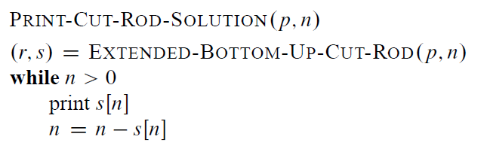
Reconstructing a Solution
Notes:
Print-Cut-Rod-Solution(p, 8)= 2, 6

Slide 37
Simulation: Rod Cutting
Length i | 1 | 2 | 3 | 4 | 5 | 6 | 7
Price p_{i} | 1 | 5 | 8 | 9 | 10 | 12 | 17
s_{i} | 1 | 2 | 3 | 2 | 2 | 3 | 2
We begin by constructing (by hand) the optimal solutions for i = 1, …, 10:
r₀ = 0
r₁ = p₁ = 1 (no cuts)
r₂ = max(p₂, p₁+r₁) = max(5,1+1) = 5 (no cuts)
r₃ = max(p₃, p₂+r₁, p₁+r₂) = max(8,5+1,1+5) = 8 (no cuts)
r₄ = max(p₄, p₃+r₁, p₂+r₂, p₁+r₃) = max(9, 8+1, 5+5, 1+8) = 10
r₅ = max{p₅, p₄+r₁, p₃+r₂, p₂+r₃, p₁+r₄}
= max(10, 9+1, 8+5, 5+8, 1+10) = 13
r₆ = max{p₆, p₅+r₁, p₄+r₂, p₃+r₃, p₂+r₄, p₁+r₅}
= max{12,11,14,16,15,14} = 16
r₇ = p2 + r5 = 5 + 13 = 18

Slide 38
Simulation: Rod Cutting
Length i | 1 | 2 | 3 | 4 | 5 | 6 | 7
Price p_{i} | 1 | 5 | 8 | 9 | 10 | 12 | 17
s_{i} | 1 | 2 | 3 | 2 | 2 | 3 | 2
Optimal Cutting lengths of a rod of length 7:
s₇ = 2
2, optimal cutting of a rod of remaining length (7-2) is: s₇₋₂ = s₅
s₅ = 2, optimal cutting of a rod of remaining length (5-2) is: s₅₋₂ = s₃
s₃= 3, remaining length = 3-3 = 0; so stop
Therefore optimal cutting lengths of a rod of length 7 is: 2,2,3

Slide 39
Practice: Find optimal cutting and max. revenue for this rod cutting problem
Length i | 1 | 2 | 3 | 4 | 5 | 6 | 7 | 8
Price p_{i} | 1 | 5 | 8 | 9 | 10 | 12 | 17 | 19
s_{i}
r8 = max (p8, p7+r1, p6+r2, p5+r3, p4+r4, p3+r5, p2+r6, p1+r7)
= max(19, 17+1, 12+5, 10+8, 9+10, 8+13, 5+16, 1+18)
= max(19, 18, 17, 18, 19, 21, 21, 19) = 21

Slide 40
Multiple Rod Cutting
You are given m rods of different lengths
A rod of length i inches will be sold for p_{i} dollars
Problem: given a table of prices p_{i} determine the maximum revenue obtainable by cutting m rods and selling the pieces.
Idea: apply the DP algorithm for rod-cutting on the longest rod and then use its solution (r,s) to compute optimal cutting and optimal revenue of each rod.
Length i | 1 | 2 | 3 | 4 | 5 | 6 | 7 | 8 | 9 | 10
Price p_{i} | 1 | 5 | 8 | 9 | 10 | 17 | 17 | 20 | 24 | 30

Slide 41
Rod Cutting having cutting-cost
You are given a rod of length n
A rod of length i inches will be sold for p_{i} dollars
Each cut costs you c dollars.
Problem: given a table of prices p_{i} determine the maximum revenue obtainable by cutting a rod of length n and selling the pieces.
Idea: Add cutting cost in the recurrence relation of rod-cutting:
r_{n} = max_{1≤i≤n}(p_{i} + r_{n-i} - c) for n>0; r₀ = 0
Length i | 1 | 2 | 3 | 4 | 5 | 6 | 7 | 8 | 9 | 10
Price p_{i} | 1 | 5 | 8 | 9 | 10 | 17 | 17 | 20 | 24 | 30
Notes:
http://ranger.uta.edu/~huang/teaching/CSE5311/HW3_Solution.pdf

Slide 42
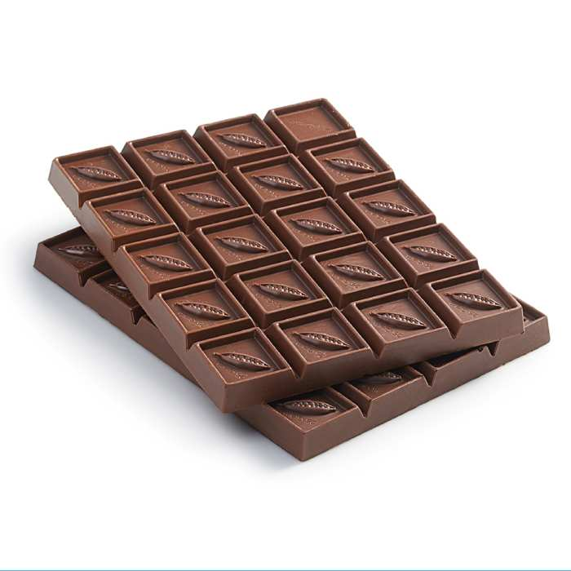
Chocolate Cutting/Breaking
You are given a Mimi chocolate having m*n blocks
In each step, we can break one piece of chocolate into two rectangular pieces horizontally/vertically (so no L shaped piece ever appears). A chocolate of i*j blocks can be sold for p_{i,j} dollars. Given p_{i,j} determine the maximum revenue r_{m,n} obtainable by breaking a chocolate with m*n blocks and then selling the pieces.
Price p_{i,j} | 1 | 2 | 3 | 4 | 5 | 6 | 7 | 8 | 9 | 10
1 | 1 | 5 | 8 | 9 | 10 | 17 | 17 | 20 | 24 | 30
2 | 5 | 6 | 18 | 22 | 31 | 35 | 37 | 39 | 40 | 45
3 | 8 | 18 | 22 | 34 | 37 | 39 | 42 | 43 | 45 | 48
4 | 9 | 22 | 34 | 40 | 44 | 47 | 48 | 50 | 52 | 53

Slide 43
Chocolate Cutting
Recurrence relation:
r_{m,n} = max{max{p_{i,n}+r_{m-i,n}}, max{p_{m,j}+r_{m,n-j}}}, when n>0
What are the base cases?
1 ≤ i ≤ n
1 ≤ j ≤ n
j
n-j
A possible cut
i
m-i

Slide 44
Chocolate Cutting
Recurrence relation:
r_{m,n} = max{max{p_{i,n}+r_{m-i,n}}, max{p_{m,j}+r_{m,n-j}}}, when n>0
Can you write memoized top-down and bottom-up algorithms to solve this problem?
1 ≤ i ≤ n
1 ≤ j ≤ n
j
n-j
A possible cut
i
m-i

Slide 45
Properties of DP Problems
How can one tell if a DP algorithm will be able to solve an optimization problem i.e., whether a problem is a “DP problem”?
There are 2 properties exhibited by most DP Problems (problems solvable via a DP algorithm):
Overlapping Subproblem Property: To solve a large problem, the same subproblem is required to be solved again & again
It implies that a we can save time by solving each subproblem exactly once & saving that in a table, so that whenever that solution is required later, we can simply look up that table and reuse that value
Optimal Sub-structure Property: Optimal solution of a problem depends on optimal solution(s) of its subproblem(s)
It implies that the optimal solution(s) of subproblem(s) can be combined together to obtain the optimal solution of the problem itself

