Slide 1
Software Project Lab-01
Project Name : A simple Email System
Presented By: Supervised By:
Nazeeb Ahmed Chowdhury Associate Prof. Dr. Kishan Kumar Roll:1432 Ganguli

Slide 2
Project details and motivation:
This project will help me improve my coding skills by implementing some algorithms and data structures .
Creating an Account ,Storing all Accounts in a Linked List Data structure, Sign up , Log in, Sending And Receiving Emails , Compressing files(Huffman) and sending them.
Secure Hash Algorithm Implementation
Use of Socket Programming.

Slide 3
OVERVIEW
Tasks that I have already Completed Of My project:
Creating a Mail class to store Address , Name, Password, Mobile no.
Username.
Multiple user Sign-Up and each stored As an object of class Mail In a Linked List
Traversing the Link List to Log in for a particular User.
After log in , Composing a message and send it to another user id
Received messages saving in a Link List of structures
Viewing All available accounts In the Link List
Compressing File data Via Huffman Coding
Understood the algorithm of Secure Hash Algorithm 256

Slide 4
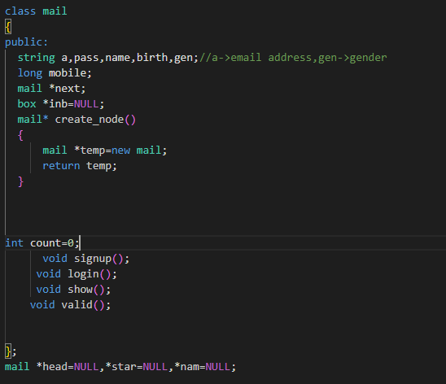
Mail class
Mail Class
Mail Basic Functions
Mail Type pointer For the Link Lists

Slide 5
Account Storage visual
HEAD
Mail 1w
Mail2
Mail 3
NULL

Slide 6
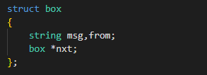
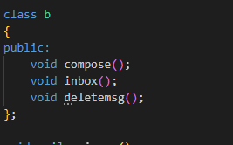
Box type structure for the message part of an email
After log in Functions

Slide 7
Secure Hash Algorithm -256
In order to confirm the security of passwords, SHA- 256 is one of the best ones
The idea is not about Encryption and Decryption ,rather it is more of an authentication method that must be decoded. The passwords are stored in database in a Hash value format
A hash value format is a 64 characters long Hexadecimal format , where each characters represents 4 bits . So the total number of bits is 256
Even if a Hacker breaches out into the password database, it is almost impossible to retrieve the Original password message from the corresponding Hash Value.

Slide 8
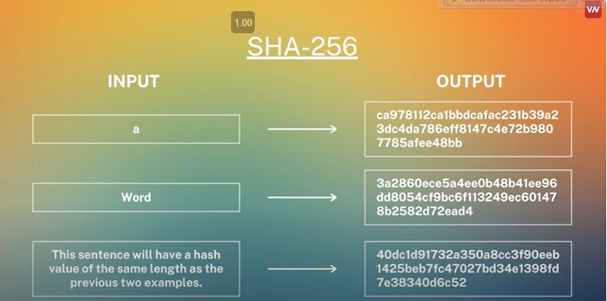
More features
Whatever the input password length is, The Hash value is always 64 HEX characters long, meaning 256 bits

Slide 9
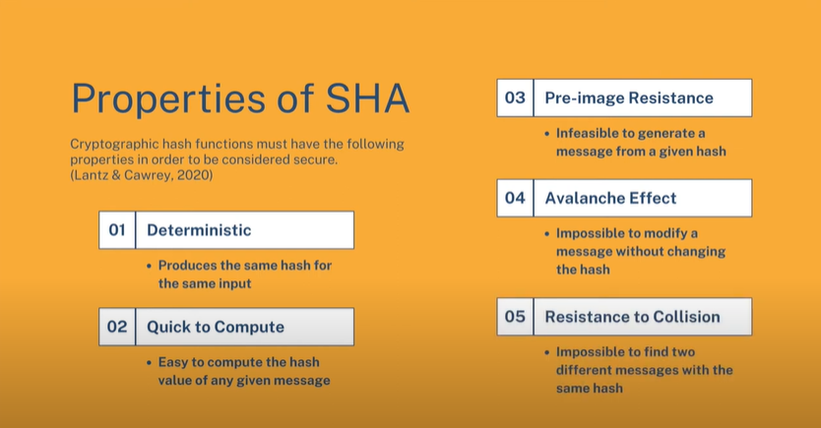
Why I want to use SHA-256

Slide 10
Data Compression (Huffman)
Huffman coding is a very efficient way of compressing data. It can be used to compress all sorts of data, including text, images, and audio. Huffman coding can be especially beneficial when compressing large files.
Why I want to use it?
Sometimes we have to send a large file via email . If the file exceeds a certain capacity, We can use Huffman coding to compress the file and without lossless of data send it to another user.
it is a beautiful feature of email.

Slide 11
Socket programming
Email works in CS architecture of networking(client-server).
To establish connection between two machine’s process , socket programming is used
Socket Programming is a method to connect two nodes over a network to establish a means of communication between those two nodes. A node represents a computer or a physical device with an internet connection. A socket is the endpoint used for connecting to a node.
MOTIVATION for my project:
An email system should be able to transfer texts/files to another server or computer . It will help me understand how data transfer code works.

Slide 12
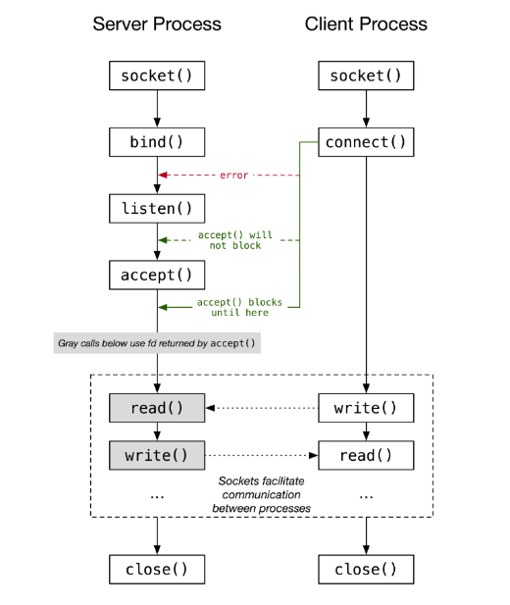
State diagram for server-client model

Slide 13
THANK YOU

