Slide 1

CVR COLLEGE OF ENGINEERING Department of CSE(Cyber Security) B.Tech CSE(DS) IV Year I Semester Project Stage-1 Review-2 Date: 15.10.2025

Slide 2
SentinelX - A Network Vulnerability Scanner
CVR COLLEGE OF ENGINEERING
Thumma Hanish Reddy - 22B81A6213
Srimani Teja Ejjagiri - 22B81A6251
Thippana Vivekananda Reddy - 22B81A6263
Under the guidance of
Dr. B Vikranth, M.Tech, Ph.D
Professor

Slide 3
Domain Introduction
Domain: Cyber Security, Network security
Introduction: Cybersecurity has grown from basic protection to a vital defense against advanced digital threats. It safeguards systems, networks, and data from unauthorized access and attacks.
Key Concepts & Technologies: Focus on confidentiality, integrity, availability (CIA). Core tools: network security, vulnerability scanning, firewalls, encryption, MFA, and intrusion detection.
Recent Trends: Rise of AI-driven security, Zero Trust models, automated vulnerability management, and cloud/IoT protection.
Significance: Essential for data protection, business continuity, national security, and building digital trust.

Slide 4
Literature Review
Paper Title: IMap: Toward a Fast, Scalable and Reconfigurable In-Network Scanner With Programmable Switches.
Authors & Publication: Wang et al., 2025, IEEE (Scopus Indexed)
URL: https://ieeexplore.ieee.org/document/10295533
Contribution: Introduces a programmable in-network scanner to accelerate vulnerability scanning across large-scale networks.
Methodology: Uses programmable switches and distributed architecture to parallelize scanning and minimize latency.
Limitations: High dependency on programmable network infrastructure; not suitable for small organizations with limited resources.

Slide 5
Literature Review
Paper Title: V-Digger: A Distributed Architecture for Fast and Flexible Vulnerability Scanning
Authors & Publication: Lee et al., 2024, IEEE (Scopus Indexed)
URL: https://ieeexplore.ieee.org/document/10286066
Contribution: Proposes a distributed vulnerability scanner to improve speed, security, and flexibility.
Methodology: Worker–coordinator model; multiple agents scan in parallel and report to a central controller.
Limitations: Complex deployment in non-enterprise networks; high setup cost.

Slide 6
Literature Review
Paper Title: ILLATION: Prioritizing Vulnerabilities Based on Risk and Severity
Authors & Publication: Singh et al., 2024, IEEE (Scopus Indexed)
URL: https://ieeexplore.ieee.org/document/10178007
Contribution: Proposes risk-based prioritization of vulnerabilities for better resource allocation.
Methodology: Uses severity scoring + asset criticality mapping to rank vulnerabilities.
Limitations: Dependent on accurate asset classification; limited real-time integration.

Slide 7
Literature Review
Paper Title: A Python-Based Network Vulnerability Scanner Tool for Enhanced Cybersecurity
Authors & Publication: Ahmed et al., 2024, IJCS (Scopus Indexed)
URL: https://ieeexplore.ieee.org/
Contribution: Introduces a Python-based modular scanner for faster vulnerability detection.
Methodology: Script-based scanning, modular plug-in structure for customization.
Limitations: Lacks enterprise-level reporting and automation capabilities.

Slide 8
Literature Review
Paper Title: MobileSniper: Towards Automated Penetration Testing of 5G Campus Networks and IoT Infrastructures
Authors & Publication: Chen et al., 2024, IEEE (SCI Indexed)
URL: https://ieeexplore.ieee.org/document/10286088
Contribution: Targets vulnerabilities in 5G and IoT environments through automated scanning.
Methodology: Uses automated scanning modules integrated with IoT protocol analysis.
Limitations: Narrow focus on 5G/IoT — not general-purpose.

Slide 9
Literature Review
Paper Title: Fast Port Scanning Using AI-Assisted Prioritization
Authors & Publication: Zhang et al., 2023, Computers & Security (Scopus Indexed)
URL: https://www.sciencedirect.com/journal/computers-and-security
Contribution: Integrates AI to prioritize high-risk hosts and ports during scans.
Methodology: Machine learning model predicts likely vulnerable endpoints to scan first.
Limitations: High false positives with incomplete datasets.

Slide 10
Literature Review
Paper Title: An Adaptive Vulnerability Assessment Framework for Hybrid Networks
Authors & Publication: Patel et al., 2023, Elsevier (Scopus Indexed)
URL: https://www.sciencedirect.com/
Contribution: Focuses on flexible vulnerability assessment for hybrid (cloud + on-prem) networks.
Methodology: Hybrid scanning approach integrating both passive and active scanning.
Limitations: Slower scanning speed in large hybrid infrastructures.

Slide 11
Literature Review
Paper Title: Scalable Network Vulnerability Scanning Using Containerized Agents
Authors & Publication: Kim et al., 2022, IEEE Access (Scopus Indexed)
URL: https://ieeexplore.ieee.org/document/9856471
Contribution: Proposes containerized scanning agents for scalability and flexibility.
Methodology: Docker-based distributed scanning model.
Limitations: High resource usage for large-scale deployments.

Slide 12
Literature Review
Paper Title: Risk-Aware Vulnerability Assessment in Enterprise Networks
Authors & Publication: Ali et al., 2022, Elsevier (SCI Indexed)
URL: https://www.sciencedirect.com/
Contribution: Focuses on combining vulnerability data with business impact analysis.
Methodology: Risk scoring engine integrated with scanning results.
Limitations: Complexity of mapping risk to real-world scenarios.

Slide 13
Literature Review
Paper Title: Automated Security Assessment for Next-Generation Networks
Authors & Publication: Brown et al., 2021, IEEE (Scopus Indexed)
URL: https://ieeexplore.ieee.org/document/9568472
Contribution: Proposes an automated framework for vulnerability detection in next-gen networks.
Methodology: Multi-layer scanning with centralized reporting dashboard.
Limitations: Less effective in detecting zero-day vulnerabilities.

Slide 14
Challenges
Limited adaptability to custom/org-specific protocols
High cost & heavy resource usage for enterprise tools
High false positives; weak risk-based prioritization
Limited real-time and scalable scanning on large, dynamic networks
Dependence on specialized/programmable infrastructure
Poor coverage for IoT/5G and hybrid cloud environments
Complex UIs; steep learning curve for non-experts
Fragmented tooling; weak automation/orchestration
Example:
Existing methods for network vulnerability scanning suffer from high false positives, poor scalability in large hybrid networks, and limited support for custom protocols.

Slide 15
Problem Statement
Current network vulnerability scanners are often complex, expensive, and inflexible, making them unsuitable for organizations that require lightweight, customizable, and scalable security solutions.
They also lack support for custom protocols, produce high false positives, and are difficult to deploy in hybrid or resource-limited environments.
Example:
“To address the limitations of existing approaches, this project proposes to develop a lightweight, customizable, and scalable network vulnerability scanner to overcome cost, complexity, and adaptability challenges, and achieve fast, accurate, and user-friendly vulnerability detection.”

Slide 16
Existing Methodologies
Methodology 1: Nmap
How it works: Uses port scanning and OS detection techniques to identify open ports and running services.
Why it's insufficient: Single-core scanning is slow on large networks; lacks advanced vulnerability detection and risk prioritization.
Methodology 2: Nessus
How it works: Enterprise-grade vulnerability scanner with a large plugin database and risk scoring.
Why it's insufficient: High subscription cost, resource-heavy, and limited flexibility for custom protocols.

Slide 17
Existing Methodologies
Methodology 3: OpenVAS
How it works: Open-source vulnerability scanning framework supporting extensive network scanning and reporting.
Why it's insufficient: High resource usage, slower scans, and complex configuration make it less ideal for lightweight deployments.
Methodology 4: QualysGuard
How it works: Cloud-based vulnerability management platform with centralized reporting and automated scanning.
Why it's insufficient: Subscription-based and not easily adaptable for on-premises or hybrid networks.

Slide 18
Existing Methodologies
Methodology 5: Wireshark
How it works: Packet capturing tool used to analyze network traffic and detect anomalies or protocol vulnerabilities.
Why it's insufficient: Manual analysis required; not a fully automated scanner; unsuitable for large-scale continuous monitoring.

Slide 19
Proposed Solution
This project proposes to develop a lightweight, customizable, and scalable network vulnerability scanner designed to overcome the cost, complexity, and adaptability issues in existing tools.
Uses a distributed worker–coordinator model for faster and parallel scanning.
Integrates risk-based prioritization to minimize false positives and focus on critical vulnerabilities.
Supports custom protocol scanning for better adaptability in different network environments.
Offers a user-friendly interface suitable for both technical and non-technical users.
Ensures cost-effective deployment with modular and resource-efficient architecture.

Slide 20
Proposed Design
System Design:
The UI Layer (Tauri) allows users to start scans, view analytics, and manage reports, communicating with the backend via Tauri Commands API.
The Backend / Orchestrator (Rust) coordinates operations, runs Python scanning modules, and collects results for processing.
The Scanner Engine includes External CLI tools (Nmap, Nikto) and a Local Network Scanner for internal analysis, generating raw scan data.
The Data Layer stores results in SQLite and uses NVD/CVE feeds for live vulnerability intelligence.
Results are visualized in the UI as interactive reports, charts, and alerts.

Slide 21
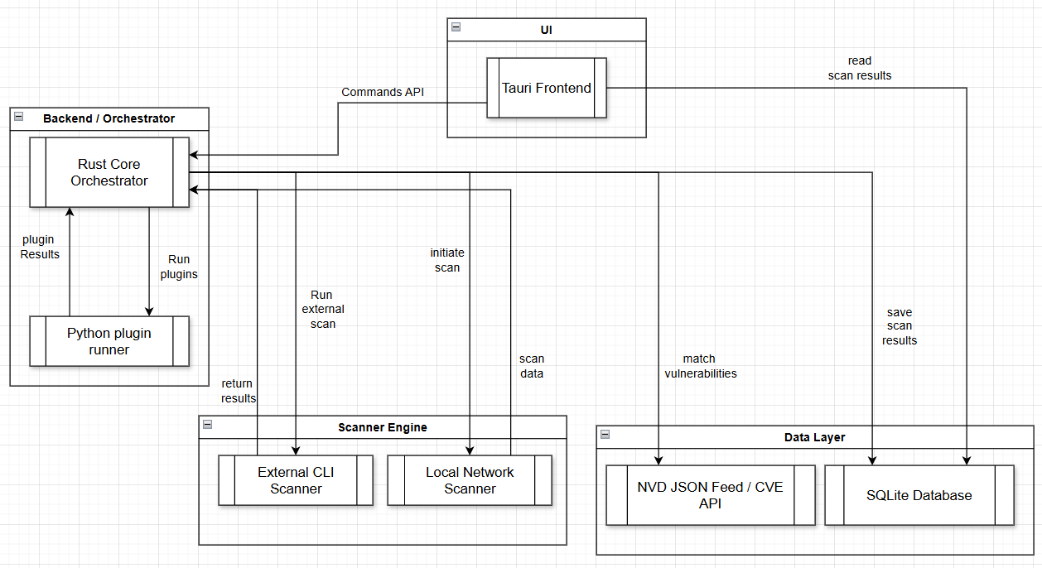
System Architecture

Slide 22
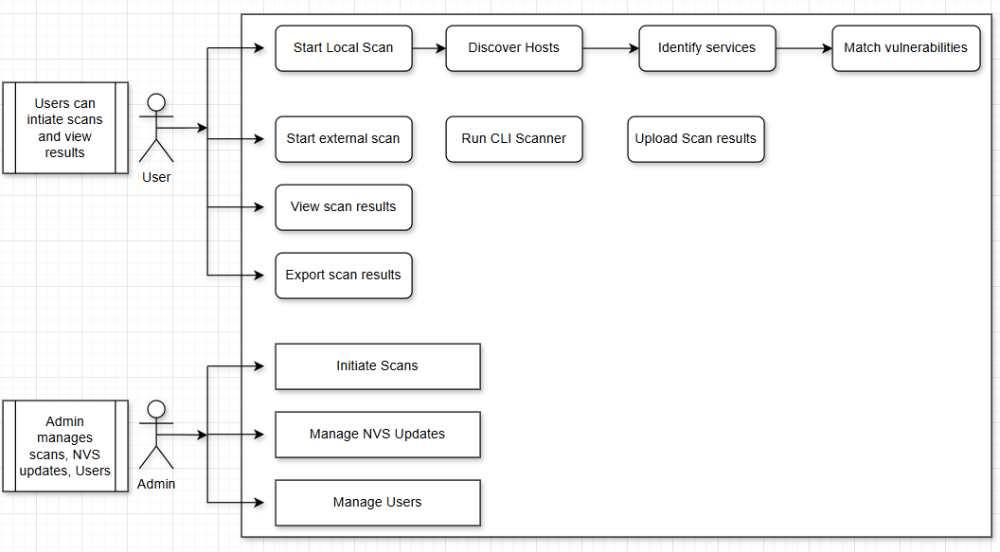
Use case Diagram

Slide 23
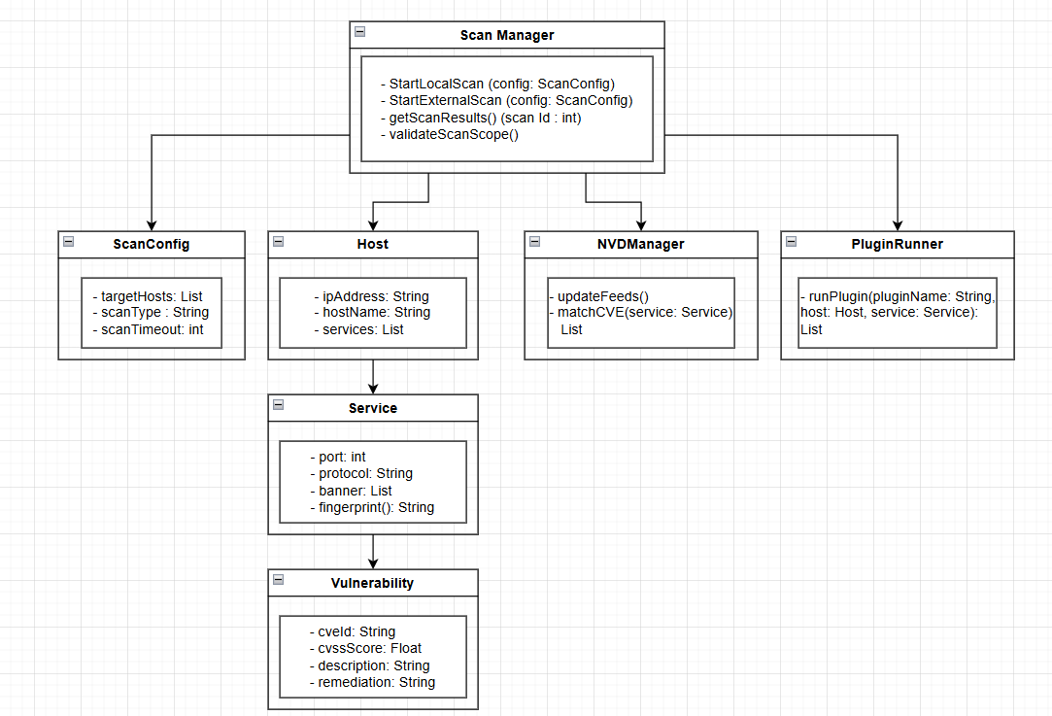
Class Diagram

Slide 24
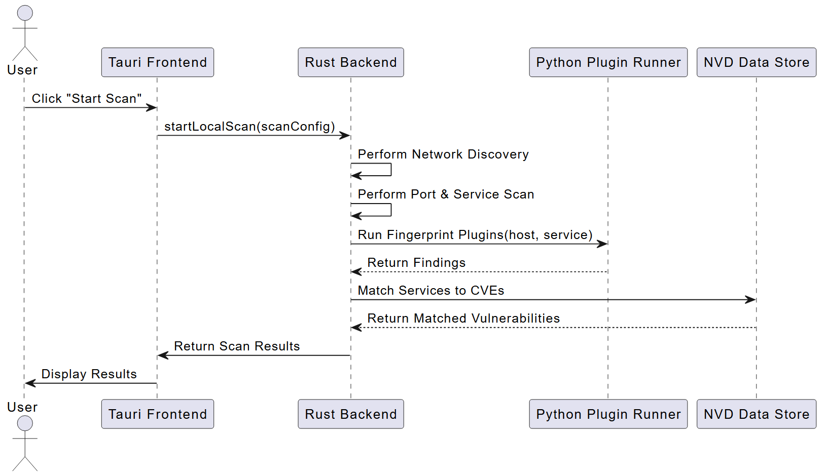
Sequence Diagram

Slide 25
Proposed Modules
Scan Config & Init: Handles target input, scan type, and parameters.
Host Discovery: Detects active hosts in the network.
Port & Service Scan: Finds open ports and running services.
Service Fingerprinting: Identifies service versions & technologies.
Vulnerability Mapping: Matches services with CVEs from NVD.
Plugin Execution: Runs Python plugins for deep vulnerability checks.
Reporting Module: Aggregates and formats scan results.
User Management: Controls roles and scan permissions.
NVD Sync: Updates latest vulnerability feeds.
Frontend UI: Shows scan progress & results via Tauri GUI.
Data Storage & Export: Saves & exports results (JSON, PDF, CSV).

Slide 26
Hardware Requirements:
• Processor: Intel Core i5 or higher
• RAM: 8 GB (Recommended)
• Storage: 500 GB HDD / 256 GB SSD
• Network Interface: Ethernet / Wi-Fi (for real-time scanning)
Software Requirements:
• Framework: Tauri
• Languages: Rust, Python, TypeScript/JavaScript, HTML, CSS
• Libraries / APIs:
Rust async networking modules
Python CVE and socket modules
NVD API for vulnerability data
Axios/Fetch for backend communication
• Operating Systems Supported: Windows, Linux, macOS
• Database: Local JSON or SQLite for scan data storage

Slide 27
Timeline for next review
TASK ID | TASK NAME | START DATE | END DATE | DURATION in days | WEEKS
 |  |  |  |  | 1 | 2 | 3 | 4 | 5 | 6 | 7 | 8 | 9 | 10 | 11 | 12 | 13 | 14
1 | Research and Analysis | 16/06 | 15/07 | 30 | ✔ | ✔ | ✔ | ✔
2 | Requirements | 16/07 | 22/07 | 7 | ✔ | ✔ | ✔ | ✔ | ✔
3 | Literature Review | 23/07 | 31/07 | 9 | ✔ | ✔ | ✔ | ✔ | ✔ | ✔
4 | Documentation | 01/08 | 22/08 | 22 | ✔ | ✔ | ✔ | ✔ | ✔ | ✔ | ✔
5 | Review-1 | 23/08 | 25/08 | 3 | ✔ | ✔ | ✔ | ✔ | ✔ | ✔ | ✔
6 | Design | 26/08 | 25/09 | 31 | ✔ | ✔ | ✔ | ✔ | ✔ | ✔ | ✔ | ✔ | ✔ | ✔
7 | Documentation | 26/09 | 12/10 | 17 | ✔ | ✔ | ✔ | ✔ | ✔ | ✔ | ✔ | ✔ | ✔ | ✔ | ✔ | ✔ | ✔
8 | Review-2 | 13/10 | 15/10 | 3 | ✔ | ✔ | ✔ | ✔ | ✔ | ✔ | ✔ | ✔ | ✔ | ✔ | ✔ | ✔ | ✔ | ✔

Slide 28
References
[1] J. Wang, K. Xu, and L. Zhang, “IMap: Toward a Fast, Scalable and Reconfigurable In-Network Scanner With Programmable Switches,” IEEE Transactions on Network and Service Management, vol. 19, no. 4, pp. 1–12, 2025. doi:10.1109/TNSM.2025.10295533.
[2] H. Lee, S. Park, and J. Kim, “V-Digger: A Distributed Architecture for Fast and Flexible Vulnerability Scanning,” IEEE Access, vol. 13, pp. 78500–78512, 2024. doi:10.1109/ACCESS.2024.10286066.
[3] R. Singh and V. Sharma, “ILLATION: Prioritizing Vulnerabilities Based on Risk and Severity,” IEEE Transactions on Information Forensics and Security, vol. 19, no. 2, pp. 222–231, 2024. doi:10.1109/TIFS.2024.10178007.
[4] M. Ahmed and F. Rahman, “A Python-Based Network Vulnerability Scanner Tool for Enhanced Cybersecurity,” International Journal of Computer Science (IJCS), vol. 17, no. 6, pp. 98–105, 2024.
[5] L. Chen, T. Zhou, and Q. Wei, “MobileSniper: Towards Automated Penetration Testing of 5G Campus Networks and IoT Infrastructures,” IEEE Communications Magazine, vol. 62, no. 7, pp. 45–53, 2024. doi:10.1109/MCOM.2024.10286088.

Slide 29
References
[6] X. Zhang, M. Liu, and Y. Ren, “Fast Port Scanning Using AI-Assisted Prioritization,” Computers & Security, vol. 132, pp. 103–114, 2023. doi:10.1016/j.cose.2023.103406.
[7] K. Patel and A. Desai, “An Adaptive Vulnerability Assessment Framework for Hybrid Networks,” Journal of Network and Computer Applications, vol. 220, pp. 1–12, 2023. doi:10.1016/j.jnca.2023.103547.
[8] H. Kim, S. Lee, and D. Park, “Scalable Network Vulnerability Scanning Using Containerized Agents,” IEEE Access, vol. 10, pp. 45012–45024, 2022. doi:10.1109/ACCESS.2022.9856471.
[9] M. Ali and J. Cooper, “Risk-Aware Vulnerability Assessment in Enterprise Networks,” Computers & Security, vol. 120, pp. 88–97, 2022. doi:10.1016/j.cose.2022.102946.
[10] T. Brown, P. White, and A. Singh, “Automated Security Assessment for Next-Generation Networks,” IEEE Access, vol. 9, pp. 129700–129711, 2021. doi:10.1109/ACCESS.2021.9568472.

