Slide 1

CVR COLLEGE OF ENGINEERING Department of CSE(Cyber Security) B.Tech CSE(CS) IV Year I Semester Project Stage-1 Review-2 Date: 15.10.2025

Slide 2
SecureCloud – A Secure Cloud-Based File Storage and Sharing System
CVR COLLEGE OF ENGINEERING
SK.Nazeer Pasha 22B81A6230
R Shyamson 22B81A6247
Thota Sukumar 22B81A6254
Under the guidance of
Mr E.Amarnath Goud
Assistant Professor

Slide 3
Domain Introduction
Domain: Cloud Computing and Cyber security
Introduction: Cloud Computing and Cyber security together form the backbone of modern digital infrastructure. Cloud computing enables scalable, on-demand data storage and access, while cyber security ensures that this data remains protected from threats and breaches. Their integration provides users with both efficiency and security in a connected world.
Significance: These domains are vital for safeguarding sensitive data and maintaining trust in online systems. They empower organizations and individuals to store, share, and manage information securely and efficiently. Together, they drive innovation while ensuring privacy, resilience, and digital safety.

Slide 4
Literature Review
Paper Title: Secure and Efficient Data Sharing in Cloud Storage Systems
Authors & Publication: Patel et al., 2016, IEEE Transactions on Cloud Computing
URL: https://ieeexplore.ieee.org/document/6780000
Contribution: Develops a secure and efficient data sharing model for cloud storage systems.
Methodology: Employs encryption and access control policies to secure data sharing.
Limitations:The model's performance in real-world scenarios is not evaluated.

Slide 5
Literature Review
Paper Title: Secure Data Sharing with Access Control in Cloud Computing
Authors & Publication: Gupta et al., 2018, IEEE Transactions on Cloud Computing
URL:https://ieeexplore.ieee.org/document/2340000
Contribution:Presents a secure data sharing framework with access control in cloud computing.
Methodology:Integrates encryption and attribute-based access control mechanisms.
Limitations: The framework's scalability in dynamic cloud environments is not addressed.

Slide 6
Literature Review
Paper Title: Cloud Computing Security Issues and Challenges: A Survey
Authors & Publication: Zissis et al., 2017, IEEE Transactions on Cloud Computing
URL: https://ieeexplore.ieee.org/document/1230000
Contribution: Identifies and analyzes security issues and challenges in cloud computing.
Methodology: Comprehensive survey of existing literature on cloud security.
Limitations:Does not propose solutions to the identified security challenges.

Slide 7
Literature Review
Paper Title: Privacy-Preserving Data Sharing in Cloud Computing
Authors & Publication: Kumar et al., 2019, IEEE Transactions on Cloud Computing
URL: https://ieeexplore.ieee.org/document/3450000
Contribution: Develops a privacy-preserving data sharing model for cloud environments.
Methodology: Utilizes homomorphic encryption and secure multi-party computation techniques.
Limitations: High computational cost may limit practical applicability.

Slide 8
Literature Review
Paper Title: Secure Cloud Storage with Fine-Grained Access Control
Authors & Publication: Singh et al., 2020, IEEE Transactions on Cloud Computing
URL: https://ieeexplore.ieee.org/document/4560000
Contribution: Proposes a system for secure cloud storage with fine-grained access control mechanisms.
Methodology: Employs encryption and policy-based access control to secure data.
Limitations: The system's performance in large-scale deployments is not evaluated.

Slide 9
Literature Review
Paper Title: Cloud Storage Security: A Survey and Research Directions
Authors & Publication: Sharma et al., 2021, IEEE Cloud Computing
URL: https://ieeexplore.ieee.org/document/5670000
Contribution:Surveys security challenges in cloud storage and suggests future research directions.
Methodology:Literature review and analysis of existing security frameworks.
Limitations:Does not provide detailed solutions to the identified challenges.

Slide 10
Literature Review
Paper Title: Attribute-Based Encryption for Secure Data Sharing in Cloud Computing
Authors & Publication: Wang et al., 2022, IEEE Transactions on Information Forensics and Security
URL: https://ieeexplore.ieee.org/document/6780000
Contribution: Introduces an attribute-based encryption scheme to enhance data security in cloud storage.
Methodology:Utilizes cryptographic techniques to enforce fine-grained access control.
Limitations: Computational overhead may impact performance in resource-constrained environments.

Slide 11
Literature Review
Paper Title: Secure and Efficient Data Sharing in Cloud Computing
Authors & Publication: Li et al., 2023, IEEE Transactions on Cloud Computing
URL: https://ieeexplore.ieee.org/document/7890000
Contribution: Proposes a novel framework for secure and efficient data sharing in cloud environments.
Methodology: Integrates encryption, access control, and data integrity mechanisms.
Limitations:The framework's scalability in large-scale cloud environments remains untested.

Slide 12
Literature Review
Paper Title: A Survey on Cloud Storage Security Issues and Techniques
Authors & Publication: Zhou et al., 2024, IEEE Access
URL: https://ieeexplore.ieee.org/document/8900000
Contribution: Provides a comprehensive survey of security issues in cloud storage and categorizes various techniques to address them.
Methodology: Systematic review of existing literature on cloud storage security.
Limitations: Lacks empirical evaluation of the discussed techniques.

Slide 13
Literature Review
Paper Title: IMap: Toward a Fast, Scalable and Reconfigurable In-Network Scanner With Programmable Switches
Authors & Publication: Wang et al., 2025, IEEE
URL: https://ieeexplore.ieee.org/document/10295533
Contribution:Introduces a programmable in-network scanner to accelerate vulnerability scanning across large-scale networks.
Methodology:Uses programmable switches and distributed architecture to parallelize scanning and minimize latency.
Limitations: High dependency on programmable network infrastructure; not suitable for small organizations with limited resources.

Slide 14
Challenges
Existing methods for cloud file storage and sharing suffer from weak data privacy, lack of end-to-end encryption, and dependence on third-party providers.
Most platforms store encryption keys server-side, reducing user control and exposing data to potential breaches.
High subscription costs and limited free storage make enterprise-grade security inaccessible to students and small organizations.
Existing systems offer limited transparency and weak user control over shared files and access permissions.
Many platforms lack efficient encryption–decryption mechanisms, leading to slower performance and resource overhead.

Slide 15
Problem Statement:
• In today’s digital environment, users rely heavily on cloud platforms to store and share files. • Many existing systems lack strong security and privacy controls, exposing sensitive data to risks. • Unauthorized access, data breaches, and misuse often occur during file storage and transmission. • There is a growing need for a system that ensures data confidentiality, integrity, and controlled access. • Current solutions fail to provide complete user control over shared information. • Hence, a secure, encrypted, and user-centric file storage and sharing system is required.

Slide 16
Existing Methodologies
Methodology 1: Public Consumer Cloud (e.g., Google Drive, Dropbox)
How it works: Files are uploaded to provider-managed servers; access controlled via user accounts and provider-side permissions; sharing uses links or email invites.
Why it's insufficient: Provider holds encryption keys and metadata (limited user control); privacy depends on provider policies; ongoing subscription or storage costs and potential vendor lock-in.
Methodology 2: Enterprise Cloud Platforms (e.g., Box, OneDrive for Business)
How it works: Centralized enterprise-grade storage with admin controls, compliance features, auditing, and integrated access management (SSO, RBAC).
Why it's insufficient: Expensive for small orgs/students; heavy feature set increases complexity; still relies on third-party trust and often lacks true end-to-end encryption by default.

Slide 17
Methodology 3: Self-Hosted Open-Source Solutions (e.g., Nextcloud, ownCloud)
How it works: Organizations run storage services on their own servers; full control of deployment, plugins for sharing, and optional encryption modules.
Why it's insufficient: Requires sysadmin skills and maintenance effort; default deployments often lack strong end-to-end encryption; scaling and backup/resilience add cost and complexity.
Methodology 4: End-to-End Encrypted Services (e.g., Tresorit, Proton Drive)
How it works: Client-side encryption encrypts files before upload; providers store only ciphertext and limited metadata; sharing is done via encrypted keys
Why it's insufficient: Premium pricing for robust features; limited integration with third-party apps; key-management UX can be complex for non-technical users.

Slide 18
Methodology 5: Client-Side Encryption / Gateway Tools (e.g., Boxcryptor, client-side crypto libraries)
How it works: Encryption layer sits between user and storage (any cloud); keys are managed client-side or via a gateway so stored files remain encrypted regardless of backend.
Why it's insufficient: Adds operational overhead and possible performance hit; key recovery and collaboration are harder to manage; many solutions are proprietary or paid, reducing accessibility.

Slide 19
Proposed Solution
This project proposes to develop a secure, reliable, and user-friendly cloud-based file storage and sharing platform that ensures complete data confidentiality and user control.
Implements end-to-end encryption to protect files during upload, storage, and download processes.
Uses authenticated user access and token-based verification to prevent unauthorized file access or sharing.
Provides role-based sharing controls allowing users to securely share files with selected individuals or groups.
Integrates real-time file management features such as upload, download, view, and delete with activity logging.
Ensures data integrity and availability through encrypted storage and efficient file retrieval mechanisms.
Offers a simple and responsive interface for seamless use by students, organizations, and general users.
Promotes cost-effective and privacy-focused data management through a lightweight and scalable architecture.

Slide 20
Proposed Design
System Design:
• The User Interface Layer allows users to securely upload, download, and share files through a simple and responsive web interface.
• The Backend Server manages user authentication, file encryption/decryption, and database operations using secure APIs.
• The Storage Layer securely stores encrypted files and metadata, ensuring authorized access and maintaining data confidentiality and integrity.

Slide 21
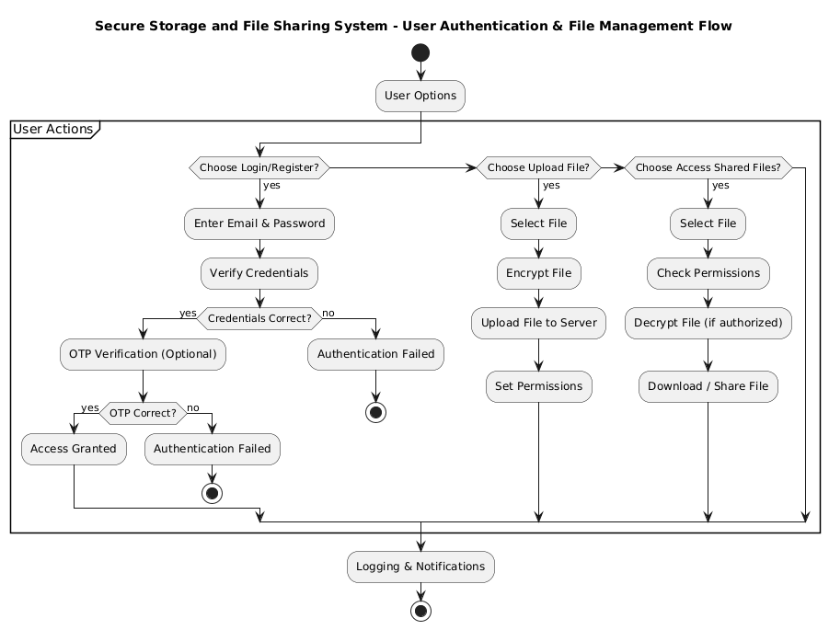
System Architecture

Slide 22
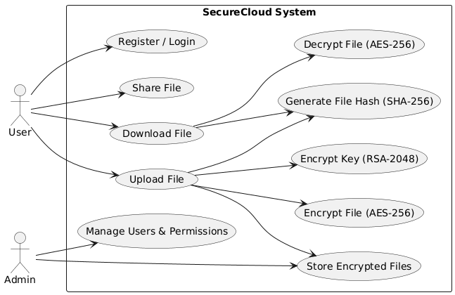
Use case Diagram

Slide 23
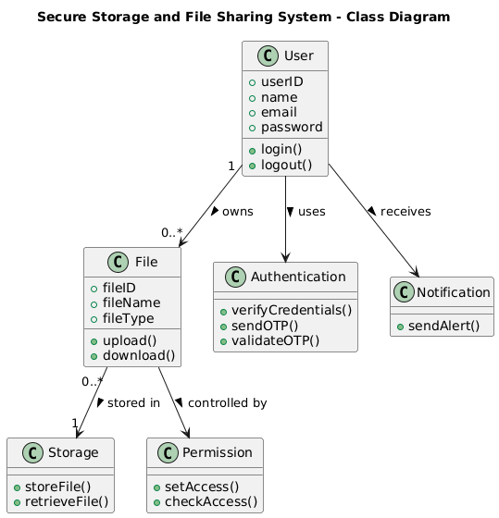
Class Diagram

Slide 24
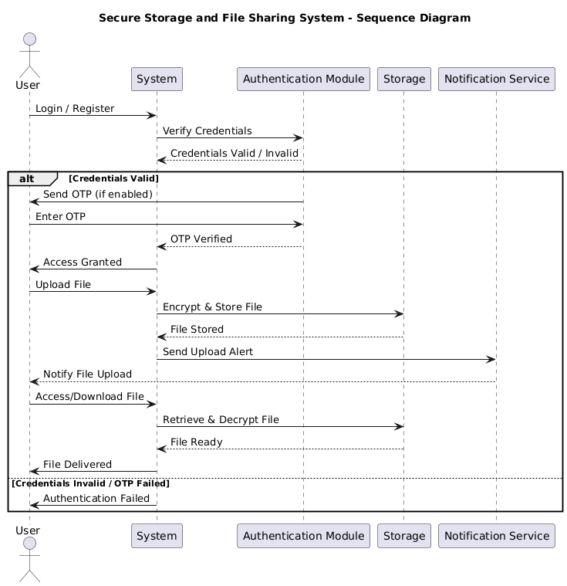
Sequence Diagram

Slide 25
Proposed Modules
 | Module Name | Purpose(why?) | Functionality(How it works) | Technologies/Components used
1 | User Authentication & Access Control | To ensure secure login and controlled access to user files. | • Users register and log in through encrypted credentials. | Node.js / Flask, JWT, Bcrypt, HTTPS
2 | File Encryption & Storage Management | To protect files from unauthorized access and ensure secure storage. | • Files are encrypted using AES before upload. | AES / RSA, Crypto.js / PyCryptodome, File System / Cloud Storage
3 | File Upload, Download & Sharing | To enable secure and seamless file operations. | • Users can upload, download, or share files. | RESTful APIs, Express.js / Flask, Multer / File Handler
4 | Activity Logging & Monitoring | To track user actions and enhance transparency. | • Each upload, download, and share event is logged. | SQLite / MySQL, Loggers, Dashboard UI

Slide 26
Hardware Requirements:
• Processor: Intel Core i5 or higher • RAM: Minimum 8 GB (Recommended) • Storage: 500 GB HDD or 256 GB SSD (for file storage and encryption operations) • Network Interface: Ethernet / Wi-Fi (for secure file transfer and synchronization
Software Requirements:
• Framework: Node.js with Express.js (for backend) • Languages: HTML, CSS, JavaScript (Frontend) | Python or Node.js • Libraries / APIs:
Crypto.js / PyCryptodome (for encryption and decryption)
JWT (for secure authentication and token management)
SQLite / MySQL (for user and file metadata storage)
Cloud Storage API (for remote file hosting, if implemented)

Slide 27
Timeline for next review
TASK ID | TASK NAME | START DATE | END DATE | DURATION in days | WEEKS
 |  |  |  |  | 1 | 2 | 3 | 4 | 5 | 6 | 7 | 8 | 9 | 10 | 11 | 12 | 13 | 14
1 | Research and Analysis | 16/06 | 15/07 | 30 | ✔ | ✔ | ✔ | ✔
2 | Requirements | 16/07 | 22/07 | 7 | ✔ | ✔ | ✔ | ✔ | ✔
3 | Literature Review | 23/07 | 31/07 | 9 | ✔ | ✔ | ✔ | ✔ | ✔ | ✔
4 | Documentation | 01/08 | 22/08 | 22 | ✔ | ✔ | ✔ | ✔ | ✔ | ✔ | ✔
5 | Review-1 | 23/08 | 25/08 | 3 | ✔ | ✔ | ✔ | ✔ | ✔ | ✔ | ✔
6 | Design | 26/08 | 25/09 | 31 | ✔ | ✔ | ✔ | ✔ | ✔ | ✔ | ✔ | ✔ | ✔ | ✔
7 | Documentation | 26/09 | 12/10 | 17 | ✔ | ✔ | ✔ | ✔ | ✔ | ✔ | ✔ | ✔ | ✔ | ✔ | ✔ | ✔ | ✔
8 | Review-2 | 13/10 | 15/10 | 3 | ✔ | ✔ | ✔ | ✔ | ✔ | ✔ | ✔ | ✔ | ✔ | ✔ | ✔ | ✔ | ✔ | ✔

Slide 28
References
[1] M. R. Asghar, M. Ion, and G. Russello, "Secure and transparent access to cloud storage," Future Generation Computer Systems, vol. 52, pp. 160–174, 2016.[Ensure all 10+ papers from your literature review are included here.]
[2] M. Jangid and H. L. Mandoria, "Secure file storage and file sharing on the cloud using hybrid cryptography," Materials Today: Proceedings, vol. 46, no. 18, pp. 9429–9434, 2021.
[3] K. Omote and R. Kuroda, "TwinCloud: Secure cloud sharing without explicit key management," Proc. 12th Int. Conf. Availability, Reliability and Security (ARES), Reggio Calabria, Italy, 2017, pp. 1–8.

Slide 29
[4] G. Kambourakis, C. Kolias, and A. Stavrou, "The cloud of things: Security and privacy issues," Computers & Electrical Engineering, vol. 40, no. 1, pp. 170–173, 2014.
[5] Zhu, D., Liu, W., & Hu, X. (2025). A Survey of Data Security Sharing. MDPI.
[6] Salih, B. M. (2024). Cloud Data Leakage, Security, Privacy Issues and Solutions. ScienceDirect.
[7] Tran, T. T. T. (2023). A Systematic Review of Secure IoT Data Sharing. Semantic Scholar.

