Slide 1

CVR COLLEGE OF ENGINEERING Department of CSE(Cyber Security) B.Tech CSE(DS) IV Year I Semester Project Stage-1 Review-2 Date: 15.10.2025

Slide 2
SecureCloud – A Secure Cloud-Based File Storage and Sharing System
CVR COLLEGE OF ENGINEERING
SK.Nazeer Pasha 22B81A6230
R Shyamson 22B81A6247
Thota Sukumar 22B81A6254
Under the guidance of
Dr. R Raja
Associate Professor

Slide 3
Domain Introduction
Domain: Cloud Computing and Cybersecurity
Introduction: Cloud Computing and Cybersecurity together form the backbone of modern digital infrastructure. Cloud computing enables scalable, on-demand data storage and access, while cybersecurity ensures that this data remains protected from threats and breaches. Their integration provides users with both efficiency and security in a connected world.
Significance: These domains are vital for safeguarding sensitive data and maintaining trust in online systems. They empower organizations and individuals to store, share, and manage information securely and efficiently. Together, they drive innovation while ensuring privacy, resilience, and digital safety.

Slide 4
Literature Review
Paper Title: [Title of Paper 1]
Authors & Publication: [Author(s), Year, Journal Name, e.g., Scopus/SCI/Web of Science]
URL: [web page of the publication]
Contribution: Briefly describe the problem addressed and the solution proposed in the paper.
Methodology: Explain the key method or algorithm used.
Limitations: Critically analyze the paper's shortcomings or what it didn't solve.
(Repeat the structure above for summarizing one paper per slide. Make sure to use at least 10 different Scopus/SCI/Web of Science indexed papers in reverse chronological order. )

Slide 5
Challenges
Current Challenges: Based on your literature review, what are the specific gaps or limitations in the existing research?
List key challenges in your chosen domain that current methods fail to address effectively.
Example: Existing methods for [task] suffer from [problem 1], [problem 2], and [problem 3].

Slide 6
Problem Statement:
In today’s digital environment, users frequently rely on cloud platforms to store and share files, but many existing systems lack strong security and privacy controls. Sensitive data is often at risk of unauthorized access, breaches, or misuse during storage and transmission. There is a growing need for a system that ensures data confidentiality, integrity, and controlled access. Current solutions also fail to provide full user control over shared information. Hence, a secure, encrypted, and user-centric file storage and sharing system is required.

Slide 7
Existing Methodologies
Methodology 1: [Name of existing method, e.g., Traditional statistical model]
How it works: [Brief description]
Why it's insufficient: [Explain its drawback or limitation]
Methodology 2: [Name of existing method, e.g., Deep learning approach]
How it works: [Brief description]
Why it's insufficient: [Explain its drawback or limitation]
(List at least 5 methodologies here, highlighting their limitations in relation to your project.)

Slide 8
Proposed Solution
A brief summary of your project's approach.

Slide 9
Proposed Design
System Design: [Brief summary]
Architectural Diagram: [A high-level visual representation showing the flow of data and interaction between different parts of your system.]
Include a Use-case diagram, Class Diagram and a Sequence diagram.

Slide 10
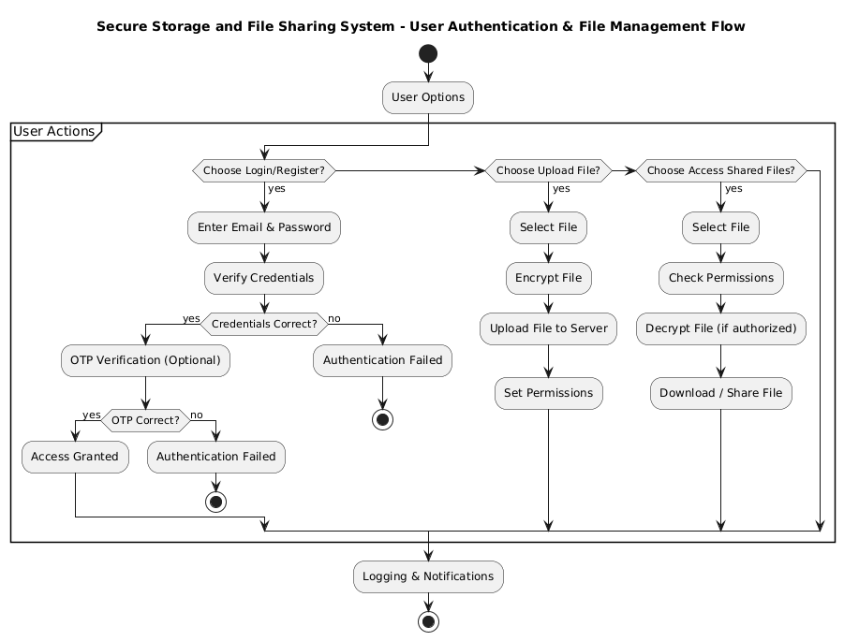
System Architecture

Slide 11
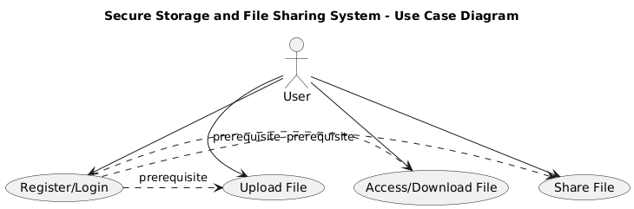
Use case Diagram

Slide 12
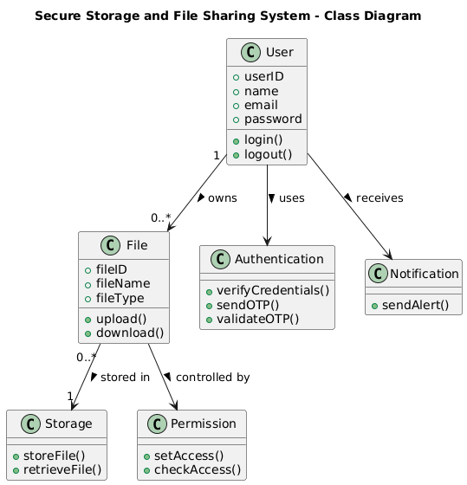
Class Diagram

Slide 13
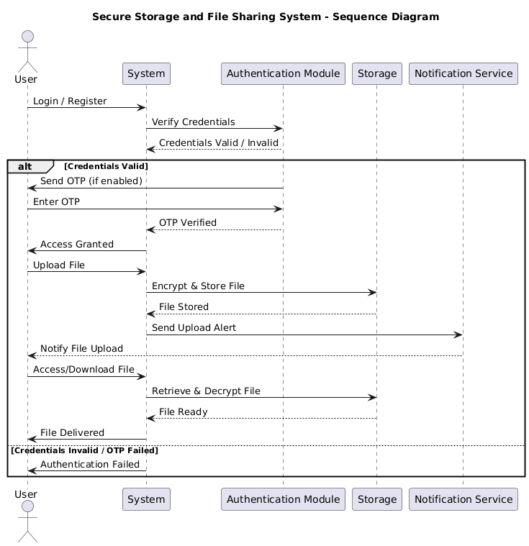
Sequence Diagram

Slide 14
Proposed Modules
Module 1: [Name] - [Purpose]
Module 2: [Name] - [Purpose]
Module 3: [Name] - [Purpose]
Module 4: [Name] - [Purpose]

Slide 15
Hardware and Software Requirements
Languages: Python, JavaScript
Libraries: Flask/Django (web framework), PyCryptodome (encryption), SMTP/Email libraries, Tkinter or React (UI)
Database : MySQL / PostgreSQL
Dashboard: Web-based dashboard for file management and activity notifications

Slide 16
Timeline for next review
The start date and end date can be modified according to your project
TASK ID | TASK NAME | START DATE | END DATE | DURATION in days | WEEKS
 |  |  |  |  | 1 | 2 | 3 | 4 | 5 | 6 | 7 | 8 | 9 | 10 | 11 | 12 | 13 | 14
1 | Research and Analysis | 27/11 | 10/12 | 12 | ✓ | ✓ | ✓ | ✓
2 | Requirements | 11/12 | 12/12 | 2 | ✓ | ✓ | ✓ | ✓
3 | Literature Review | 13/12 | 20/12 | 8 | ✓ | ✓ | ✓ | ✓
4 | Documentation | 26/12 | 28/12 | 3 | ✓ | ✓ | ✓ | ✓
5 | Review-1
6 | Design
7 | Documentation
8 | Review-2

Slide 17
References
[1] M. R. Asghar, M. Ion, and G. Russello, "Secure and transparent access to cloud storage," Future Generation Computer Systems, vol. 52, pp. 160–174, 2016.[Ensure all 10+ papers from your literature review are included here.]
[2] M. Jangid and H. L. Mandoria, "Secure file storage and file sharing on the cloud using hybrid cryptography," Materials Today: Proceedings, vol. 46, no. 18, pp. 9429–9434, 2021.
[3] K. Omote and R. Kuroda, "TwinCloud: Secure cloud sharing without explicit key management," Proc. 12th Int. Conf. Availability, Reliability and Security (ARES), Reggio Calabria, Italy, 2017, pp. 1–8.

