Slide 1
Functions
Shiva K

Slide 2
Repetition
One of the problems with the code is you are frequently doing the same thing again and again.
- The same few lines of code
- The same task
- The same operations

Slide 3
Repetition
One of the problems with the code is you are frequently doing the same thing again and again.
- The same few lines of code
- The same task
- The same operations

Slide 4
Repetition
One of the problems with the code is you are frequently doing the same thing again and again.
- The same few lines of code
- The same task
- The same operations

Slide 5

What if we could just create the button that does the work?
Then, just press that button.

Slide 6
Introducing functions...

Slide 7
What is a function?
Function:
- (Noun) A reusable section of code with a name that does something.
- Often called method.
You already used functions.
- print
- open
- write
- close

Slide 8
Why create functions?
Code reuse
- You are doing the same thing over and over again.
Simplify your code
- Functions have names that define what they do.
- Breakdown complex blocks of code.
Easier to make changes
- If it’s only been written once,you only have to update once.

Slide 9
How do you create a function?
Use the keyword def.
- Short for define.
Give your function a name.
- You may also have parameter names.
Write the code in the body of the function.

Slide 10
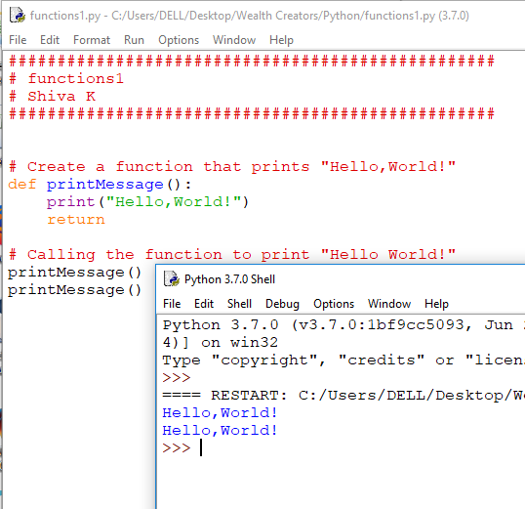

Slide 11
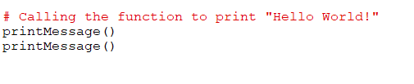
How do you call a function?
Simply use its name

Slide 12
Parameters..

Slide 13
I would like the function to be dynamic
In our example, the function we created did only one thing.
- Sometimes, that’s exactly what we want.
But sometimes, we need some flexibility.
Create custom messages to be displayed.
Provide two numbers for calculation.
- Print to the screen and optionally write to a file.

Slide 14
To create a function that accepts data, we use parameters.
A parameter is a piece of data passed into a function.
You have already used parameters.
- print(“HelloWorld!”)
Inside the functions, parameters behave like variables.
- It is good idea to give them meaningful names.

Slide 15
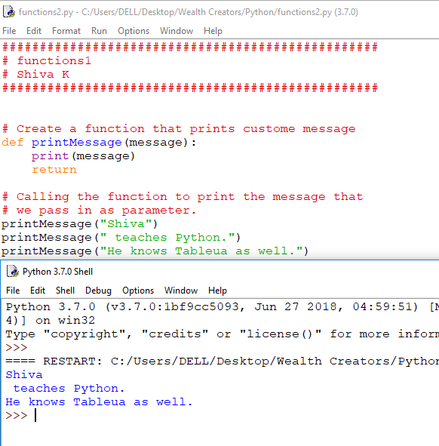

Slide 16
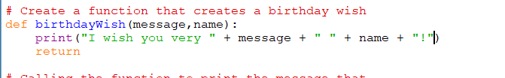
What about multiple parameters?
Simply add them in separated by commas.

Slide 17
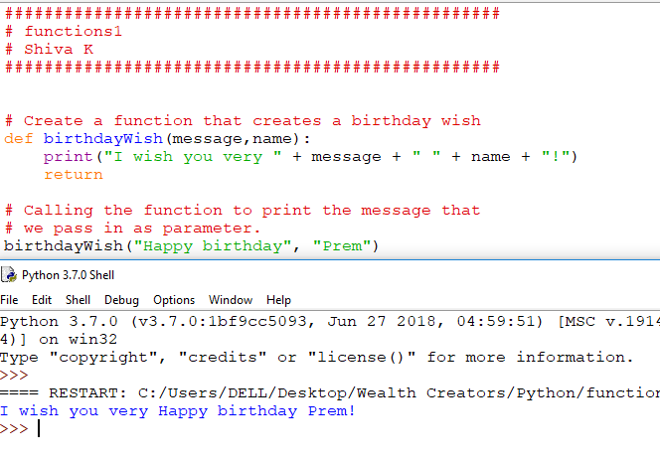

Slide 18
Returning data..

Slide 19

Functions return the data using the keyword return.
Specify the value or data you want to passback after the return keyword.
You can reuse names in different functions.

Slide 20
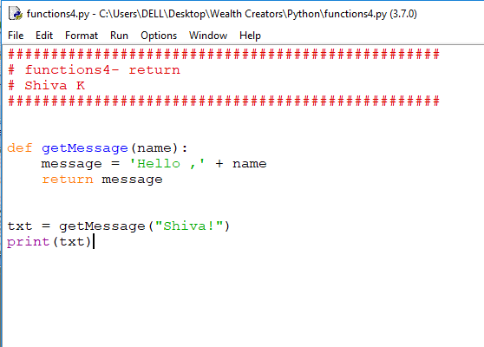

Slide 21
Wait a minute!
Did use name twice?
After a while, you can’t use always different names.
Functions are like containers for names
- You can use the same name in different functions.

Slide 22
Your challenge!
Create a function to simplify writing a file.
Set the function to accept parameters.
- One for text
- One for the name of the file.
Add the code,that will write the text out to the file.

Slide 23
Congratulations!
You can now same time by coding routine tasks into functions.

