Slide 1
Handling errors!
Shiva Kambala

Slide 2
try except

Slide 3
Even the best laid plans sometimes go wrong.
You create the grocery list and after reaching the store, you realize that you forgot the list at home.
You want to buy a pair of shoes, but the size is out of stock.
You need to call someone, but cell phone battery is dead.

Slide 4
Things go wrong in programs as well!
A program can not find file it needs.
A user enters a date in the wrong format.
You try to divide a number by zero.

Slide 5
Error types

Slide 6
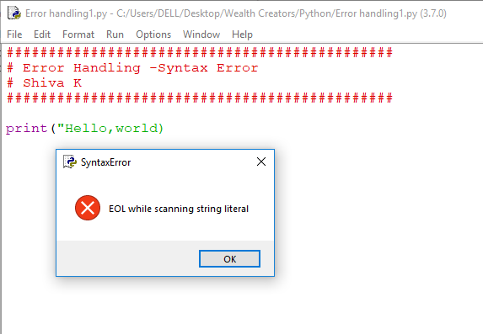
Syntax errors are errors that development tool can detect!
print(“hello World)

Slide 7
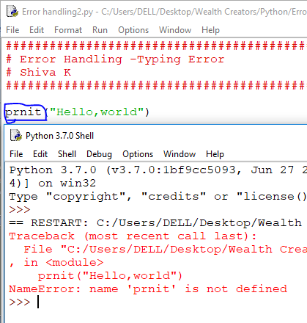
Sometimes typing mistakes can not be detected until the program is run.
prnit(“Hello world”)

Slide 8
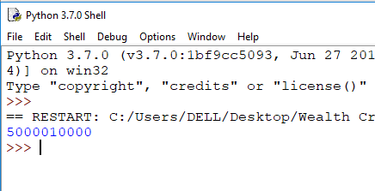
Logical errors are syntactically correct,but they do not do what you want to do.
Salary = 50000
Bonus = 10000
payCheck = Salary + Bonus
print(payCheck)

Slide 9
Gracefully handling errors..

Slide 10
Runtime errors occur when the code basically works but something out of the ordinary crashes the code.
You write calculator program and user tried divide number by zero.
Your program tries to read a file and, a file is missing.
Your program is trying to perform a date calculation, but the date specified is in different format.

Slide 11
Having your code crash is a very poor user experience.
You can add error handling to your code to handle runtime errors gracefully.

Slide 12
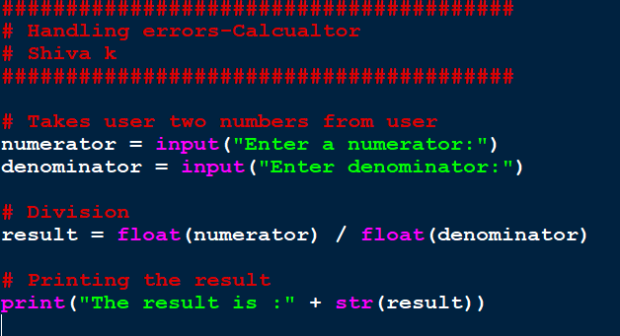
Let’s create a caculator program that takes two numbers and divides!

Slide 13
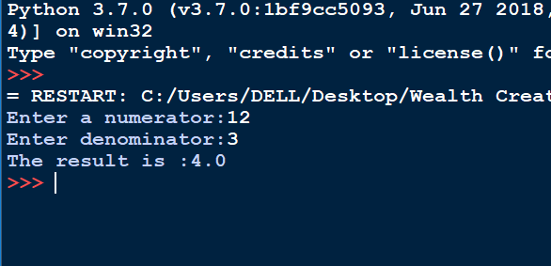
We test it and it works!

Slide 14
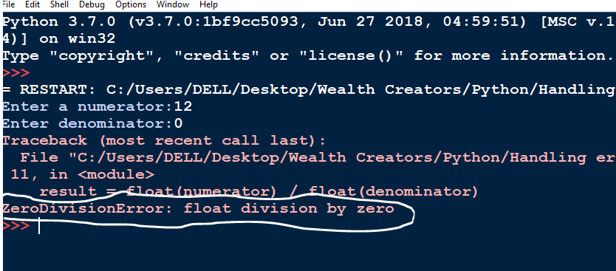
What will happen,if we enter 0 as the denominator?
You get an error at run time!

Slide 15
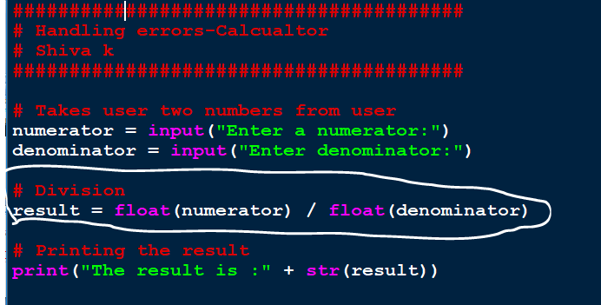
Which line of code generated the error?

Slide 16
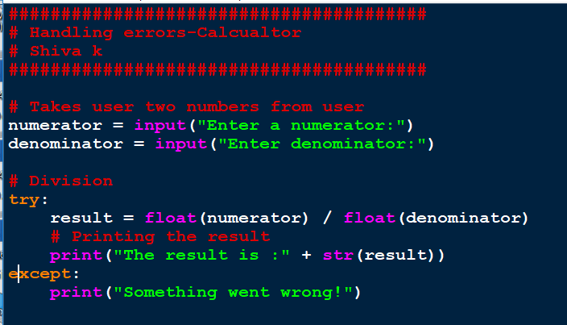
You can add try/except around that code to handle that error gracefully!

Slide 17
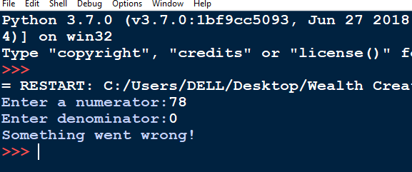
You can notice how gracefully we handled the error with try/except.
The code in the except part is executed only if there is an error in the code in try.

Slide 18
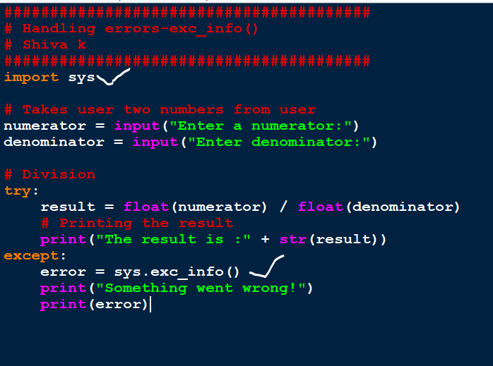
If you want to know what the error was, you can use the function sys.exc_info()

Slide 19
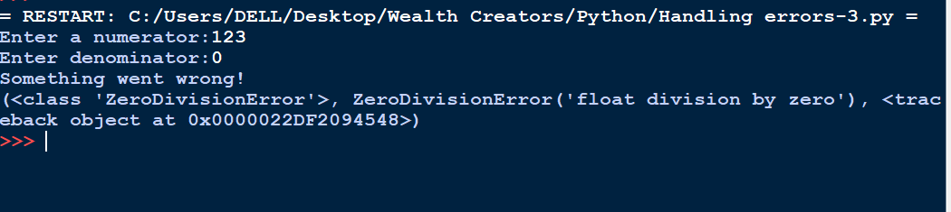

Slide 20
If you know exactly what error is occuring, you can specify how to handle that exact error.

Slide 21
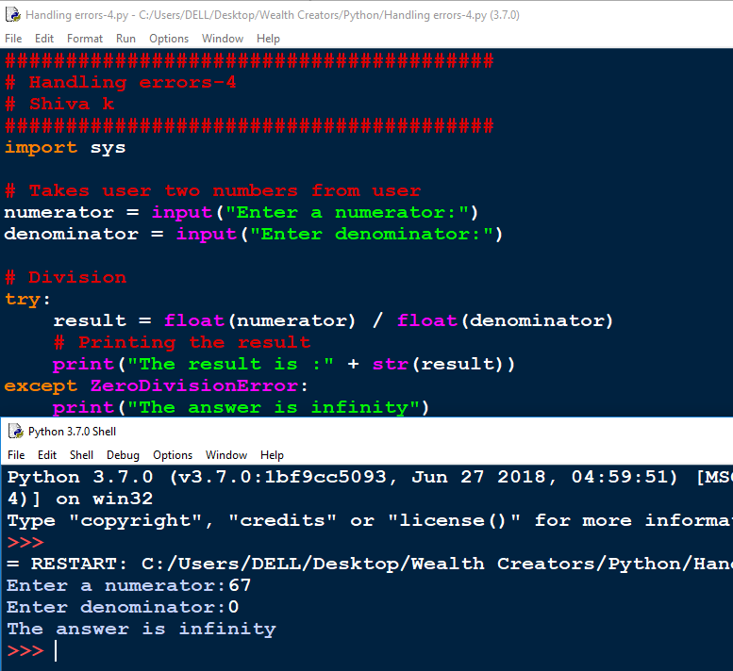

Slide 22
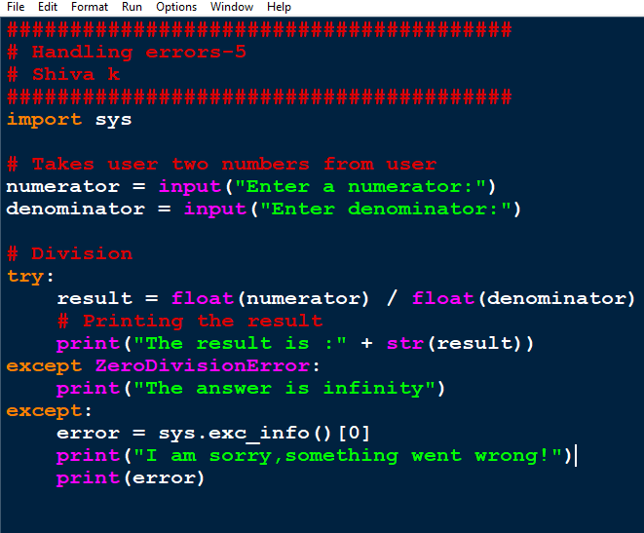
Ideally,you should have one one or two specific error handlers and one generic error handler.

Slide 23
Any code that you place after try/except always execute.

Slide 24
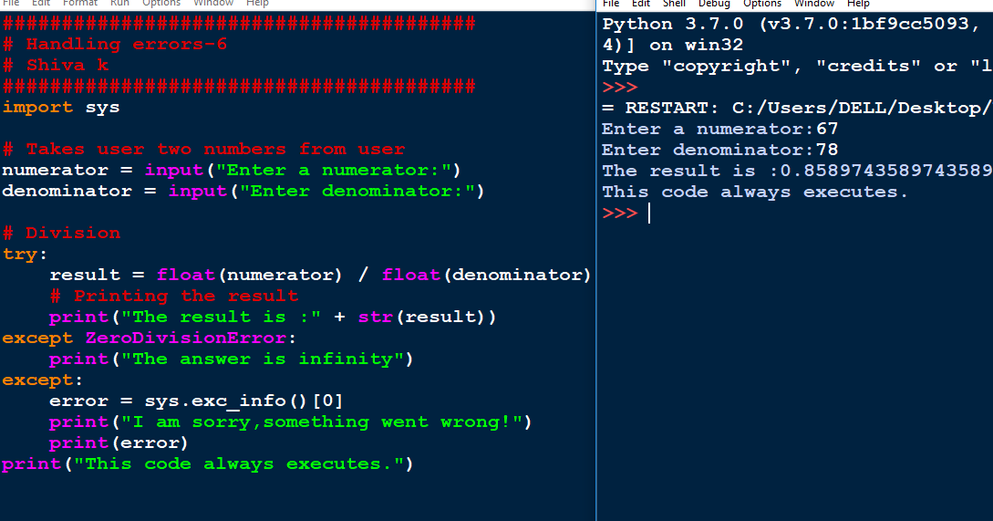

Slide 25
How can I force my program to exit if an error occurs and I don’t want to continue?
You can use the function sys.exit() in the sys library

Slide 26
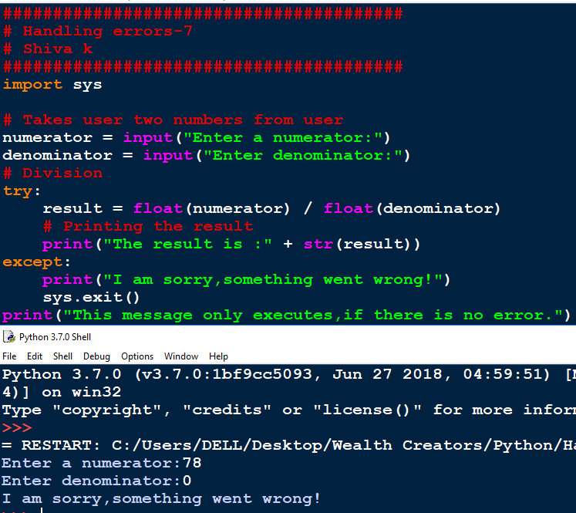

Slide 27
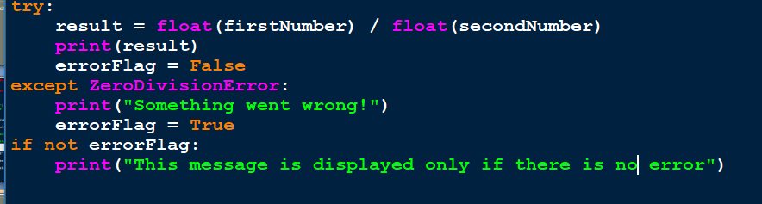
You can also use variables and if statement to control what happens after an error.

Slide 28
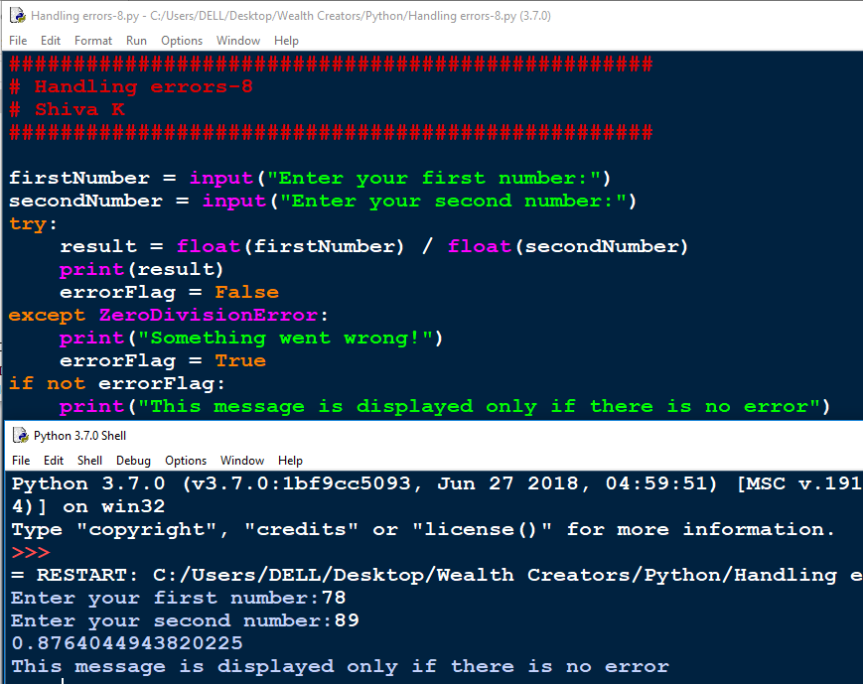

Slide 29
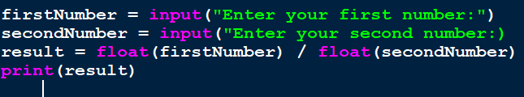
Is there any other code in the program that can give us an error at run time?

Slide 30
There are lot of different situations that can raise errors in our code.
Converting between datatypes
Opening files
Mathematical calculations
Trying to access a value in a list that does not exist.

Slide 31
How do you know what errors will be raised?
You can test it yourself and when error occurs use the sys.exc_info() function to get the name of the error.
There is a list of standard python errors.
- https://docs.python.org/3/c-api/exceptions.html#standard-exceptions

Slide 32
The most important thing to do is to test!
Execute your code with everything running normally.
Execute your code with incorrect user input.
- Enter letters instead of numbers.
- Enter 0 or spaces
- Enter a value in the wrong format(such as date)
Try other error scenarios such as missing files.
Try anything you think of that might crash your code.
- Entering big numbers
- Negative numbers

Slide 33
Do I need to handle EVERY possible error
Sometimes writing code to handle errors takes more time than writing the original program.
Whether it is necessary to handle every error depends on how the code will be used.
If you are writing the code for air traffic control, I would need very thorough error handling.
if you are writing code for a fun little app which tweets when your plant needs water, I would not worry much on error handling.

Slide 34
Your Challenge
Write code to open and read file.
Allow the user specify the file name.
Add error handling to provide suitable error messageif the file specified by the user could not be found.

Slide 35
Congratulations!
Now, You can handle errors gracefully and your code does not crash.

